Slide 1
ANSI Meter Forms
Monday, July 22, 2024
3:15 PM-4:30 PM
Carl Chermak

Slide 2
Agenda
Meters 101 - Electro-Mechanical vs Solid-State
Self-Contained vs Transformer Rated
Blondel’s Theorem
Meter Forms
Available References

Slide 3
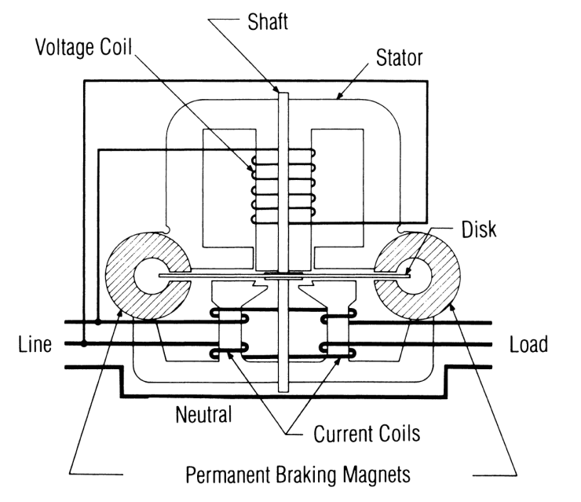
Induction Meters
Two coils and a conducting (usually aluminum) disk. A braking magnet.
Magnetic field from the first coil generates eddy currents in the disk
Magnetic field from the second coil interacts with the eddy currents to cause motion
Disk would accelerate without bound except for eddy currents caused by motion through fixed magnetic field which slows the disk
The end result is that each revolution of the disk measures a constant amount of energy

Slide 4
Basic Energy Formula
The essential specification of a watthour meter’s measurement is given by the value K_{h} [ Watthours per disk revolution ]
A Kh of 7.2 is typical. In this example, each full rotation of the disk is equivalent to 7.2Wh of energy.
The watthour meter formula is as follows:
tescometering.com
4

Slide 5
Meters 101 – Solid-state
Overview of Functionality
Potential and Current is scaled down and conditioned with transformers and filters
ADC’s (analog to digital converters) digitize the signals
A micro-processor or DSP executes the calculations
Resulting data is displayed, sent externally via the communication circuits, and used for the calibrated pulse output
MICRO
PROC
CURRENT TRANSFORMER
DISPLAY
FILTER
ADC
COMM
POTENTIAL TRANSFORMER
FILTER
ADC
PULSE

Slide 6
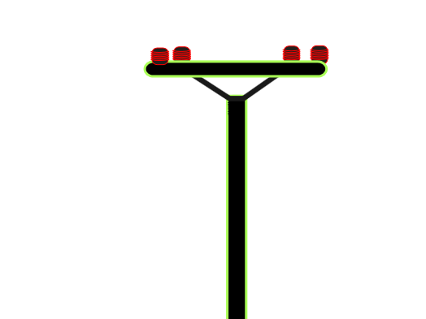
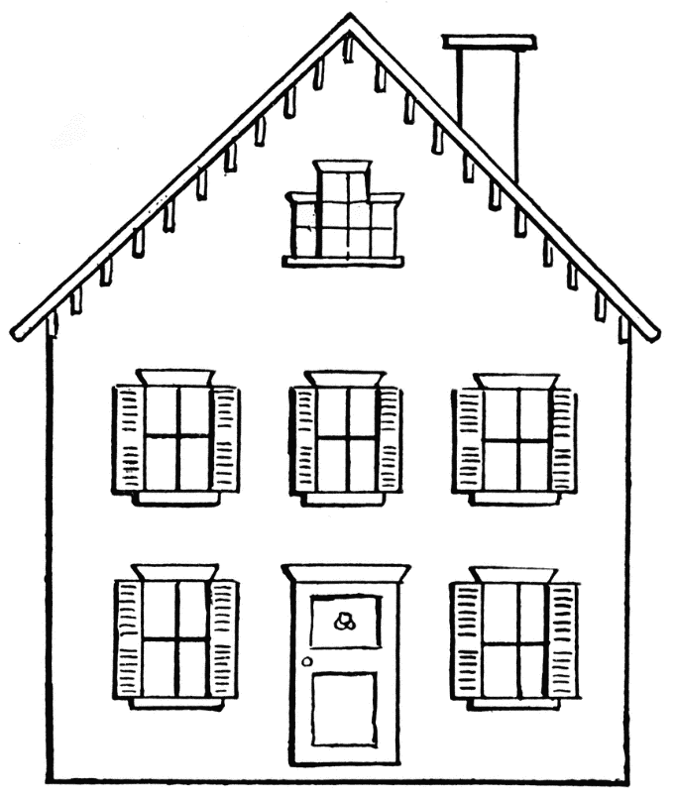
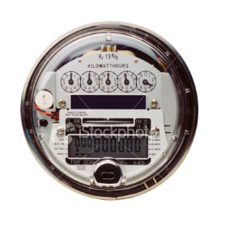
Self-Contained Meters
Primarily Residential
Relatively Low Current
Example: 100A

Slide 7
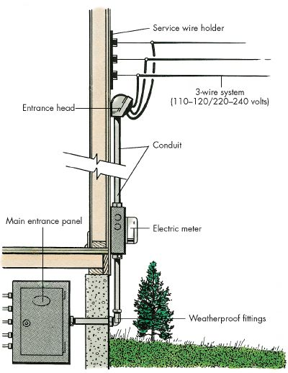
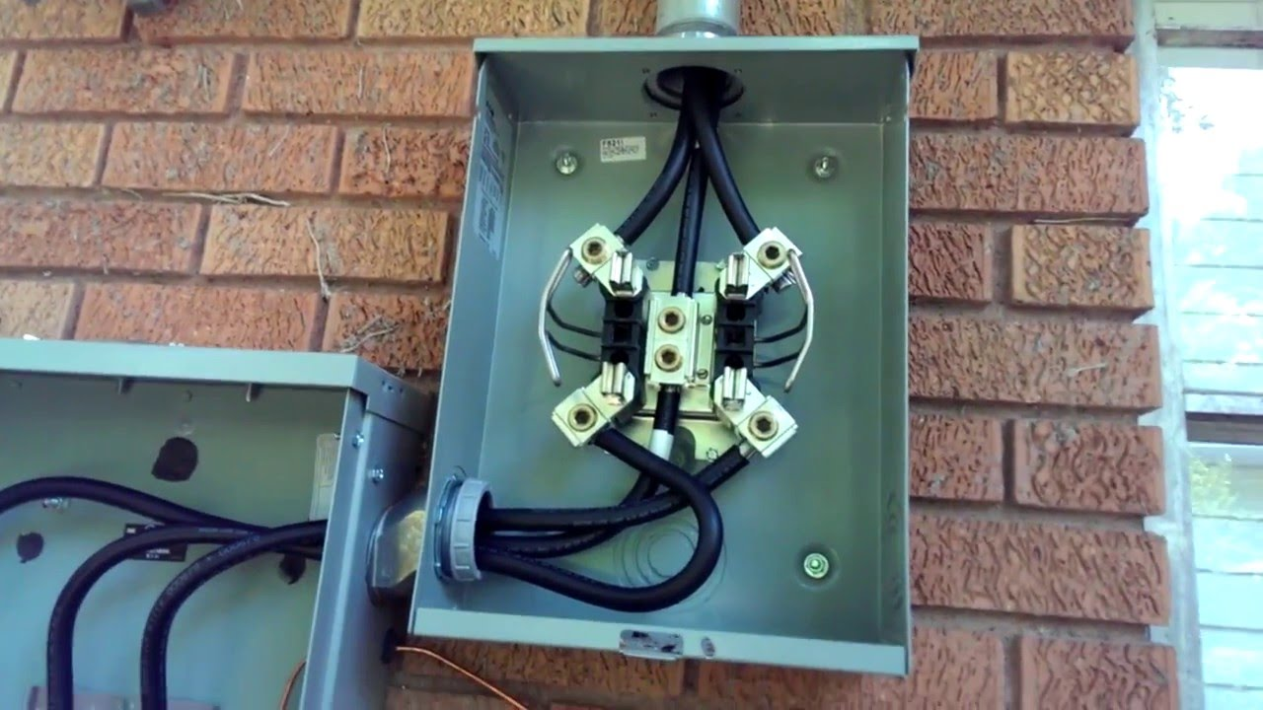
Self-Contained
Primarily Residential

Slide 8
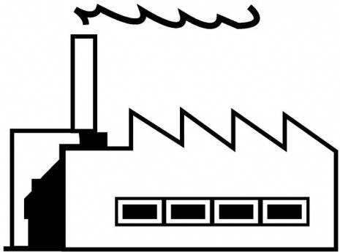
Transformer-Rated Meters
Primarily Commercial/Industrial
Relatively High Current
Example: 4000A
Notes:
8

Slide 9
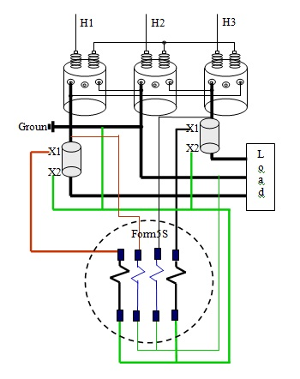
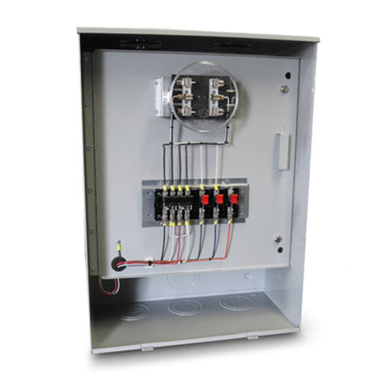
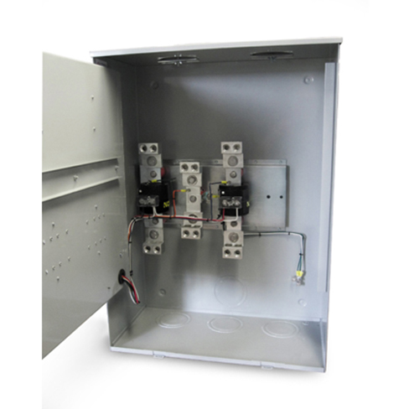
Transformer-Rated Meters
Primarily Commercial/Industrial

Slide 10
Services Commonly Metered
2 wire, 1 φ
3 wire, 1 φ
3 wire, network
3 wire, delta
4 wire, delta
4 wire, wye
Notes:
These are Commonly metered services in North America.
The windings represent the source.
They could be distribution transformers stepping the voltage down from distribution voltages to <600 volts, or they could represent transmission substation transformers, or they could represent windings of a generator.
When we consider what service we are working with, the question to answer is:
How many wires allow a load to be connected to the source and could possibly have current flowing in them?
Murphy’s Law may be restated as:
If the service is determined by considering only the load, someone will come along and hang a different load on the service.
The appropriate metering service could be different than the physical connection of the source. For example:
Some generators are connected wye, but relaying ensures that the generator is tripped off line if there is any current in the neutral, this means that the metering service may be treated as 3 wire, delta.

Slide 11
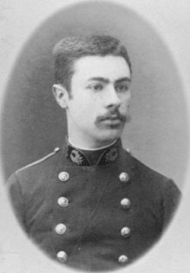
Blondel’s Theorem
French Electrical Engineer Andre Blondel
Attempt to simplify electrical measurements and validation of the results
Paper submitted to the International Electric Congress in Chicago in 1893.
E = n - 1
The theorem states that the power provided to a system of N conductors is equal to the algebraic sum of the power measured by N watt-meters. The N watt-meters are separately connected such that each one measures the current level in one of the N conductors and the potential level between that conductor and a common point. In a further simplification, if that common point is located on one of the conductors, that conductor's meter can be removed and only N-1 meters are required.

Slide 12
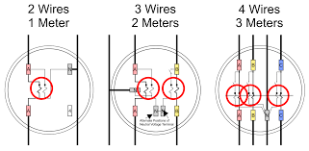
Blondel’s Theorem
Blondel Compliant
E = n - 1
1S
12S
9S
The theorem states that the power provided to a system of N conductors is equal to the algebraic sum of the power measured by N watt-meters. The N watt-meters are separately connected such that each one measures the current level in one of the N conductors and the potential level between that conductor and a common point. In a further simplification, if that common point is located on one of the conductors, that conductor's meter can be removed and only N-1 meters are required.

Slide 13
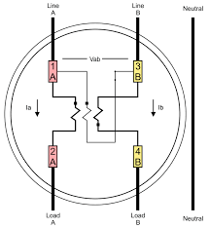
Blondel’s Theorem
Non-Blondel Compliant
E = n - 1
2S
The theorem states that the power provided to a system of N conductors is equal to the algebraic sum of the power measured by N watt-meters. The N watt-meters are separately connected such that each one measures the current level in one of the N conductors and the potential level between that conductor and a common point. In a further simplification, if that common point is located on one of the conductors, that conductor's meter can be removed and only N-1 meters are required.

Slide 14
Blondel’s Theorem
Why is non-Blondel metering bad?
Makes assumptions about the service
Example: balanced voltages
Assumptions might not be true
When these assumptions are not true, then there are power measurement errors even if the meter is working perfectly.
The theorem states that the power provided to a system of N conductors is equal to the algebraic sum of the power measured by N watt-meters. The N watt-meters are separately connected such that each one measures the current level in one of the N conductors and the potential level between that conductor and a common point. In a further simplification, if that common point is located on one of the conductors, that conductor's meter can be removed and only N-1 meters are required.

Slide 15
Blondel’s Theorem
Why are non-Blondel meters used?
Fewer elements (meters) = lower cost
Especially true for electro-mechanical meters
Fewer CT’s and PT’s = lower cost
Less wiring and cheaper sockets
The theorem states that the power provided to a system of N conductors is equal to the algebraic sum of the power measured by N watt-meters. The N watt-meters are separately connected such that each one measures the current level in one of the N conductors and the potential level between that conductor and a common point. In a further simplification, if that common point is located on one of the conductors, that conductor's meter can be removed and only N-1 meters are required.

Slide 16
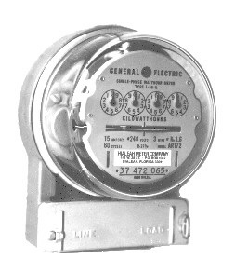
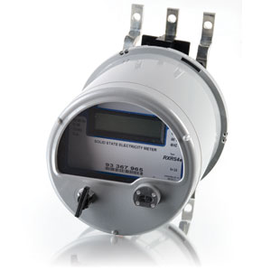
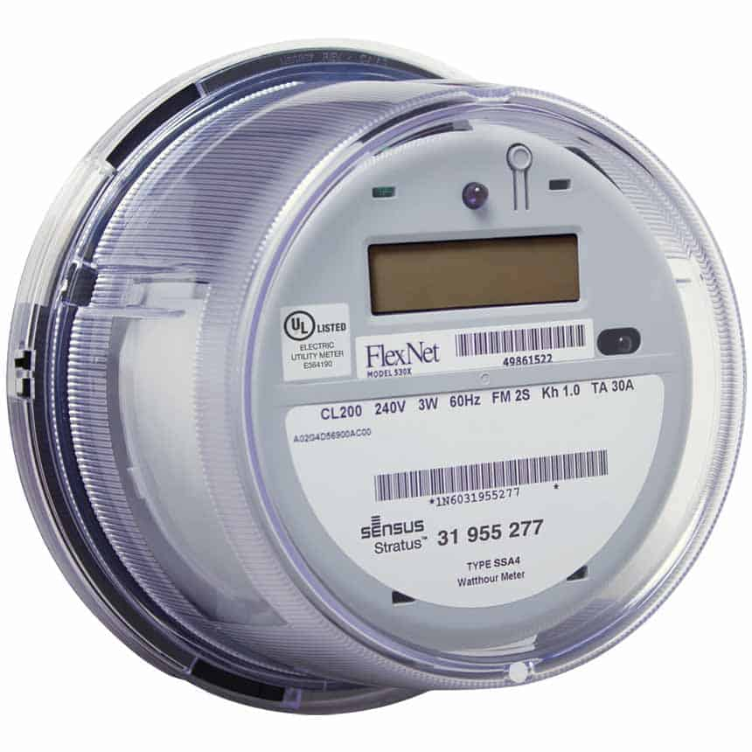
Meter Forms

Slide 17
Meter Standardization (Background)
1928 First detachable meter produced in US
Forerunner of today’s Socket Meter
Provides outside mountable meter
1933 Introduction of a true “socket system”
Type “S” socket and Type “CS” meter
Wide spread acceptance
1934 Parameters for “socket” meters standardized
Interchangeable mounting was developed
Participation by all manufacturers okayed

Slide 18
Meter Standardization (Background)
1934 Metering committees establish guidelines
Edison Electric Institute
Association of Edison Illuminating Companies
1940 Standard dimensions & wiring documented
Published in “Electrical Metermen’s Handbook
Reference numbers look like forms but are not

Slide 19
“Form” Standards Established
1958 - 1960 First Standards Published
MSJ-10 Standard established (includes Forms)
Published jointly by AEIC, EEI, & NEMA
1978 New ANSI Standard Introduced
MSJ-10 replaced by ANSI C12.10 Standard
No change to established “Forms”

Slide 20
What is a meter Form Number?
IEEE Standard Dictionary of Electrical and Electronic Terms defines a watthour meter “form designation” as:
An alphanumeric designation denoting the circuit arrangement for which the meter is applicable and it’s specific terminal arrangement.
The same designation is applicable to equivalent meters of all manufactures.

Slide 21
What is a meter Form Number?
A Form designation tells us:
The Physical Configuration of the meter
Socket (S)
Bottom Connected (A)
The number and arrangement of meter terminals
The number of voltage circuits within the meter
The number of current circuits within the meter
The number and arrangement of meter elements (stators)
Notes:
A Form designation tells us:
The number and arrangement of meter terminals,
The number and connection of meter elements (stators),
Whether a meter is self contained or transformer rated.
Whether the form designation tells us if a meter is self contained or transformer rated is disputed.
Mike Coit believes Form designation does not imply SC vs TR,
David Ellis thinks he sees a pattern that supports the relationship.
- Form 26S is shown as both SC and TR in the current version of ANSI C12.10. A draft of a future version of ANSI C12.10 shows only a transformer rated Form 26S.
- Form 13S and 5S have the same terminal arrangement and connection of meter elements, one is self-contained the other is transformer rated.
- Greg May has an application for a self contained meter that is connected like a Form 9S.
- Since ANSI standards are written and revised by committees, this issue could be decided either way in the future.

Slide 22
“Form” Describes the Meter
The Form designation describes the meter, not the electrical service.
Same Form is applicable to equivalent meters of all manufacturers
With modern electronic meters, Form consolidation is possible thus reducing variety while improving measurement accuracy
Form does not change with current or voltage rating
Form does not necessarily identify meter as Self-contained or Transformer-rated
Form does not change with addition of meter accessories
More than one meter Form could be used with a particular service, depending on the connection of Instrument Transformers.

Slide 23
NEW Electronic Meter Forms
New Forms were added (1994 - 1999) to accommodate modern electronic meter construction
Broad voltage range meter designs require different internal connections
Typically affects transformer rated applications
Cannot support isolated voltage circuits
In most popular services, “broad range” meters are compatible with existing socket wiring
Special applications need to be verified for compatibility

Slide 24
NEW Electronic Meter Forms
New Meter
FORMS
(Electronic Meter)
Replacement
for existing
FORM
Typical
Service
Application
45S (or 35S)
36S (or 46S)
56S (or 66S)
45A (or 35A)
36A (or 46A)
48A
5S
6S
26S
5A
6A
10A (alternate)
3W-3Ø
4W-Y
3W-3Ø
3W-3Ø
4W-Y
4W-Yor

Slide 25
Dissecting the Diagram
Form 5S
SOCKET STYLE (S)
Form 35S
Meter Terminals
Current Circuits
(Heavy Dark Lines)
Voltage Circuits
Element or Stator
(Includes both a voltage
and a current circuit)
Isolated voltage circuits
Common voltage connection
Electromechanical
or
Electronic
with voltage transformers
Electronic
with
broad range voltage

Slide 26
Dissecting the Diagram
Form 5S
SOCKET STYLE (S)
Form 45S
Meter Terminals
Current Circuits
(Heavy Dark Lines)
Voltage Circuits
Element or Stator
(Includes both a voltage
and a current circuit)
Isolated voltage circuits
Common voltage connection
Electromechanical
or
Electronic
with voltage transformers
Electronic
with
broad range voltage

Slide 27
Single Phase Forms
Form 1S*
Form 2S*
Form 3S*
Form 4S*
1 Element,
Self Contained
2 wire, single phase
1 Element,
Self Contained
3 wire, single phase
1 Element,
Transformer Rated
2 wire, single phase,
3 wire, single phase
1 Element,
Transformer Rated
3 wire, single phase
ANSI Forms looking from the front of the meter.
Notes:
The kV meter will also be available as a Form 1S, 2S, 3S and 4S.
Note that the 5th terminal of the 3S meters is moveable, meaning that the user may remove the terminal from one position and reattach it to a second position. Meters may be ordered with this 5th terminal mounted in either position. The 5th terminal is most often mounted in the 9:00 position.

Slide 28
Self Contained - 3 Wire Polyphase
Form 12S*
Form 13S
2 Element,
Self Contained
3 wire delta, network
2 Element,
Self Contained
3 wire delta
ANSI Forms looking from the front of the meter.
Notes:
The kV meter will also be available as a Form 12S.
Note that the 5th terminal of 12S meters is moveable, meaning that the user may remove the terminal from one position and reattach it to another position. The terminal is L shaped and may be mounted in two orientations in the lower position (5:00 position or 6:00 position). Meters may be ordered with this 5th terminal mounted in either position. The 5th terminal is most often mounted in the 9:00 position.
The Form 13S meter has been used on some 3 wire delta self contained services. Some utilities avoid this meter because the terminal arrangement is identical to the 5S and people don’t want to see 5S meters accidentally installed in self contained sockets.

Slide 29
Self Contained - 4 Wire
Form 16S*
Form 14S
Form 15S
Form 17S
3 Element,
4 wire, wye
2½ Element,
4 wire, wye
2 Element,
4 wire, delta
3 Element,
4 wire, delta
Meterman’s view of ANSI Forms looking from the front of the meter.
Notes:
With wide range power supplies, Form consolidation allows us to use a Form 16S meter in place of Form 16S, 14S, 15S or 17S.
Remember that Form 14S and 15S meters are non Blondel solutions. Their answers are valid if the voltages are balanced in magnitude and phase angle. Form 16S, being a 3 element meter, will give us a valid answer for a 4 wire service even with a voltage imbalance.
With a Form 15S, the wild leg MUST be connected to the C Phase (the right hand element). A wide voltage range Form 16S (or 17S) will correctly measure a 4 wire - delta service regardless of where the wild leg is connected. (Note that the wild leg is changed if the neutral connection is moved from one transformer in a bank to another.)
(Note that these same 4 wire - delta comments apply to the transformer rated meter transition from a Form 8S to a Form 9S.)
The Form 17S connections are identical to a Form 16S. Nominal voltages are different for delta vs wye connection, but this becomes unimportant when the meter can accommodate a wide range of voltages.
The kV meter is offered as a 16S.

Slide 30
Transformer Rated - 4 Wire
K Y Z
K
Y
Z
K
Y
Z
Form 6S, (36S*)
Form 9S*
Form 10S
Form 8S
2½ Element,
4 wire, wye
3 Element,
4 wire, wye
3 Element,
4 wire, wye
2 Element,
4 wire, delta
Meterman’s view of ANSI Forms looking from the front of the meter.
Notes:
With transformer rated - 4 wire meters with wide range power supplies, Form consolidation allows us to use a Form 9S meter in place of Form 8S or 9S.
The Form 6S meter is a non-Blondel solution for a 4 wire - wye service. Where the voltage is 120/208, it may be easy to transition to a Form 9S meter. Where voltage transformers are used, it may be very difficult to add a third voltage transformer and transition from a 6S to a 9S. In this case, a Form 36S is suggested.
A requirement of many wide range voltage sensing designs, is that there must be a common voltage terminal (often a neutral). In the Form 6S the two voltage windings are isolated. In most cases, the neutral end of these voltage windings are tied together and grounded in the socket. The Form 36S is used with wide voltage range meters in place of the Form 6S.
Form 10S is often used at metering points where real and reactive information is collected with electromechanical meters. The isolated voltage terminals allow the most commonly used kVARh and kQh meter connections. With the availability of real and reactive measures in one solid state meter, it is expected that the reactive meter sockets will be removed and the active Form 10S sockets will be rewired for Form 9S meters.
The kV meter will be available as a Form 9S or 36S.

Slide 31
Transformer Rated - 2 Element
Form 5S
Form 35S
Form 45S*
2 Element,
3 wire
4 wire, wye
4 wire, delta
2 Element,
3 wire
4 wire, wye
2 Element,
3 wire
4 wire, wye
4 wire, delta
ANSI Forms looking from the front of the meter.
Notes:
While we often think of a 5S meter as a 3 wire - delta meter, it may be used for many metering applications:
3 wire - network Blondel
3 wire - delta Blondel
4 wire - wye Non Blondel
4 wire - delta Non Blondel
5 wire - 2 phase Non Blondel
A requirement of many wide range voltage sensing designs, is that there must be a common voltage terminal (often a neutral). In the Form 5S the two voltage windings are isolated. The form 35 and 45 have been introduced as wide voltage range versions of the 5S.
Note that the 35S should not be used with 4 wire - delta or 5 wire - 2 phase services as it will under register energy usage.
The Form 45S adds an additional voltage winding to correctly measure 4 wire - delta or 5 wire - 2 phase services. In other service connections, typical practice is to jumper between the socket jaws shorting out this voltage winding preventing any affect on meter registration.
Refer to MIL 1861, dated March 1, 1996 for additional information.
The kV meter is offered as a Form 45S.

Slide 32
Transformer Rated - 2 Element
K Y Z
K Y Z
K Y Z
Form 26S
Form 66
Form 56S*
2 Element,
3 wire
4 wire, wye
4 wire, delta
5 wire, 2 φ
2 Element,
3 wire
4 wire, wye
2 Element,
3 wire
4 wire, wye
4 wire, delta
5 wire, 2 φ
ANSI Forms looking from the front of the meter.
Notes:
These meter connections are analogous to Form 5S, 35S, and 45S, except that the meters may be installed in a 13 terminal socket and KYZ may be brought out through the base.
Form 56S is available in the kV meter.
The drawings for Form ?? and 56S are the authors interpretation of how new Forms could be connected. It is thought that these Forms may be included in C12.10 when it is issued.

Slide 33
Self Contained - A Base
K
Y
Z
K
Y
Z
Form 16A*
Form 13A*
3 Element,
4 wire, wye
4 wire, delta
2 Element,
3 wire, delta
3 wire, network
ANSI Forms looking from the front of the meter.
Notes:
With wide range power supplies, Form consolidation allows us to use a Form 16A meter in place of Form 16A, 14A, or 15A.
Remember that Form 14A and 15A meters are non Blondel solutions. Their answers are valid if the voltages are balanced in magnitude and phase angle. Form 16A, being a 3 element meter, will give us a valid answer for a 4 wire service even with a voltage imbalance.
With a Form 15A, the wild leg MUST be connected to the C Phase (the right hand element). A wide voltage range Form 16A will correctly measure a 4 wire - delta service regardless of where the wild leg is connected. (Note that the wild leg is changed if the neutral connection is moved from one transformer in a bank to another.)
(Note that these same 4 wire - delta comments apply to the transformer rated meter transition from a Form 8A to a Form 10A or 48A.)
Form 13A is used to replace Form 12A and 13A Meters.
The kV meter is offered as a 16A and 13A.

Slide 34
Transformer Rated - A Base 4 Wire
K
K
K
Y
Z
K
Y
Z
Y
Z
Y
Z
Form 10A*
Form 9A
Form 48A*
Form 8A
3 Element,
4 wire, wye
3 Element,
4 wire, wye
3 Element,
4 wire, wye
3 Element,
4 wire, delta
ANSI Forms looking from the front of the meter.
Notes:
With transformer rated - 4 wire meters with wide range power supplies, Form consolidation allows us to use either a Form 10A or 48A meter in place of both Form 8A or 9A.
Sometimes Form 9A are used at metering points where real and reactive information is collected with electromechanical meters. The isolated voltage terminals allow the most commonly used kVARh and kQh meter connections. With the availability of real and reactive measures in one solid state meter, it is expected that the reactive meters will be removed and the active Form 9A positions will be rewired for Form 10A or 48A meters.
Remember that Form 8A meters have 2 elements and give non Blondel solutions. Their answers are valid if the voltages are balanced in magnitude and phase angle. 3 element meters, will give us a valid answer for a 4 wire service even with a voltage imbalance.
With Form 8A, the wild leg MUST be connected to the C Phase (the right hand element). A wide voltage range Form 10A or 48A will correctly measure a 4 wire - delta service regardless of where the wild leg is connected. (Note that the wild leg is changed if the neutral connection is moved from one transformer in a bank to another.)
The kV meter will be available as a Form 10A or 48A.

Slide 35
Transformer Rated - A Base 2½ element
K
Y
Z
K
Y
Z
Form 36A*
Form 6A
2½ Element,
4 wire, wye
2½ Element,
4 wire, wye
ANSI Forms looking from the front of the meter.
Notes:
The Form 6A meter is a non-Blondel solution for a 4 wire - wye service. Where the voltage is 120/208, it may be easy to transition to a Form 10A or 48A meter. Where voltage transformers are used, it may be very difficult to add a third voltage transformer and transition from a 6A to a three element meter. In this case, a Form 36A is suggested.
A requirement of many wide range voltage sensing designs, is that there must be a common voltage terminal (often a neutral). In the Form 6A the two voltage windings are isolated. In most cases, the neutral end of these voltage windings are tied together and grounded in the socket. The Form 36A is used with wide voltage range meters in place of the Form 6A.
The kV meter is offered as a 36A.

Slide 36
Transformer Rated - A Base 2 element
K
Y
Z
K
Y
Z
Form 45A*
Form 5A
2 Element,
3 wire
4 wire, wye
4 wire, delta
2 Element,
3 wire
4 wire, wye
4 wire, delta
ANSI Forms looking from the front of the meter.
Notes:
While we often think of a 5A meter as a 3 wire - delta meter, it may be used for many metering applications:
3 wire - network Blondel
3 wire - delta Blondel
4 wire - wye Non Blondel
4 wire - delta Non Blondel
5 wire - 2 phase Non Blondel
A requirement of many wide range voltage sensing designs, is that there must be a common voltage terminal (often a neutral). In the Form 5A the two voltage windings are isolated. The Form 45A has been introduced as wide voltage range versions of the 5A.
The Form 45A adds an additional voltage winding to correctly measure 4 wire - delta or 5 wire - 2 phase services. In other service connections, typical practice is to jumper between the meter terminals shorting out this voltage winding preventing any affect on meter registration.
Refer to MIL 1861, dated March 1, 1996 for additional information.
The kV meter is offered as a Form 45A.

Slide 37
Switchboard Meters
Switchboard Connection Designations
Wide voltage range electronic meter - voltage windings are not isolated
GE Connection Designations similar to S-Base & A-Base meters
Switchboard Connection Designations are not covered by ANSI standards
These connections are retrofit compatible with GE DS-60* and ES meters
DS-64 (3-stator) retrofit uses existing “tall” case
Actual construction may vary from diagrams shown (for Mfg. convenience)
3Z
45Z
36Z
9Z
* 9Z connection shown in short case, DS-64 was built in tall case.
Notes:
A detail: All Switchboard kV Meters are built as full 3 element meters. By programming the meter with factory software, the meter takes on the identity of one of the 4 connections shown above (measurement and site diagnostics).
The diagram for the 36Z shows 3 current signals and the two voltage signals each being used with two different current signals. The 2½ element kV meter uses the following math with current and voltage signals:
Meter Watts = V_{A} • I_{A}
- (V_{A} + V_{C}) • I_{B}
+ V_{C} • I_{C}

Slide 38
References
Wikipedia – of course
https://en.wikipedia.org/wiki/Blondel%27s_theorem
Power Measurement Handbook – Dr. Bill Hardy – TESCO CTO Emeritus
http://www.powermeasurements.org/library/Presentations/NCMS%202013%20-%20Non-Blondel%20Metering.pdf
Third Party meter sites
https://www.baycitymetering.com/

Slide 39
Questions and Discussion
Carl Chermak
July 22, 2024
This presentation can also be found under Meter Conferences and Schools on the TESCO website: tescometering.com
ISO 9001:2015 Certified Quality Company
ISO 17025:2017 Accredited Laboratory

