Slide 1
Cellular Metering Solutions and Integration with MV-90 and Fiber
July 22, 2024
1:00 PM -- 2:30 PM
Jon Scott

Slide 2
Adaptiv Architecture

Slide 3
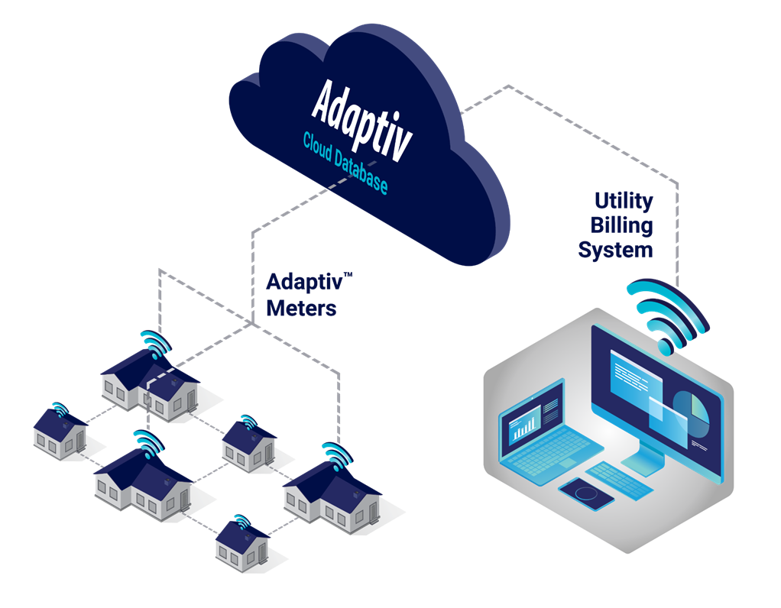
Adaptiv Benefits
Zero Infrastructure
Easy to deploy
No costly infrastructure to install or maintain
Billing Data Transfer
Standards-based integration to utility billing applications
Multispeak, MV-RS, CMEP
Solution as a Service
Seamless Cloud Software and Support
No IT hardware to buy or databases to manage
Nighthawk provides all hosting and support
Secure, Reliable Reads scheduled or on demand
Daily consumption
Move in/move out reads
Disconnects

Slide 4
Adpativ Deployment Options
Full AMI
Typically targeted at small – medium-size municipalities/cooperatives.
Cell + Mesh
Multi-service
Full two-way AMI for electric or electric + water (no water-only).
Gas remote reading is handled through ERT collection using our ERT Collector Hub Meters. NOT full two-way AMI for Gas.
Gap Fill
Typically targeted at larger utilities to fill in gaps in existing AMI systems.
Tactical/Targeted Solutions
Used for targeted applications like remote disconnect, remote reading, Christmas Lights, crypto-mining, etc.
When dealing with a utility, can naturally grow into a full AMI system.
ERT Collection
For electric and water customers, can be used as a bridge to Full two-way AMI.
Rarely do we reliably collect ALL electric, water and gas ERT signals.

Slide 5
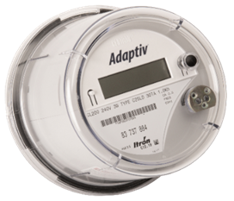
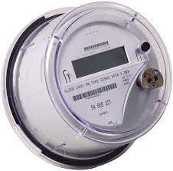
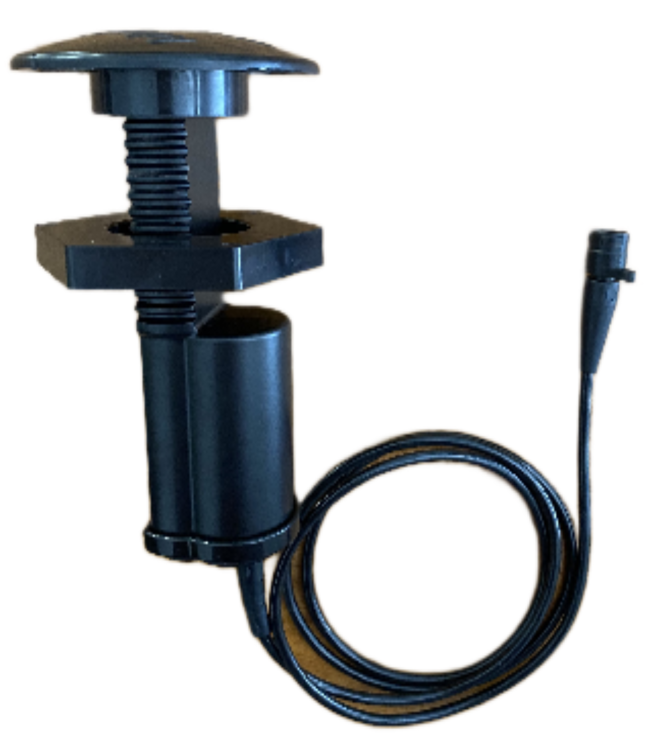
Adaptiv Endpoints
All Adaptiv devices contain a 2.4GHz RF Mesh transceiver connecting all devices, including HUBS
Cellular Hubs manage multiple LEAF devices
Population diversity: ~10% HUB to 90% LEAF
Electric meters available in all S Base form factors and classes
Device Type | Cellular + RF Mesh HUB | ERT Reader Cell+Mesh HUB | RF Mesh only LEAF | Disconnect option
Aclara kV2c |  | --- | --- | ---
Aclara I-210+c |  | ---
Itron Centron II |  |  | ---
Water End Point | --- | --- |  | ---

Slide 6
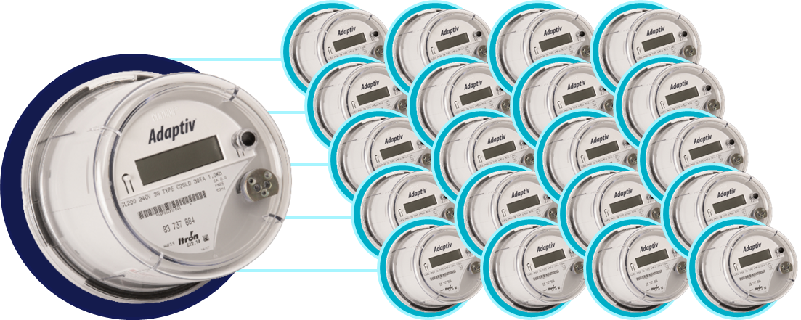
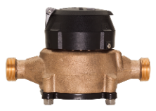
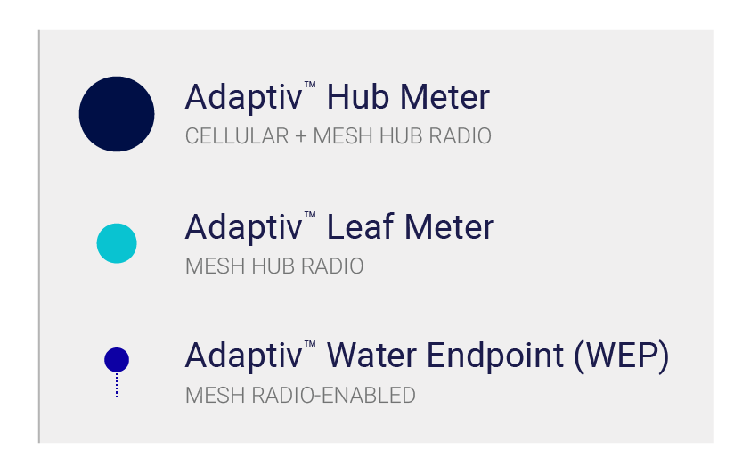
ADAPTIV™ | ONE HUB TO MANY LEAFS
Scalable, self-healing, self-configuring RF Mesh network
High bandwidth LTE cellular-mesh
One HUB per cluster of 10 -20 LEAF devices – electric and water
LEAF devices provide up to 4 hops to maximize coverage
Built-in security and redundancy
Water interval data and leak detection with exceptional battery life
Simple installation and maintenance
Cellular LTE
2.4 GHz RF Mesh

Slide 7
What does this have to do with Fiber?

Slide 8
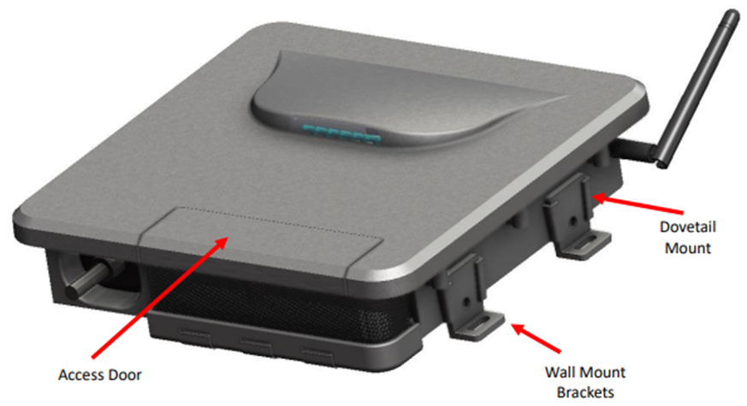
Fiber Hub Intro
Introducing late 4th quarter 2023
The Nighthawk Ethernet HUB product is a self-contained mesh HUB device with a wired Ethernet uplink.
Fiber hub is Adaptiv compatible – uses same Synapse mesh module
Acts as a collector for multiple devices
Technically an infrastructure device
“Fiber” is used because the initial product offering has been designed to work with customer deployed PON networks
With further development, network uplink could be connected to any copper Ethernet interface
Circuitry included to support cellular based version (replaces PON) – reduces operating costs (less cellular outtakes)
Customer assisted testing and validation ongoing
LED Status Indicators
2.4GHz Mesh Antenna

Slide 9
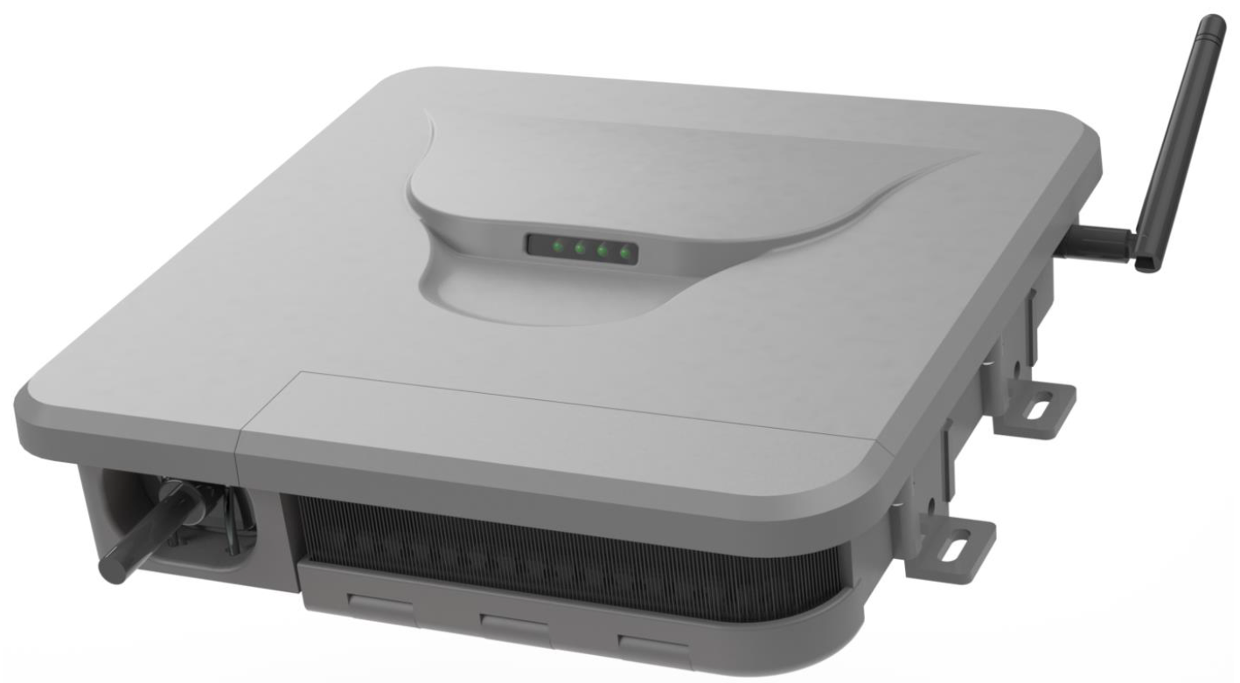
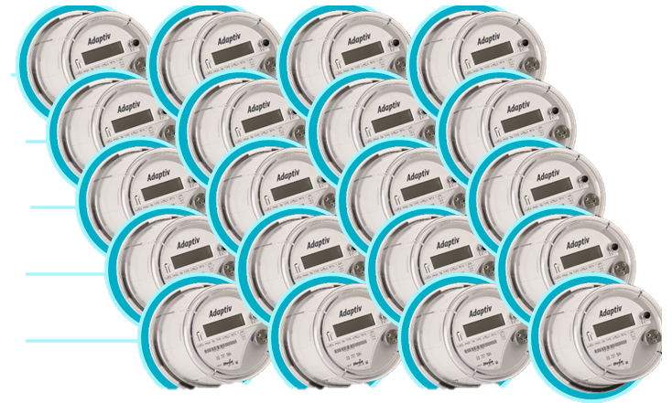
ADAPTIV™ | ONE HUB TO MANY LEAFS
Scalable, self-healing, self-configuring RF Mesh network
Utilize High bandwidth Fiber backhaul
One HUB per cluster of greater than 20 LEAF devices – electric and water
LEAF devices provide up to 4 hops to maximize coverage
Built-in security and redundancy
Water interval data and leak detection with exceptional battery life
Simple installation and maintenance
Fiber Network
2.4 GHz RF Mesh
Fiber Hub

Slide 10
Fiber Hub Use Cases
Ideal for utilities who have mostly fiber throughout service territory
Federal government incentivizing rural coop fiber to the home
Utilities looking for applications to use the deployed fiber
Allows for network performance tuning
Mounting on a pole improves device connectivity – increased RF range
Allow stranded devices network access
To be confirmed in validation testing:
Connect > 20 devices via mesh
Height is our friend
Standard hub averages up to 10-20 leaf devices
Maximum hub capacity 150 leafs

Slide 11
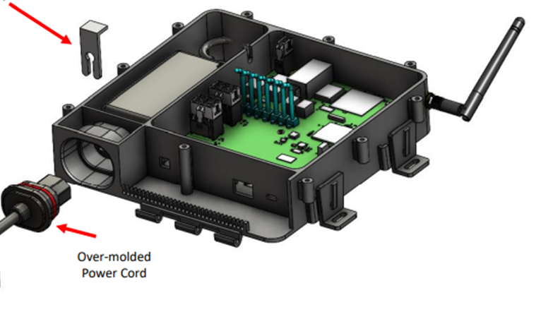
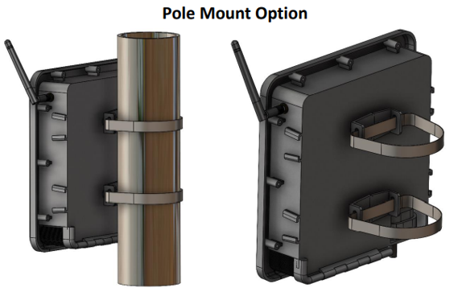
Fiber Hub Features
120/240 VAC power input
Locking power cord
Size: 7” x 6” x 2.5”
Wall or Pole mounting
Operating Temp: -20C / +65C
External I/O’s:
12 VDC output for downstream devices (optional)
RJ-45 sealed connector – 100Base-TX
USB-C sealed Terminal Access Port for configuration, diagnostics, and Synapse script upgrades
LED Status Indicators for power, network uplink, and alarm status
Microprocessor based to support multiple peripherals
ST Micro STM32F767ZIT6
Processor firmware OTA upgradable
LED Status Indicators
2.4GHz Mesh Antenna
Wall mount Brackets

Slide 12
Fiber Hub Features – con’t
Advanced Outage Management power fail detection
Configurable blink and sustained outage event thresholds, event logging and data upload
Rechargeable Battery Backup of 10 minutes to allow for last gasp transmissions
Powers internal circuitry only
Supports OTA firmware upgrades to associated mesh devices
Robust end to end security and encryption

Slide 13
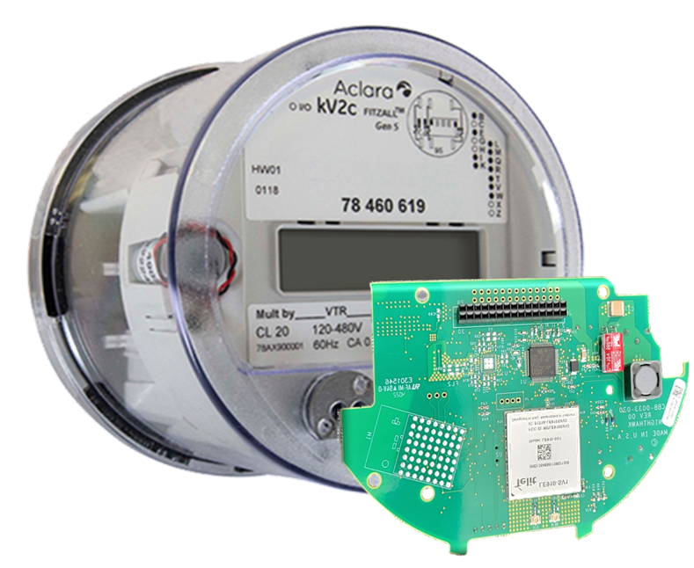
DirectConnect
Compatible with all data acquisition software that supports TCP/IP connections

Slide 14
DirectConnect Solution
Introducing Nighthawk DirectConnect TCP/IP connectivity on the Aclara kV2c mid second quarter 2023
Connects directly to the meter’s C12.19 data structure
Connects directly with Itron MV-90, Aclara MeterMate, Trilliant PrimeRead, or Trilliant UnitySuite data acquisition software
Robust, secure, and efficient bidirectional message delivery mechanism
Utilizes same proven LTE hardware as Adaptiv HUB solutions (less RF mesh module)
Cellular devices only – not compatible with Leaf (mesh) meters
In final testing now
Full data retrieval
Features such as last gasp, modem configuration and firmware update supported
Can use MeterMate to update meter firmware and configuration
Compatible with Nighthawk kV2c meters – full meter functions supported
Itron Poly to follow late 2023/early 2024
Currently supported on Verizon or AT&T
14

Slide 15
DirectConnect Solution
Does not require any middleware
Stand alone solution that does not require Adaptiv HES or other Adaptiv endpoints
No recurring fees from Nighthawk. Utilize existing utility private contract with AT&T or Verizon
Customer provides SIMs
Other carriers can be supported
Other carriers can be supported with purchase commitments
Requires testing and certification
Warranty Term: 1 year

Slide 16
Module Specifications
Radio Performance
DirectConnect Functionality
protocols | TCP/IP
modulation | OFDM (Orthogonal Frequency Division Multiplex)
data rate | LTE Cat-1 (5 Mbps ↑, 10 Mbps ↓ )
frequency band | LTE Bands 2, 4, and 12 or 13
transmit EIRP | +20 dBm (including antenna gain)
sensitivity | -103 dBm (@ 1% PER; incl. antenna gain)
connectivity | AT&T or Verizon LTE cellular
security | ANSI C12.22 128-bit AES/EAX’ (combined encryption/authentication)
memory | 40 kB
clock synch | to LTE network
firmware | over-the-air upgradable
power outage & restoration reporting | aggregated real-time reporting
Power, Physical, & Environmental
Compliance
burden (including module) | 120 V: 1.3 W 240 V: 1.6 W | 277 V: 1.7 W 480 V: 2.4 W
S-Base | 6.95”/17.65 cm (diam). x 4.38”/11.11 cm (D) 4 lbs / 1.8 kg net
temperature | -22° F / -30° C to +158°F / +70° C
humidity | 5 to 95% non-condensing
radio emissions | FCC Part 15 Class A Industry Canada ICES-003 Class A
device IDs | FCC ID: RI7LE910NAV2 IC ID: 5131A-LE910NAV2
safety | ANSI C37.90.1 ANSI C62.41
metrology | ANSI C12.1 ANSI C12.18 ANSI C12.19 | ANSI C12.20 ANSI C12.21

Slide 17
Simple Configuration

Slide 18
Questions and Discussion
Jon Scott
TESCO NIGHTHAWK Sales Manager
TESCO – The Eastern Specialty Company
Bristol, PA
404.451.8444
This presentation can also be found under Meter Conferences and Schools on the TESCO website: tescometering.com
ISO 9001:2015 Certified Quality Company
ISO 17025:2017 Accredited Laboratory

