Slide 1
Current Transformers and Ratio, Burden and Admittance Testing
July 24, 2024
10:30 AM – 12 PM
Rob Reese

Slide 2
Agenda
  CT Functionality Basics
  The Faceplate: Terminology and Specifications
  Ratio Testing
  Burden Testing
  Admittance Testing

Slide 3
Meter Forms and Applications
14S
39S
17S
1S
2S
3S
12S
35S
4S
25S
10S
76S
46S
45S
66S
11S
32S
5S
26S
6S
16S
9S
15S
56S
24S
13S

Slide 4
Meter Forms and Applications
SELF-CONTAINED
TRANSFORMER RATED
1S
39S
7S
14S
36S
3S
2S
12S
29S
76S
5S
35S
25S
46S
4S
8S
16S
11S
26S
17S
66S
6S
45S
9S
13S
10S
15S
32S
56S
24S

Slide 5
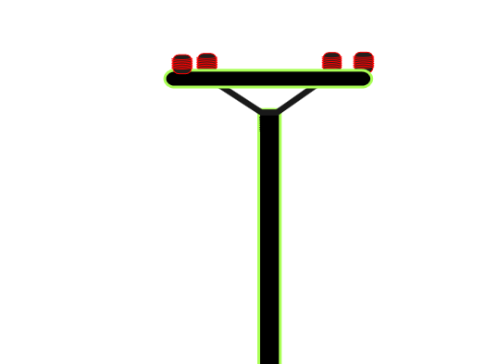
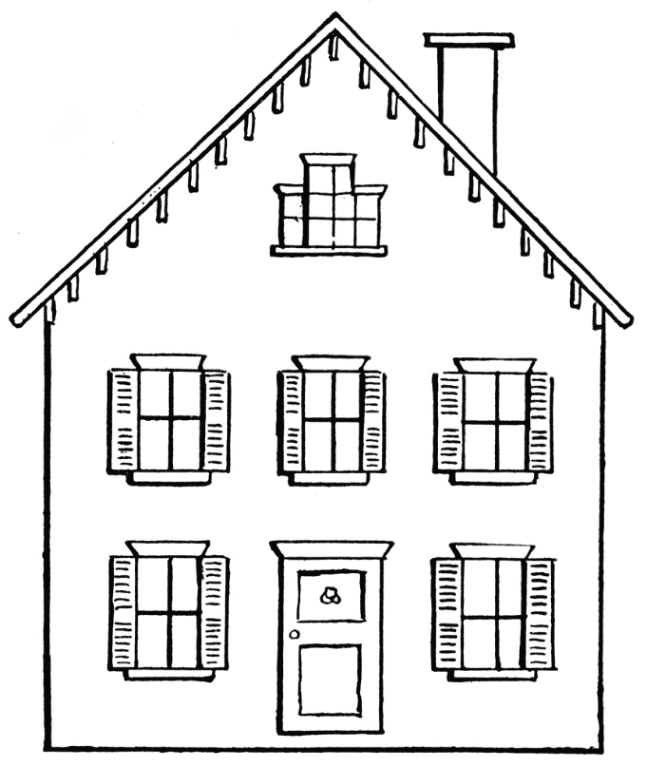
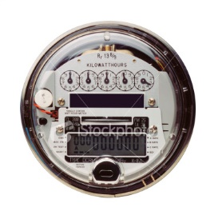
Self-Contained Metering
Primarily Residential
(1S, 2S, 12S)
Relatively Low Current
Example: 100A

Slide 6
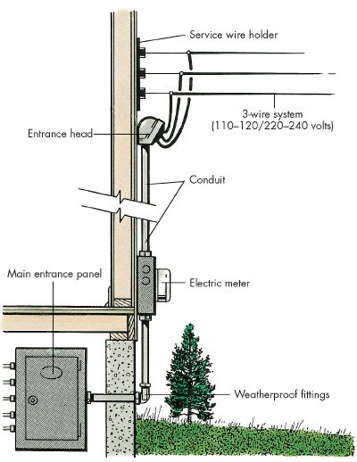
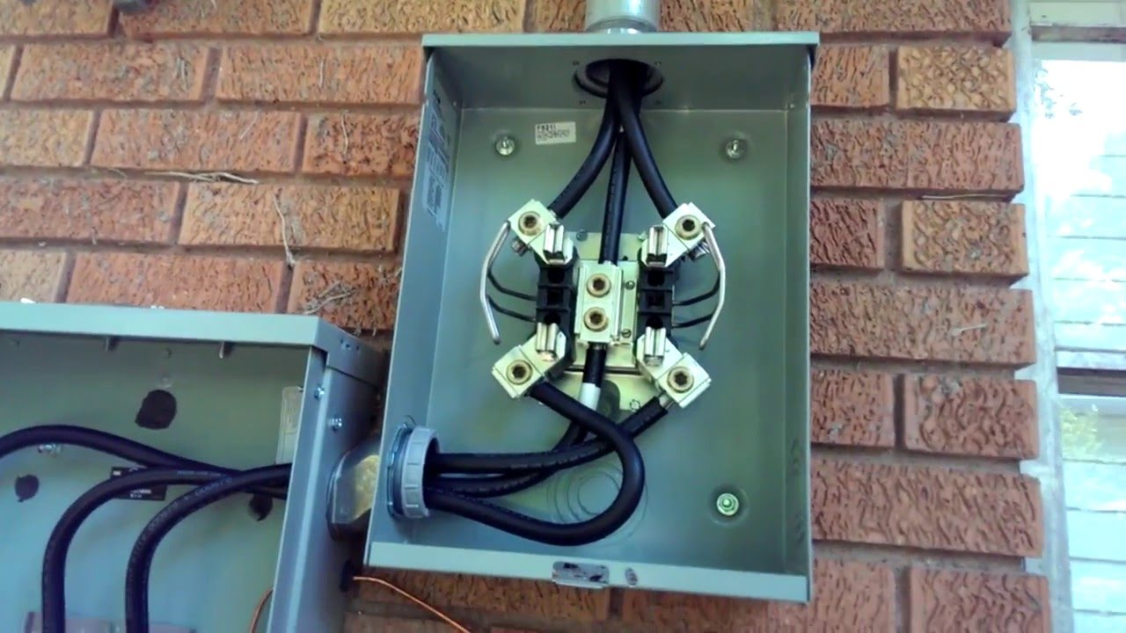
Self-Contained Metering
Primarily Residential
(1S, 2S, 12S)

Slide 7
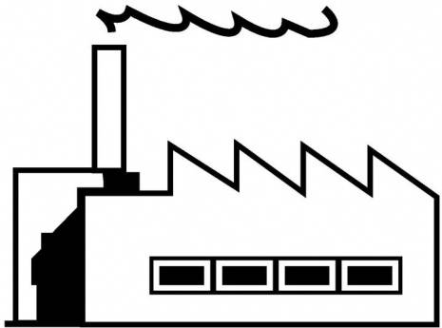
Transformer-Rated Metering
Primarily Commercial/Industrial
Relatively High Current
Example: 2000A

Slide 8
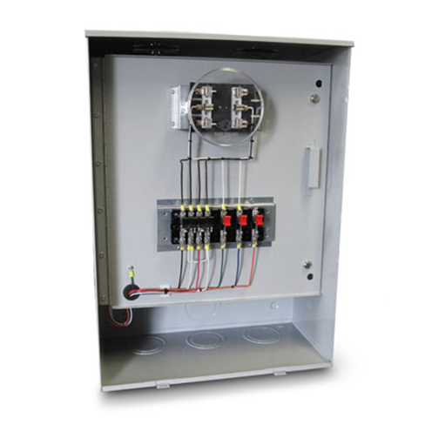
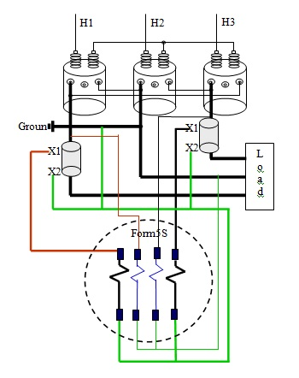
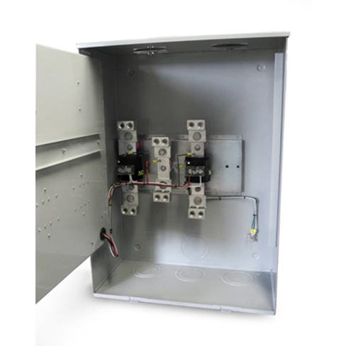
Transformer-Rated Metering
Primarily Commercial/Industrial

Slide 9
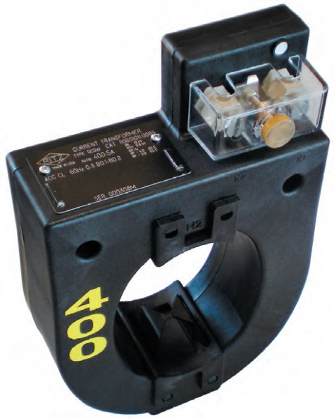
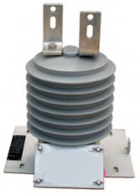
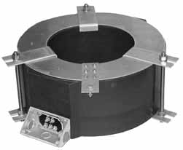
What is a CT?
“A current transformer (CT) is used for measurement of alternating electric currents. Current transformers, together with voltage (or potential) transformers (VT or PT), are known as instrument transformers. When current in a circuit is too high to apply directly to measuring instruments, a current transformer produces a reduced current accurately proportional to the current in the circuit, which can be conveniently connected to measuring and recording instruments. A current transformer isolates the measuring instruments from what may be very high voltage in the monitored circuit. Current transformers are commonly used in metering and protective relays in the electrical power industry.” - Wikipedia

Slide 10
Current Transformers Conceptual Representation
As current is applied in the primary, it produces a magnetic flux in the core. This flux flows through the core and induces a current in the secondary windings and circuit that is proportional to the number of turns.
Ideal. No losses
Real, with core losses

Slide 11

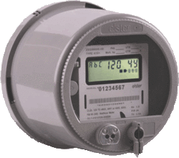
Example Application
SOURCE
LOAD
PHASE A
400A
PHASE B
400A
PHASE C
400A
9S Meter Installation
5A
5A
5A

Slide 12
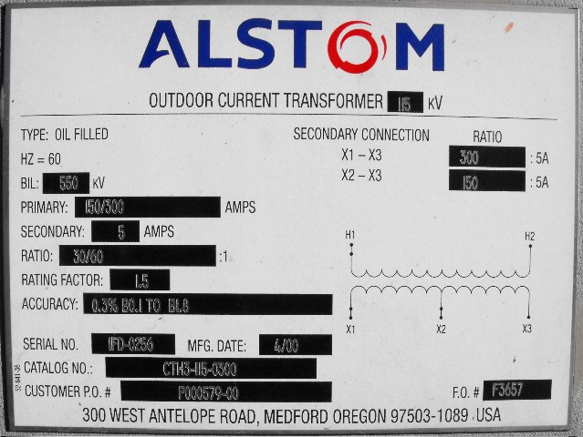
Faceplate Specifications

Slide 13
Faceplate Specifications
Ratio

Slide 14
CT’s Ratio
5Amps
400Amps
For instance, a CT with a 400:5 ratio will produce 5A on the secondary, when 400A are applied to the primary.

Slide 15
Faceplate Specifications
Thermal factor

Slide 16
CT’s – Functions and Terminology
Thermal Rating factor
A value representing the amount by which the primary current can be increased without exceeding the allowable temperature rise.
For instance, a RF of 4.0 at 30° ambient on a 400:5 ratio CT would allow for a primary current up to 1600A.

Slide 17
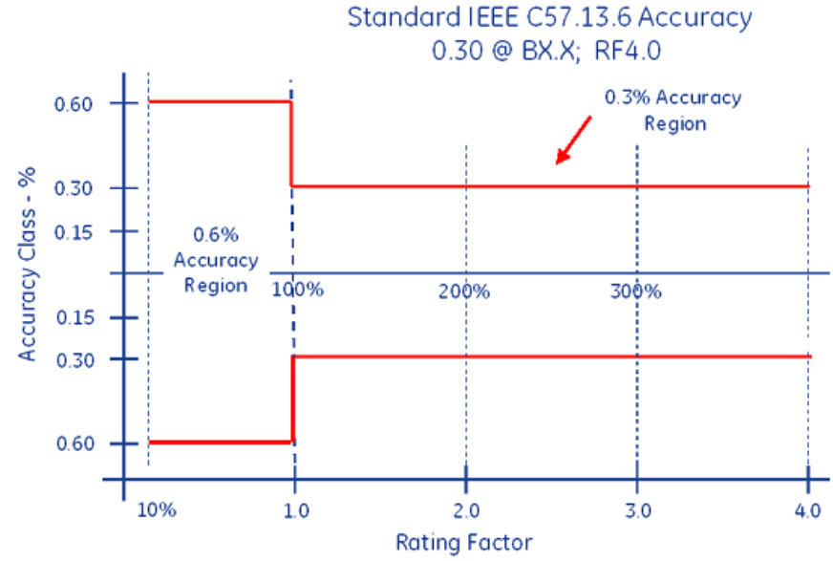
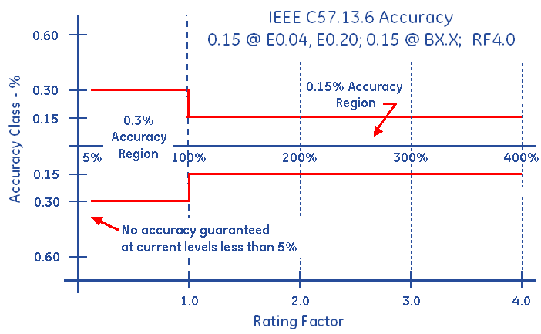
Faceplate Specifications
Accuracy Classifications
All CT’s fall within an accuracy class.
IEEE Standards have defined accuracy classes.

Slide 18
Faceplate Specifications
BurdenRating

Slide 19
Burden Rating
The burden range, present in the secondary circuit, that the manufacturer will guarantee their CT’s will still accurately function, in regards to the ratio specification.

Slide 20
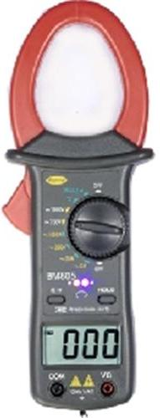
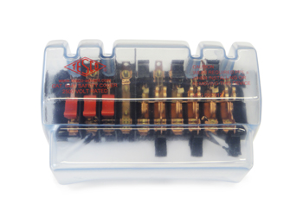
Ratio Testing
Ratio of Primary Current to Secondary Current
SOURCE
LOAD
PHASE A
400A
400A
400A
5A
5A
5A
Calculate Ratio

Slide 21
Burden Testing
Functionality with Burden Present on the Secondary Loop
PHASE A
Some burden will always be present – junctions, meter coils, test switches, cables, etc.
CT’s must be able to maintain an accurate ratio with burden on the secondary.

Slide 22
Burden Testing
Functionality with Burden Present on the Secondary Loop
PHASE A
Some burden will always be present – junctions, meter coils, test switches, cables, etc.
CT’s must be able to maintain an accurate ratio with burden on the secondary.

Slide 23
Burden Testing
Functionality with Burden Present on the Secondary Loop
Example Burden Spec:
0.3% @ B0.1, B0.2, B0.5
or
There should be less than the 0.3% change in secondary current from initial (“0” burden) reading, when up to 0.5Ohms of burden is applied

Slide 24
Burden Testing
Functionality with Burden Present on the Secondary Loop
ANSI Burden Values
0.1 Ohms
0.2 Ohms
0.5 Ohms
1 Ohms
2 Ohms
4 Ohms
8 Ohms

Slide 25
Burden Testing
0.3% @ B0.1, B0.2, B0.5
Initial Reading = 5Amps
0.3% x 5A = 0.015A
5A – 0.015 = 4.985A
Burden | Reading
0 | 5.0000
0.1 | 4.9999
0.2 | 4.9950
0.5 | 4.9900
1 | 4.9800
2 | 4.9500
4 | 4.0000
8 | 0.8000

Slide 26
Burden Testing
0.3% @ B0.1, B0.2, B0.5
Initial Reading = 5Amps
0.3% x 5A = 0.015A
5A – 0.015 = 4.985A
Burden | Reading
0 | 5.0000
0.1 | 4.9999
0.2 | 4.9950
0.5 | 4.9900
1 | 4.9800
2 | 4.9500
4 | 4.0000
8 | 0.8000
At 0.5Ohms of Burden
the secondary current is still at 4.990A – Less than 0.3% change – Good CT!

Slide 27
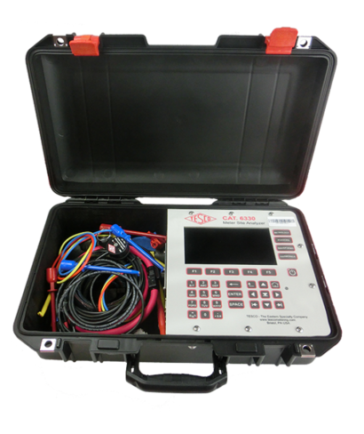
Admittance Testing
What is Admittance?
Admittance testing measures the overall “health” of the secondary loop of the CT.
Measured in units of MiliSiemens (mS)
Admittance is the inverse of impedance.
Impedance is the opposition to current.
Therefore, admittance testing measures the overall “health” of the secondary loop of the CT.

Slide 28

Admittance Testing
Admittance testing devices inject an audio sine wave signal into the secondary loop of the CT.
The resulting current is measured.
The voltage of the initial signal is known.
From these two parameters, the impedance, and thus the admittance can be calculated.

Slide 29

Admittance Testing
Admittance test results are not immediately intuitive.
Some analysis and interpretation is need.
What do all these mS values mean?

Slide 30

Admittance Testing
Three phase process is recommended.
Test each CT individually
Test the matched sets
Test over time

Slide 31

Questions and Discussion
Rob Reese
Midwestern Regional Sales Manager
rob.reese@tescometering.com
TESCO Metering Bristol, PA
215.228.0500
This presentation can also be found under Meter Conferences and Schools on the TESCO website: tescometering.com
ISO 9001:2015 Certified Quality Company
ISO 17025:2017 Accredited Laboratory

