Slide 1
Introduction to Transformer Rated Metering
July 24, 2024
10:30 AM – 12:00 PM
Dan Falcone

Slide 2
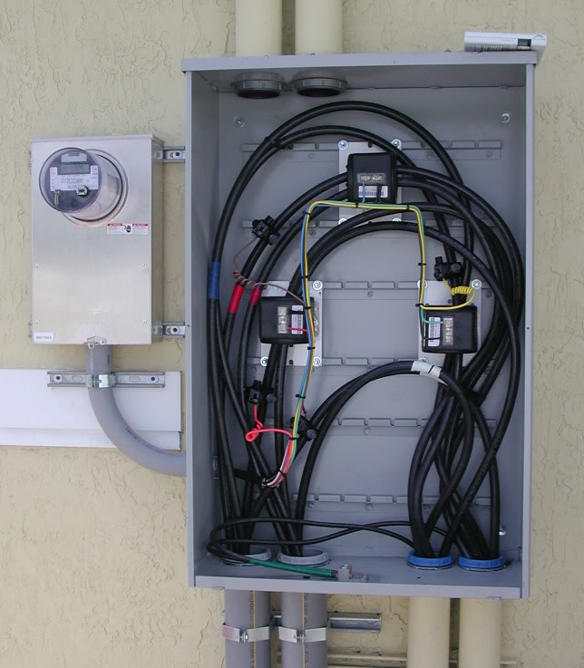
Topics we will be covering
The Basics- Differences Between Self Contained and Transformer or Instrument Rated Meter Sites
Brief Discussion of polyphase metering for self-contained and transformer rated applications
Transformer Rated Meter Forms
Test Switches and CT’s
Blondel’s Theorem and why this matters to us in metering
Meter Accuracy Testing in the Field
Checking the Health of your CT’s and PT’s
Site Verification and not just meter testing
2

Slide 3
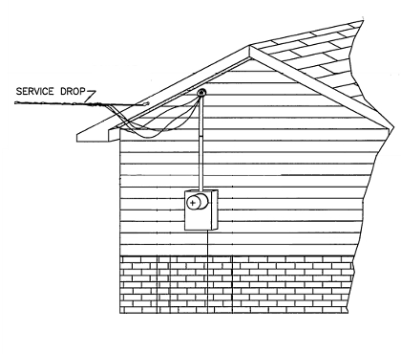
Self Contained Metering
Typically found in residential metering
Meters are capable of handling the direct incoming amperage
Meter is connected directly to the load being measured
Meter is part of the circuit
When the meter is removed from the socket, power to the customer is interrupted
3

Slide 4
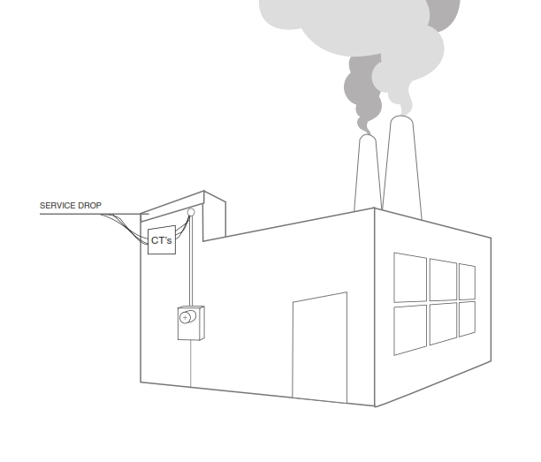
Transformer Rated Metering
Meter measures scaled down representation of the load.
Scaling is accomplished by the use of external current transformers (CTs) and sometimes voltage transformers or PTs).
The meter is NOT part of the circuit
When the meter is removed from the socket, power to the customer is not effected.
4

Slide 5
1-Phase and 3-Phase Power
V
0 30 60 90 120 150 180 210 240 270 300 330 360
Voltage = V_{max} sine α

Slide 6
1-Phase and 3-Phase Power
V_{C}
120⁰
120⁰ ₁₂₀₀
V_{A}
0 30 60 90 120 150 180 210 240 270 300 330 360
V_{B}
Volts Phase A Volts Phase B Volts Phase C
Forward Rotation, ABC

Slide 7
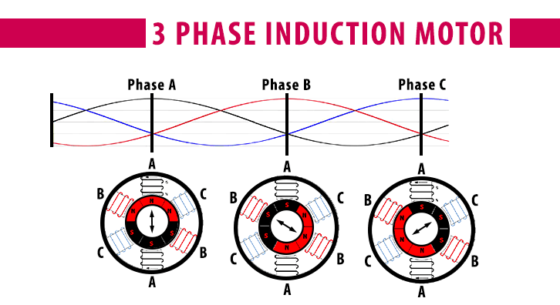
The Need for 3-Phase Power
Single-phase motors provide a pulsating torque to a mechanical load. Loads which require more than 10 horsepower generally also require the steadier torque of a
3-phase motor.

Slide 8
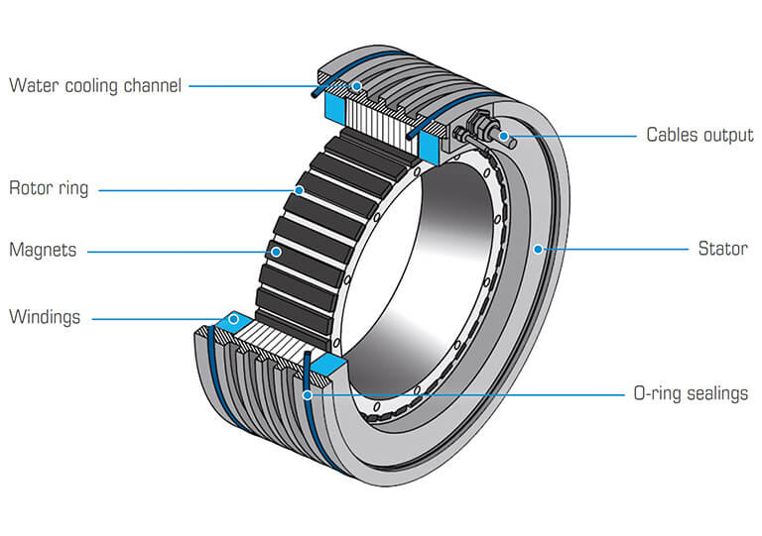
Benefits of 3-Phase Power
Steadier motor torque
Less vibration in machinery
Greater mechanical efficiency
Better voltage regulation
Lower heat losses
Lighter weight conductors

Slide 9
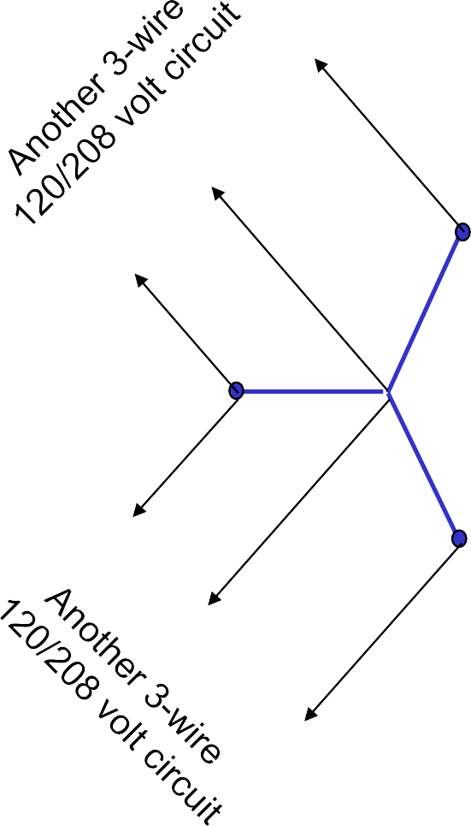
Network Service & Loads
A
N
A
A
C
120 and 208 volt loads
N
C
N
C
B
B
N
B

Slide 10
3-Wire Delta Service & Loads
C
B-C
C-A
A-B-C
B
A
A-B
Need to meter single phase line-line loads, as well as three phase loads.

Slide 11
4-Wire Delta Service & Loads
A
A-B-C
C
A-N
C-A
A-B
N
B-N
B
B-C
Need to meter single phase line-neutral and
line-line loads, as well as three phase loads.

Slide 12
4-Wire Wye Service & Loads
C
A-B-C
C-N
C-A
B-C
A
N
A-N
A-B
B
B-N
Need to meter single phase line-neutral and
line-line loads, as well as three phase loads.

Slide 13
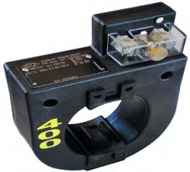
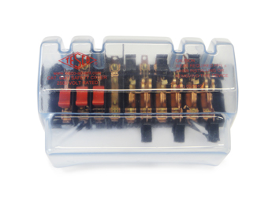
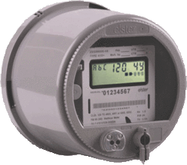
Transofrmer Rated - The Basic Components
9S Meter Installation with 400:5 CT’s
SOURCE
400A
LOAD
PHASE A
PHASE B
400A
PHASE C
400A
5A
5A
5A
13

Slide 14
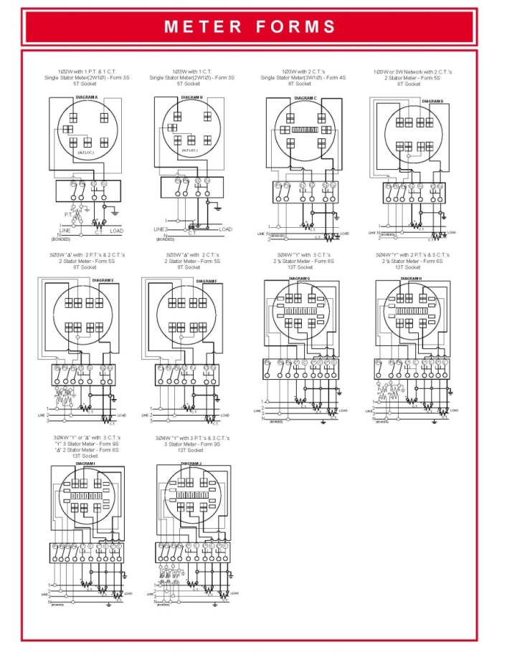
Typical Connections
Typical Connections for Common Transformer (Instrument) Rated Meter Forms
Note: See Chapter 4 of the Power Measurement Handbook for more detailed form by form information
14

Slide 15

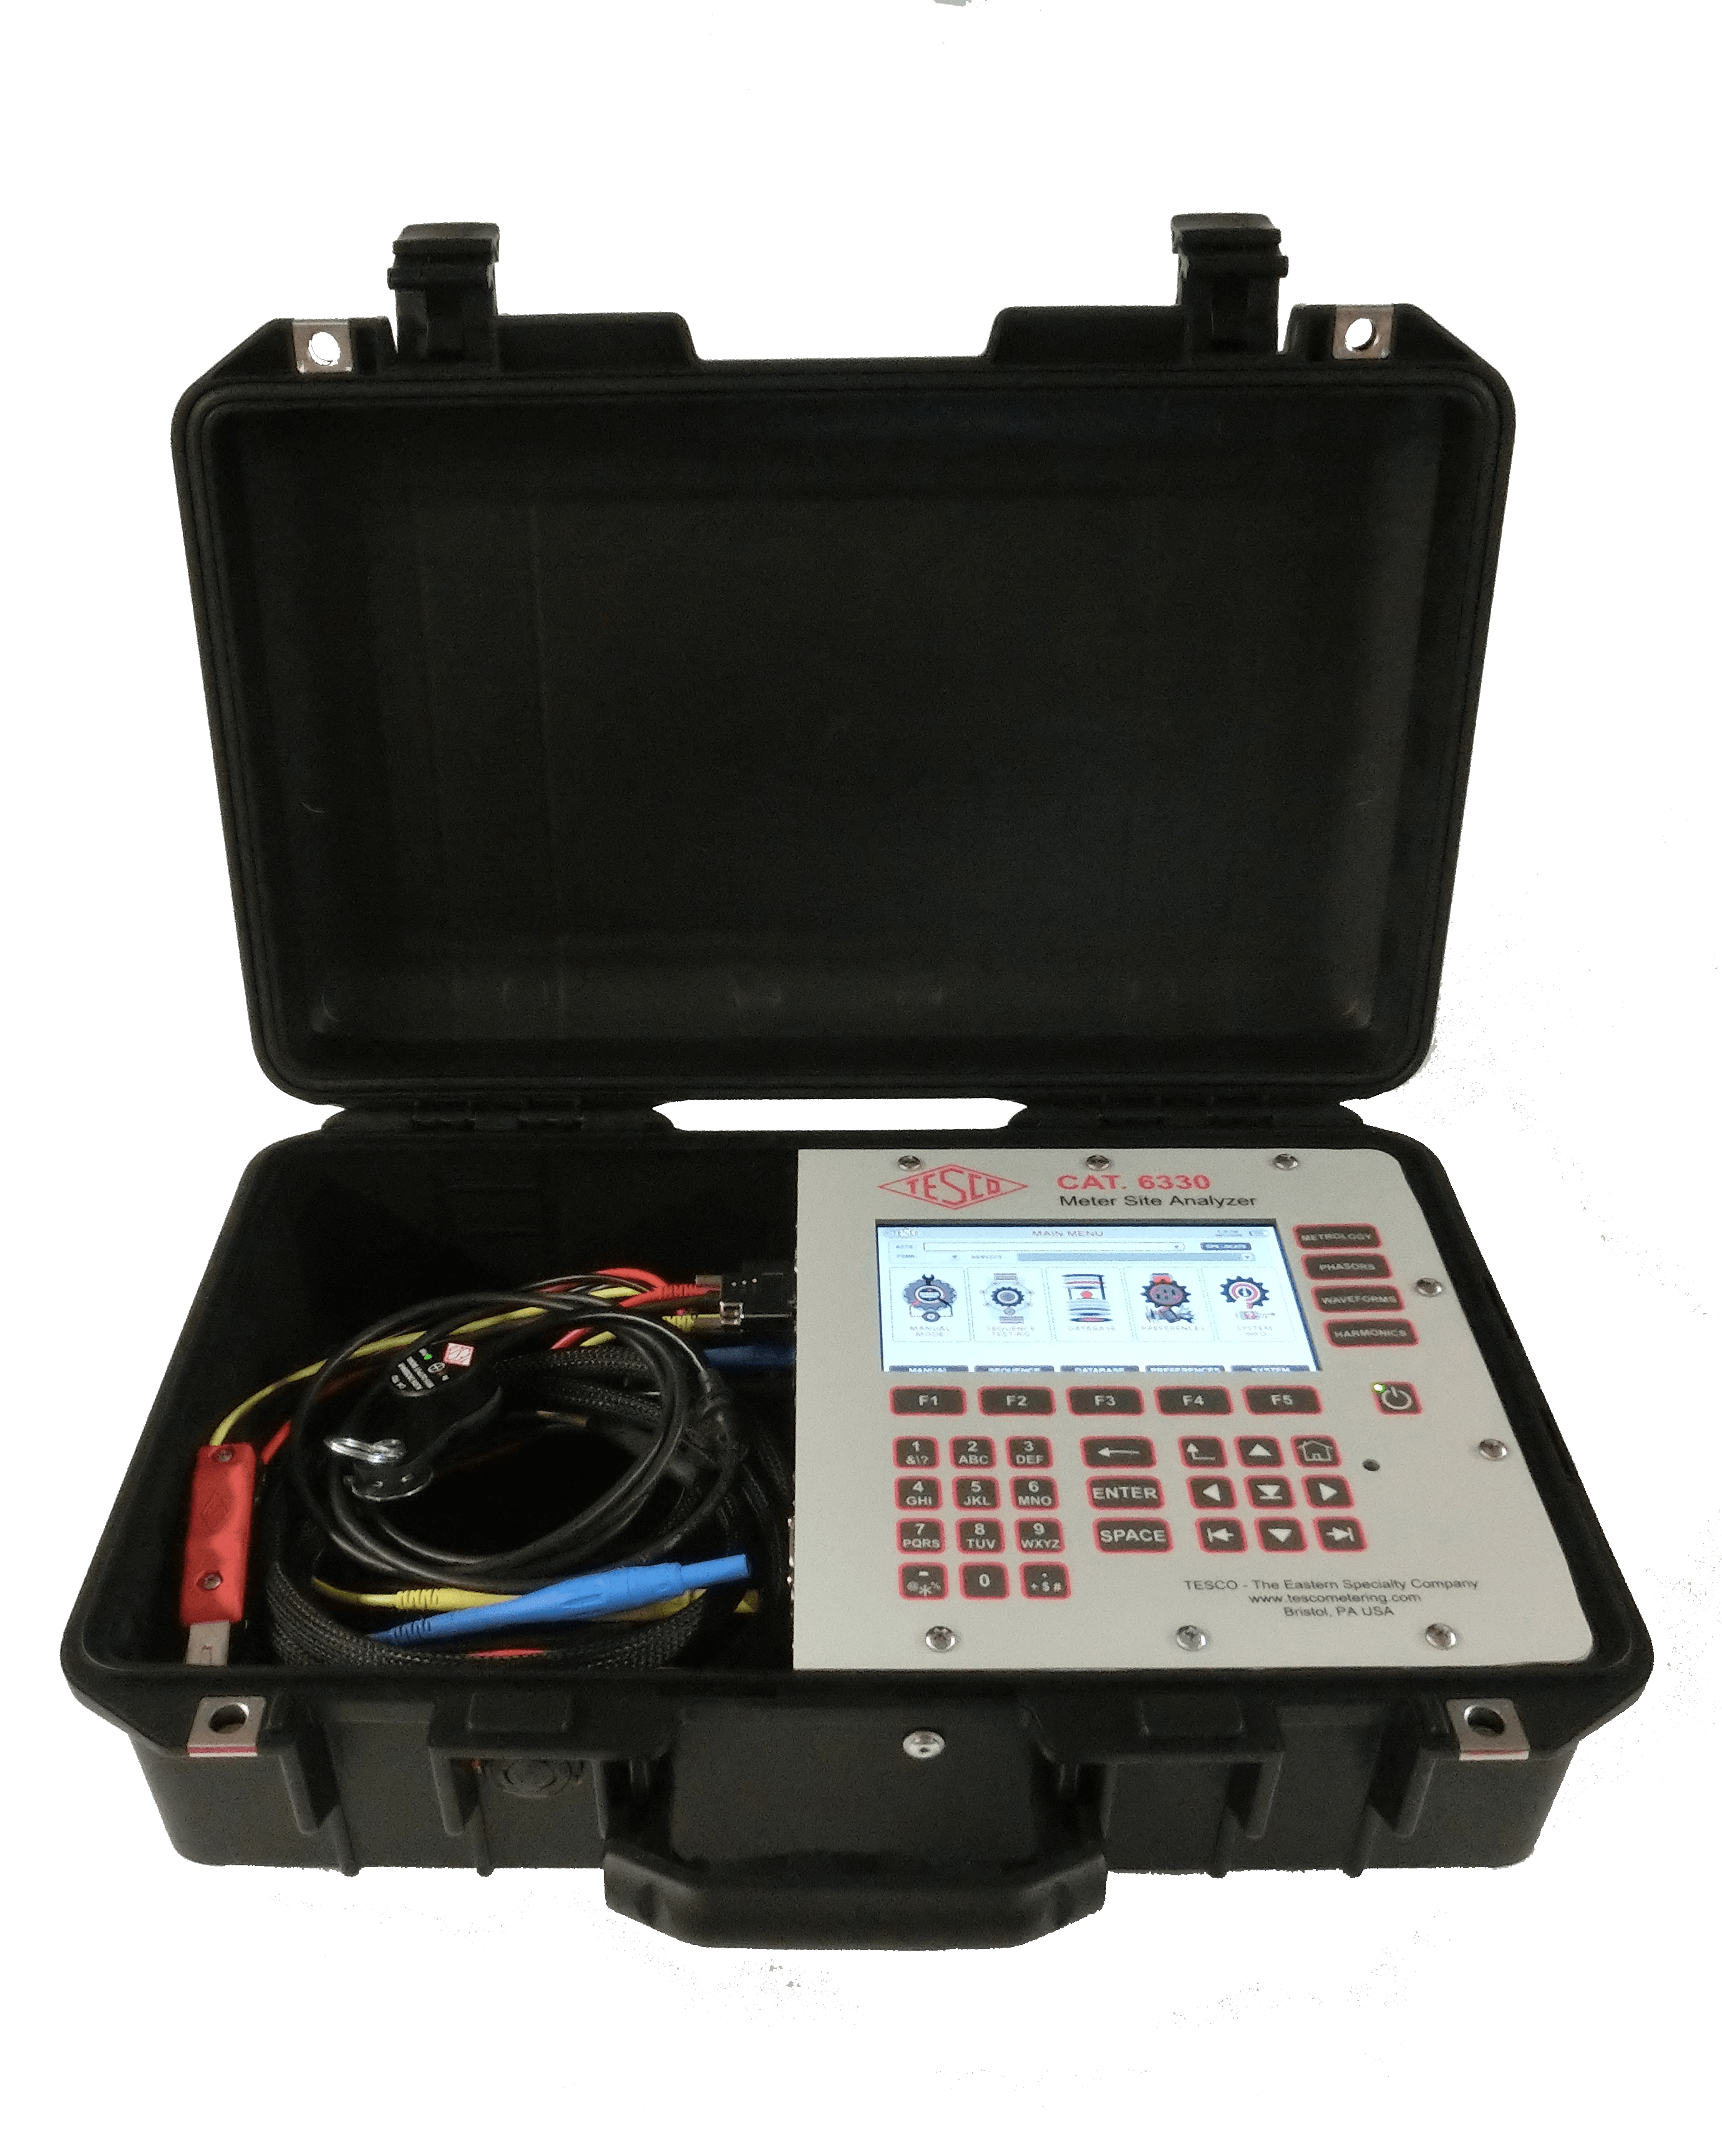
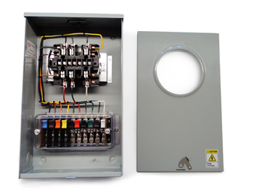
Meter Accuracy Testing
Meter Accuracy Testing in a Nutshell
Full Load
Light Load
Power Factor
15
15

Slide 16
The Importance of CT Testing in the Field
One transformer in three wired backwards will give the customer a bill of 1/3rd the actual bill.
One broken wire to a single transformer will give the customer a bill of 2/3rd the actual bill
One dual ratio transformer inappropriately marked in the billing system as 400:5 instead of 800:5 provides a bill that is ½ of the actual bill. And the inverse will give a bill double of what should have been sent. Both are lose-lose situations for the utility.
16

Slide 17

The Importance of CT Testing in the Field (cont)
Cross Phasing (wiring errors)
Loose or Corroded Connections
CT Mounted Backwards
CT’s with Shorted Turns
Wrong Selection of Dual Ratio CT
Detect Magnetized CT’s
Burden Failure in Secondary Circuit
Open or Shorted Secondary
Mislabeled CT’s
Ensures all Shorting Blocks have been Removed
17

Slide 18
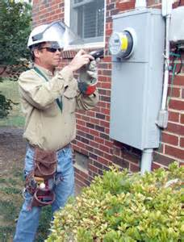
Testing at Transformer Rated Sites
Meter Accuracy
Full Load
Light Load
Power Factor
CT Health
Burden Testing
Ratio Testing
Admittance Testing
Site Verification
18

Slide 19
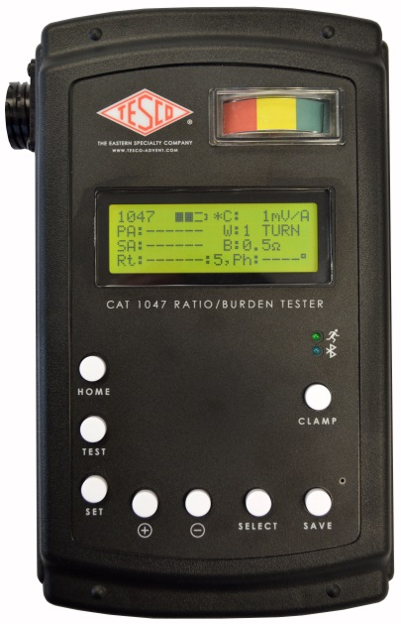
Fundamentals of Polyphase Field Meter Testing and Site Verification
Functionality with Burden Present on the Secondary Loop
PHASE A
Some burden will always be present – junctions, meter coils, test switches, cables, etc.
CT’s must be able to maintain an accurate ratio with burden on the secondary.
19

Slide 20
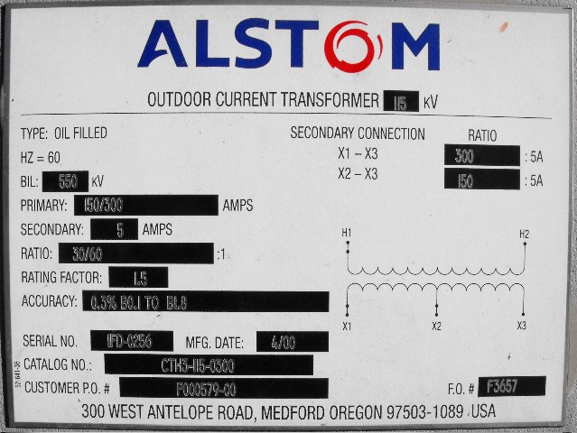
Fundamentals of Polyphase Field Meter Testing and Site Verification
Functionality with Burden Present on the Secondary Loop
Example Burden Spec:
0.3% @ B0.1, B0.2, B0.5
or
There should be less than the 0.3% change in secondary current from initial (“0” burden) reading, when up to 0.5 Ohms of burden is applied
20

Slide 21
Fundamentals of Polyphase Field Meter Testing and Site Verification
Ideal. No losses
Real, with core losses
21

Slide 22
Fundamentals of Polyphase Field Meter Testing and Site Verification
Functionality with Burden Present on the Secondary Loop
Initial Reading = 5Amps
0.3% x 5A = 0.015A
5A – 0.015 = 4.985A
0.3% @ B0.1, B0.2, B0.5
Burden | Reading
0 | 5.0000
0.1 | 4.9999
0.2 | 4.9950
0.5 | 4.9900
1 | 4.9800
2 | 4.9500
4 | 4.0000
8 | 0.8000
22

Slide 23
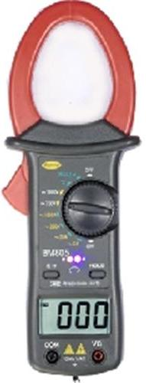

Fundamentals of Polyphase Field Meter Testing and Site Verification
Ratio of Primary Current to Secondary Current
SOURCE
LOAD
PHASE A
400A
400A
400A
5A
5A
Calculate Ratio
23

Slide 24

Three Phase Power: Blondel’s Theorem
The theory of polyphase watthour metering was first set forth on a scientific basis in 1893 by Andre E. Blondel, engineer and mathematician. His theorem applies to the measurement of real power in a polyphase system of any number of wires. The theorem is as follows:
  - If energy is supplied to any system of conductors through N wires, the total power in the system is given by the algebraic sum of the readings of N wattmeters, so arranged that each of the N wires contains one current coil, the corresponding voltage coil being connected between that wire and some common point. If this common point is on one of the N wires, the measurement may be made by the use of N-1 wattmeters.
24

Slide 25
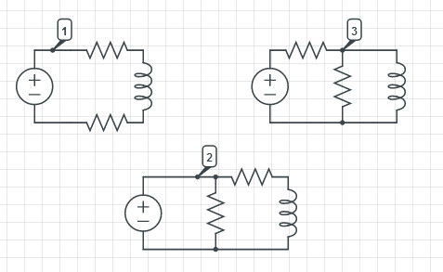
Three Phase Power: Blondel’s Theorem
Simply – We can measure the power in a
N wire system by measuring the power in N-1 conductors.
For example, in a 4-wire, 3-phase system we need to measure the power in 3 circuits.
25

Slide 26

Three Phase Power: Blondel’s Theorem
If a meter installation meets Blondel’s Theorem then we will get accurate power measurements under all circumstances.
If a metering system does not meet Blondel’s Theorem then we will only get accurate measurements if certain assumptions are met.
26

Slide 27
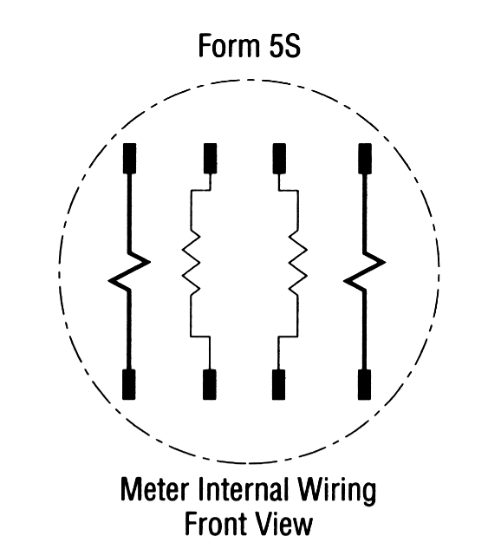
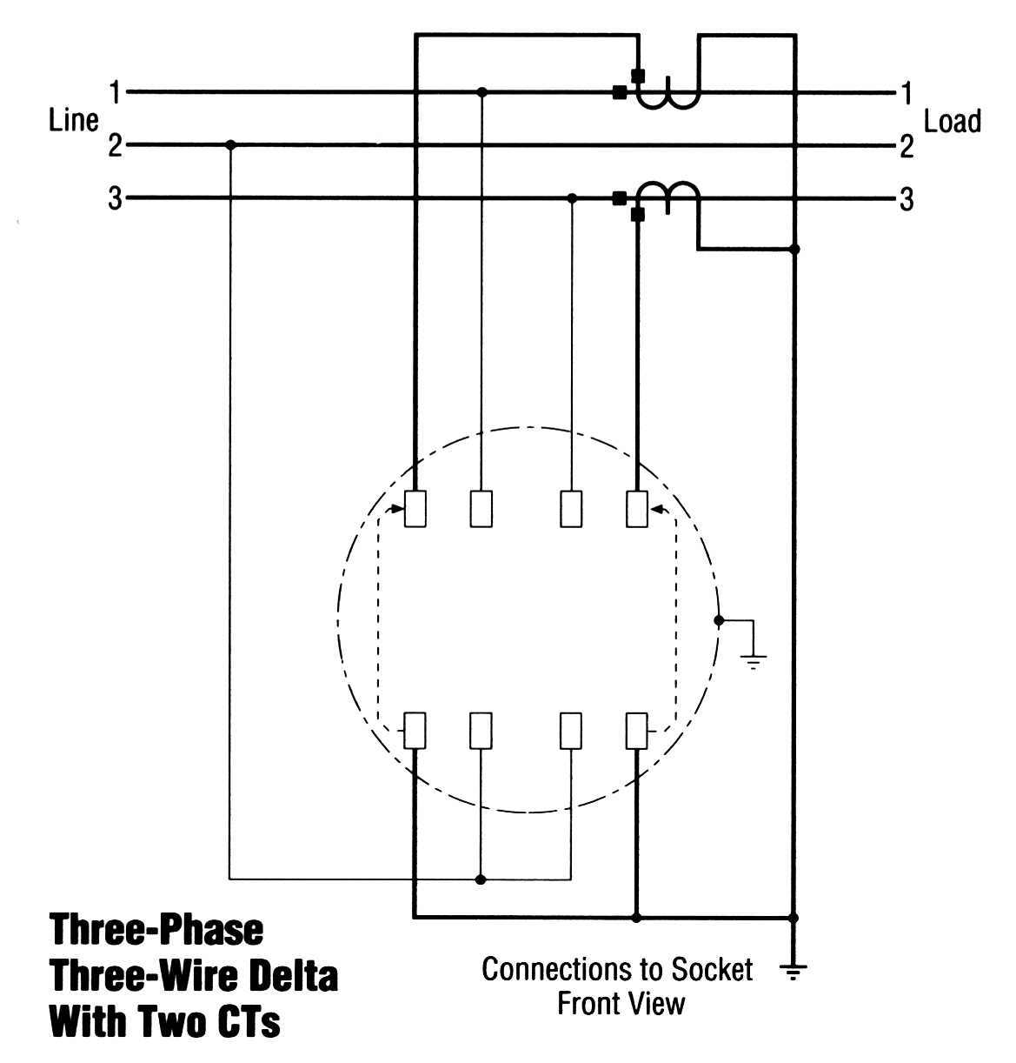

Blondel’s Theorem
Three wires
Two voltage measurements with one side common to Line 2
Current measurements on lines 1 & 3.
This satisfies Blondel’s Theorem.
27

Slide 28
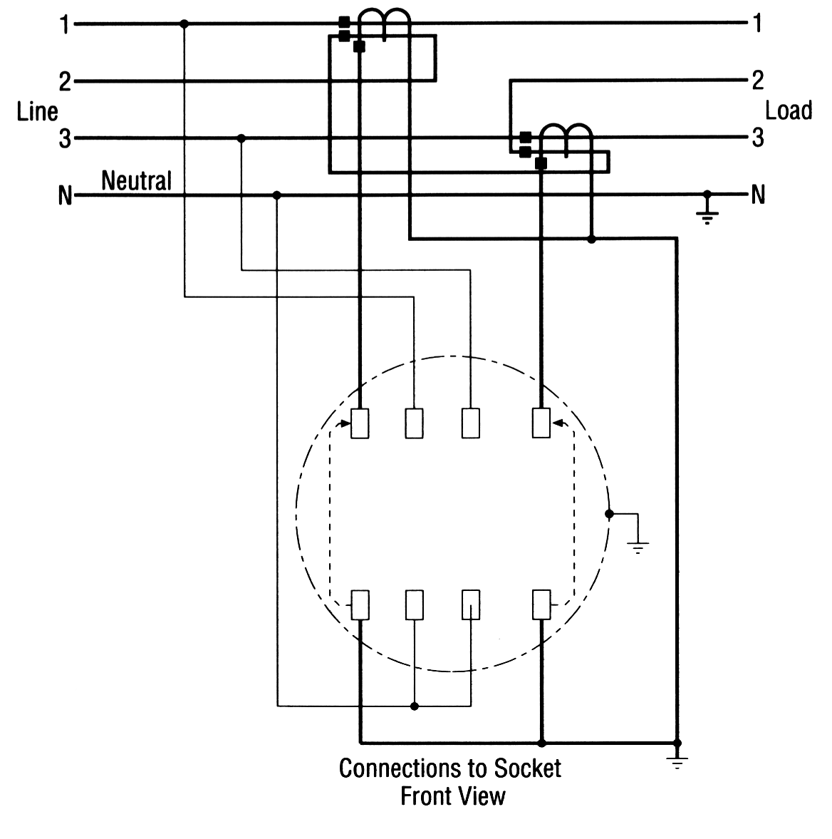

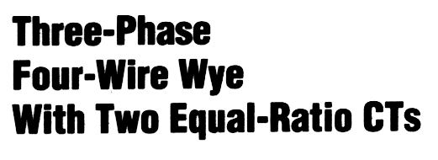
Blondel’s Theorem
Four wires
Two voltage measurements to neutral
Current measurements on lines 1 & 3. How about line 2?
This DOES NOT satisfy Blondel’s Theorem.
28

Slide 29
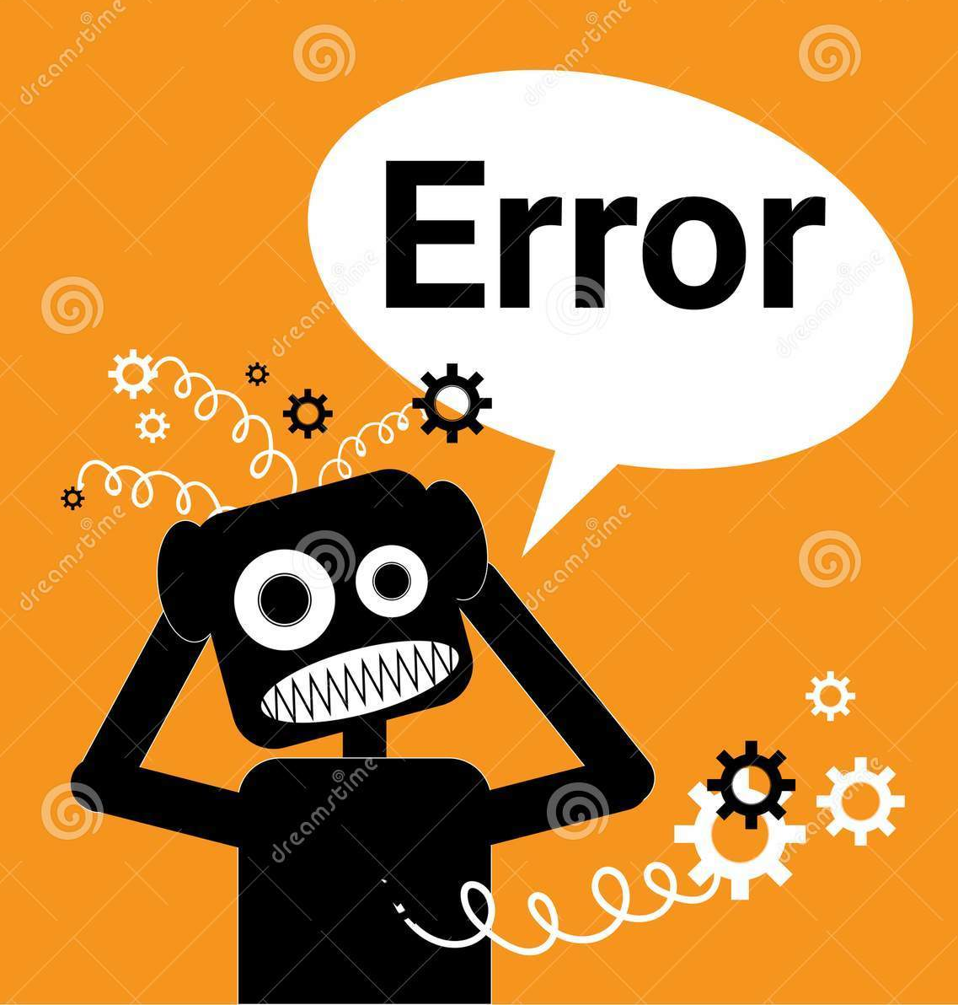
Blondel’s Theorem
In the previous example:
  What are the “ASSUMPTIONS”?
  When do we get errors?
What would the “Right Answer” be?
What did we measure?
29

Slide 30

Blondel’s Theorem
Phase B power would be:
  P = Vb Ib cosθ
But we aren’t measuring Vb
What we are measuring is:
  IbVacos(60- θ) + IbVccos(60+ θ)
cos(α + β) = cos(α)cos(β) - sin(α)sin(β)
cos(α - β) = cos(α)cos(β) + sin(α)sin(β)
So
30

Slide 31

Blondel’s Theorem
Pb = Ib Va cos(60- θ) + Ib Vc cos(60+ θ)
Applying the trig identity
  IbVa(cos(60)cos(θ) + sin(60)sin(θ))
  IbVc (cos(60)cos(θ) - sin(60)sin(θ))
  Ib(Va+Vc)0.5cos(θ) + Ib(Vc-Va) 0.866sin(θ)
Assuming
  Assume Vb = Va = Vc
  And, they are exactly 120° apart
Pb = Ib(2Vb)(0.5cosθ) = IbVbcosθ
31

Slide 32
Blondel’s Theorem
If Va ≠ Vb ≠ Vc then the error is
%Error =
-Ib{(Va+Vc)/(2Vb) - (Va-Vc) 0.866sin(θ)/(Vbcos(θ))
How big is this in reality? If
Va=117, Vb=120, Vc=119, PF=1 then E=-1.67%
Va=117, Vb=116, Vc=119, PF=.866 then E=-1.67%
32

Slide 33
Blondel’s Theorem
Power Measurements Handbook
Condition | % V | % I | Phase A |  |  |  | Phase B |  |  |  | non-Blondel
 | Imb | Imb | V | φvan | I | φian | V | φvbn | I | φibn | % Err
All balanced | 0 | 0 | 120 | 0 | 100 | 0 | 120 | 180 | 100 | 180 | 0.00%
Unbalanced voltages PF=1 | 18% | 0% | 108 | 0 | 100 | 0 | 132 | 180 | 100 | 180 | 0.00%
Unbalanced current PF=1 | 0% | 18% | 120 | 0 | 90 | 0 | 120 | 180 | 110 | 180 | 0.00%
Unbalanced V&I PF=1 | 5% | 18% | 117 | 0 | 90 | 0 | 123 | 180 | 110 | 180 | -0.25%
Unbalanced V&I PF=1 | 8% | 18% | 110 | 0 | 90 | 0 | 120 | 180 | 110 | 180 | -0.43%
Unbalanced V&I PF=1 | 8% | 50% | 110 | 0 | 50 | 0 | 120 | 180 | 100 | 180 | -1.43%
Unbalanced V&I PF=1 | 18% | 40% | 108 | 0 | 75 | 0 | 132 | 180 | 125 | 180 | -2.44%
Unbalanced voltages PF≠1 PFa = PFb | 18% | 0% | 108 | 0 | 100 | 30 | 132 | 180 | 100 | 210 | 0.00%
Unbalanced current PF≠1 PFa = PFb | 0% | 18% | 120 | 0 | 90 | 30 | 120 | 180 | 110 | 210 | 0.00%
Unbalanced V&I PF≠1 PFa = PFb | 18% | 18% | 108 | 0 | 90 | 30 | 132 | 180 | 110 | 210 | -0.99%
Unbalanced V&I PF≠1 PFa = PFb | 18% | 40% | 108 | 0 | 75 | 30 | 132 | 180 | 125 | 210 | -2.44%
Unbalanced voltages PF≠1 PFa ≠ PFb | 18% | 0% | 108 | 0 | 100 | 60 | 132 | 180 | 100 | 210 | -2.61%
Unbalanced current PF≠1 PFa ≠ PFb | 0% | 18% | 120 | 0 | 90 | 60 | 120 | 180 | 110 | 210 | 0.00%
Unbalanced V&I PF≠1 PFa ≠ PFb | 18% | 18% | 108 | 0 | 90 | 60 | 132 | 180 | 110 | 210 | -3.46%
Unbalanced V&I PF≠1 PFa ≠ PFb | 18% | 40% | 108 | 0 | 75 | 60 | 132 | 180 | 125 | 210 | -4.63%
33

Slide 34
Selecting the right meter form
Select the meter form based on the source, not the load.
  The “service type” is not always obvious.
  Loads other than the “known” load can be connected and may be unmetered.
Meter form numbers describe certain meter characteristics not the service or application
Consider that ground can be a current carrying conductor when applying Blondel’s Theorem.
Understand the operation of present day, polyphase solid state meters and how they may be used to advantage

Slide 35

Site Verification: Why should we invest our limited meter service resources here
These customers represent a disproportionately large amount of the overall revenue for every utility in North America.
For some utilities the ten percent of their customers who have transformer rated metering services can represent over 70% of their overall revenue.
While these numbers will vary from utility to utility the basic premise should be the same for all utilities regarding where Meter Services should focus their efforts
This is perhaps one of the larger benefits that AMI can provide for our Utilities – more time to spend on C&I metering and less on residential
Easy Answer:
Money.
35

Slide 36

Potential list of tasks to be completed during a Site Verification of a Transformer Rated Metering Site
Double check the meter number, the location the test result and the meter record
Perform a visual safety inspection of the site. This includes utility and customer equipment. Things to look for include intact down ground on pole, properly attached enclosure, unwanted voltage on enclosure, proper trimming and site tidiness (absence of discarded seals, etc.)
Visually inspect for energy diversions (intentional and not). This includes broken or missing wires, jumpers, open test switch, unconnected wires and foreign objects on meters or other metering equipment. Broken or missing wires can seriously cause the under measurement of energy. A simple broken wire on a CT or VT can cause the loss of 1/3 to 1/2 of the registration on either 3 element or 2 element metering, respectively.
36

Slide 37
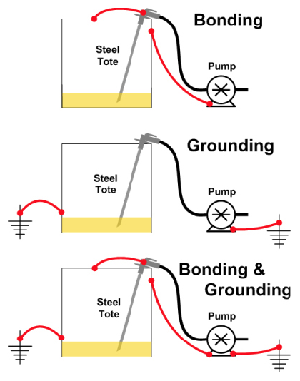
Site Verification Checklist (cont)
Visually check lightning arrestors and transformers for damage or leaks.
Check for proper grounding and bonding of metering equipment. Poor grounding and bonding practices may result in inaccurate measurements that go undetected for long periods of time. Implementing a single point ground policy and practice can reduce or eliminate this issue.
Burden test CTs and voltage check PTs.
Verify service voltage. Stuck regulator or seasonal capacitor can impact service voltage.
Verify condition of metering control wire. This includes looking for cracks in insulation, broken wires, loose connections, etc.
Confirm we have a Blondel compliant metering set up
Compare the test switch wiring with the wiring at the CTs and VTs. Verify CTs and VTs not cross wired. Be sure CTs are grounded in one location (test switch) only.
37

Slide 38
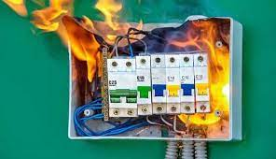
Site Verification Checklist (cont)
Check for bad test switch by examining voltage at the top and bottom of the switch. Also verify amps using amp probe on both sides of the test switch. Verify neutral connection to cabinet (voltage).
Check rotation by closing in one phase at a time at the test switch and observing the phase meter for forward rotation. If forward rotation is not observed measurements may be significantly impacted as the phases are most likely cancelling each other out.
38

Slide 39

Site Verification Checklist (cont)
Test meter for accuracy. Verify demand if applicable with observed load. If meter is performing compensation (line and/or transformer losses) the compensation should be verified either through direct testing at the site or by examining recorded pulse data.
Loss compensation is generally a very small percentage of the overall measurement and would not be caught under utilities normal high/low checks. However, the small percentages when applied to large loads or generation can really add up overtime. Billing adjustments can easily be in the $million range if not caught early.
39

Slide 40

Site Verification Checklist (cont)
Verify metering vectors. Traditionally this has been done using instruments such as a circuit analyzer. Many solid state meters today can provide vector diagrams along with volt/amp/pf and values using meter manufacturer software or meter displays. Many of these desired values are programmed into the meters Alternate/Utility display. Examining these values can provide much information about the metering integrity. It may also assist in determining if unbalanced loads are present and if CTs are sized properly. The vendor software generally has the ability to capture both diagnostic and vector information electronically. These electronic records should be kept in the meter shop for future comparisons.
If metering is providing pulses/EOI pulse to customers, SCADA systems or other meters for totalization they also should be verified vs. the known load on the meter. If present test/inspect isolation relays/pulse splitters for things like blown fuses to ensure they are operating properly.
Verify meter information including meter multiplier, serial number, dials/decimals, Mp, Ke, Primary Kh, Kr and Rate. Errors in this type of information can also cause a adverse impact on measured/reported values.
Verify CT shunts are all opened.
Look for signs of excessive heat on the meter base e.g.
melted plastic or discoloration related to heat
40

Slide 41
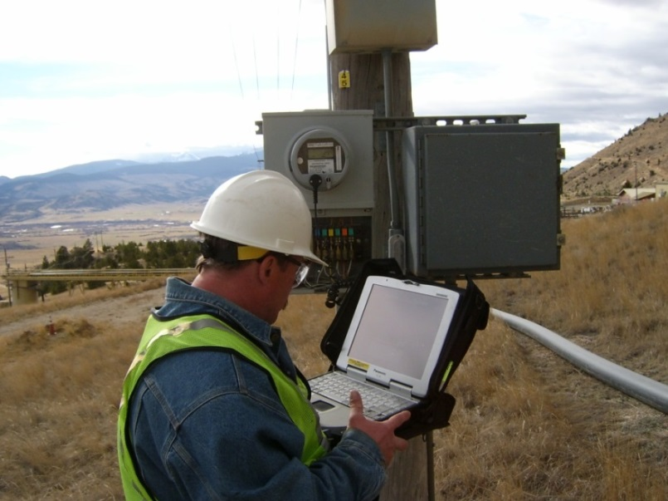
Periodic Site Inspections…..
….Can Discover or Prevent:
Billing Errors
Bad Metering set-up
Detect Current Diversion
Identify Potential Safety Issues
Metering Issues (issues not
related to meter accuracy)
AMR/AMI Communications Issues
The need for Unscheduled Truck Rolls due to Undetected Field Related Issues
Discrepancies between what is believed to be at a given site versus the actual setup and equipment at the site
41

Slide 42

Questions and Discussion
Dan Falcone
ConnectDER
This presentation can also be found under Meter Conferences and Schools on the TESCO web site: tescometering.com
42

