Slide 1

Basic Electricity
Monday July 22
10:30 AM – 12:00 PM
Eric Sassi

Slide 2
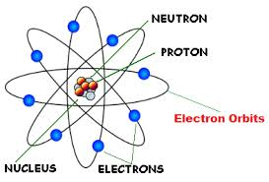
Some Background
The Atom
  All matter is made up of atoms.
  Atoms are composed of three particles
    Protons – with a positive charge
    Electrons – with a negative charge
    Neutrons – with no charge
Video
Each atom has the same number of protons and electrons. That number is called the atomic number of the atom and determines the element.
For example: If the atomic number is 8 as shown in the figure to the left the element is Oxygen (O).

Slide 3
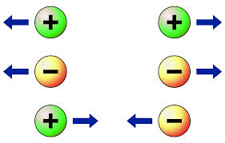
Some Background
Charge
  Opposite charges attract each other.
  That is what holds the electrons of an atom to the protons of the nucleus.
  Like charges repel each other.

Slide 4
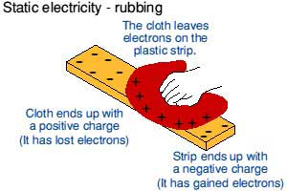
Man “Discovers” Electricity
Volage
Static Electricity
  What is this strange force? “Static” electricity.
    Rubbing the cloth across an insulator causes electrons to move from one object to the other. This leaves one object with more electrons than it should have and the other with less. The cloth has less so it becomes positively charged.

Slide 5
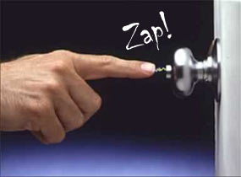
“Dynamic” Electricity
Current – Electrons flowing from one place to another
  If one object has a negative charge and another has a positive charge Electrons will flow from the negative to the positive if they are connected

Slide 6
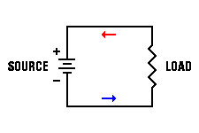
Practical Electricity
Direct Current – DC
  In our “zap” electrons briefly travelled from the negative object to the positive object.
    Until the excess electrons ran out the current flowed.
    Once they ran out the current stopped.
  A battery is a device that continuously supplies electrons through a chemical reaction.
    Hook the positive side of a battery through a load to the negative side and electrons will flow.
    This is a current (a flow of electrons)
    Since it goes in only one direction it is called DIRECT CURRENT

Slide 7

Practical Electricity
Direct Current – DC
  Sources of direct current include
    Batteries – electrons are supplied by a chemical reaction
    Thermocouples – electrons are supplied by heat
    Photovoltaic cells – electrons are supplied by light
    Electronic Power Supplies – Generally transform AC electricity to DC electricity because electronic devices run off of DC electricity
  There always has to be some form of energy to produce the electrons for the current
  Modern electronic devices all run off of DC electricity

Slide 8
DC Electricity
Basic Concepts
  Current – The flow of electrons
    The general convention is that a POSITIVE current is a current that flows from the positive terminal of the source to the negative terminal of the source
    Why – Electrons actually flow the other direction?
      Scientists made up the conventions long before they discovered electrons, they got it backwards and we still use the convention today.
  Voltage – A measure of the potential difference between two points
    Voltage is to current, as the pressure in a pipe is to the water
    The higher the voltage (potential difference), the easier it is for current to flow
  Impedance – Something which resists the flow of current.
    Resistor – The most common and simplest impedance
    Capacitor – An impedance which stores the electrons as they try to flow through
      Energy is stored in an electric field
    Inductor – An impedance which resists the change in current flowing through the device
      Energy is stored in a magnetic field

Slide 9
Basic Electrical Units
Charge – Coulombs
  “Q” – 1 coulomb = 6.2415 x10¹⁸ electron charges
Current – Amperes
  “I or A” – 1 ampere = 1 coulomb per second of charge flow
Voltage – Volt
  “V or E” – The potential difference required to do 1 joule of work
Impedance – Resistance - Ohm
  “R” – Resistance
  Ohm’s Law - V = IR
  One volt applied across one ohm results in 1 ampere of current.

Slide 10
Basic Electrical Units
Impedance – Capacitance - Farad
  “C” – Capacitance
Impedance – Inductance - Henry
  “L” – Inductance
Power – Watt
  A rate of energy consumption. A measure of work performed.
  For DC electricity = product of voltage and current
Energy – For Electricity – Watt-Hours (DC ONLY – AC IS MORE COMPLICATED)
  The energy when one ampere flows with a potential of one volt for one hour

Slide 11

Basic Electrical Laws
Ohms Law
  Voltage = Current times Resistance
  V = I X R
  THE MOST USEFUL AND THE MOST FUNDAMENTAL OF THE ELECTRICAL LAWS

Slide 12
Basic Concepts: Electricity and Water
Comparing Electricity to Water flowing from a hose
  Voltage is the equivalent of the pressure in the hose
  Current is water flowing through a hose (coulombs/sec vs gal/sec). The water in a system is the “charge” (coulombs)
  Impedance(Resistance) is the size of the hose. The nozzle would provide a change in resistance.
  Power is how fast water flows from a pipe (gallons per minute vs kilowatts). Power is a rate of energy consumption

Slide 13
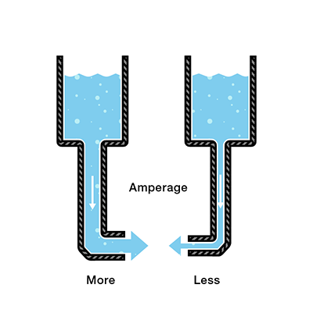
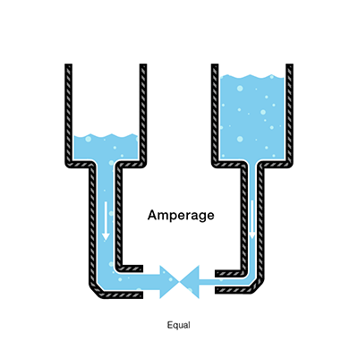
Basic Concepts: Electricity and Water

Slide 14
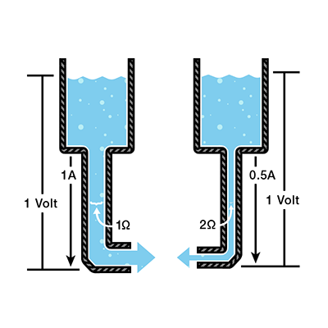
Basic Concepts: Electricity and Water

Slide 15
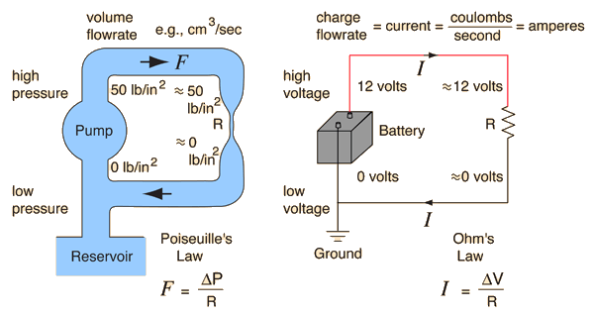
Practical Electricity

Slide 16
Basic Electrical Laws
Ohms Law Examples
  If V = 20 volts and I = 5 amperes what is the resistance?
    R = V / I = 20 / 5 = 4 ohms
  If R = 20 ohms and V = 120 volts what is the current?
    I = V / R = 120 / 20 = 6 amps
  If I = 10 amperes and R = 24 ohms what is the voltage?
    V = I x R = 10 x 24 = 240 volts
  Problem: If V = 240 volts and R = 6 ohms what is the current?
    I = V / R = 240 / 6 = 40 amps

Slide 17
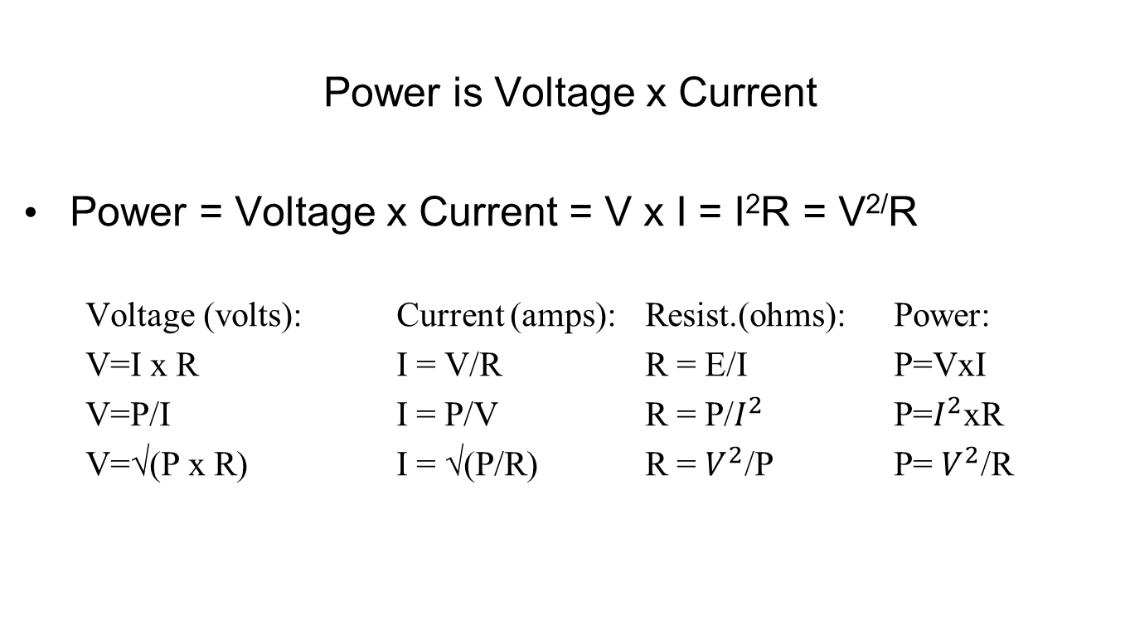
Basic Electrical Laws
3 Phase power

Slide 18
Basic Electrical Laws
Power = Voltage x Current = V x I = I²R = V^{2/}R
  If V = 20 volts and I = 8 amperes what is the power?
    P = V x I = 20 x 8 = 160 watts
  If R = 5 ohms and V = 120 volts what is the power?
    P = V^{2/}R = 120 x 120 / 5 = 2880 watts
  If I = 10 amperes and R = 20 ohms what is the power?
    P = I²R = 10 x 10 x 20 = 2000 watts
    1 kilowatt (kW) = 1,000 watts
    1 megawatt (MW) = 1,000,000 watts

Slide 19
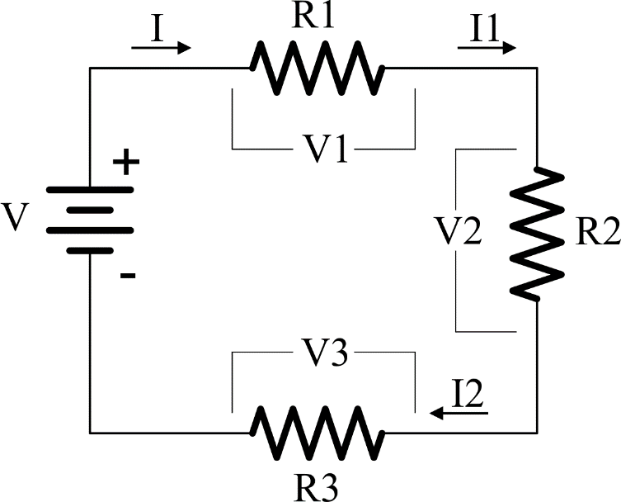
Basic Electrical Laws
Kirchoff’s Voltage Law (KVL)
The sum of the voltages around a circuit loop is zero.
  V = V1 + V2 + V3 = I * (R1 + R2 + R3) = I1 * R1 + I2 * R2 + I3 * R3
  I = I1 = I2 = I3
Resistors in series add

Slide 20
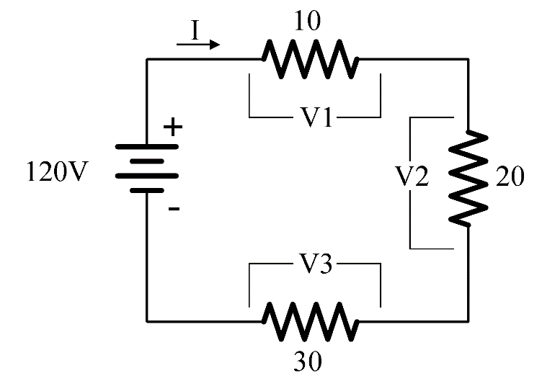
Basic Electrical Laws
Kirchoff’s Voltage Law (KVL) – PROBLEM #1
  I = V / R = V / (R1 + R2 + R3) = 120/(10+20+30) = 2 amperes
  V1 = I*R1 = 2 *10 = 20 volts
  V2 = I*R2 = 2 *20 = 40 volts
  V3 = I*R3 = 2 *30 = 60 volts
What is the current in the circuit?
What are V1, V2, V3?

Slide 21
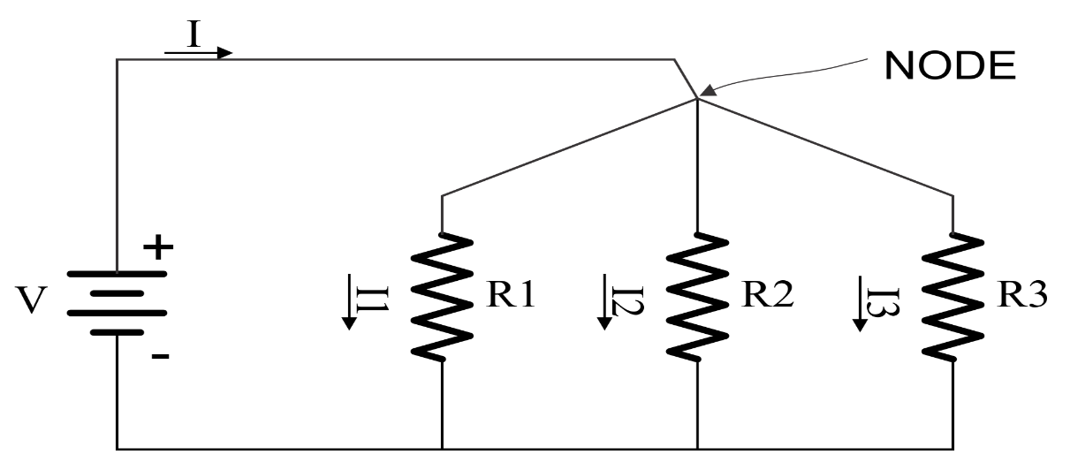
Basic Electrical Laws
Kirchoff’s Current Law (KCL)
The sum of the currents at a node in a circuit is zero.
  I = I1 + I2 + I3
  If Loads are placed in parallel they sum up.
  So does power
  P = V x I = V x I1 + V x I2 + V x I3

Slide 22
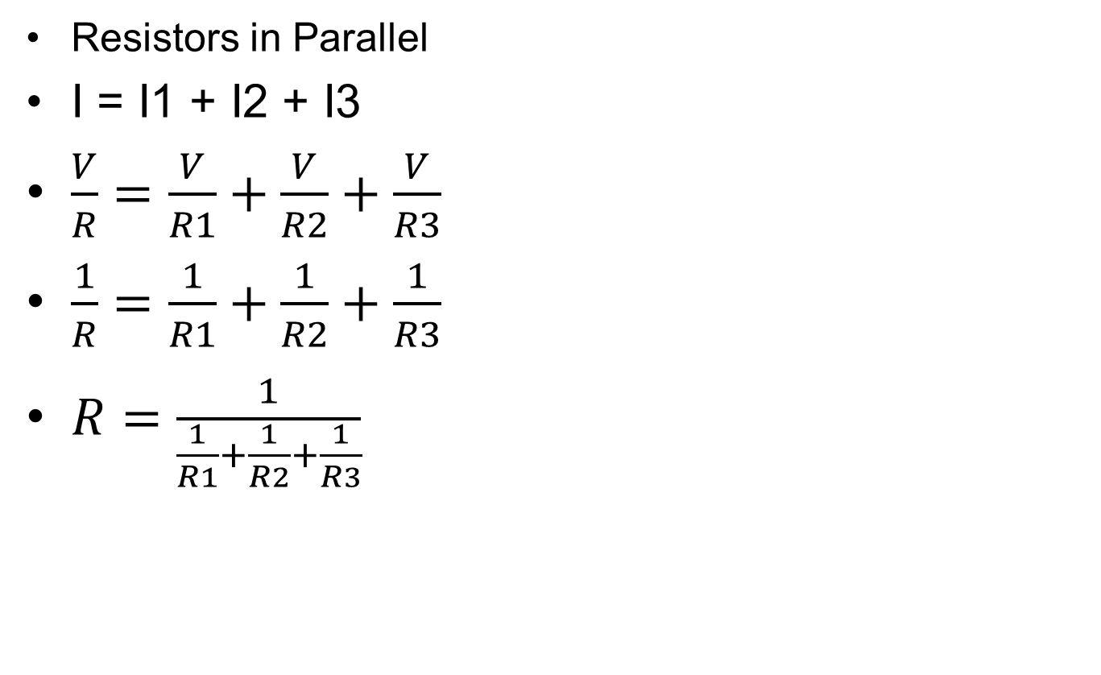

Basic Electrical Laws

Slide 23
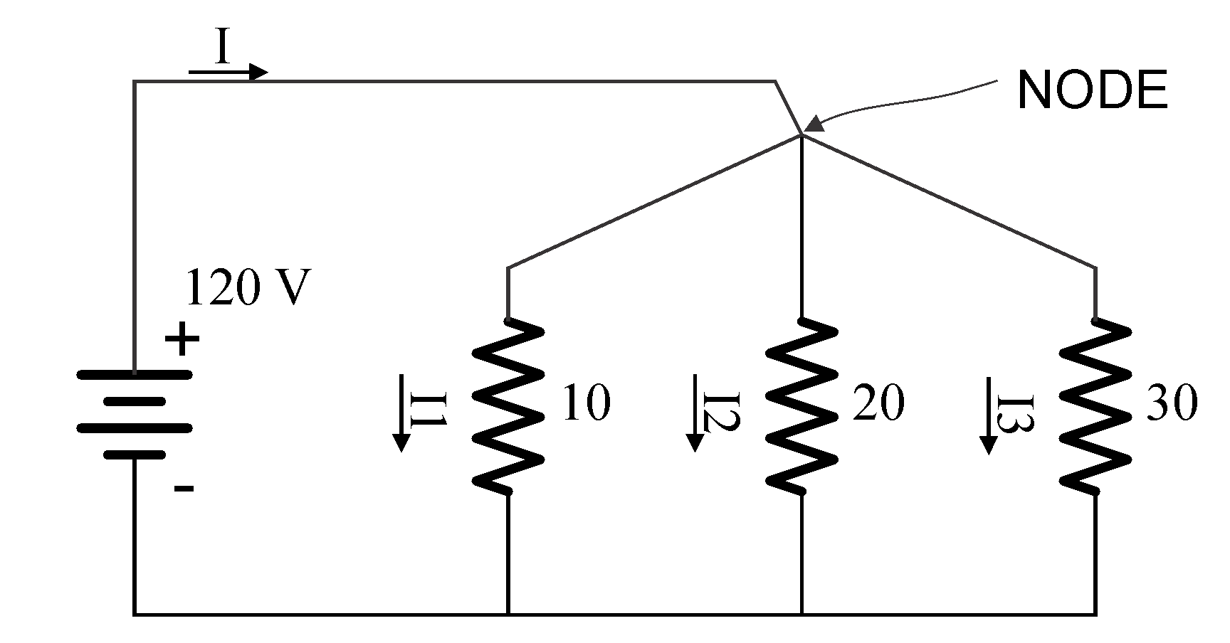
Basic Electrical Laws
Compute
I1, I2, I3
I
R (parallel resistance of R1, R2, R3)
  I1 = 120/10 = 12A, I2=120/20=6A, I3=120/30= 4A
  I = 12 + 6 + 4 =22A
  R = V/I = 120 / 22 = 5.4545 ohms

Slide 24
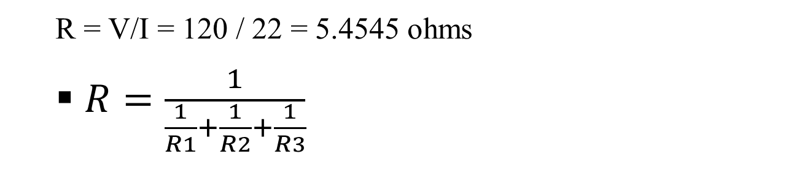
Basic Electrical Laws
Compute
I1, I2, I3
I
R (parallel resistance of R1, R2, R3)

Slide 25

Basic Electrical Laws
Compute
R1, R2, R3
I
R (parallel resistance of R1, R2, R3)
  I = 10 + 20 + 5 =35A
  R = V/I = 240 / 35 = 6.857 ohms

Slide 26
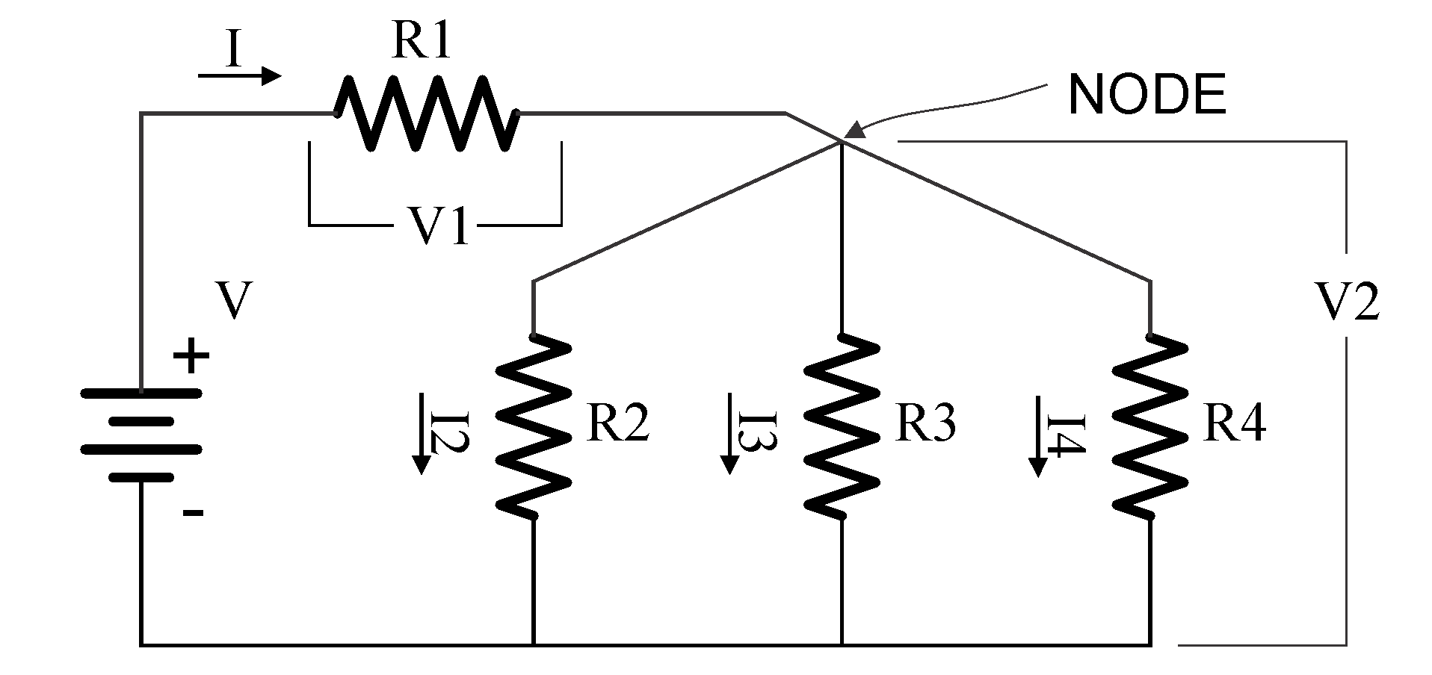
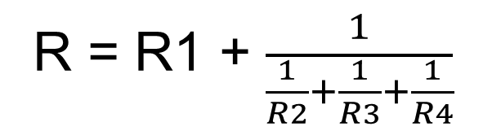
Basic Electrical Laws
More complex circuits
  V = V1 + V2
  I = I1 + I2 + I3

Slide 27

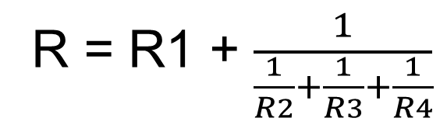
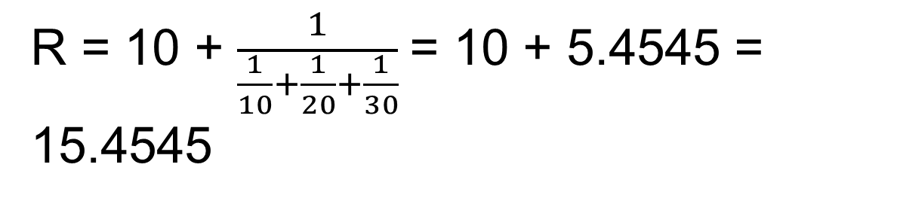
Basic Electrical Laws
More complex circuits

Slide 28
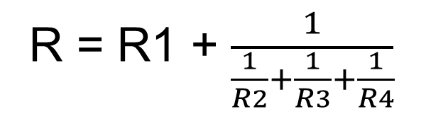
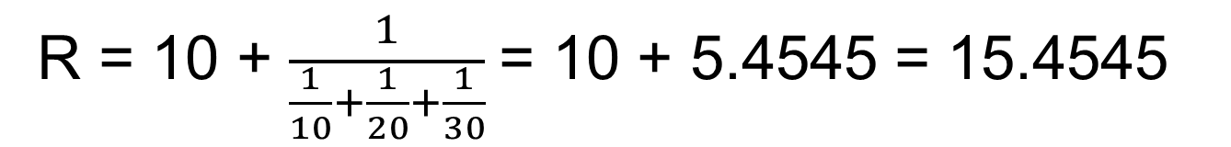
Basic Electrical Laws
More complex circuits

Slide 29
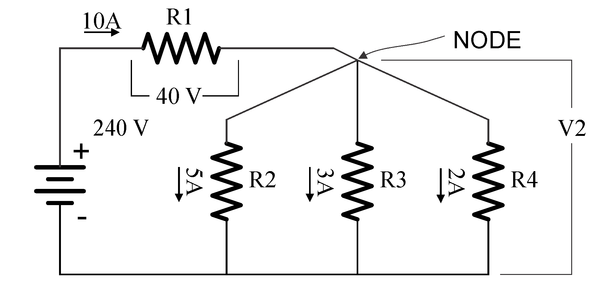
Basic Electrical Laws
More complex circuits
Compute
V2
R1, R2, R3, R4
Total Power
V2 = 240 – 40 = 200 volts
R1 = 40/10 = 4, R2 = 200/5 = 40,
R3 = 200/3 = 66.667, R4 = 200/2 = 100

Slide 30
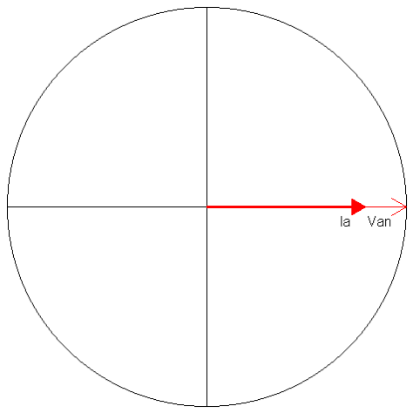
Basic AC Theory
Power – The Simple View
E = Voltage (rms)
I = Current (rms)
PF = Power Factor
Power = Watts = E x I x PF
Power is sometimes
referred to as Demand
Sinusoidal
Waveforms
Only
NO
Harmonics
For a 120 Volt service drawing
13 Amps at Unity (1.0) PF,
how much power is being drawn?
Power = 120 x 13 x 1.0 = 1560 Watts

Slide 31
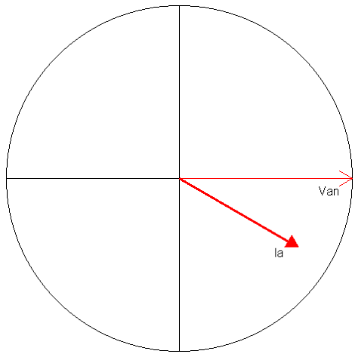
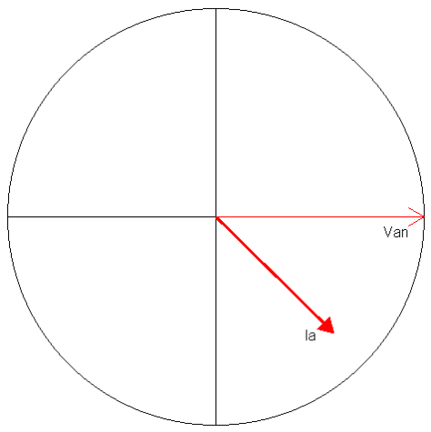
Basic Meter Math
Power – The Simple View
For a 120 Volt service drawing
13 Amps at 0.866 PF,
how much power is being drawn?
Power = 120 x 13 x 0.866 = 1351 Watts
For a 480 Volt service drawing
156 Amps at 0.712 PF,
how much power is being drawn?
Power = 480 x 156 x 0.712 = 53,315 Watts

Slide 32
Basic AC Theory
Power – The Simple View
In the previous example we had:
Power = 480 x 156 x 0.712 = 53,315 Watts
Normally we don’t talk about Watts, we speak in Kilowatts
1000 Watts = 1 Kilowatt = 1 kW
Watts / 1000 = Kilowatts
For a 480 Volt service drawing
156 Amps at Unity (0.712) PF,
how many Kilowatts are being drawn?
Power = 480 x 156 x 0.712 / 1000 = 53.315 kW

Slide 33
Basic AC Theory
Energy – What We Sell
If power is how fast water flows from a pipe,
then energy is how much water we have in a bucket
after the water has been flowing for a specified time.
Energy = Power x Time
1 kW for 1 Hour = 1 Kilowatt-Hour = 1 kWh
Energy (Wh) = E x I x PF x T
where T = time in hours
Energy (kW) = (E x I x PF / 1000) x T

Slide 34
Basic Meter Math
Energy – What We Sell
For a 120 Volt service drawing 45 Amps at a Power Factor of 0.9 for 1 day,
how much Energy (kWh) has been used?
Energy = (120 x 45 x 0.9 / 1000) x 24 = 116.64 kWh
For a 240 Volt service drawing 60 Amps at a Power Factor of 1.0 for 5.5 hours,
how much Energy (kWh) has been used?
Energy = (240 x 60 x 1.0 / 1000) x 5.5 = 79.2 kWh

Slide 35
Basic Meter Math
Energy – What We Sell
For a 120 Volt service drawing 20 Amps at a Power Factor of 0.8 from 8:00AM to 6:00PM,
and 1 Amp at PF=1.0 from 6:00PM to 8:00AM
how much Energy (kWh) has been used?
8:00AM to 6:00PM = 10 hours
6:00PM to 8:00AM = 14 hours
Energy = (120 x 20 x 0.8 / 1000) x 10 = 19.2 kWh
Energy = (120 x 1 x 1 / 1000) x 14 = 1.68 kWh
Energy = 19.2 kWh + 1.68 kWh = 20.88 kWh

Slide 36
Basic AC Theory
What is VA?
Power was measured in Watts. Power does useful work. The power that does useful work is referred to as
“Active Power.”
VA is measured in Volt-Amperes. It is the capacity required to deliver the Power. It is also referred to as the “Apparent Power.”
Power Factor = Active Power / Apparent Power
VA = E x I
PF = W/VA

Slide 37
Basic Meter Math
Power – VA
For a 120 Volt service drawing 13 Amps at 0.866 PF
How much power is being drawn?
Power = 120 x 13 x 0.866 = 1351 Watts
How many VA are being drawn?
VA = 120 x 13 = 1560 Volt-Amperes

Slide 38
Basic Meter Math
Power – VA
For a 480 Volt service drawing 156 Amps at 0.712 PF
How much power is being drawn?
Power = 480 x 156 x 0.712 = 53,315 Watts
How many VA are being drawn?
VA = 480 x 156 = 74,880 Volt-Amperes

Slide 39
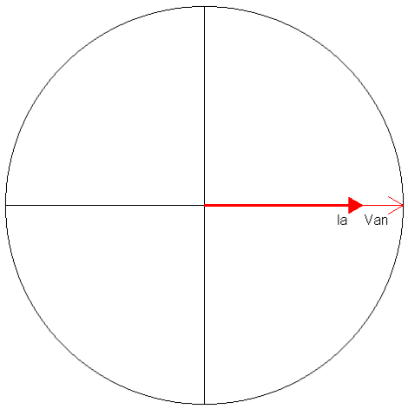
Basic Meter Math
Power – VA
For a 120 Volt service drawing 60 Amps at 1.00 PF
How much power is being drawn?
Power = 120 x 60 x 1.00 = 7,200 Watts
How many VA are being drawn?
VA = 120 x 60 = 7,200 Volt Amperes

Slide 40
Basic AC Theory
Sinusoidal Waveforms
Peak Value
RMS Value

Slide 41
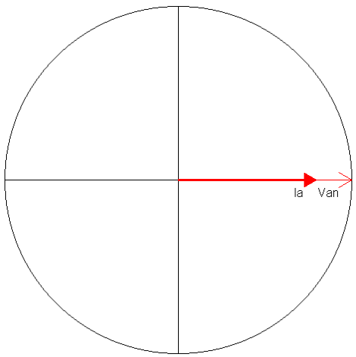
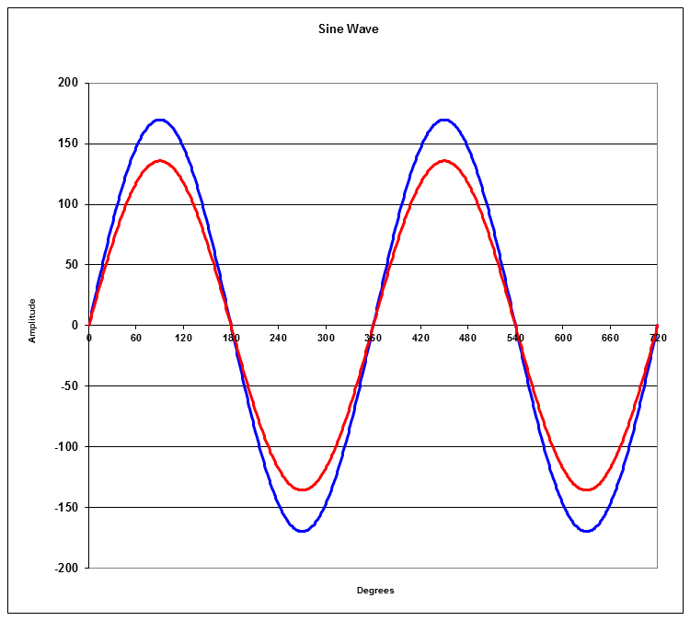
Basic AC Theory
Power Factor = 1.0

Slide 42
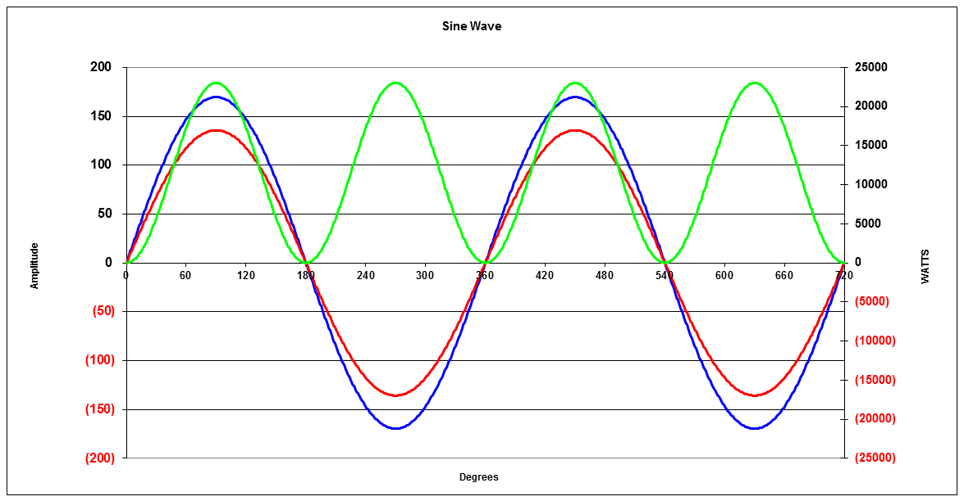
Basic AC Theory
Instantaneous Power
Average Power
P = 11520 Watts
Power is a “rate of flow” like water running through a pipe.

Slide 43
Basic AC Theory
Instantaneous Power
Average Power
P = 9,976 Watts
PF=0.866

Slide 44
Basic Meter Math
What about polyphase systems?
Calculating power in a polyphase system is actually simple but sometimes we make it complex.
3 Phase, 4-Wire “Y” Service

Slide 45
Basic Meter Math
3 Phase, 4-Wire “Y” Service
Va
Vb
Vc
The total power is equal to the sum of the power in each phase.
P_{total} = E_{a} x I_{a} x Cos(θ_{a}) + E_{b} x I_{b} x Cos(θ_{b}) + E_{c} x I_{c} x Cos(θ_{c})
In a balanced system where V_{a} = V_{b} = V_{c} and I_{a} = I_{b} = I_{c}and θ_{a} = θ_{a} = θ_{a}
P_{total} = 3 x E_{a} x I_{a} x Cos(θ_{a})

Slide 46
Basic Meter Math
3 Phase, 4-Wire “Y” Service
For a balanced system
E = 277 V
I = 20 A
PF = 1.00
In a balanced system where V_{a} = V_{b} = V_{c} and I_{a} = I_{b} = I_{c} and θ_{a} = θ_{a} = θ_{a}
P_{total} = 3 x E_{a} x I_{a} x Cos(θa) = 3 x Ea x Ia x PF
P_{total} = 3 x 277 x 20 x 1.0
P_{total} = 3 x 277 x 20 x 1.0 = 16,620 W

Slide 47
Basic Meter Math
3 Phase, 4-Wire “Y” Service
For a unbalanced system
E_{a} = 284 V, E_{b} = 274 V, E_{c} = 276 V
I_{a} = 20 A, I_{b} = 32 A, I_{c} = 30 A
PF_{a} = 0.900, PF_{b} = 0.784, PF_{c} = 0.866
The total power is equal to the sum of the power in each phase.
P_{total} = P_{a} + P_{b} + P_{c}
P_{total} = E_{a} x I_{a} x Cos(θ_{a}) + E_{b} x I_{b} x Cos(θ_{b}) + E_{c} x I_{c} x Cos(θ_{c})
P_{a} = 284 x 20 x .900
= 5,112
P_{b} = 274 x 32 x .784
= 6,874
P_{c} = 276 x 30 x .866
= 7,170
P_{total} = 5,112 + 6,874 + 7,170 = 19,156

Slide 48
Basic AC Theory
What is VA?
If we were trying to decide how big the transformers in the last example need to be, we would need to calculate the kVA of the loads rather than the kW.
REMEMBER
VA is measured in Volt-Amperes. It is the capacity required to deliver the Power. It is also referred to as the “Apparent Power”.
VA = E x I
PF = W/VA

Slide 49
Basic Meter Math
3 Phase, 4-Wire “Y” Service
What is the VA for each phase?
E_{a} = 284 V, E_{b} = 274 V, E_{c} = 276 V
I_{a} = 20 A, I_{b} = 32 A, I_{c} = 30 A
PF_{a} = 0.900, PF_{b} = 0.784, PF_{c} = 0.866
The total power is equal to the sum of the power in each phase.
VA_{total} = VA_{a} + VA_{b} + VA_{c}
VA_{total} = E_{a} x I_{a} + E_{b} x I_{b} + E_{c} x I_{c}
P_{a} = 284 x 20 = 5,680
P_{b} = 274 x 32 = 8,768
P_{c} = 276 x 30 = 8,280
P_{total} = 5,680 + 8,768 + 8,280 = 25,328
Would you use 5kVA, 7.5kVA, 10kVA, 25kVA or 40kVA transformers?

Slide 50
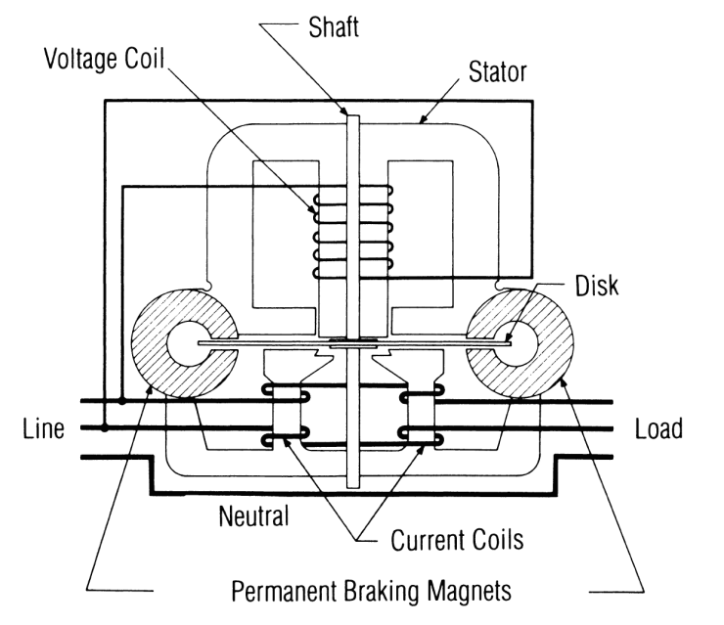
Induction Meters
Using concepts put forth by Tesla and Ferraris, several inventors created early induction watthour meters
Two coils and a conducting (usually aluminum) disk. A braking magnet.
Magnetic field from the first coil generates eddy currents in the disk
Magnetic field from the second coil interacts with the eddy currents to cause motion
Disk would accelerate without bound except for eddy currents caused by motion through fixed magnetic field which slows the disk
The end result is that each revolution of the disk measures a constant amount of energy

Slide 51
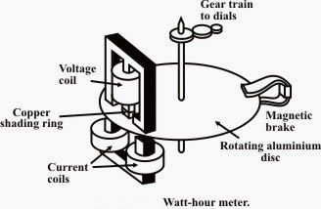
Basic Energy Formula
The essential specification of a watthour meter’s measurement is given by the value
Kh [ Watthours per disk revolution ]
The watthour meter formula is as follows:
tescometering.com

Slide 52
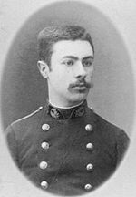
1893: Blondel’s Theorem
The theory of polyphase watthour metering was first set forth on a scientific basis in 1893 by Andre E. Blondel, engineer and mathematician. His theorem applies to the measurement of real power in a polyphase system of any number of wires. The theorem is as follows:
  - If energy is supplied to any system of conductors through N wires, the total power in the system is given by the algebraic sum of the readings of N wattmeters, so arranged that each of the N wires contains one current coil, the corresponding voltage coil being connected between that wire and some common point. If this common point is on one of the N wires, the measurement may be made by the use of N-1 wattmeters.

Slide 53

Questions and Discussion
Tom Lawton
President
tom.lawton@tescometering.com
TESCO – The Eastern Specialty Company
Bristol, PA
215.228.0500
This presentation can also be found under Meter Conferences and Schools on the TESCO website: tescometering.com
ISO 9001:2015 Certified Quality Company
ISO 17025:2017 Accredited Laboratory

Slide 54
Video References
https://www.youtube.com/watch?v=mc979OhitAg (INTRO)
https://www.youtube.com/watch?v=w82aSjLuD_8 (VOLTS)
https://www.youtube.com/watch?v=8Posj4WMo0o (AMPS)
https://www.youtube.com/watch?v=4oRT7PoXSS0 (3PH)
https://www.youtube.com/watch?v=HsLLq6Rm5tU (OHM)

