Slide 1
Three Phase Theory
Monday, July 22, 2024
1:00 PM – 2:30 PM
Pete Brown

Slide 2
Three Phase Power Introduction
Basic Assumptions
Three AC voltage sources
Voltages Displaced in time
Each sinusoidal
Identical in Amplitude

Slide 3
AC Theory – Sine Wave

Slide 4
AC Theory - Phase

Slide 5
Three Phase Theory
Single Phase - Voltage Plot
ONE CYCLE
Van

Slide 6
Three Phase Theory
Two Phases - Voltage Plot
ONE CYCLE
Van
Vbn

Slide 7
Three Phase Theory
Three Phase - Voltage Plot
ONE CYCLE
Van
Vbn
Vcn

Slide 8
Three Phase Power
At the Generator
Van
Vbn
Vcn
Three voltage vectors each separated by 120°.
Peak voltages essentially equal.
Most of what makes three phase systems seem complex is what we do to this simple picture in the delivery system and loads.

Slide 9
Three Phase Power
Basic Concept – Phase Rotation
Phase Rotation:
The order in which the phases reach peak voltage.
There are only two possible sequences:
A-B-C (previous slide)
C-B-A (this slide)
Vcn
Vbn
Van
Phase rotation is important because the direction of rotation of a three phase motor is determined by the phase order.

Slide 10
Three Phase Theory
Phasors and Vector Notation
Phasors are a graphical means of representing the amplitude and phase relationships of voltages and currents.
90
V = sin(θ)
180
0
270

Slide 11
Three Phase Power
Phasors and Vector Notation
As stated in the Handbook of Electricity Metering, by common consent, counterclockwise phase rotation has been chosen for general use in phasor diagrams.
90
V = V0sin(θ-120)
180
0
270

Slide 12
Three Phase Power
Phasors and Vector Notation
The phasor diagram for a simple 3-phase system has three voltage phasors equally spaced at 120° intervals.
Going clockwise the order is A – B – C.
90
V = V0sin(θ-240)
180
0
270

Slide 13

Three Phase Theory
Symbols and Conventions
Systems formed by interconnecting secondary of 3 single phase transformers.
Generally primaries are not show unless details of actual transformer are being discussed.

Slide 14
Three Phase Theory
Symbols and Conventions
Often even the coils are not shown but are replaced by simple line drawings

Slide 15
3 Phase, 4-Wire “Y” Service
0° = Unity Power Factor
Three Voltage Phasors
120° Apart
Three Current Phasors
Aligned with Voltage at PF=1

Slide 16
Symbols and Conventions
Labeling
Voltages are generally labeled Va, Vb, Vc, Vn for the three phases and neutral
This can be confusing in complex cases.
The recommended approach is to use two subscripts so the two points between which the voltage is measured are unambiguous.
Vab means voltage at “a” as measured relative to “b”.

Slide 17
2 Phase, 3-Wire “Y” Service
“Network Connection”
Single phase variant of the service.
Two voltage sources with their returns connected to a common point.
Provides 208 rather than 240 volts across “high side” wires.

Slide 18
2 Phase, 3-Wire “Network” Service
Two Voltage Phasors
120° Apart
Two Current Phasors
Aligned with Voltage at PF=1

Slide 19
3 Phase, 3-Wire Delta Service
Common service type for industrial customers. This service may have NO neutral.
Voltages normally measured relative to phase B.
  Sometimes phase B will be grounded
Voltage and current vectors do not align.
Service is provided even when a phase is grounded.

Slide 20
3 Phase, 3-Wire Delta Service
Resistive Loads
Two Voltage Phasors
60° Apart
Two Current Phasors
For a resistive load one current leads by 30° while the other lags by 30°

Slide 21
3 Phase, 3-Wire Delta Service
Understanding the Diagram
C
C
Vbc
Vca
Vcb
B
Vab
A
B
Vab
A

Slide 22
3 Phase, 3-Wire Delta Service
Understanding the Diagram
Iab
Ica
Iac
Ic
Ia
Icb

Slide 23
3 Phase, 3-Wire Delta Service
Resistive Load
Two Voltage Phasors
60° Apart
Two Current Phasors
For a resistive
load one current
leads by 30° while
the other lags by 30°

Slide 24
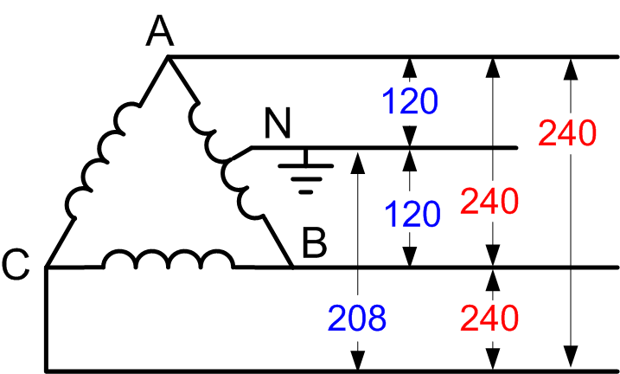
3 Phase, 4-Wire Delta Service
Common service type for industrial customers. Provides a residential like 120/240 service (lighting service) single phase 208 (high side) and even 3 phase 240 V.
Voltage phasors form a “T” 90° apart
Currents are at 120° spacing
In 120/120/208 form only the “hot” (208) leg has its voltage and current vectors aligned.

Slide 25
3 Phase, 4-Wire Delta Service
Resistive Load
Three Voltage Phasors
90° Apart
Three Current
Phasors
120° apart

Slide 26
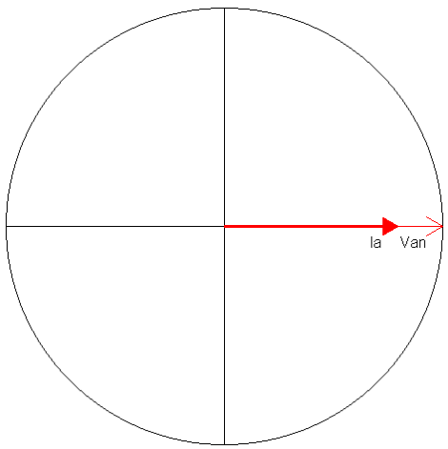
AC Theory – Resistive Load
Resistors are measured in Ohms. When an AC voltage is applied to a resistor, the current is in phase. A resistive load is considered a “linear” load because when the voltage is sinusoidal the current is also sinusoidal.

Slide 27
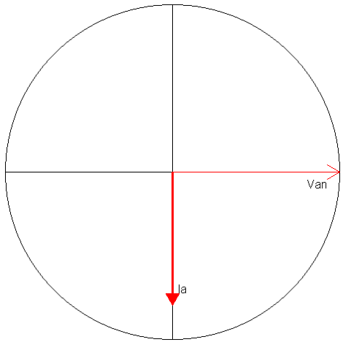
AC Theory – Inductive Load
Inductors are measured in Henries. When an AC voltage is applied to an inductor, the current is 90 degrees out of phase. We say the current “lags” the voltage. A inductive load is considered a “linear” load because when the voltage is sinusoidal the current is also sinusoidal.

Slide 28
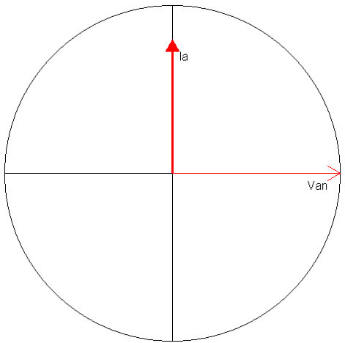
AC Theory – Capacitive Load
Capacitors are measured in Farads. When an AC voltage is applied to a capacitor, the current is 90 degrees out of phase. We say the current “leads” the voltage. A capacitive load is considered a “linear” load because when the voltage is sinusoidal the current is sinusoidal.

Slide 29
AC Theory – Power
Power is defined as P = VI
Since the voltage and current at every point in time for an AC signal is different, we have to distinguish between instantaneous power and average power. Generally when we say “power” we mean average power.
Average power is only defined over an integral number of cycles.

Slide 30
Time Out for Trig
(Right Triangles)
The Right Triangle:
The Pythagorean theory
c² = a² + b²

Slide 31
AC Theory – Power Triangle
(Sinusoidal Waveforms)
VA
VARs
Watts
If V = sin(ωt) and I = sin(ωt - θ) (the load is linear)
then
Active Power = VIcos(θ) Watts
Reactive Power = VIsin(θ) VARs
Apparent Power = VI VA
Power Factor = Active/Apparent = cos(θ)

Slide 32
AC Theory
Instantaneous Power
For a resistive load:
P = 11520 Watts

Slide 33
AC Theory
Instantaneous Power
For an inductive load:
P = 0 Watts

Slide 34
AC Theory
Instantaneous Power
For a capacitive load:
P = 0 Watts

Slide 35
AC Theory – Complex Circuits
Amplitude (Current)
Phase (Current)
V_{C}
V_{L}
V
V_{C}
V_{R}

Slide 36
AC Theory – Instantaneous Power

Slide 37
Three Phase Power
Blondel’s Theorem
If energy be supplied to any system of conductors through N wires, the total power in the system is given by the algebraic sum of the readings of N wattmeters, so arranged that each of the N wires contains one current coil, the corresponding voltage coil being connected between that wire and some common point. If this common point is on one of the N wires, the measurement may be made by the use of N-1 wattmeters.

Slide 38
Three Phase Power
Blondel’s Theorem
Simply – We can measure the power in a N wire system by measuring the power in N-1 conductors.
For example, in a 4-wire, 3-phase system we need to measure the power in 3 circuits.

Slide 39
Three Phase Power
Blondel’s Theorem
If a meter installation meets Blondel’s Theorem then we will get accurate power measurements under all circumstances.
If a metering system does not meet Blondel’s Theorem then we will only get accurate measurements if certain assumptions are met.

Slide 40
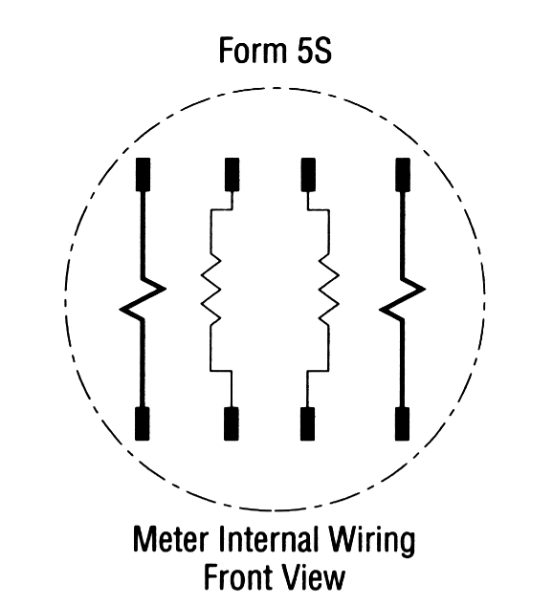
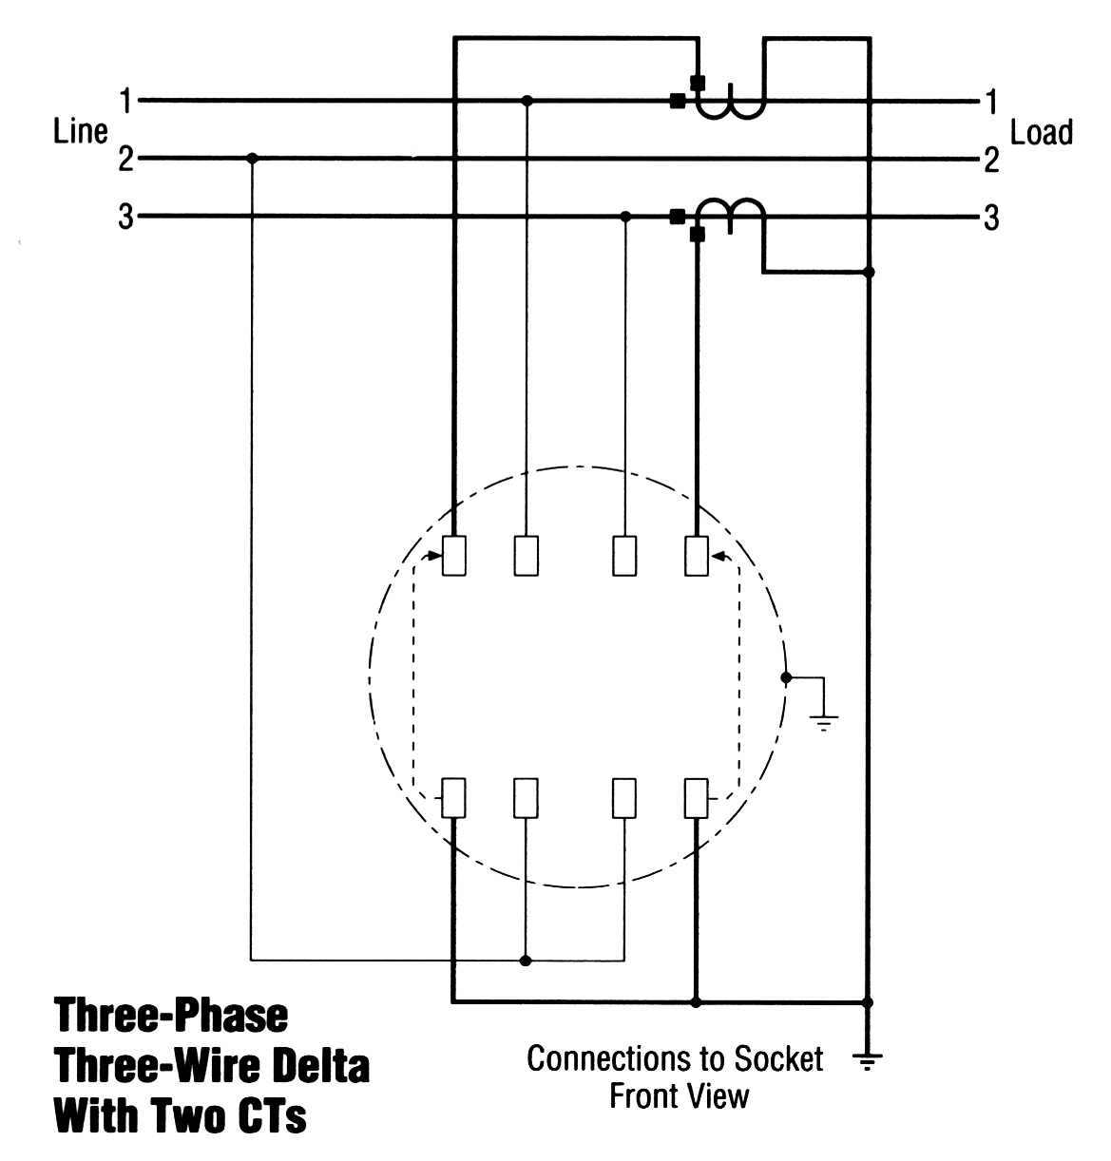
Blondel’s Theorem
Three wires
Two voltage measurements with one side common to Line 2
Current measurements on lines 1 & 3.
This satisfies Blondel’s Theorem.

Slide 41
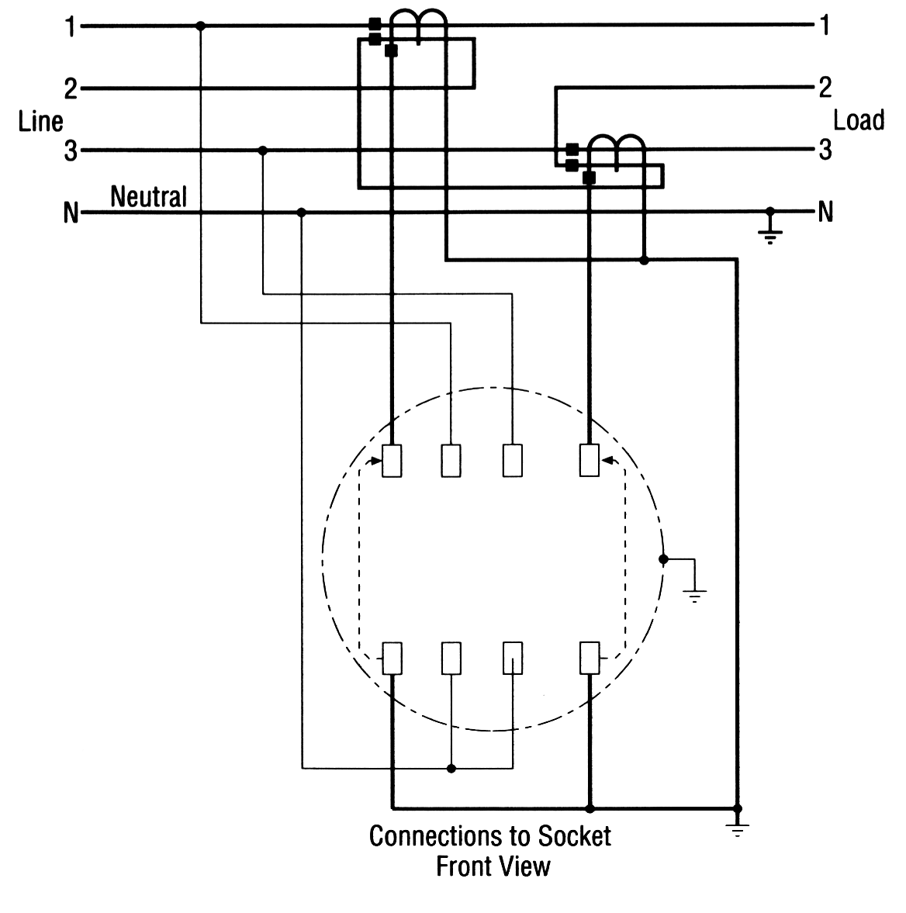
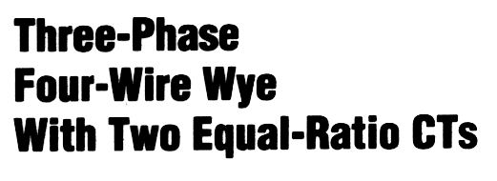
Blondel’s Theorem
Four wires
Two voltage measurements to neutral
Current measurements on lines 1 & 3. How about line 2?
This DOES NOT satisfy Blondel’s Theorem.

Slide 42
Blondel’s Theorem
In the previous example:
  What are the “ASSUMPTIONS”?
  When do we get errors?
What would the “Right Answer” be?
What did we measure?

Slide 43
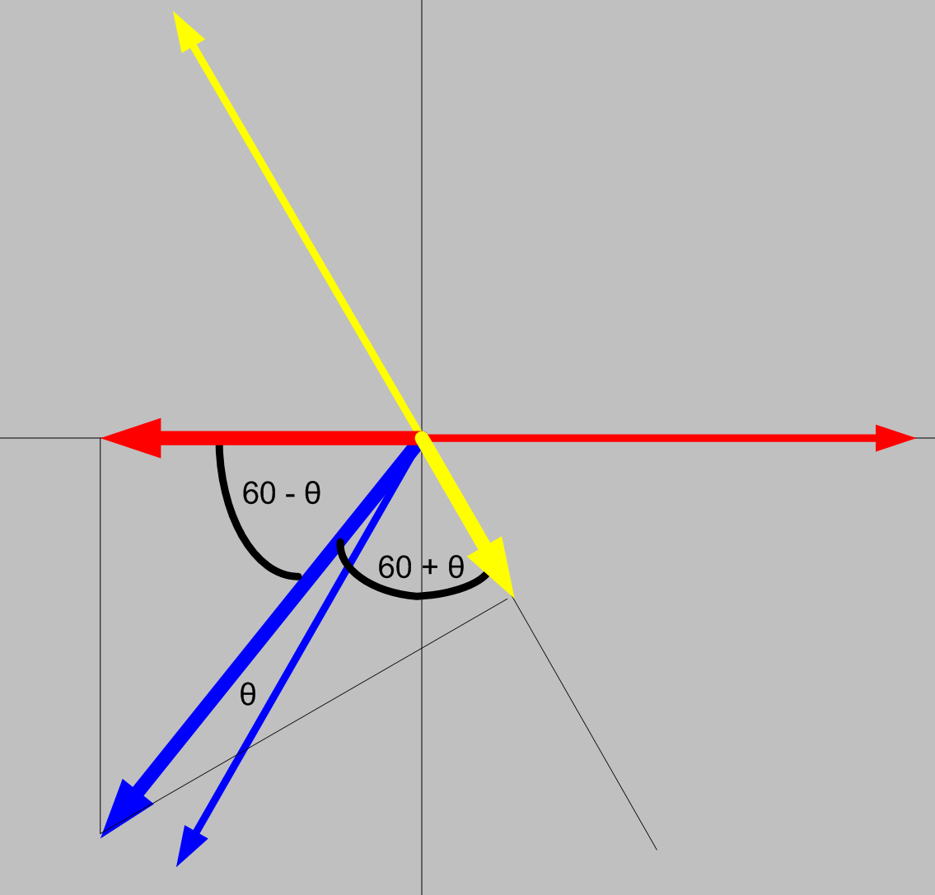
Blondel’s Theorem

Slide 44
Blondel’s Theorem
Phase B power would be:
  P = Vb Ib cosθ
But we aren’t measuring Vb
What we are measuring is:
  IbVacos(60- θ) + IbVccos(60+ θ)
cos(α + β) = cos(α)cos(β) - sin(α)sin(β)
cos(α - β) = cos(α)cos(β) + sin(α)sin(β)
So

Slide 45
Blondel’s Theorem
Pb = Ib Va cos(60- θ) + Ib Vc cos(60+ θ)
Applying the trig identity
  IbVa(cos(60)cos(θ) + sin(60)sin(θ))
  IbVc (cos(60)cos(θ) - sin(60)sin(θ))
  Ib(Va+Vc)0.5cos(θ) + Ib(Vc-Va) 0.866sin(θ)
Assuming
  Assume Vb = Va = Vc
  And, they are exactly 120° apart
Pb = Ib(2Vb)(0.5cosθ) = IbVbcosθ

Slide 46
Blondel’s Theorem
If Va ≠ Vb ≠ Vc then the error is
%Error =
-Ib{(Va+Vc)/(2Vb) - (Va-Vc) 0.866sin(θ)/(Vbcos(θ))
How big is this in reality? If
Va=117, Vb=120, Vc=119, PF=1 then E=-1.67%
Va=117, Vb=116, Vc=119, PF=.866 then E=-1.67%

Slide 47
Blondel’s Theorem
Power Measurements Handbook
Condition | % V | % I | Phase A |  |  |  | Phase B |  |  |  | non-Blondel
 | Imb | Imb | V | φvan | I | φian | V | φvbn | I | φibn | % Err
All balanced | 0 | 0 | 120 | 0 | 100 | 0 | 120 | 180 | 100 | 180 | 0.00%
Unbalanced voltages PF=1 | 18% | 0% | 108 | 0 | 100 | 0 | 132 | 180 | 100 | 180 | 0.00%
Unbalanced current PF=1 | 0% | 18% | 120 | 0 | 90 | 0 | 120 | 180 | 110 | 180 | 0.00%
Unbalanced V&I PF=1 | 5% | 18% | 117 | 0 | 90 | 0 | 123 | 180 | 110 | 180 | -0.25%
Unbalanced V&I PF=1 | 8% | 18% | 110 | 0 | 90 | 0 | 120 | 180 | 110 | 180 | -0.43%
Unbalanced V&I PF=1 | 8% | 50% | 110 | 0 | 50 | 0 | 120 | 180 | 100 | 180 | -1.43%
Unbalanced V&I PF=1 | 18% | 40% | 108 | 0 | 75 | 0 | 132 | 180 | 125 | 180 | -2.44%
Unbalanced voltages PF≠1 PFa = PFb | 18% | 0% | 108 | 0 | 100 | 30 | 132 | 180 | 100 | 210 | 0.00%
Unbalanced current PF≠1 PFa = PFb | 0% | 18% | 120 | 0 | 90 | 30 | 120 | 180 | 110 | 210 | 0.00%
Unbalanced V&I PF≠1 PFa = PFb | 18% | 18% | 108 | 0 | 90 | 30 | 132 | 180 | 110 | 210 | -0.99%
Unbalanced V&I PF≠1 PFa = PFb | 18% | 40% | 108 | 0 | 75 | 30 | 132 | 180 | 125 | 210 | -2.44%
Unbalanced voltages PF≠1 PFa ≠ PFb | 18% | 0% | 108 | 0 | 100 | 60 | 132 | 180 | 100 | 210 | -2.61%
Unbalanced current PF≠1 PFa ≠ PFb | 0% | 18% | 120 | 0 | 90 | 60 | 120 | 180 | 110 | 210 | 0.00%
Unbalanced V&I PF≠1 PFa ≠ PFb | 18% | 18% | 108 | 0 | 90 | 60 | 132 | 180 | 110 | 210 | -3.46%
Unbalanced V&I PF≠1 PFa ≠ PFb | 18% | 40% | 108 | 0 | 75 | 60 | 132 | 180 | 125 | 210 | -4.63%

Slide 48
AC Theory – Power
Power is defined as P = VI
Since the voltage and current at every point in time for an AC signal is different, we have to distinguish between instantaneous power and average power. Generally when we say “power” we mean average power.
Average power is only defined over an integer number of cycles.

Slide 49
Harmonics
Curse of the Modern World
Every thing discussed so far was based on “Linear” loads.
  For linear loads the current is always a simple sine wave. Everything we have discussed is true.
For nearly a century after AC power was in use ALL loads were linear.
Today, many loads are NON-LINEAR.

Slide 50
Harmonic Load Waveform
Eq.# | Quantity | Phase A
1 | V(rms) (Direct Sum) | 100
2 | I(rms) (Direct Sum) | 108
3 | V(rms) (Fourier) | 100
4 | I(rms) (Fourier) | 108
5 | Pa = (∫ V(t)I(t)dt) | 10000
6 | Pb = ½∑VnIncos(θ) | 10000
7 | Q = ½∑VnInsin(θ) | 0.000
8 | Sa = Sqrt(P^2 +Q^2) | 10000
9 | Sb = Vrms*Irms(DS) | 10833
10 | Sc = Vrms*Irms(F) | 10833
13 | PF = Pa/Sa | 1.000
14 | PF = Pb/Sb | 0.923
15 | PF = Pb/Sc | 0.923
V = 100Sin(ωt) I = 100Sin(ωt) + 42Sin(5 ωt)

Slide 51
Harmonic Load Waveform
Eq.# | Quantity | Phase A
1 | V(rms) (Direct Sum) | 100
2 | I(rms) (Direct Sum) | 108
3 | V(rms) (Fourier) | 100
4 | I(rms) (Fourier) | 108
5 | Pa = (∫ V(t)I(t)dt) | 10000
6 | Pb = ½∑VnIncos(θ) | 10000
7 | Q = ½∑VnInsin(θ) | 0.000
8 | Sa = Sqrt(P^2 +Q^2) | 10000
9 | Sb = Vrms*Irms(DS) | 10833
10 | Sc = Vrms*Irms(F) | 10833
13 | PF = Pa/Sa | 1.000
14 | PF = Pb/Sb | 0.923
15 | PF = Pb/Sc | 0.923
Important things to note:
  Because the voltage is NOT distorted, the harmonic in the current does not contribute to active power.
  It does contribute to the Apparent power.
  Does the Power Triangle hold
  There is considerable disagreement about the definition of various power quantities when harmonics are present.
V = 100Sin(ωt) I = 100Sin(ωt) + 42Sin(5 ωt)

Slide 52
3 Phase Power Measurement
We have discussed how to measure and view power quantities (W, VARs, VA) in a single phase case.
How do we combine them in a multi-phase system?
Two common approaches:
  Arithmetic
  Vectorial

Slide 53
3 Phase Power Measurement

Slide 54
3 Phase Power Measurement
VAR and VA calculations can lead to some strange results:
  If we define
PH | W | Q | VA
A | 100 | 0 | 100
B | 120 | 55 | 132
C | 120 | -55 | 132
Arithmetic VA |  |  | 364
Vector VA |  |  | 340

Slide 55

Questions and Discussion
Pete Brown
TSTM
This presentation can also be found under Meter Conferences and Schools on the TESCO website: tescometering.com
ISO 9001:2015 Certified Quality Company
ISO 17025:2017 Accredited Laboratory

