Slide 1
ROUNDTABLE: - Tracking Failure Curves of Early AMI Deployments - Considerations for AMI 2.0 - System Obsolescence Considerations
July 24, 2024
8:45 AM -- 10:15 AM
Glenn Pritchard

Slide 2
Ice Breaker
Introductions
What company are you representing and what is your role?
Describe your AMI deployment and when was it installed?

Slide 3
PECO’s AMI Deployment

Slide 4
AMI at PECO
PECO is located in Southeastern Pennsylvania, serving Philadelphia and the surrounding counties
PECO installed a Sensus FlexNet AMI platform from 2011-2016
The system serves:
1.725M electric meters
550k gas meters
4,200+ Distribution Automation devices (Reclosers, Capacitors, FCI’s, etc)
Initial goals of the AMI deployment included:
Meeting Pa. Act 129 of 2008 required meter functionality, including
Hourly interval data (15 minute or faster as needed)
Remote disconnect & connect
Outage Alarming
Meeting and exceeding performance levels of the existing Ladis+Gyr CellNet AMR system
Creating opportunities to expand and deliver enhanced functions that leverage the network and meters

Slide 5
AMI Background

Slide 6
Meter Obsolescense

Slide 7
Meter Lifecycle
New Smart Meters have a finite useful life (15-20yrs)
It is important to recognize that there will be a future need to replace both the meters and the networks
Is a future full redeployment an option?
What about a future annual replacement plan?
It pays to plan for this now, account for it in your Long-Range Financial Plans
It is also advisable to include your regulators and stakeholders

Slide 8
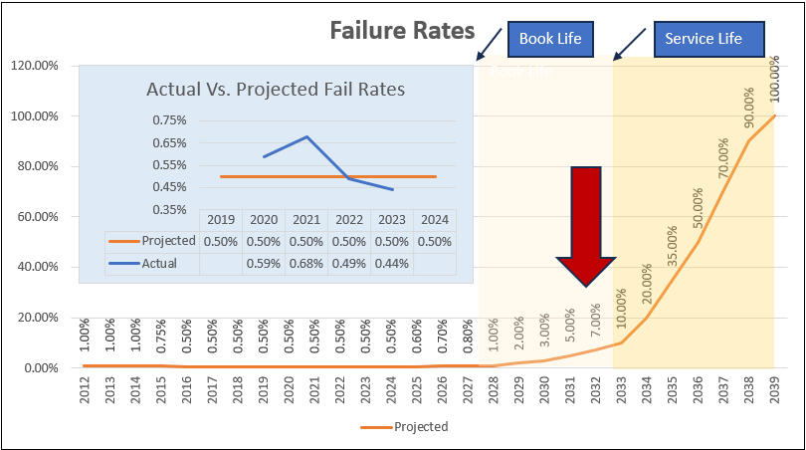
Projected Meter Failures
Analysis of failure rates over the past 3 years confirms current failure rate curve projections
Recommend beginning replacement in earnest by 2027 to stay ahead of the expected failure rates
Meter failure rates will quickly increase by 2029, exceeding meter shop capacity to adequately respond without significant additional support
~50% deployment needed by 2031 to stay ahead of failure curve
Notes:
Southern Cal Edison currently has a 2% failure rate in their meters (1/3 due to corroded batteries and 2/3 due to other issues).
By 2028 the rate is expected to increase to 80%.
Current meter population is 5.2M meters
Replacement Plan will be funded through their Utility Commission (5-6 year Plan starting in 2028 costing $2.5B-$3B). Plan will also include the cost of a communication system upgrade (Silver Springs Network or new system)

Slide 9
Impacts from the Pandemic
How did COVID change AMI?
Material Supply Constraints
Premature Material Obsolescence
Technology Evolution
New Customer Expectations

Slide 10
AMI 2.0?

Slide 11
AMI 2.0
What is AMI 2.0?
What is changing?

Slide 12
AMI 2.0
AMI 2.0 is a system upgrade that results in increased network reliability and more reliable exchanges of data
The functions build upon AMI 1.0, which set the foundation for the future
“Many of the end user/customer advantages promised by AMI 1.0 did not materialize.”

Slide 13
More Data & New Functions
Increased Sample Rates
60-, 15-, 5- & 1-minute samples are possible
Multiple Recording Channels
Some vendors are claiming up to 32 independent channels are available
Distributed Intelligence and Decision Making local to the meter
Question – Has the network and head-end kept pace with the new meter capabilities?

Slide 14
New Functions
On-Board Decision Making
EV Management
Voltage Regulation
Analytics
Non-intrusive load monitoring & Load Disaggregation
New Communications Methods for FAN and HAN
WiFi Enabled Meters

Slide 15
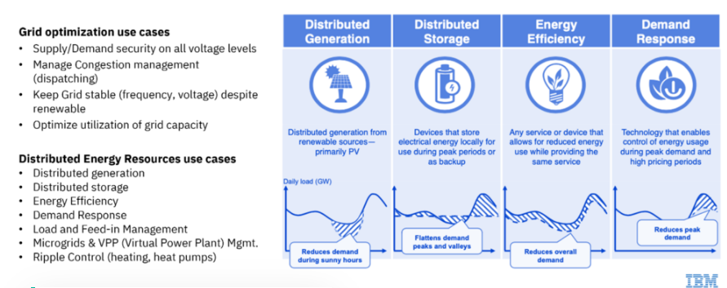
AMI 2.0 Use Cases
AMI – Advanced Analytics Opportunities - Utility Analytics Institute

Slide 16
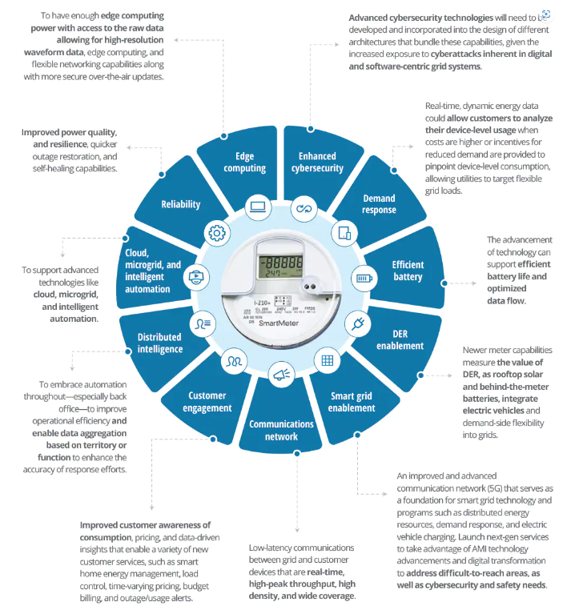
From Deloitte’s AMI 2.0 Study
https://www2.deloitte.com/us/en/pages/energy-and-resources/articles/next-gen-advanced-metering-infrastructure.html

Slide 17
Distributed Intelligence
Recently, several meter manufacturers have begun to develop Distributed Intelligent models and applications for their AMI meters
This is seen as a new means to add future functions to the meters
The concept mimics the “Apple iStore” concept where apps are available to be downloaded into meters as needed
Apps are often targeted on Real-Time decision making and control solutions
DI is often associated with Mesh Network based systems where latency in communications may be a factor

Slide 18
Distributed Intelligence
Sample Use Cases:
Hot Socket Monitoring & Action
Smart Inverter Interface – Autonomous control
Solar and Battery Support – Load Coordination
Power Quality Analysis

Slide 19
Alternative Perspectives

Slide 20
Sensus FlexNet V2 – “Crowded Highways Presentation”*
* - Full slides in Appendix
The FlexNet V2 Protocol enable more efficient use of the RF Channels, delivering higher speed, higher capacity and more secure communications

Slide 21
Sensus V2 Protocol
What is V2?
The V2 protocol is a new method to communicate to our meters
It easily coexists with the legacy V1 protocol, using the same RF spectrum
V2 is built upon higher speed messages and more efficient data packets
Why do we need it?
Performance Improvements
Improved Security
Enables new functionality on NextGeneration Electric and Gas Meters
When is V2 available?
NOW, All eligible transceivers are configured to support V2 communications
Do we have any devices on the V2 Protocol?
YES, more than 25,000 meters using the V2 Protocol today

Slide 22
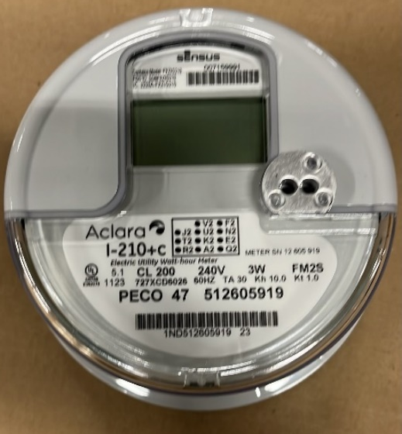
What is a NextGen Meter?
Meters Continue to Evolve
PECO’s initial AMI meters were installed in 2012-2016
Sensus has introduced new functions over the years
Enhanced Supervisory Messaging (ESM)
Snapshot Data
Firmware Upgrades/Enhancements
Changes driven by both the comms module and the meter
Aclara i210+c/DT-105
Sensus Stratus IQ/DT-96
Communications
V2 – More efficient utilization of infrastructure leading to higher capacity and speed
Security / Encryption – mandatory, enhanced security measures
New Network hardware – improved software and contemporary hardware
Functionality
Multiple Independent Channels – beyond usage, including voltage, power quality, etc.
Firmware improvements / speed to upgrade
More flexible remote configuration
A NextGen Meter is the newest type meter available for use at PECO. A key characteristic is its ability to support the V2 communications and its enhanced security measures.

Slide 23
Next Gen AMI
New Meter Functions
V2 Protocol
More Data / Multiple Channels
New Functions
Distributed Intelligence / Grid Edge
Loss of Neutral Detection
Enhanced Temperature Sensing and Action
Ultrasonic Gas Metering
Remote Disconnect
Pressure Sensing
Distributed Energy Resources – Solar, Batteries, etc
Electric Vehicles
Load Disaggregation
Charging Management

Slide 27
Conclusion
Meter systems continue to evolve and increase functionality
NextGen Meters and AMI 2.0 are two similar manifestations of this evolution
Many of the initial deployments are nearing their useful end of life, leading to significant decisions by the AMI Operators

Slide 28
Appendix

Slide 29
PECO’s SGSM Team

Slide 30
PECO F&MS and SGS
E05 Sr Maintenance Manager
E06 Director FMS and SGS
E05 Sr Manager SG Operations
E05 Sr Mgr SG Operatons
Administrative Assistant
Field Operation
Data Analytics and Back Office operation
Smart Meter Strategy & Distribution Automation

Slide 31
PECO F&MS and SGS – SG Ops
E04 Mgr Analytics
E05 Sr Manager Advanced Grid Ops/Analytics
Glen Murphy
E04 Mgr SG Ops & Special Projects
1 Bus Analyst
2 Sr Quantitative Analyst
2 Sr Business Analyst
1 Assoc Business Analyst
1 AMI Ops Supervisor
2 Sr Business Analysts
E04 Principal Business Analyst
E04 Meter Maintenance Back Office
1 Sr. Business Analyst—Vendor Manager—N. Nayee
1 Sr. Contract Coordinator—TBD
1 Business Analyst—B. Enz
1 Assoc. Business Analyst —V. Elliot (4) Back office Contractors
(2) CCB Contractors until 6/2024
1 E02 Work Planner (Accenture) – A. Wilson
(14) Offshore Accenture Contractors
1 MM Back Office supervisor- N. Panetta
(4)- Business Analyst
(4) – Associate Business Analyst
(2) Long Term MM back-office Contractors
1 Rev Pro Back Office Supervisor- M. Salahuddin
(2) Business Analyst
(4) Associate Business Analyst
(2) U12
Luv Gera
Rasheeda Clark
Anthony Portelli
Lamar Ellis

Slide 32
PECO F&MS and SGS – SG COE (Engineering)
E04 Mgr AMI
E05 Sr Manager Advanced Grid Ops
Glenn Pritchard
E04 Mgr Dist Automation
Quantitative Engineer
1 Network Engineer
1 AMI Endpoint Engineer
1 DA Endpoint engineer
1 Sawtooth Engineer
1 General Engineer (Meter Standards)
1 Sup Work Management
3 Engineering Tech Specialists
3 DA Ops Engineers
Sr RF Engineering Tech
OT SGP Program (Contractors)
Nate Nichols
Marc Bourrie
Open

Slide 33
PECO F&MS and SGS – Meter Maint
E05 Sr. Meter Maintenance Manager
Mickey Bracey
E04 Revenue Protection Manager
Keith Steger
E03 Supervisor Rev Pro and HB
1 Work Planner — T. Mont
Open
E04 Meter Maintenance Manager Field
Harry Sheneman
E03 Supervisor Meter Shop and Electric MM 1 Work Planner — P. Morroney
Shawn Carbone
E03 Supervisor Gas MM
1 Work Planner — V. Stetler
Brendan Ryan
Administrative Coordinator
Darlene Banks

