Slide 1
New Products Intro and Feedback
TESCOOL 2024
July 24, 2024
8:45 AM - 10:15 AM
John Williams and Ujjay Brawley

Slide 2

Released Since Our Last Meeting
EVSE Higher Amperage DC Charger Testing Capability:
Catalog #T4350 to enable testing of DC Chargers up to 350A sustained.
Catalog #MiTM-350- 350 Amp capable Man-in-the-Middle Cable for use between the T4350, DC charging station and electric vehicle.
Catalog #PL4150 DC Load Box for use in back of Weights and Measures Truck capable of testing up to 150KW with ramp loading that will work at 400V and 800V.

Slide 3
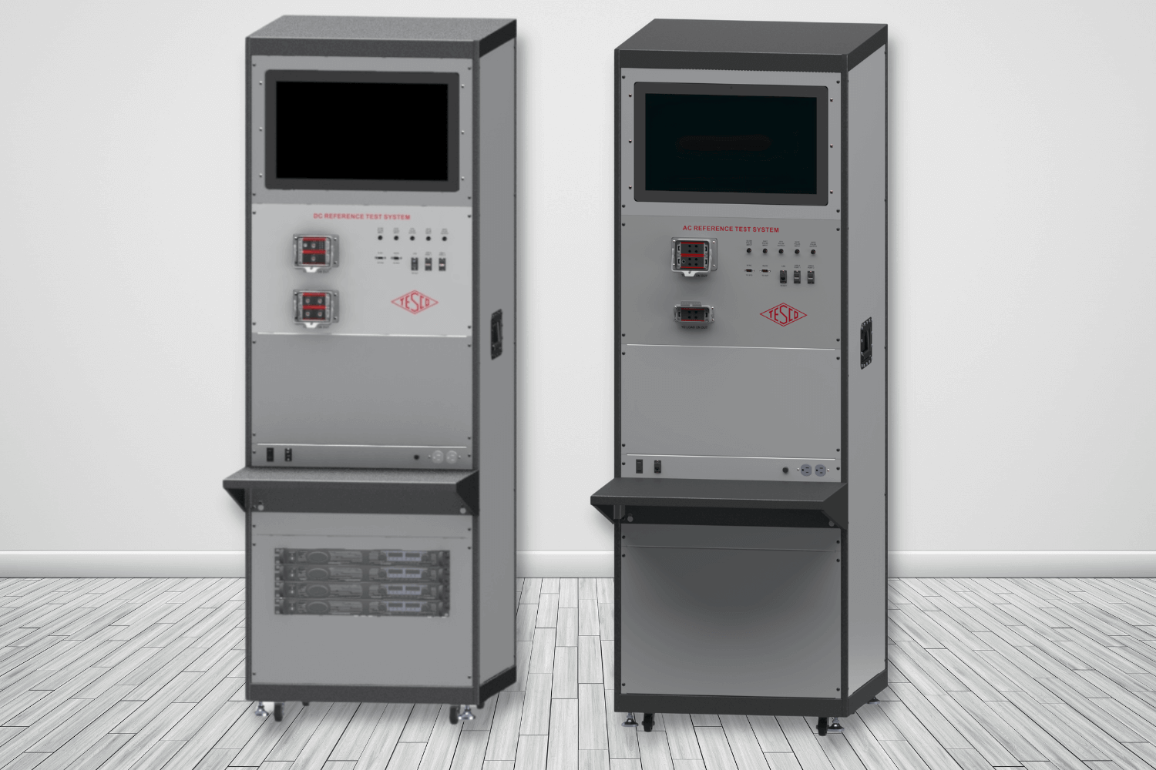
Released Since Our Last Meeting
ACT/DCT Laboratory AC/DC EVSE Test System:
This system enables the testing and accuracy verification of both AC and DC Electric Vehicle Service Equipment and Field Test Equipment for testing EVSE’s in the field. The system is rated for 0.04% accuracy for power, and 0.02% for voltage and current.

Slide 4
Released Since Our Last Meeting
Updated 30A Back Up Power Transfer Meter Design:
Requirement for the user to shut off the main disconnect to the house is now eliminated.
Requirement for the user to unplug the generator is removed.
More robust voltage sensing.
Increased the robustness of the disconnect contact sensing.
Increased power for the disconnect motor drive to enable the BPTM to overcome sticky motor shafts with greater ease as well as to allow it to be used with Aclara meters with relay disconnects.

Slide 5

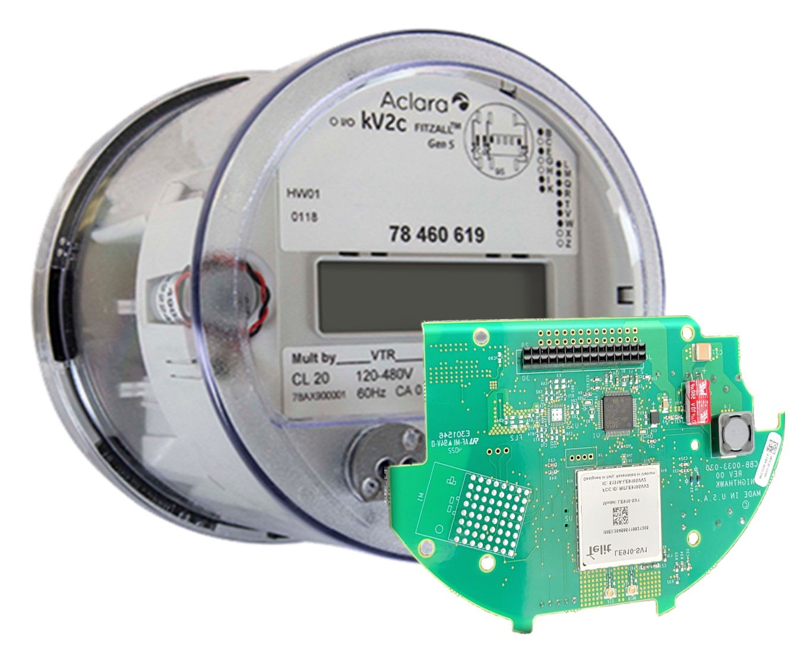
Released Since Our Last Meeting
Nighthawk DirectConnect:
Connects directly with Itron MV-90, Aclara MeterMate, Trilliant PrimeRead, or Trilliant UnitySuite data acquisition software
Robust, secure, and efficient bidirectional message delivery mechanism
Utilizes same proven LTE hardware as Adaptiv HUB solutions
Does not require any middleware – DirectConnect to MV-90 (or other host)
No recurring fees from Nighthawk. Utility should have its own private contract with AT&T or Verizon

Slide 6
Released Since Our Last Meeting
TESCO Meter Socket UL Approval – we were granted UL approval for our 13T meter socket.

Slide 7
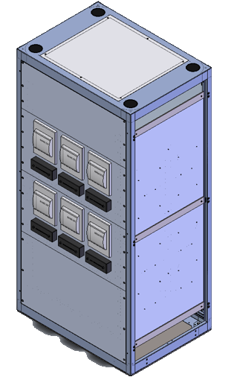
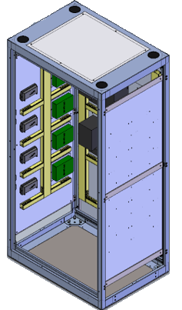
Released Since Our Last Meeting
Substation Panel: Fully assembled and wired to customer specifications

Slide 8
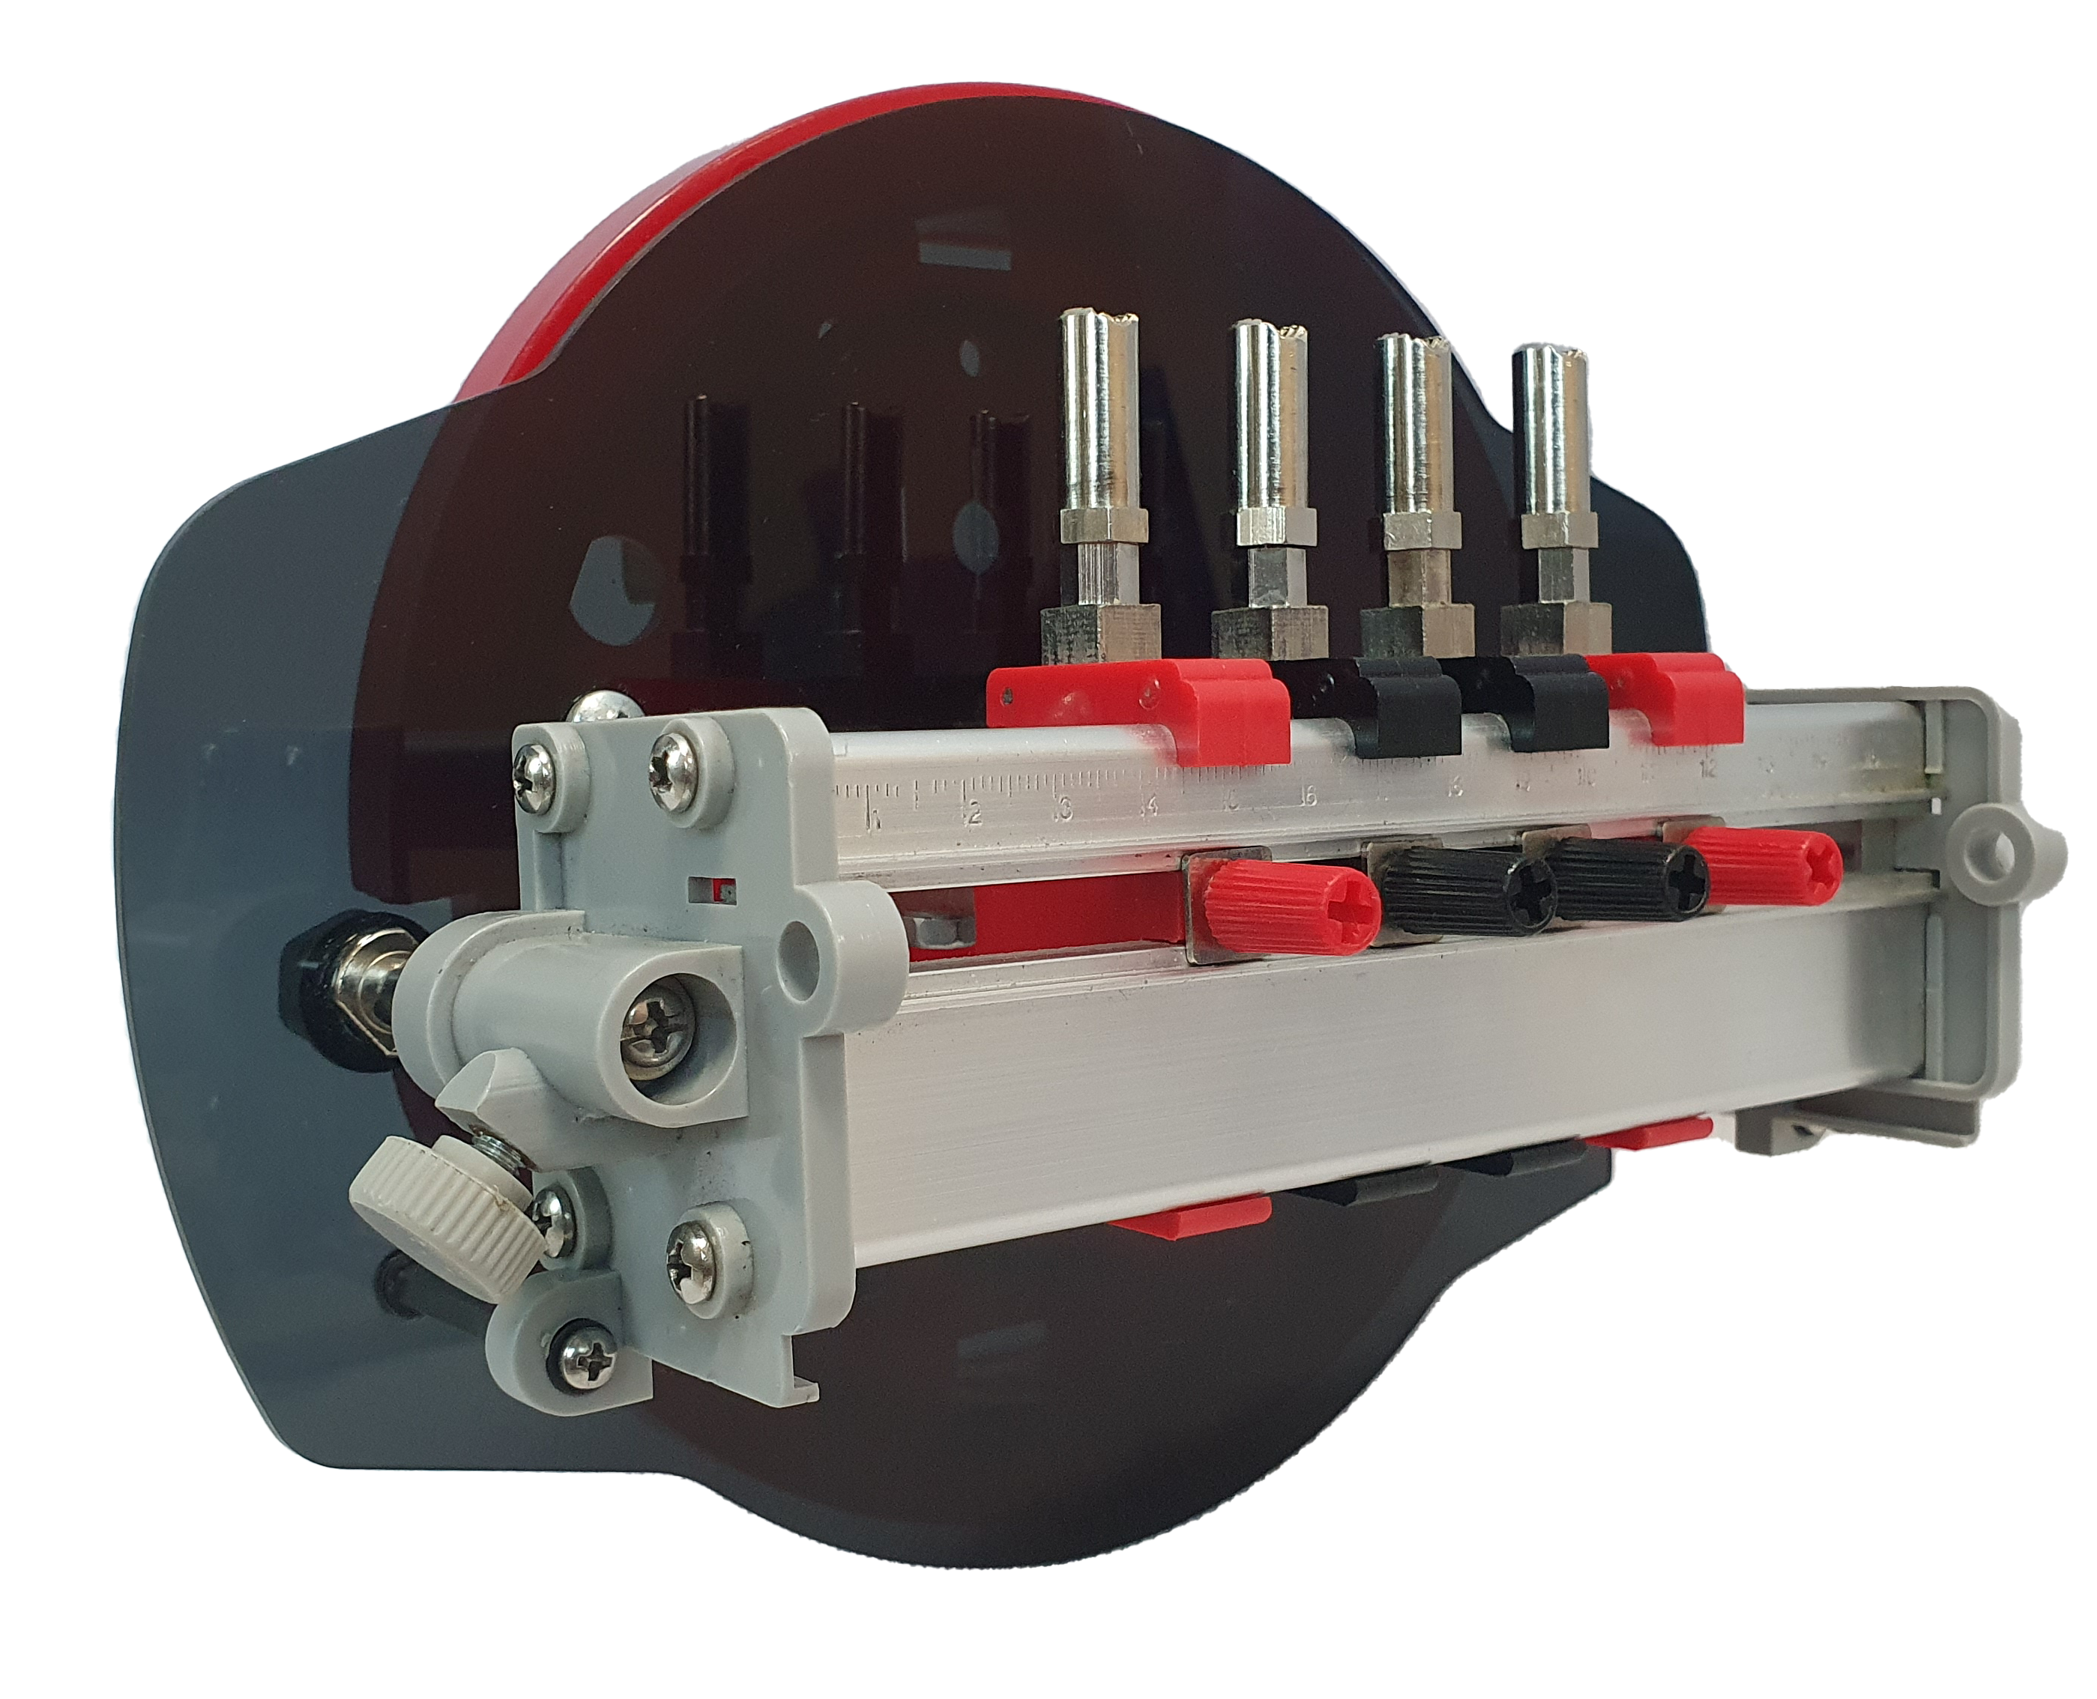
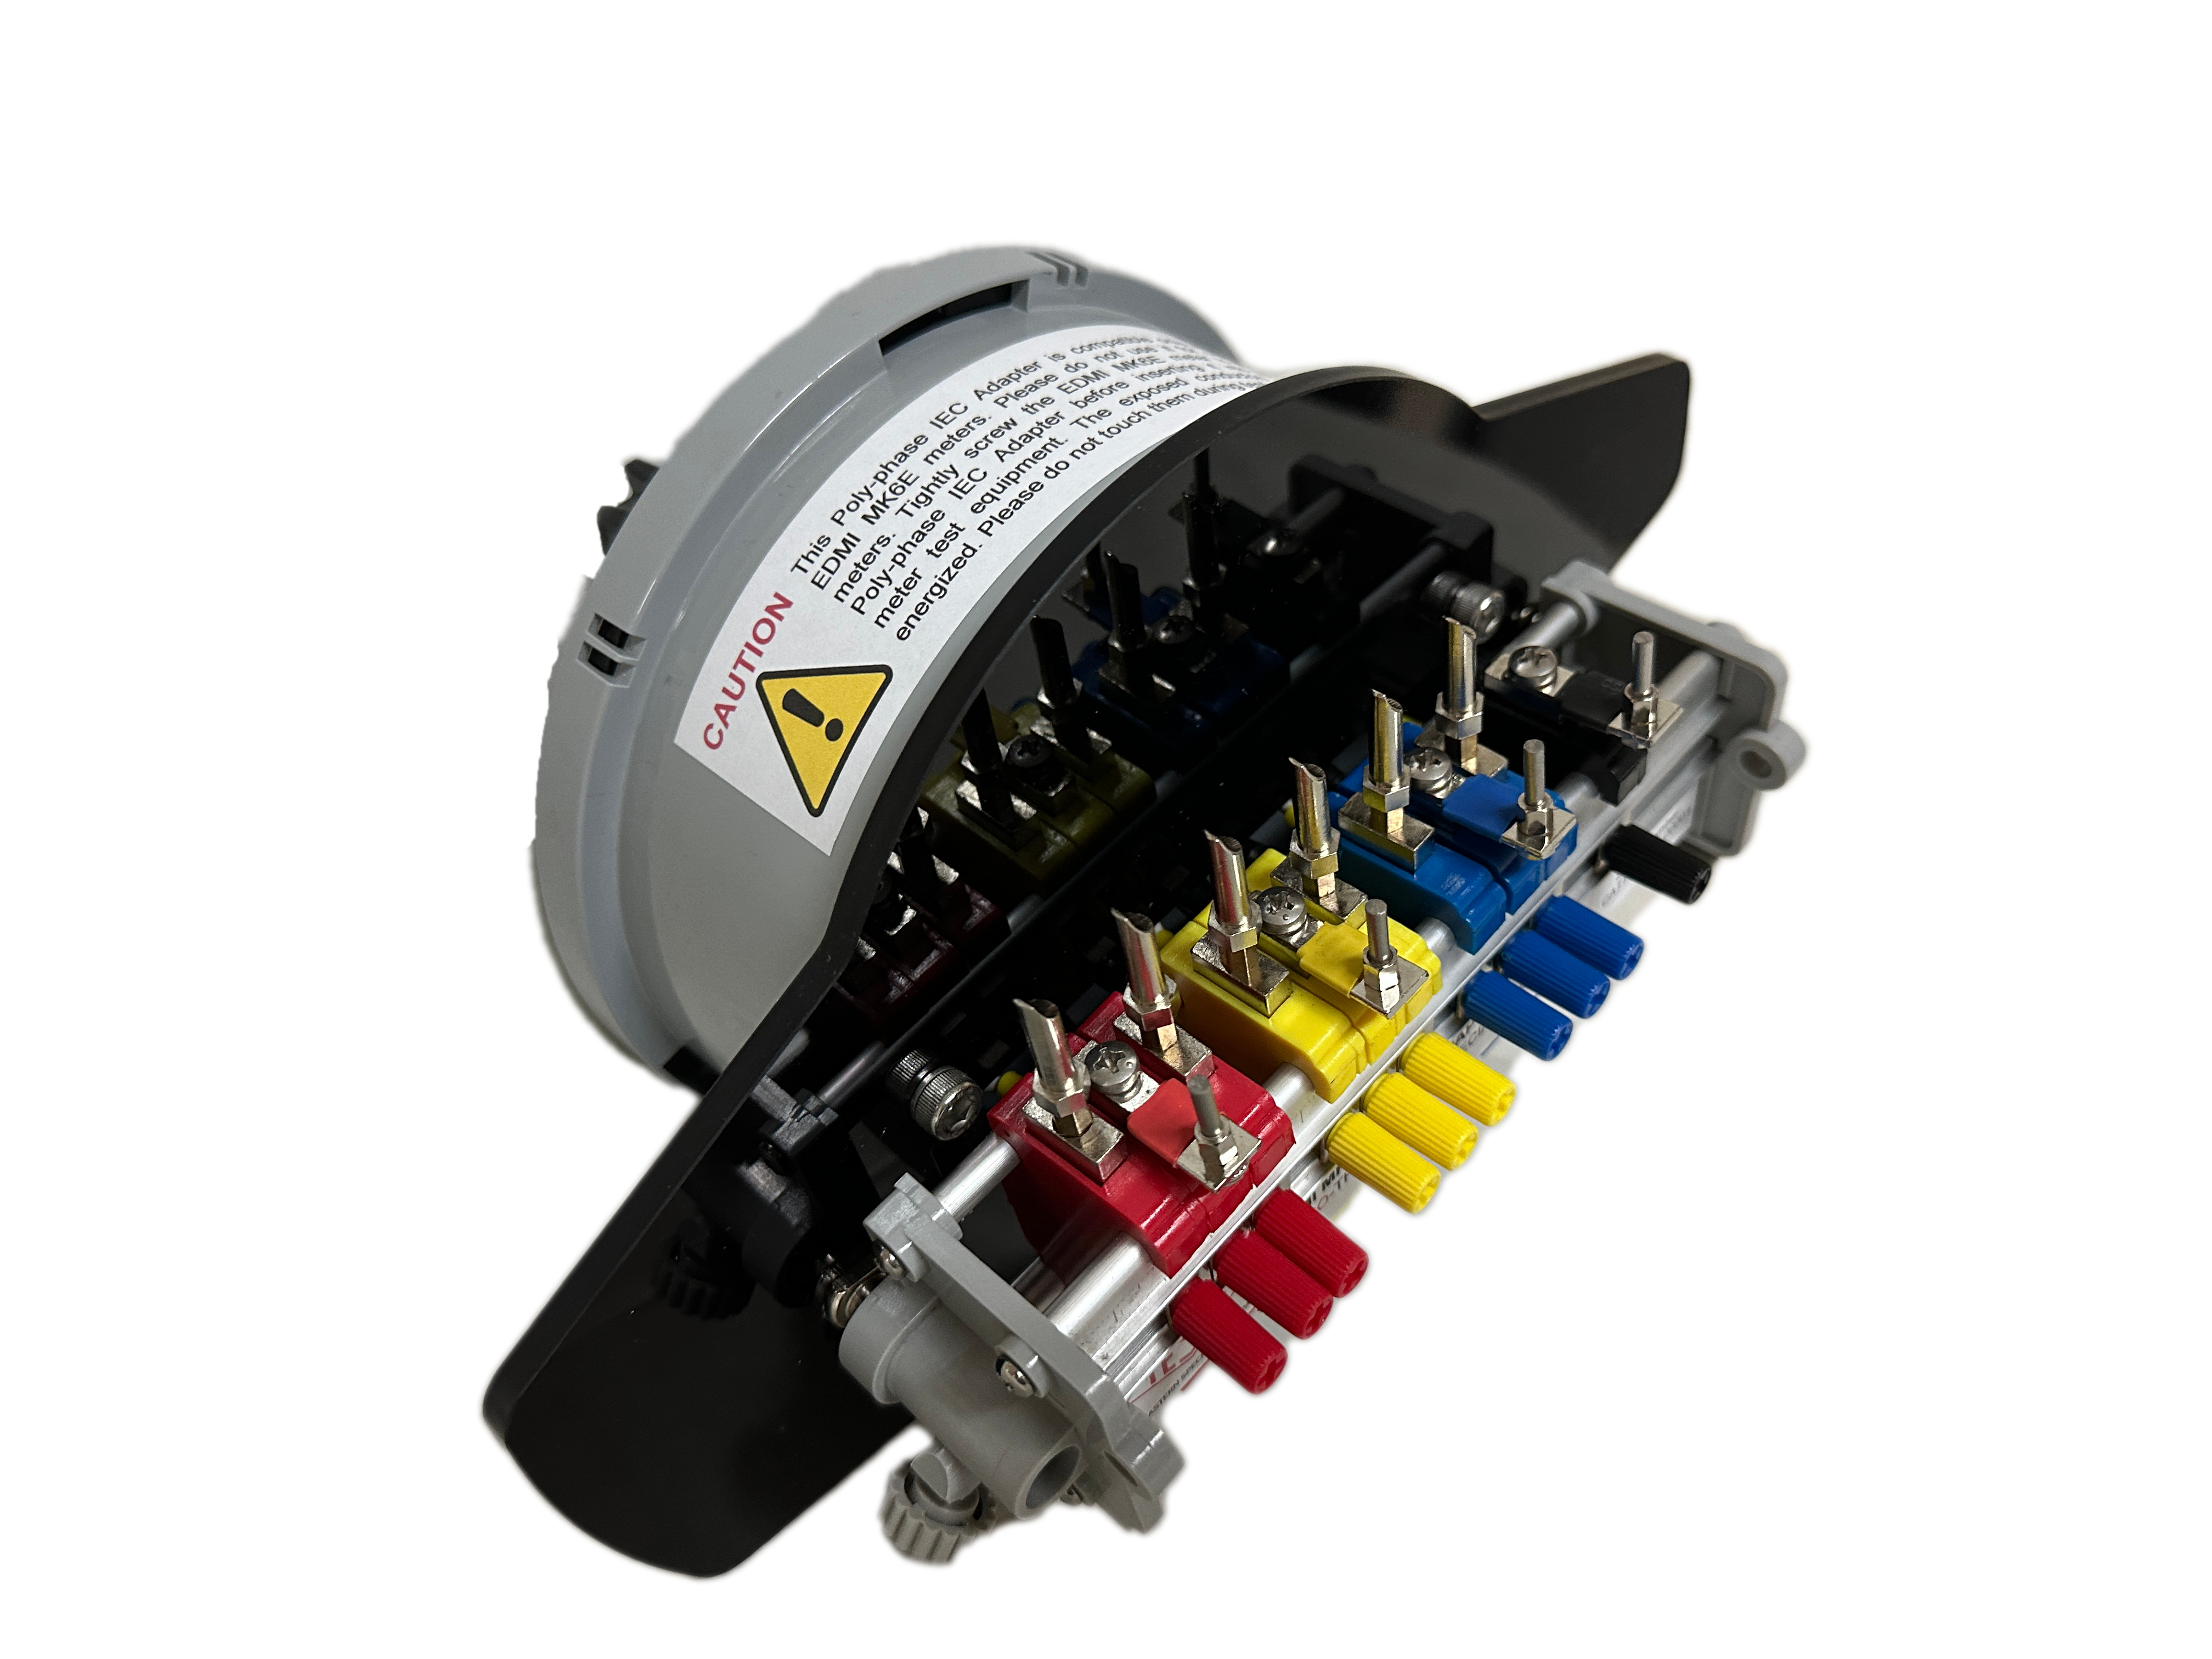
Released Since Our Last Meeting
IEC Meter Adapter:
An IEC Meter Adapter makes testing IEC meters possible with the NextGen meter test boards.
Comes in different versions to cater to the various types of IEC meters. We have adapters for Single Phase, Three Phase, EDMI, and Landis & Gyr meters.

Slide 9
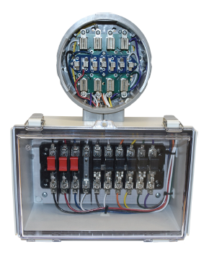
Released Since Our Last Meeting
Test Switch Adapter:
The Test Switch Adapter easily wires in a test switch into a transformer-rated meter box that doesn’t currently have one.
Simply remove the meter, plug it into the adapter, then plug the adapter into the socket to use the test switch to facilitate meter/site testing.
Designed as a handy, portable accessory for the 6330, the 290-13T (pictured) also comes in other versions for different service configurations: 290-8T, the 290-6T-4S, and the 290-6T-3S.

Slide 10
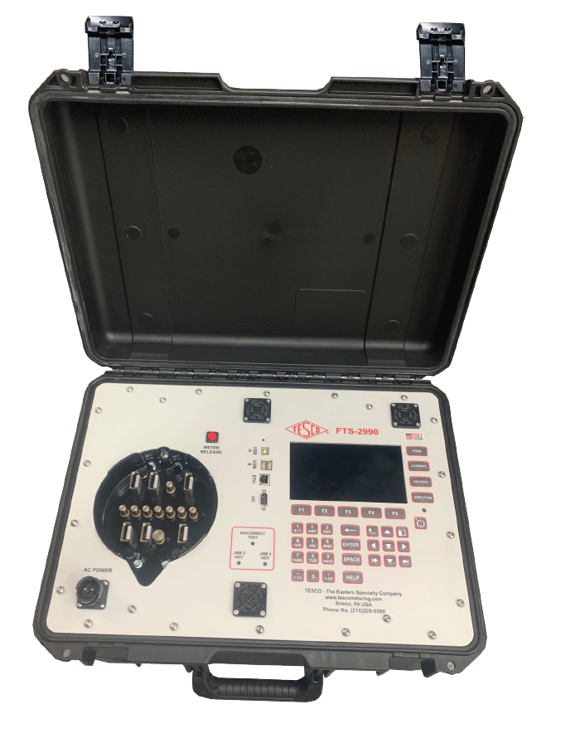
Products scheduled for Release 2024/2025
FTS-2990:
A portable, rugged test station for when you are out in the field and need all the functionality of a 2990.
The FTS-2990 can be transported via wheels or handles.
A fully ANSI compliant test board, the FTS-2990 offers complete testing of all meters under the widest range of test conditions. The new waveform generator has all waveforms called out in ANSI C12.20-2015 (pub. 4/2017). All common electromechanical and solid-state meters up to 50 amps can be tested with the FTS-2990 using the single voltage and three isolated current sources.

Slide 11
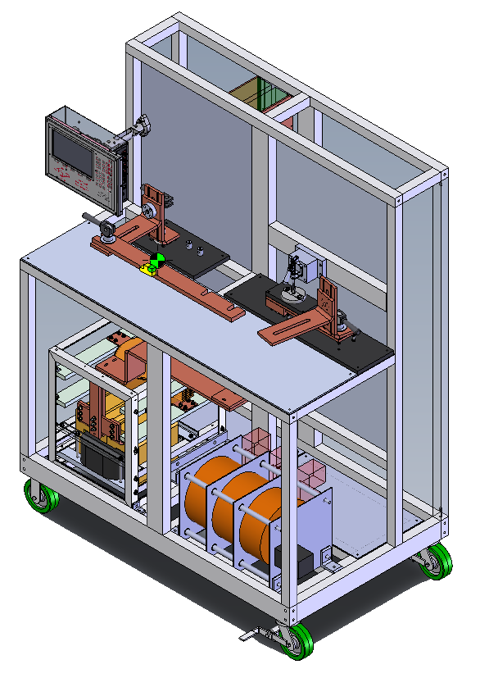
Products scheduled for Release 2024/2025
Advanced KCTS:
Traceable Accuracy down to 1% Rating Factor
  Ability to test beyond 10% and 5% Rating Factor, now down to 0.5% with traceability to 1%
  Validate extended range CTs for greater flexibility of metering and superior billing accuracy at customer site
Electronically Compensated Burdens
  Active Impedance and Power Factor compensation to maintain accuracy down to 1% Rating Factor
  Live Burden Measurement displayed on screen and recorded for advanced testing records and test validation
Improved Safety, Self-Check, and Diagnostics
  System can detect errors and point to any issues that may arise from invalid test setup
  Routine self-check discovers errors before causing costly mistakes
  Configurable Interlock safety circuit
Simplified Servicing
  Advanced diagnostics helps to increase uptime and reduce service time, getting the system back to testing CT’s faster
  Advanced diagnostics also assists operators to quickly locate system errors
Meter Manager and TDM Integration
  Automatically capture test results within establish meter database
  Simplify infrastructure overhead
  See all your data in one place with analysis tools
  Backward compatible serial port for integration with existing data capture

Slide 12
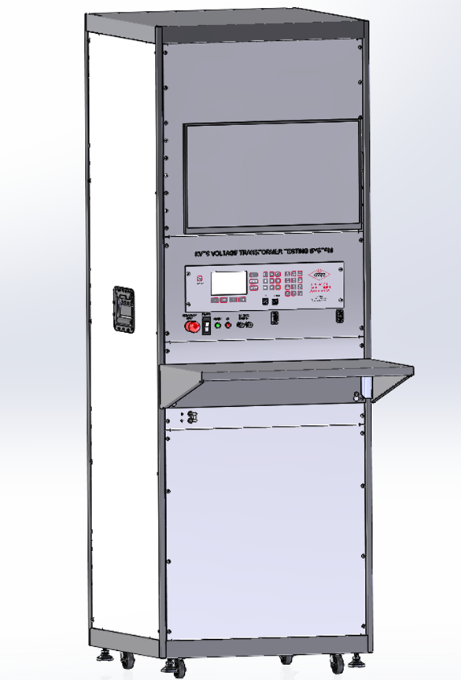
Products scheduled for Release 2024/2025
Automated KVTS:
Computer controlled operation
Able to save and recall VTs by serial number
Self test check to monitor ref transformer health
Ramping and test functions will be controlled automatically.
Enhanced diagnostics can pinpoint TUT or connection problems during setup.

Slide 13
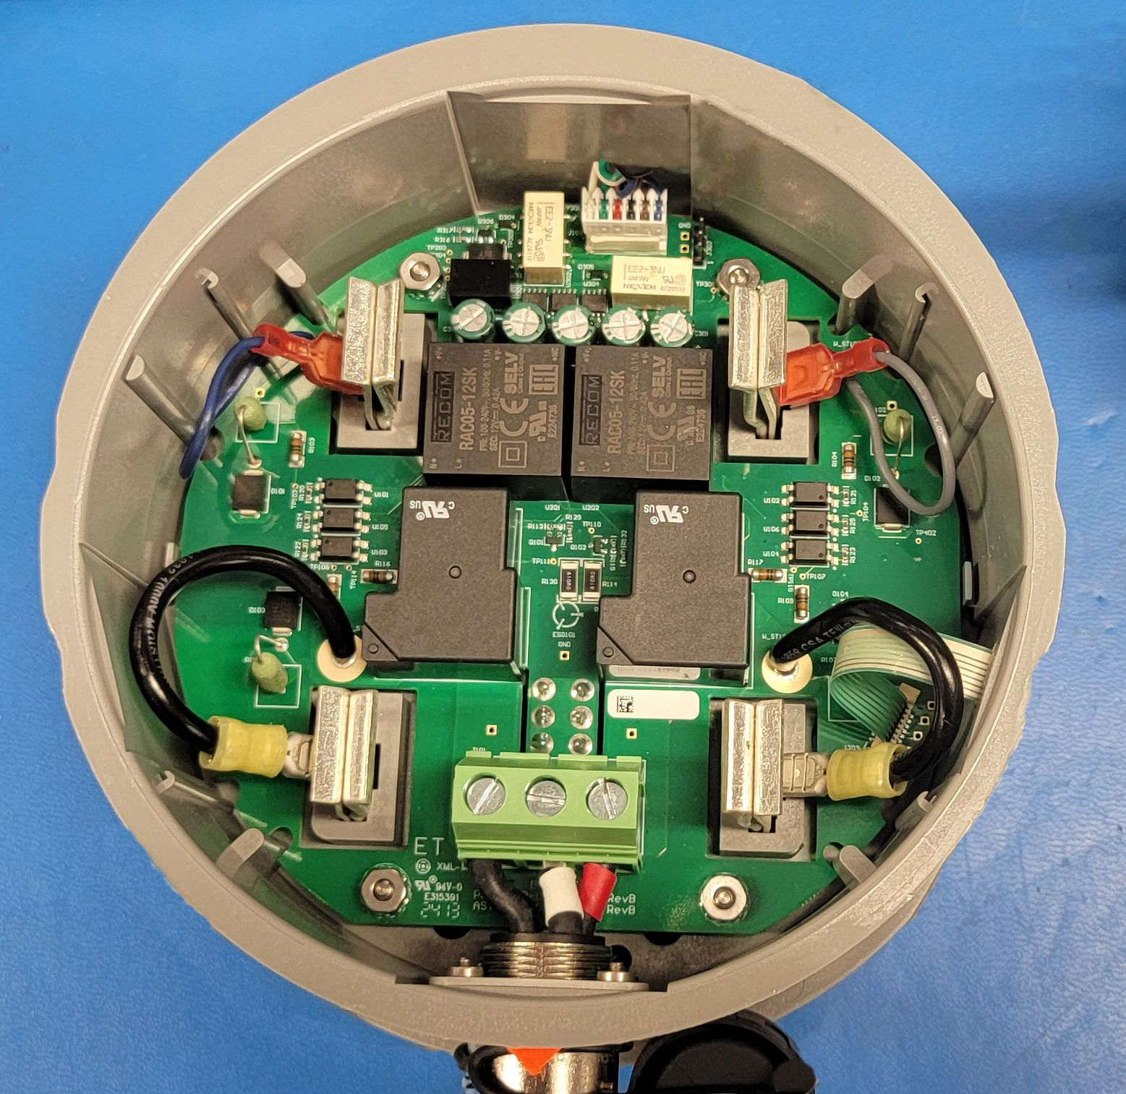
Products scheduled for Release 2024/2025
In-Socket Tester:
Uses customer voltage
Will generate up to three phases of current in synch with the applicable voltages
Same high accuracy metrology as CAT 2990 and CAT3050.
Will have the ability to test all self-contained meter forms.

Slide 14
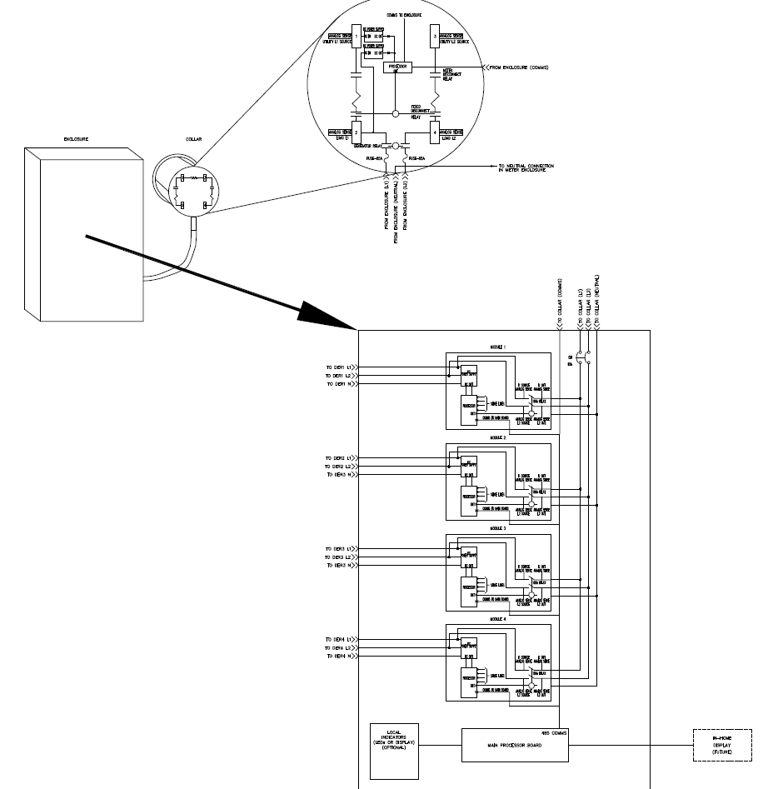
Products scheduled for Release 2024/2025
DER Multiplexer:
Based on existing BPTM design
Automatic transfer switch for up to 4 DER inputs.
Each DER input rated up to 55A
Easy installation
Built-in utility-side surge protection
UL and NEMA/ANSI tested and approved
Will have configurable switching algorithms based on priority, time of day, etc.
Optional in-home customer interface panel

Slide 15
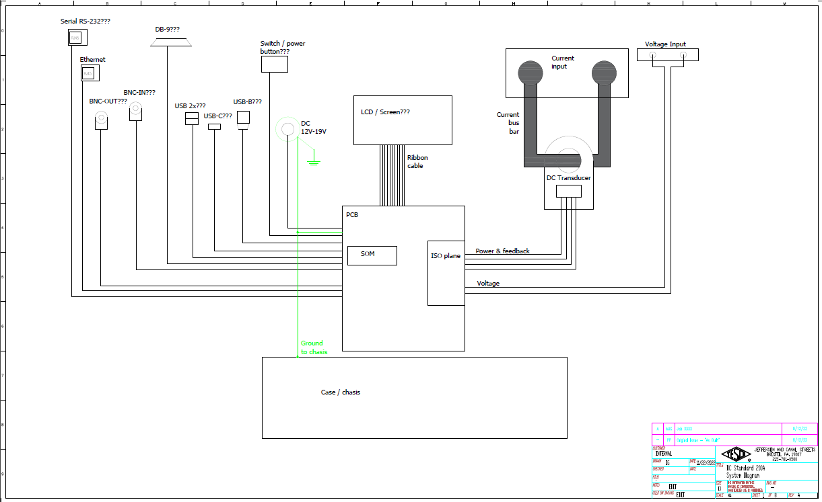
Products scheduled for Release 2024/2025
DC Transfer Standard:
A portable, NIST-traceable DC reference standard that will be used to do field calibrations of EVSE test equipment.

Slide 16
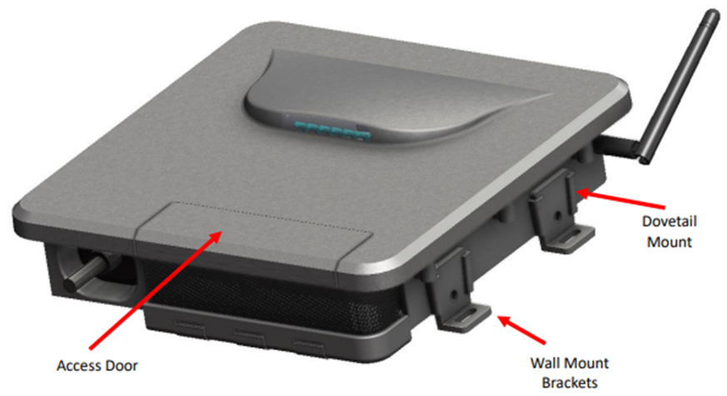
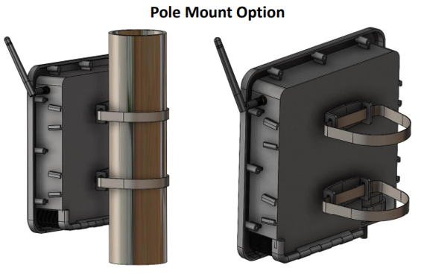
Products scheduled for Release 2024/2025
Nighthawk Fiber Hub:
The Fiber HUB product is a self-contained mesh HUB device with a wired Ethernet uplink.
  Fiber hub is Adaptiv compatible
  Acts as a cost-effective collector for multiple devices
Ideal for utilities who have mostly fiber throughout service territory
  Federal government incentivizing rural co-op fiber to the home
  Utilities looking for applications to use the deployed fiber
Advanced Outage Management power fail detection
  Configurable blink and sustained outage event thresholds, event logging and data upload
Rechargeable Battery Backup of 10 minutes to allow for last gasp transmissions
Supports OTA firmware upgrades to associated mesh devices
Robust end to end security and encryption

Slide 17
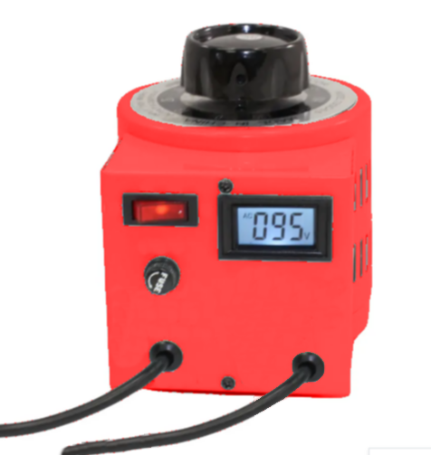
Products scheduled for Release 2024/2025
Intertie Tester:
Add-on module to CAT 6330
Will generate local voltage that the CAT 6330 can sink its current output to.
Simple connections to make setup easier.

Slide 18

Suggestions?
Suggestions from the group for other items needed for the marketplace?

