Slide 1
ANSI Meter Forms
Prepared by Perry Lawton, TESCO
The Eastern Specialty Company
For North Carolina Electric Meter School
Polyphase Track
Monday June 10, 2024
2:45 PM

Slide 2
Agenda
Meters 101 - Electro-Mechanical vs Solid-State
Meter Forms
Self-Contained vs Transformer Rated
Blondel’s Theorem
Available References (Hardy’s Power Measurement Handbook, UGLY’s Elect Ref)
Examples
1S, 2S, 3S, 4S, 5/35S, 8/9S, 16S

Slide 3
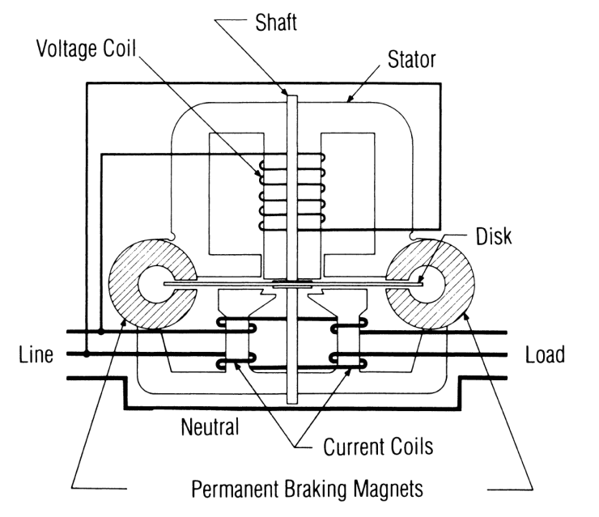
Induction Meters
Two coils and a conducting (usually aluminum) disk. A braking magnet.
Magnetic field from the first coil generates eddy currents in the disk
Magnetic field from the second coil interacts with the eddy currents to cause motion
Disk would accelerate without bound except for eddy currents caused by motion through fixed magnetic field which slows the disk
The end result is that each revolution of the disk measures a constant amount of energy

Slide 4
Basic Energy Formula
The essential specification of a watthour meter’s measurement is given by the value K_{h} [ Watthours per disk revolution ]
A Kh of 7.2 is typical. In this example, each full rotation of the disk is equivalent to 7.2Wh of energy.
The watthour meter formula is as follows:
tescometering.com
4

Slide 5
Meters 101 – Solid-State
Overview of Functionality
Potential and Current is scaled down and conditioned with transformers and filters
ADC’s (analog to digital converters) digitize the signals
A micro-processor or DSP executes the calculations
Resulting data is displayed, sent externally via the communication circuits, and used for the calibrated pulse output
MICRO
PROC
CURRENT TRANSFORMER
DISPLAY
FILTER
ADC
COMM
POTENTIAL TRANSFORMER
FILTER
ADC
PULSE

Slide 6
Meter Forms
14S
39S
17S
1S
2S
3S
12S
35S
4S
25S
10S
76S
46S
45S
66S
11S
32S
5S
26S
6S
16S
9S
13S
15S
24S
56S

Slide 7
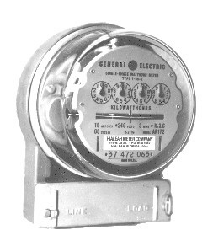
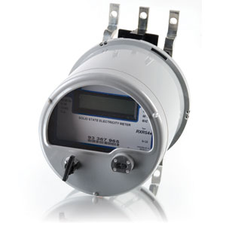
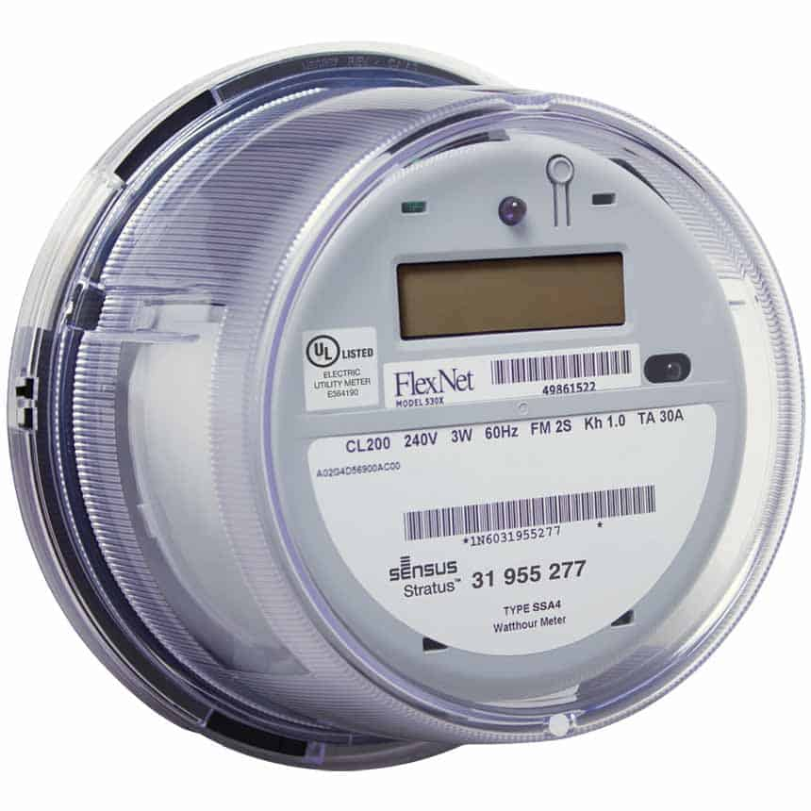
Meter Forms

Slide 8
Meter Forms
14S
39S
17S
1S
2S
3S
12S
35S
4S
25S
10S
76S
46S
45S
66S
11S
32S
5S
26S
6S
9S
16S
13S
56S
15S
24S

Slide 9
Meter Forms
SELF-CONTAINED
TRANSFORMER-RATED
39S
36S
1S
14S
3S
7S
12S
29S
2S
76S
5S
35S
25S
46S
4S
8S
16S
11S
26S
17S
66S
9S
45S
13S
6S
56S
10S
24S
15S
32S

Slide 10
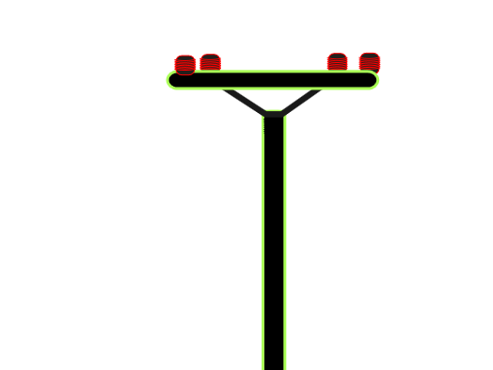
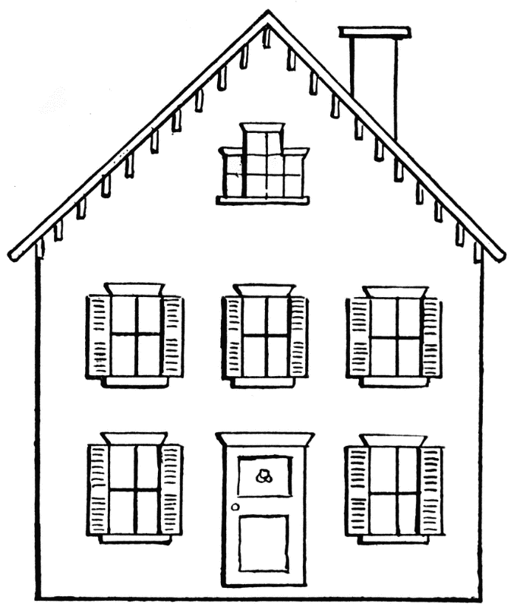
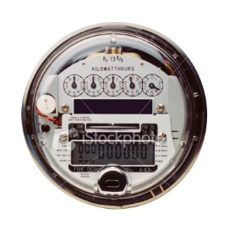
Self-Contained Meters
Primarily Residential
Relatively Low Current
Example: 100A

Slide 11
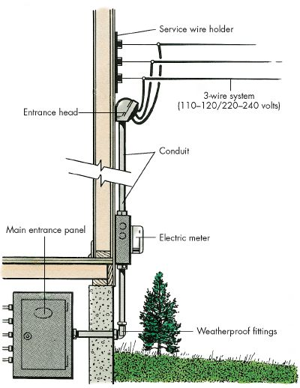
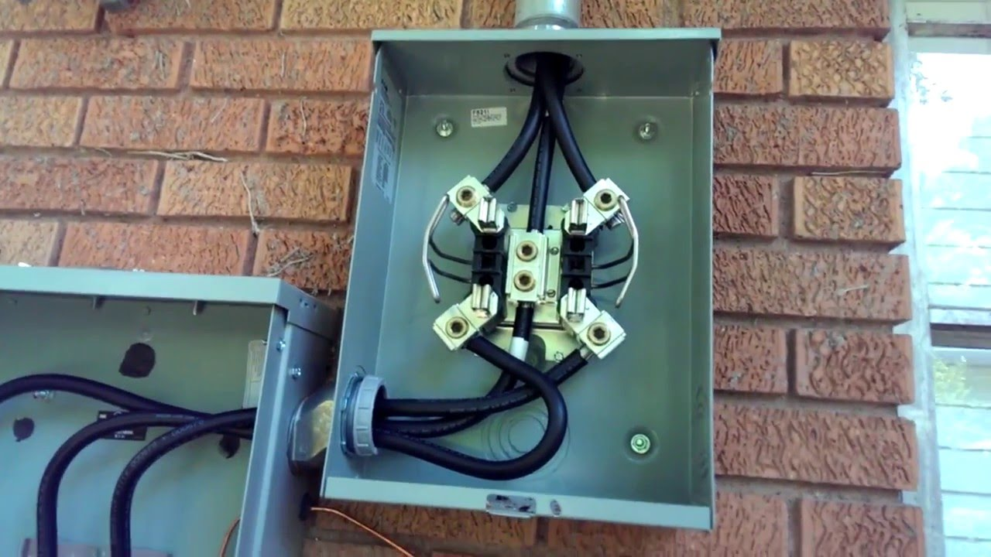
Self-Contained
Primarily Residential

Slide 12
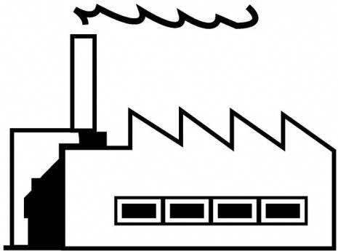
Transformer-Rated Meters
Primarily Commercial/Industrial
Relatively High Current
Example: 4000A
Notes:
12

Slide 13
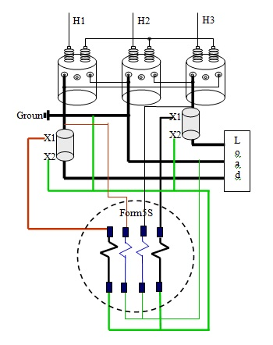
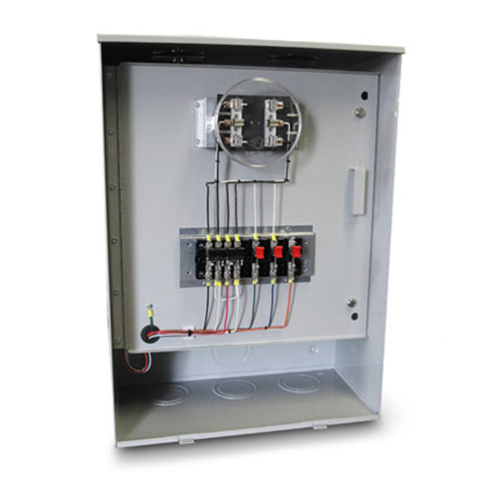
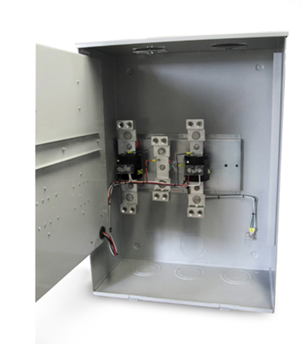
Transformer-Rated Meters
Primarily Commercial/Industrial

Slide 14
Diagram Example
References
Power Measurements Handbook, Dr. Bill Hardy
UGLY’s Electrical References
Meterman’s Handbook
Manufacturer’s websites

Slide 15
Diagram Example
References
Power Measurements Handbook, Dr. Bill Hardy
UGLY’s Electrical References
Meterman’s Handbook
Manufacturer’s websites

Slide 16
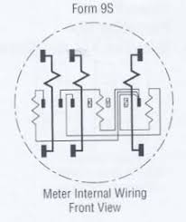
Diagram Example
3 Current Coils
3 Potential Coils

Slide 17
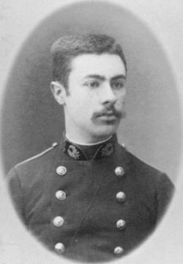
Blondel’s Theorem
French Electrical Engineer Andre Blondel
Attempt to simplify electrical measurements and validation of the results
Paper submitted to the International Electric Congress in Chicago in 1893.
E = n - 1
The theorem states that the power provided to a system of N conductors is equal to the algebraic sum of the power measured by N watt-meters. The N watt-meters are separately connected such that each one measures the current level in one of the N conductors and the potential level between that conductor and a common point. In a further simplification, if that common point is located on one of the conductors, that conductor's meter can be removed and only N-1 meters are required.

Slide 18
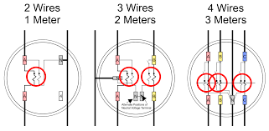
Blondel’s Theorem
Blondel Compliant
E = n - 1
1S
12S
9S
The theorem states that the power provided to a system of N conductors is equal to the algebraic sum of the power measured by N watt-meters. The N watt-meters are separately connected such that each one measures the current level in one of the N conductors and the potential level between that conductor and a common point. In a further simplification, if that common point is located on one of the conductors, that conductor's meter can be removed and only N-1 meters are required.

Slide 19
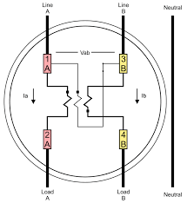
Blondel’s Theorem
Non-Blondel Compliant
E = n - 1
2S
The theorem states that the power provided to a system of N conductors is equal to the algebraic sum of the power measured by N watt-meters. The N watt-meters are separately connected such that each one measures the current level in one of the N conductors and the potential level between that conductor and a common point. In a further simplification, if that common point is located on one of the conductors, that conductor's meter can be removed and only N-1 meters are required.

Slide 20
Blondel’s Theorem
Why is non-Blondel metering bad?
Makes assumptions about the service
Example: balanced voltages
Assumptions might not be true
When these assumptions are not true, then there are power measurement errors even if the meter is working perfectly.
The theorem states that the power provided to a system of N conductors is equal to the algebraic sum of the power measured by N watt-meters. The N watt-meters are separately connected such that each one measures the current level in one of the N conductors and the potential level between that conductor and a common point. In a further simplification, if that common point is located on one of the conductors, that conductor's meter can be removed and only N-1 meters are required.

Slide 21
Blondel’s Theorem
Why are non-Blondel meters used?
Fewer elements (meters) = lower cost
Especially true for electro-mechanical meters
Fewer CT’s and PT’s = lower cost
Less wiring and cheaper sockets
The theorem states that the power provided to a system of N conductors is equal to the algebraic sum of the power measured by N watt-meters. The N watt-meters are separately connected such that each one measures the current level in one of the N conductors and the potential level between that conductor and a common point. In a further simplification, if that common point is located on one of the conductors, that conductor's meter can be removed and only N-1 meters are required.

Slide 22
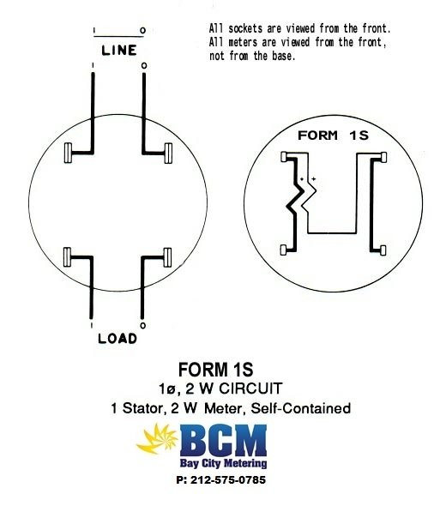
Metering Examples

Slide 23
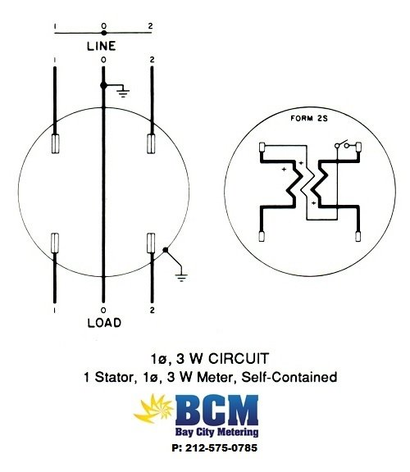
Metering Examples

Slide 24
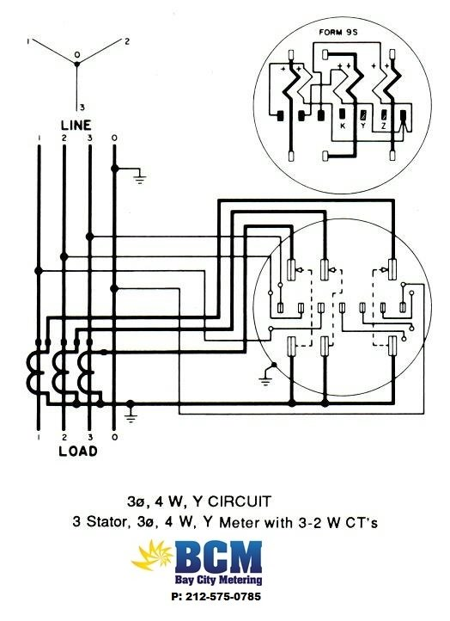
Metering Examples

Slide 25
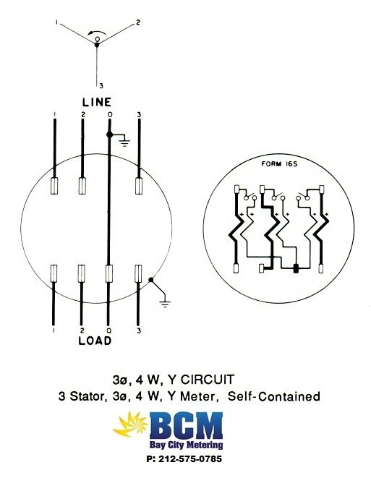
Metering Examples

Slide 26
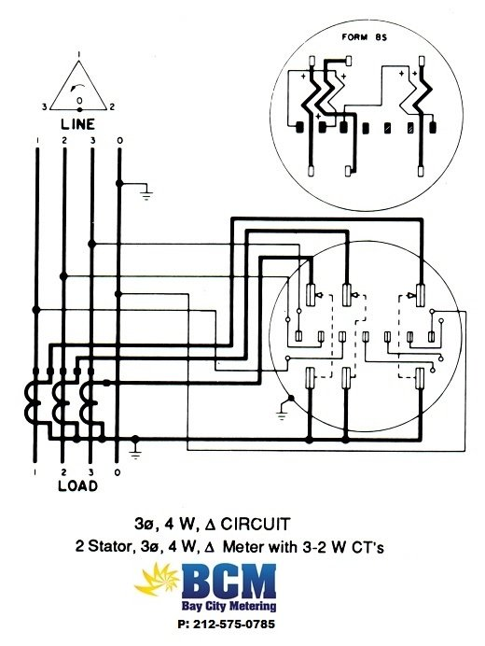
Metering Examples

Slide 27
References
Wikipedia – of course
https://en.wikipedia.org/wiki/Blondel%27s_theorem
Power Measurement Handbook – Dr. Bill Hardy – TESCO CTO Emeritus
http://www.powermeasurements.org/library/Presentations/NCMS%202013%20-%20Non-Blondel%20Metering.pdf
Third Party meter sites
https://www.baycitymetering.com/

Slide 28
Agenda
Meters 101 - Electro-Mechanical vs Solid-State
Meter Forms
Self-Contained vs Transformer Rated
Blondel’s Theorem
Available References

Slide 29
Questions and Discussion
Perry Lawton
Northeastern Regional Sales Manager
perry.lawton@tescometering.com
TESCO Metering Bristol, PA
215.500.7511
This presentation can also be found under Meter Conferences and Schools on the TESCO website: tescometering.com
ISO 9001:2015 Certified Quality Company
ISO 17025:2017 Accredited Laboratory

Slide 30
Tesco hospitality suite
We would like you to join us in the TESCO Hospitality Suite for networking and more discussions about metering. The discussion will not be exclusively metering……….but we love metering and that is the most common topic.
TESCO Hospitality Suite – Brighton Tower
Monday and Tuesday 8:00 PM – 10:00 PM

