Slide 1
How Harmonics Can Distort Metering Forms
Prepared by Tom Lawton, TESCO
The Eastern Specialty Company
For North Carolina Electric Meter School
Advanced
Wednesday, June 12, 2024
1:45 PM

Slide 2
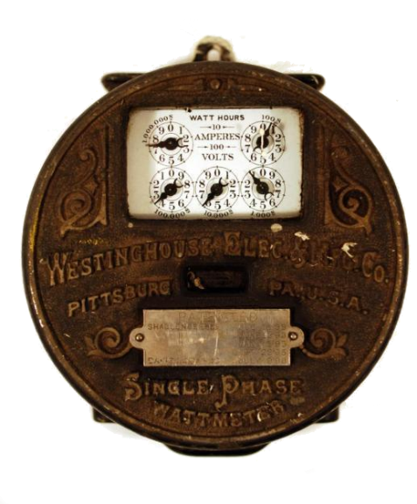
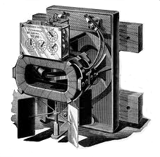
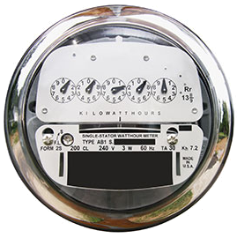
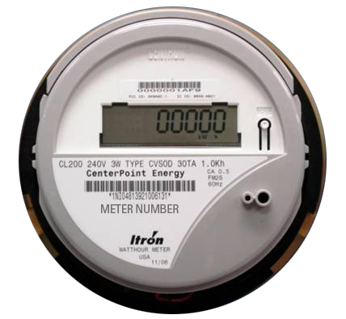
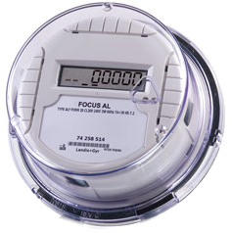
Then – Now – Tomorrow?- Meters
Westinghouse 1905
2005
First Meters mid-1890s
Westinghouse 1905
2005
2023
2035 ???
2006
2023
2035 ???

Slide 3
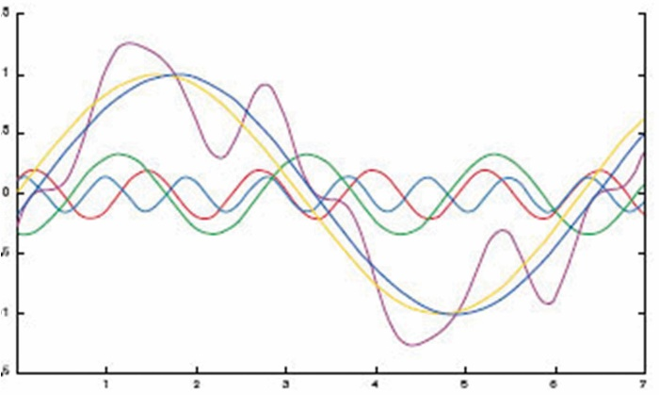
Effects of Harmonics
Harmonics in your electrical distribution system not only bleeds electrical power, but can damage equipment, cause catastrophic failure of equipment, fires and even violent explosions. Every one of these effects is expensive and avoidable.

Slide 4
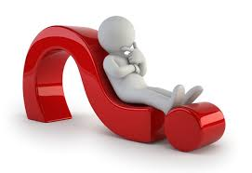
What are Harmonics
To answer this,we should start with another question;
“What is Power Quality?”
Power quality is how the utilization and the delivery of electric power affects the performance of electrical equipment.

Slide 5
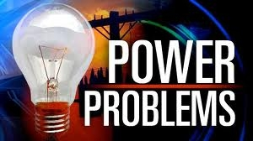
Who is Responsible for Power quality
Customer (according to most utilities)
Utility (according to most customers)
“Electrical power problems cost U.S. industry $40–$150 billion each year, according to some estimates. Most problems originate outside the plant and are therefore beyond the plant’s control—for example, outages, voltage interruptions, voltage sag, voltage reductions, and blackouts.”
–Department of Energy

Slide 6
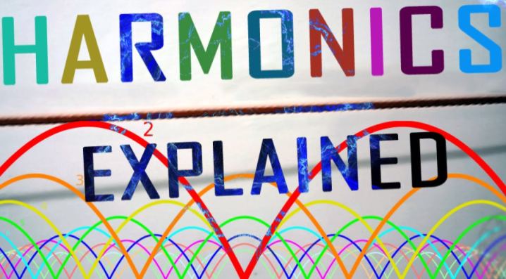
What are Harmonics?
Harmonic frequencies in power systems are a primary cause of power quality problems.
Harmonic voltages and currents in an electric power system are a result of non-linear electric loads.
Harmonics in power systems result in increased heating in equipment and conductors.
Harmonics stress the distribution system and potentially damage equipment. They may disrupt the normal operation of equipment and increase operating costs.

Slide 7
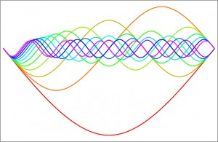
But What are Harmonics?
The presence of harmonics in power systems means that current and voltage waveforms are distorted and deviate from sinusoidal waveforms.

Slide 8
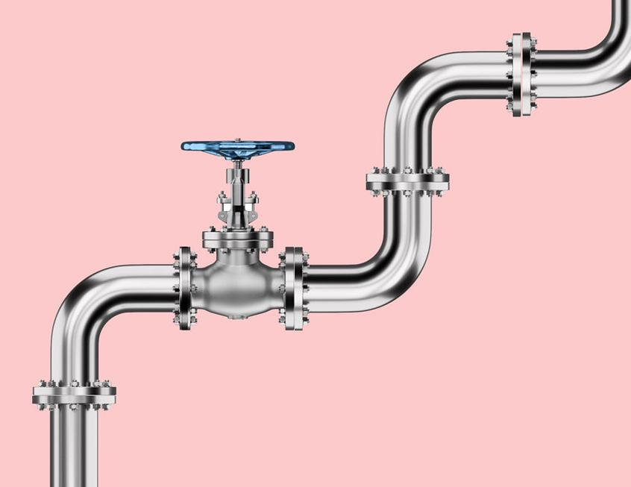
What are and What Causes Harmonics?
To give an understanding of this, consider a water piping system. Have you ever taken a shower when someone turns on the cold water at the sink? You experience the effect of a pressure drop to the cold water, reducing the flow of cold water. The end result is you get scalded by the untempered hot water flow .
Imagine that someone at the sink alternately turns on and off the cold and hot water. You would be effectively hit with alternating cold and hot water! Therefore, the performance and function of the shower is reduced by other systems. The illustration is like an electrical system with non-linear loads generating harmonics. Any SMPS equipment will create continuous distortion of the power source that stresses the facility's electrical distribution system and power equipment. When this happens, electrical panels and transformers become mechanically resonant (they buzz) to the magnetic field generated by the higher frequency harmonics (the pipes rattle, to continue the analogy).

Slide 9
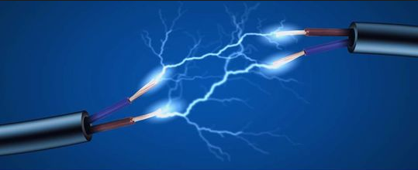
Background
Harmonics are one of the most important issues effecting power quality. Even though the issue of harmonics seems relatively new, the issue has been around for a long time.
In 1893, only eight years after first AC power plant was built, engineers conducted a harmonic analysis to identify and solve a motor heating problem.
A paper written by E.J. Houston and A.E. Kennely in 1894, was one of the first documents in which the word harmonic was used.

Slide 10
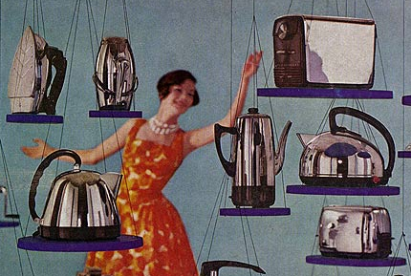
Background
Up to the 1960’s, most of the electric loads were linear loads - in other words, the current flowing through the appliances had a sinusoidal sine wave.
These electric loads included induction motors, domestic lighting, stoves and other household appliances.

Slide 11
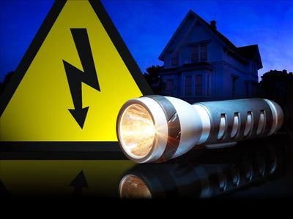
Background
UPS (uninterruptible power supply) systems convert the incoming AC supply to DC in order to charge batteries in the event of a power outage.
The DC component has a very high frequency signal and interferes with the AC power supplies.
Most of the distortion in the modern distribution system is customer generated.

Slide 12
Basic Concept
A pure sinusoidal voltage is a conceptual quantity produced by an ideal AC generator built with finely distributed stator and field windings that operate in a uniform magnetic field. Since neither the winding distribution nor the magnetic field are uniform in a working AC machine, voltage waveform distortions are created, and the voltage-time relationship deviates from the pure sine function. The distortion at the point of generation is very small (about 1% to 2%), but nonetheless it exists. Because this is a dfromeviation a pure sine wave, the deviation is in the form of a periodic function, and by definition, the voltage distortion contains harmonics.
When a sinusoidal voltage is applied to a certain type of load, the current drawn by the load is proportional to the voltage and impedance and follows the envelope of the voltage waveform. These loads are referred to as linear loads (loads where the voltage and current follow one another without any distortion to their pure sine waves). Examples of linear loads are resistive heaters, incandescent lamps, and constant speed induction and synchronous motors.

Slide 13
Basic Concept
In contrast, some loads cause the current to vary disproportionately with the voltage during each half cycle. These loads are classified as nonlinear loads, and the current and voltage have waveforms that are nonsinusoidal, containing distortions, whereby the 60-Hz waveform has numerous additional waveforms superimposed upon it, creating multiple frequencies within the normal 60-Hz sine wave. The multiple frequencies are harmonics of the fundamental frequency.
Normally, current distortions produce voltage distortions. However, when there is a stiff sinusoidal voltage source (when there is a low impedance path from the power source, which has sufficient capacity so that loads placed upon it will not affect the voltage), one need not be concerned about current distortions producing voltage distortions.

Slide 14
Basic Concept
Examples of nonlinear loads are battery chargers, electronic ballasts, variable frequency drives, and switching mode power supplies. As nonlinear currents flow through a facility's electrical system and the distribution-transmission lines, additional voltage distortions are produced due to the impedance associated with the electrical network. Thus, as electrical power is generated, distributed, and utilized, voltage and current waveform distortions are produced.
Power systems designed to function at the fundamental frequency, which is 60-Hz in the United States, are prone to unsatisfactory operation and, at times, failure when subjected to voltages and currents that contain substantial harmonic frequency elements. Very often, the operation of electrical equipment may seem normal, but under a certain combination of conditions, the impact of harmonics is enhanced, with damaging results.

Slide 15
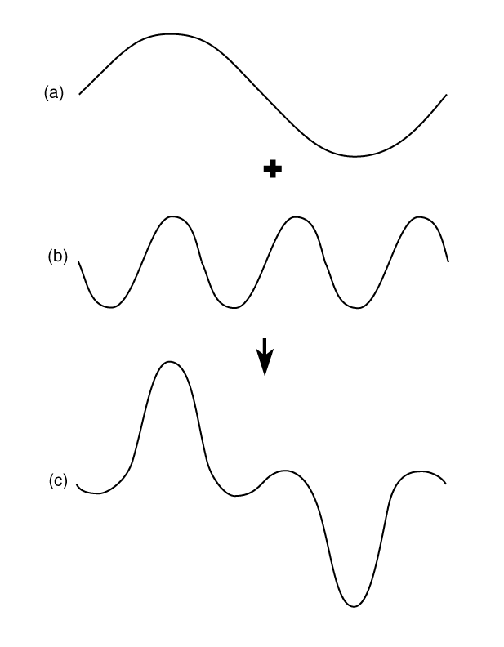
Harmonics :Distorted waveforms
Sine wave of current, fundamental frequency
Sine wave of current at 3rd harmonic
Combination of (a) and (b), resulting in a distorted wave shape

Slide 16
Motors
There is an increasing use of variable frequency drives (VFDs) that power electric motors. The voltages and currents emanating from a VFD that go to a motor are rich in harmonic frequency components. Voltage supplied to a motor sets up magnetic fields in the core, which create iron losses in the magnetic frame of the motor. Hysteresis and eddy current losses are part of iron losses that are produced in the core due to the alternating magnetic field. Hysteresis losses are proportional to frequency, and eddy current losses vary as the square of the frequency. Therefore, higher frequency voltage components produce additional losses in the core of AC motors, which in turn, increase the operating temperature of the core and the windings surrounding in the core. Application of non-sinusoidal voltages to motors results in harmonic current circulation in the windings of motors. The net rms current is I_{rms} = √[(I₁)² + (I₂)² + (I₃)² + …],
where the subscripts 1, 2, 3, etc. represent the different harmonic currents. The I²R losses in the motor windings vary as the square of the rms current. Due to skin effect, actual losses would be slightly higher than calculated values. Stray motor losses, which include winding eddy current losses, high frequency rotor and stator surface losses, and tooth pulsation losses, also increase due to harmonic voltages and currents.

Slide 17
Motors
The phenomenon of torsional oscillation of the motor shaft due to harmonics is not clearly understood, and this condition is often disregarded by plant personnel. Torque in AC motors is produced by the interaction between the air gap magnetic field and the rotor-induced currents. When a motor is supplied non-sinusoidal voltages and currents, the air gap magnetic fields and the rotor currents contain harmonic frequency components.
The harmonics are grouped into positive (+), negative (-) and zero (0) sequence components. Positive sequence harmonics (harmonic numbers 1, 4, 7, 10, 13, etc.) produce magnetic fields and currents rotating in the same direction as the fundamental frequency harmonic. Negative sequence harmonics (harmonic numbers 2, 5, 8, 11, 14, etc.) develop magnetic fields and currents that rotate in a direction opposite to the positive frequency set. Zero sequence harmonics (harmonic numbers 3, 9, 15, 21, etc.) do not develop usable torque, but produce additional losses in the machine. The interaction between the positive and negative sequence magnetic fields and currents produces torsional oscillations of the motor shaft. These oscillations result in shaft vibrations. If the frequency of oscillations coincides with the natural mechanical frequency of the shaft, the vibrations are amplified and severe damage to the motor shaft may occur. It is important that for large VFD motor installations, harmonic analyses be performed to determine the levels of harmonic distortions and assess their impact on the motor.

Slide 18
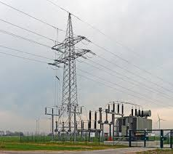
Transformers
The harmful effects of harmonic voltages and currents on transformer performance often go unnoticed until an actual failure occurs. In some instances, transformers that have operated satisfactorily for long periods have failed in a relatively short time when plant loads were changed or a facility's electrical system was reconfigured. Changes could include installation of variable frequency drives, electronic ballasts, power factor improvement capacitors, arc furnaces, and the addition or removal of large motors.
Application of nonsinusoidal excitation voltages to transformers increase the iron lesses in the magnetic core of the transformer in much the same way as in a motor. A more serious effect of harmonic loads served by transformers is due to an increase in winding eddy current losses. Eddy currents are circulating currents in the conductors induced by the sweeping action of the leakage magnetic field on the conductors. Eddy current concentrations are higher at the ends of the transformer windings due to the crowding effect of the leakage magnetic fields at the coil extremities. The eddy current losses increase as the square of the current in the conductor and the square of its frequency. The increase in transformer eddy current loss due to harmonics has a significant effect on the operating temperature of the transformer. Transformers that are required to supply power to nonlinear loads must be derated based on the percentages of harmonic components in the load current and the rated winding eddy current loss.

Slide 19
Transformers
One method of determining the capability of transformers to handle harmonic loads is by k factor ratings. The k factor is equal to the sum of the square of the harmonic currents multiplied by the square of the frequencies.
k = [([I.sub.1]).sup.2]([1.sup.2]) + [([I.sub.2]).sup.2]([2.sup.2]) + [([I.sub.3]).sup.2]([3.sup.2]) + . . . + [([I.sub.n]).sup.2]([n.sup.2]).
where [I.sub.1] = ratio of fundamental current to total rms current, [I.sub.2] = ratio of second harmonic current to total rms current, [I.sub.3] = ratio of third harmonic current to total rms current, etc., and 1,2,3, ... n are harmonic frequency numbers. The total rms current is the square root of the sum of square of the individual currents.
By providing additional capacity (larger-size or multiple winding conductors), k factor rated transformers are capable of safely withstanding additional winding eddy current losses equal to k times the rated eddy current loss. Also, due to the additive nature of triple harmonic (3, 9, 15, etc.) currents flowing in the neutral conductor, k rated transformers are provided with a neutral terminal that is sized at least twice as large as the phase terminals.

Slide 20
Transformers
Example: A transformer is required to supply a nonlinear load comprised of 200A of fundamental (60 Hz), 30A of 3rd harmonic, 48A of 5th harmonic and 79A of 7th harmonic. Find the required k factor rating of the transformer:
Total rms current, I = [square root of [([I.sub.1]).sup.2] + [([I.sub.3]).sup.2] + [([I.sub.5]).sup.2] + [([I.sub.7]).sup.2]]
Total rms current, I = [square root of [(200).sup.2] + [(30).sup.2] + [(48).sup.2] + [(79).sup.2]] = 222.4A
[I.sub.1] = 200 / 222.4 = 0.899
[I.sub.3] = 30 / 222.4 = 0.135
[I.sub.5] = 48 / 222.4 = 0.216
[I.sub.7] = 79 / 222.4 = 0.355
k = [(0.899).sup.2][(1).sup.2] + [(0.135).sup.2] [(3).sup.2] + [(0.216).sup.2]([5).sup.2] + [(0.355).sup.2][(7).sup.2] = 8.31
To address the harmonic loading in this example, you should specify a transformer capable of supplying a minimum of 222.4A with a k rating of 9. Of course, it would be best to consider possible load growth and adjust the minimum capacity accordingly.

Slide 21
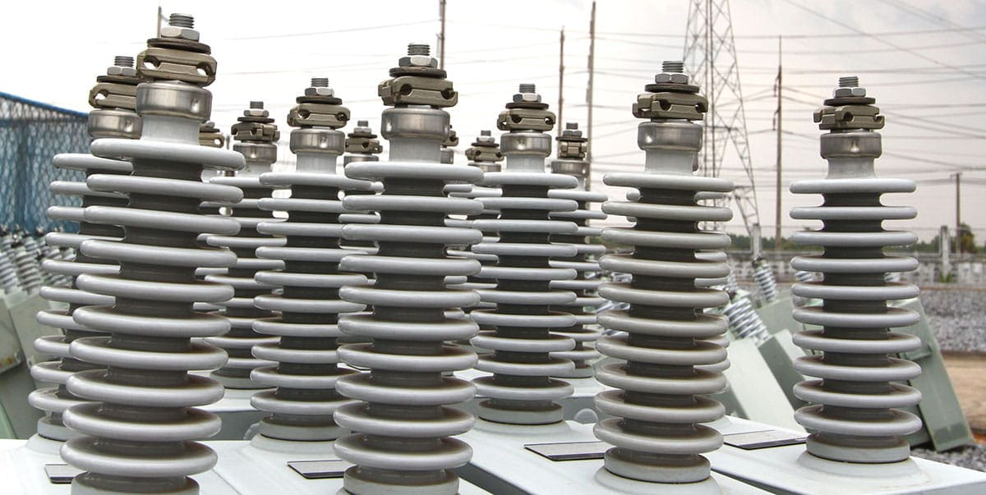
Capacitor Banks
Many industrial and commercial electrical systems have capacitors installed to offset the effect of low power factor. Most capacitors are designed to operate at a maximum of 110% of rated voltage and at 135% of their kVAR ratings. In a power system characterized by large voltage or current harmonics, these limitations are frequently exceeded, resulting in capacitor bank failures. Since capacitive reactance is inversely proportional to frequency, unfiltered harmonic currents in the power system find their way into capacitor banks, These banks act like a sink, attracting harmonic currents, thereby becoming overloaded.

Slide 22
Capacitor Banks
Capacitor Banks
A more serious condition, with potential for substantial damage, occurs as a result of harmonic resonance. Resonant conditions are created when the inductive and capacitive reactance become equal in an electrical system. Resonance in a power system may be classified as series or parallel resonance, depending on the configuration of the resonance circuit. Series resonance produces voltage amplification and parallel resonance causes current multiplication within an electrical system. In a harmonic rich environment, both types of resonance are present. During resonant conditions, if the amplitude of the offending frequency is large, considerable damage to capacitor banks would result. There is a high probability that other electrical equipment on the system would also be damaged.

Slide 23
What are and What Causes Harmonics?
In a normal alternating current power system, the current varies sinusoidally at a specific frequency, usually 50 or 60 hertz. When a linear load is connected to the system, it draws sinusoidal current at the same frequency as the voltage.
Harmonics are currents or voltages with frequencies that are integer multiples of fundamental power frequencies, 50 or 60 Hz (50Hz for European power and 60Hz for American power). For example, if fundamental power is 60Hz, then the 2nd harmonic is 120Hz and the 3rd is 180Hz, etc. In modern test equipment today harmonics can be measured up to the 63rd harmonic.

Slide 24
What are and What Causes Harmonics?
Harmonic distortion is caused by and are the by-products of modern electronic equipment such as adjustable speed drives, variable frequency drives, computerized mechanical controls, UPS, computers of all types, laser printers fax machines, battery chargers and any other equipment powered by switch mode power supply (SMPS) equipment, also referred to as non-linear loads.
This type of non-linear loads or SMPS equipment generates the very harmonics they are sensitive to and that originate right within your building or facility. SMPS equipment typically account for a large portion of the of the non-linear loads in most electrical distribution systems.
There are basically two types of non-linear loads: single phase and three phase. Single-phase non-linear loads are common in modern office buildings while three-phase nonlinear loads are widespread in factories and industrial plants.

Slide 25
What are and What Causes Harmonics?
In today’s environment, all computerized systems use SMPS that convert utility AC voltage to regulated low voltage DC for internal electronics. These non-linear power supplies draw current at high amplitude short pulses at a consistent rate.
These current pulses create significant distortion in the electrical current and voltage wave shape. This is referred to as a harmonic distortion and is measured in Total Harmonic Distortion (THD). The distortion travels back into the power source and can affect other equipment connected to the same source.

Slide 26
Why Do These Changes Matter?
Today’s loads look more like these

Slide 27
Why Do These Changes Matter?
Today’s loads look more like these

Slide 28
Why Do These Changes Matter?
Today’s loads look more like these

Slide 29
What Problems do Harmonics Create?
Large load currents in the neutral wires of a 3-phase system. Theoretically the neutral current can be up to the sum of all three phases therefore causing overheating of the neutral wires. Since only the phase wires are protected by circuit breakers or fuses, this can result in a potential fire hazard.
Over heating of standard electrical supply transformers which shortens the life of a transformer and will eventually destroy it. When a transformer fails, the cost of lost productivity during the emergency repair can far exceeds the replacement cost of the transformer itself.
High voltage distortion exceeding IEEE Standard 110-1992 " Recommended Practice for Powering and Grounding Sensitive Equipment" and Manufacture's equipment specifications which may void warrantees.
High current distortion will cause costly excessive line current draw on branch circuits also exceeding IEEE standards.
Poor power factor conditions that result in monthly utility penalty fees for major users ( manufactures, factories and industrial) with a poor factor less than 0.9.
Resonance that produce over current surges. (In comparison, this is the equivalent to continuous feedback through a PA System) This results in destroyed capacitors and their fuses and damaged surge suppressors which will cause an electrical system shut down.
False tripping of branch circuits

Slide 30
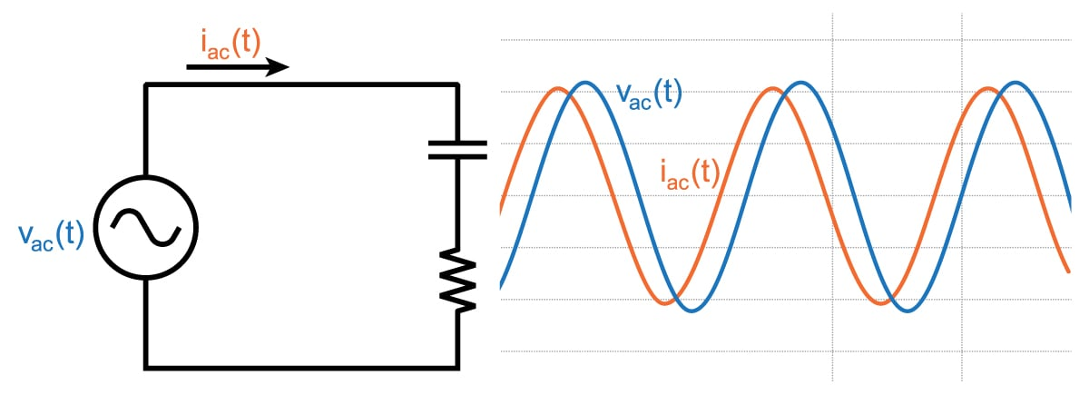
How do Harmonics Affect my site or facility ?
Above we identified the problems directly affecting your electrical distribution system. In turn, these problems affect your entire site or facility in a number of different ways.
Voltage distortion or voltage drop can cause the equipment connected to the branch circuit to draw more current to maintain the power rating (watts) of the unit. The bigger the current draw from the unit, the more it produces excess heat within the unit, not factored for by its original design. In turn, the excessive heat causes premature component level failure.

Slide 31
How do Harmonics Affect my site or facility ?
Additionally, you may experience computers locking up and other operational malfunctions that are unexplainable. Think of how many times you have experienced " no problem found" syndrome with your compute diagnostics.
The excessive heat produced can directly contribute to downtime. The excessive heat can also be directly related to increased energy costs required to maintain power ratings of a unit as well as maintaining appropriate environmental conditions required for operation.

Slide 32
Effects of Harmonics
It is easy to see how the power quality of a system might be compromised by the presence of harmonics.
Modern plant equipment and the associated controlling power electronics are more reliant than ever on good power quality for optimum operation.
Deviations from ideal power quality is acceptable. But even a small amount of interference can have a serious effect on the power system.

Slide 33
Effects of Harmonics
Some of the main risks linked to harmonics:
Overload of distribution networks due to the increase of rms currents.
Overload of neutral conductors – neutral current can exceed the phase currents.
Overload, vibration and premature aging of generators, transformers and motors as well as increased transformer noise.
Nuisance tripping of circuit breakers

Slide 34
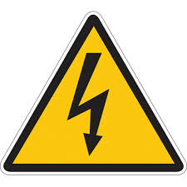
Effects of Harmonics
Distortion of the supply voltage that can disturb sensitive loads,
Disturbance in communication networks and telephone lines.
Malfunction of UPS systems and generator systems.
Metering problems
Computer malfunctions
Additionally, the life span of many devices are reduced by elevated operating temperatures.

Slide 35
Effects of Harmonics
Harmonic currents can cause problems for both the distribution system and the customer’s installation.
The effects and the solutions are very different and need to be addressed separately.
The measures that are appropriate for controlling the effects of harmonics within the installation may not necessarily reduce the distortion caused on the supply and vice versa.

Slide 36
Economic Impacts of Harmonics
Harmonics can damage customer equipment and parts of the distribution system.
Harmonics can cause premature aging of equipment – more frequent replacement costs.
Overload on the distribution network means higher equipment rating, increased subscribed power level for the industrial customer, and increased power losses.
Unexpected current distortion can lead to nuisance tripping and production interruptions for the customer.

Slide 37
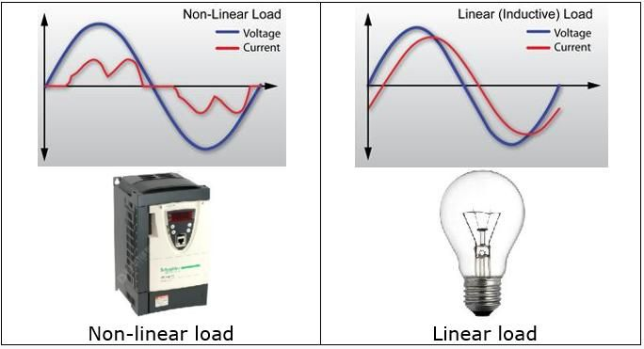
Why are Harmonics unknown or Untreated in the Electrical Distribution Systems?
First of all, the electrical distribution system of most sites or facilities were never designed to deal with an abundance of non-linear loads.
It's a problem that has only recently begun to be recognized in the building industry.
Within the last 20 years, the widespread use of computers and SMPS equipment is turning modern commercial and industrial facilities into high tech computer environments.
Even older buildings that are renovated are not retrofitted for modern harmonic treatment or cancelation.

Slide 38
Why are Harmonics unknown or Untreated in the Electrical Distribution Systems?
The end result is a building or facility unable to fully support today's technology and the high-tech problems that it brings along with it. Obviously, given the problems harmonics can cause, it is imperative today's electrical systems must account for non-linear electronic loads, not just linear electrical loads.
Unfortunately standing building codes and engineering designs do not treat the needs of today's technology.
With the advent of newer SMPS equipment, the harmonic problems will continue to get worse.
Which means higher electric bills, shorter equipment life and more downtime.

Slide 39
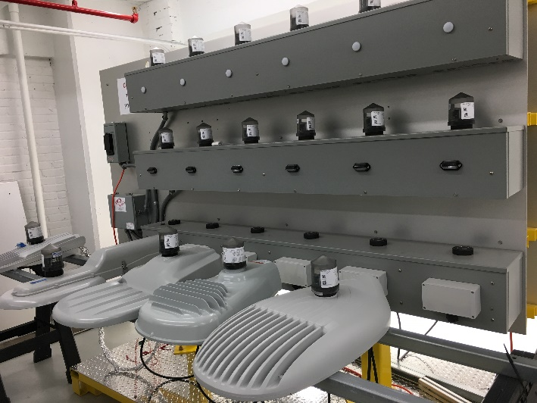
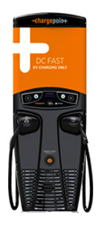
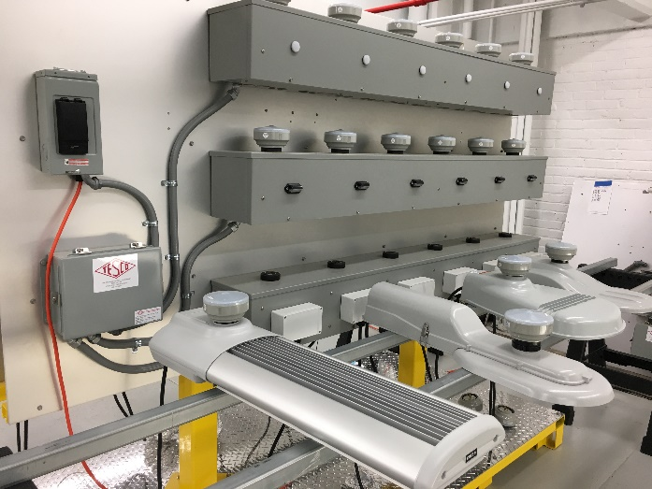
Then – Now – Tomorrow?

Slide 40
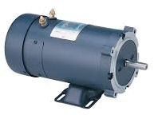
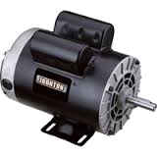
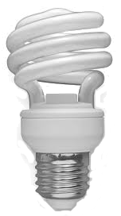
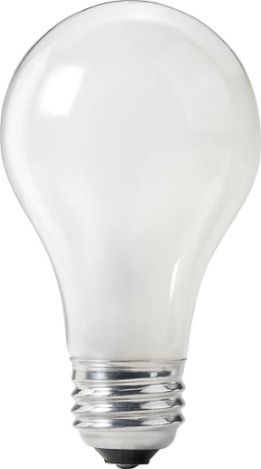
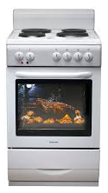
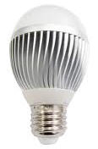
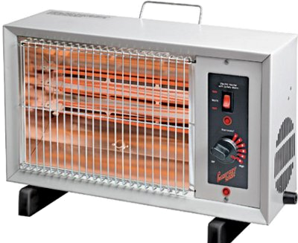
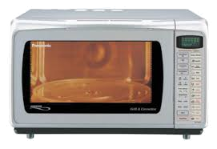
Then – Now – Tomorrow? Loads
YESTERDAY
TODAY

Slide 41
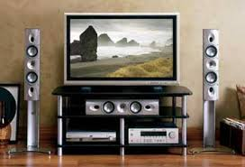
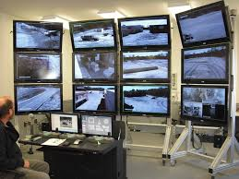
Then – Now – Tomorrow? Loads
TODAY

Slide 42
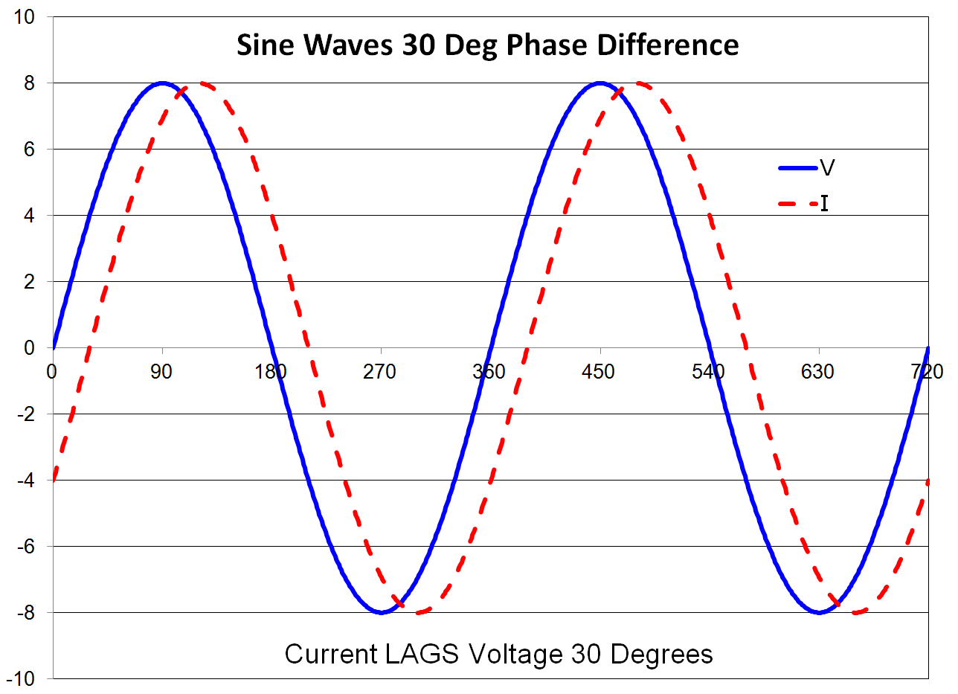
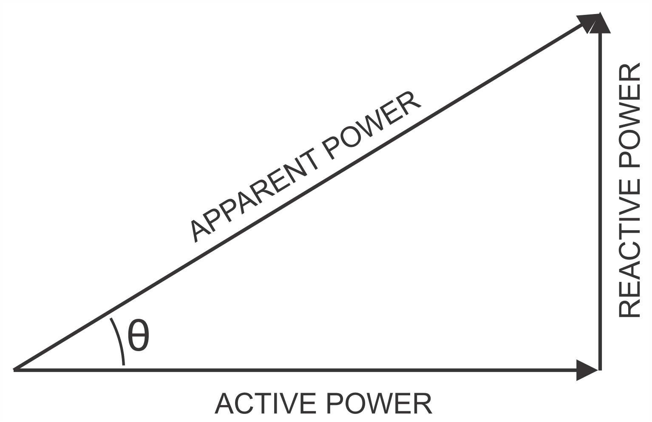
Why Do These Changes Matter?
Changes to our loads have changed the basic computations of metering.
When loads were linear the power triangle was all we needed to know

Slide 43
Standards of Change
New Revision of C12.20 just Published
Polyphase meters tested using polyphase
Recommended now, required 2020
Unbalanced load testing required
Full harmonic testing required
0.1% Accuracy Class added
Specific call out of Non-Blondel applications where C12.20 does not apply
Detailed requirements and specs for test outputs added

Slide 44
Harmonic Load Waveforms
ANSI C12.20 now addresses harmonic waveforms

Slide 45
Next Generation Standards
ANSI C12.46
Covers ALL waveform types
sinusoidal, harmonic, time varying
Defines the meter as everything under the cover
If there is auxiliary functions in the meter they must be fully operational during accuracy testing
If a option is added to a meter, it must be tested with the option running to remain qualified

Slide 46
Next Generation Standards
ANSI C12.46
View of accuracy changes
Currently changes with respect to reference
New approach is absolute error
Philosophy of C12.46 – When a meter is claimed to be of a specific accuracy class, for example , AC 0.2%, then it’s accuracy under all commonly occurring conditions should be within ±0.2% maximum error.

Slide 47
Then – Now – Tomorrow?- Meters
Westinghouse 1905
First Meters mid-1890s
Westinghouse 1905
2005
2006
2024
2035 ???

Slide 48
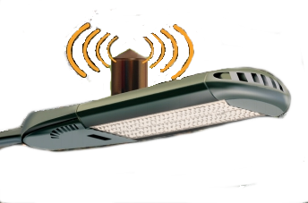
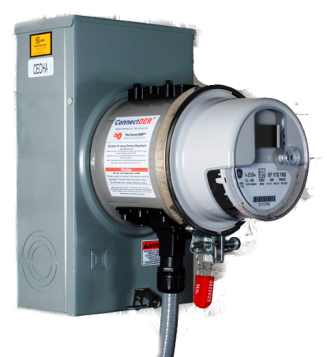
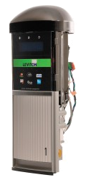
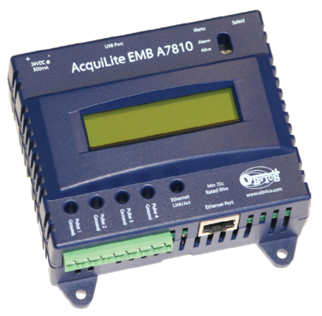
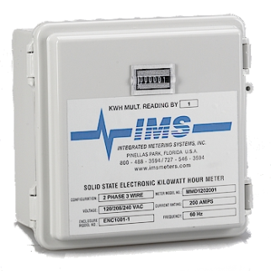
What Does the Future Hold
Over the next FEW years metering may have a whole new meaning
Do these look like meters to you?

Slide 49
Questions and Discussion
Tom Lawton
President
tom.lawton@tescometering.com
TESCO – The Eastern Specialty Company
Bristol, PA
215.228.0500
This presentation can also be found under Meter Conferences and Schools on the TESCO website: tescometering.com
ISO 9001:2015 Certified Quality Company
ISO 17025:2017 Accredited Laboratory

Slide 50
Tesco hospitality suite
We would like you to join us in the TESCO Hospitality Suite for networking and more discussions about metering. The discussion will not be exclusively metering……….but we love metering and that is the most common topic.
TESCO Hospitality Suite – Brighton Tower
Monday and Tuesday 8:00 PM – 10:00 PM

