Slide 1
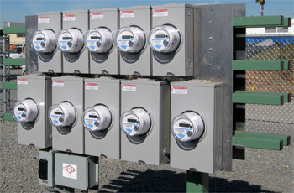
Intra-Grid Sensors and ATI for Distribution Transformers
Prepared by John Kretzschmar, SAMSCO
Spartan Armstrong Metering Supply Company
For the North Carolina Meter School
June 10, 2024 3:45PM
10/02/2012
Slide 1
Notes:
1

Slide 2
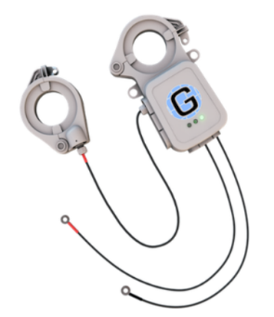
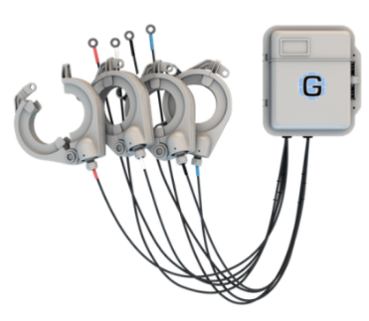
What is an Intra-Grid Sensor?
A sensor used to provide detailed information about conditions that exist between the distribution transformer and the meter.

Slide 3
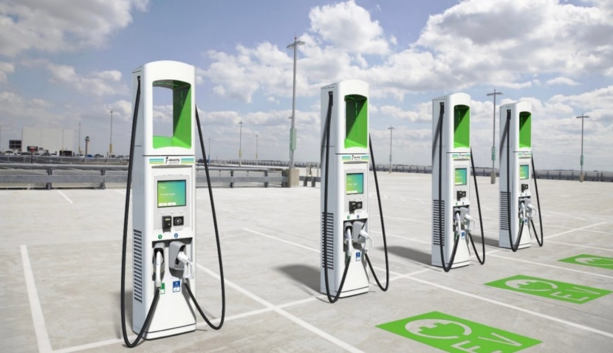
Why do we need Intra-Grid Sensors?
Grid-edge advancements and ongoing power theft present substantial unplanned loading burdens on what may now be undersized, older, and potentially failing transformers.

Slide 4
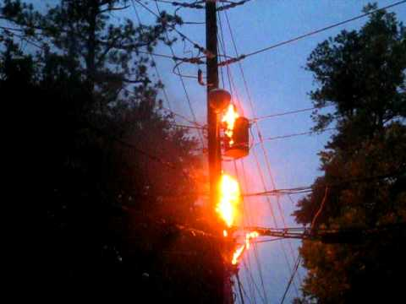
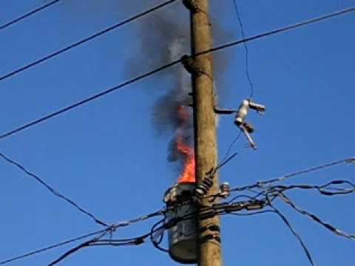
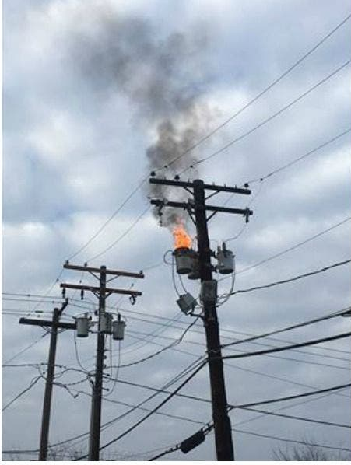
Why do we need Intra-Grid Sensors?
As a result, we can expect to see increasing power outages, increasing costs, and increasing risk of catastrophic damage.

Slide 5
Why do we need Intra-Grid Sensors?

Slide 6
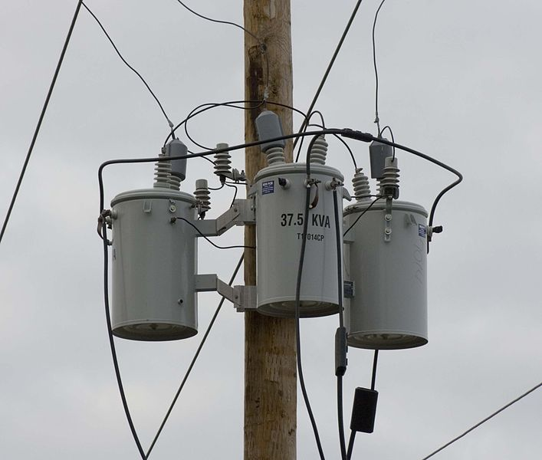
Aging Assets
According to the US Department of Energy, the average age of existing distribution grid transformer is presently in the range of around 32-36 years.
The average projected life span of transformers is typically 25 years so many transformers have already out lived their intended life span, yet we demand more performance, reliability, and various unintended service capabilities.

Slide 7
Aging Assets
Distribution Transformer Monitors (DTMs) proactively reveal over-burdened and failing transformer assets allowing utilities to effectively employ preventive maintenance efforts.
This allows utilities to transition away from the costly and disruptive, reactive management practices and become proactive.

Slide 8
Distributed Energy Resources (DER)
Through solar and wind renewables, we are introducing Reverse Energy onto the distribution grids.
The millions of existing transformers were not designed to handle this impact.
While renewables are beneficial, Reverse Energy can produce unstable, and unsafe grid conditions.

Slide 9
Distributed Energy Resources (DER)
Distribution Transformer Monitors accurately measure and report Reverse Energy, and its impacts on the grid.
Utilities without AMI, or “smart meters” need intra-grid sensors to understand the Reverse Energy impacts inside their grid.
Utilities with AMI need Distribution Transformer Monitors to understand Reverse Energy impacts and the impacts of EV charging on transformers.

Slide 10
Distributed Energy Resources (DER)
The reality is that AMI generated Reverse Energy data does not accurately indicate impacts on transformers or the resulting grid impacts.
AMI data is typically not accurately aligned to the upstream transformers due to pervasive GIS mapping errors, thus causing aggregated AMI data to be unreliable.

Slide 11
Reverse Energy
Reverse Energy creates new instances of unknown and unplanned voltage fluctuations/conditions. This contributes to potentially unstable and unsafe grid conditions.
Safety for the public at-large is important, but so is the safety of utility linemen who are increasingly at risk due to the unanticipated voltage levels being created by Distributed Energy Resources (DER).

Slide 12
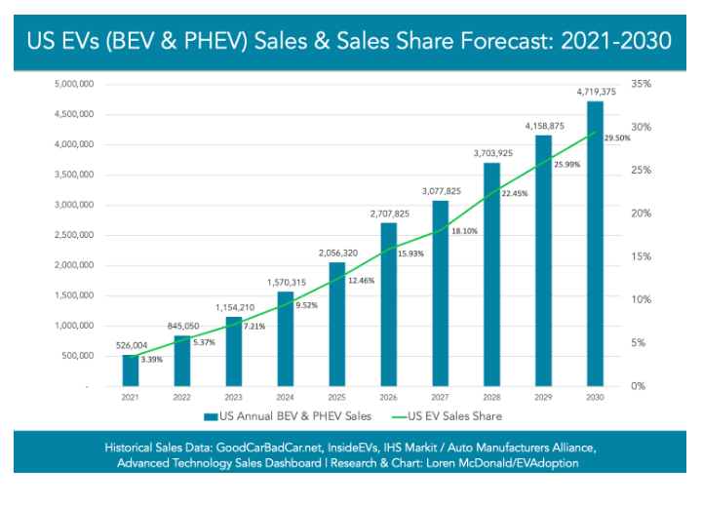
Electric Vehicles
To date, over 5 million EV’s have been sold in the US.
By 2030, annual sales are expected to reach 4.7 million EV’s.

Slide 13
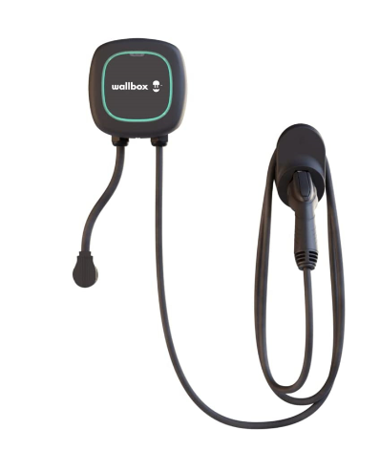
Electric Vehicles
Electric Vehicle charging stations create a new, unplanned load on transformers. Each charging station has the capability of adding up to one additional homes’ worth of power load on a transformer.
This unplanned loading impacts transformers and may exceed a transformer’s designed capacity causing major problems.

Slide 14
Illegal Marijuana Production
Illegal marijuana grow houses commonly steal significant levels of power from the grid.
Theft occurs simply by tapping power lines in front of the meters.
No endpoint meter (including AMI smart meters) can effectively detect pre-meter power theft.
This means thieves steal as much power as they want, and they steal it indefinitely without fear of detection.

Slide 15
Legalized Marijuana
When jurisdictions legalize marijuana, significant unplanned loading hits the respective transformers and the grid.
Legalization permits, in some ways encourages residents to grow marijuana using power-intense hydroponic resources. This unanticipated reality then causes additional strain on the existing transformers and the grid.

Slide 16
Power Theft
Despite significant Smart Meter penetration, power theft is a perpetual problem. Industry experts suggest that U.S. power theft is in excess of $6 Billion per year.
The locations of power theft is typically a mystery. If the affected overburdened transformers finally fail, utility operators may then learn where the theft is occurring.

Slide 17
Power Theft
Smart Meters claim to lessen power theft but the reality is that power theft has increased.
Thieves have discovered that since utility personnel are no longer coming onto their property, they can tap power lines ahead of the meter and the diversion will go undetected indefinitely.

Slide 18
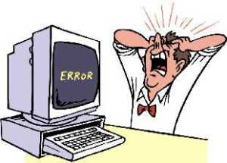
Meter Programming Issues
An incorrectly programmed meter can result in significant errors.
For example: a meter programmed for a 200:5 transformer but has a 400:5 transformer will significantly misreport usage.

Slide 19
Line Loss
According to US Energy Information Administration reports, nearly 200 Billion unmetered kWh’s are ‘leaked’ from US distribution grids annually.
This loss represents nearly $21 Billion that was unmetered but was amortized as electricity cost across US rate payer’s bills.
All of this while our government, utilities, and rate payers have invested billions of dollars in ‘smart meters’, and other energy efficiency efforts.

Slide 20
The Next Step in Grid Modernization
Advanced Transformer Infrastructure (ATI)
Reliability Improvements
DER & EV Integration
Fire Mitigation
Outage Notification
Voltage Optimization

Slide 21
Advanced Transformer Infrastructure
ATI Head-End

Slide 22
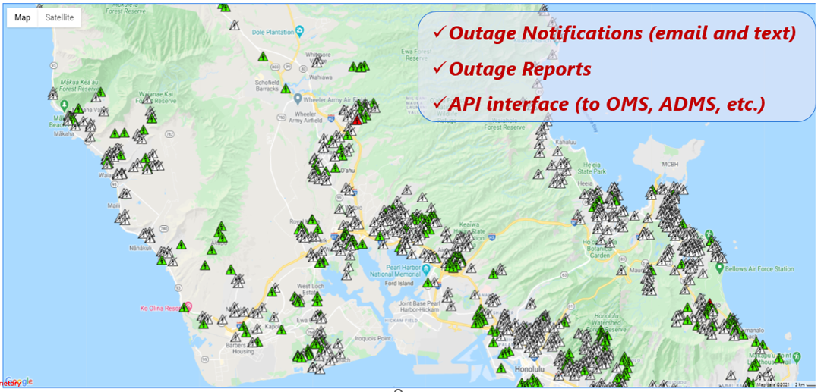
Advanced Transformer Infrastructure
:
Outage Notification

Slide 23
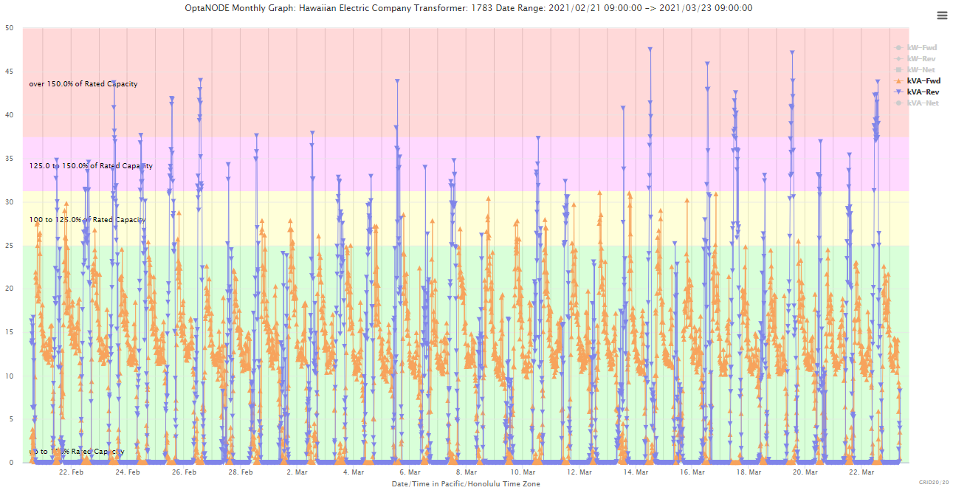
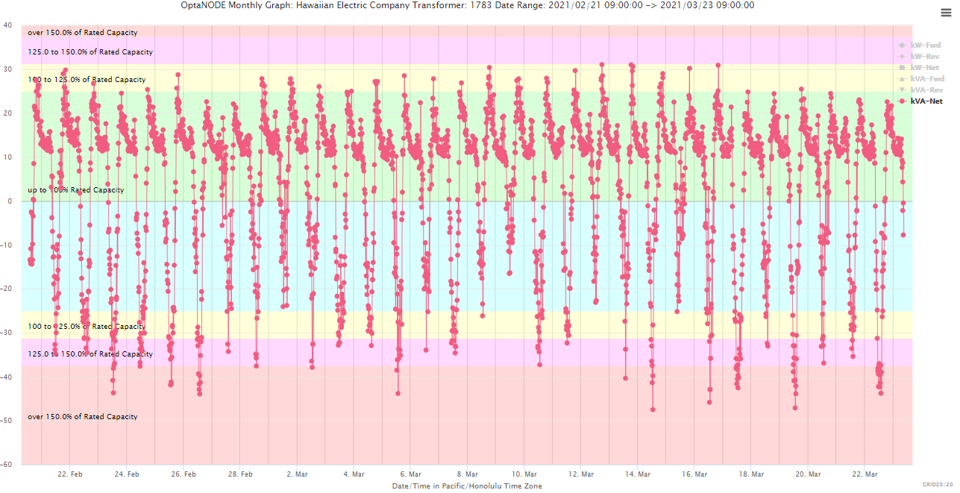
Advanced Transformer Infrastructure
Forward & Reverse Energy Impacts
The combination of excessive Delivered & Received Energy can cause Transformer Overload and Premature Failure (i.e., accelerated End of Life & potential Asset Fires)
ATI Systems can also deliver:
Transformer Overload Awareness = Preventive Intervention
Asset Fires/Wildfires Prevention = Reduces Liability Risk
Improved Lineman & Public Safety = Reduces Liability Risk

Slide 24
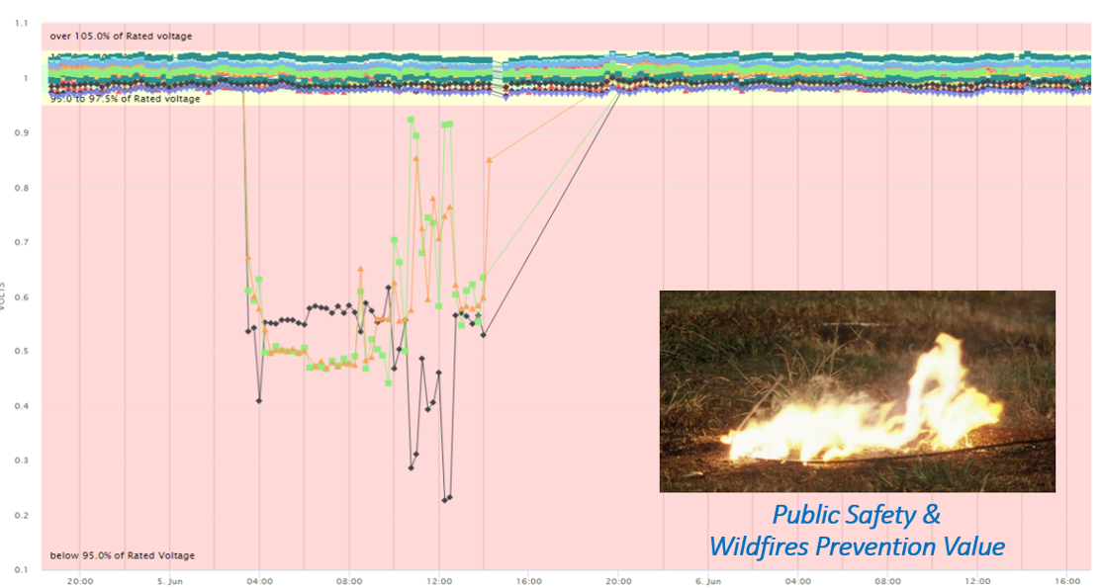
Advanced Transformer Infrastructure

Slide 25
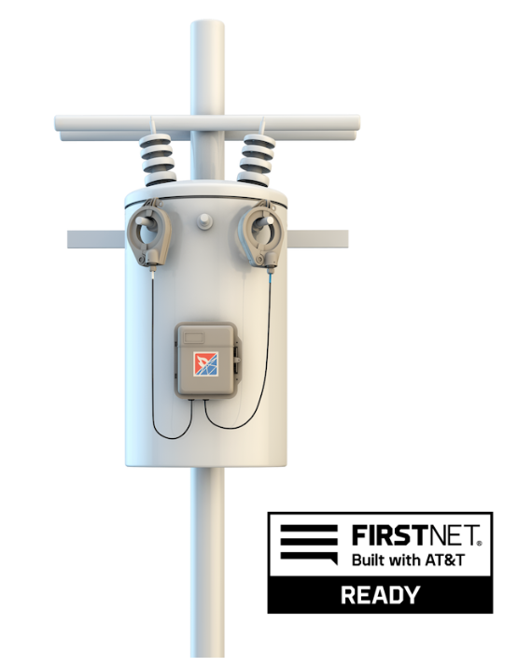
Advanced Transformer Infrastructure

Slide 26
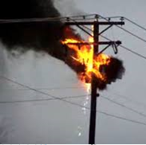
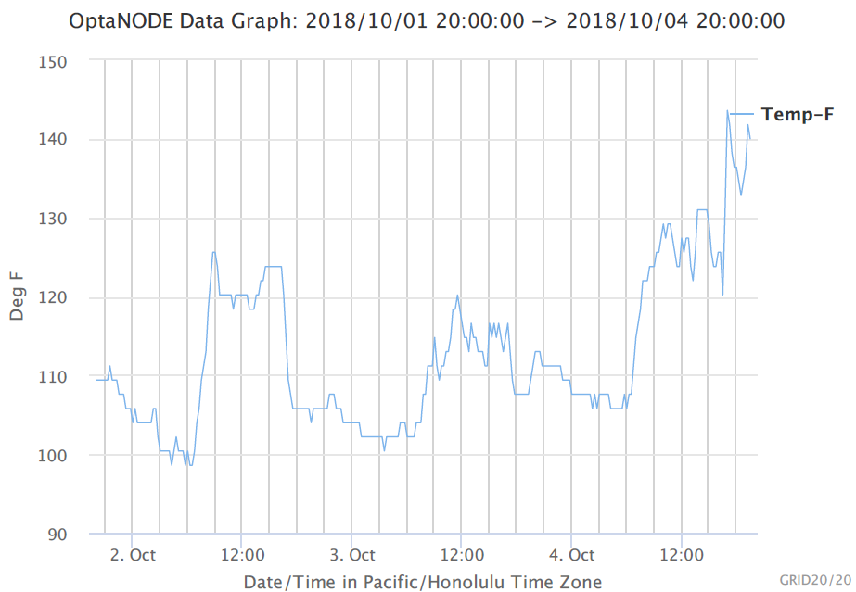
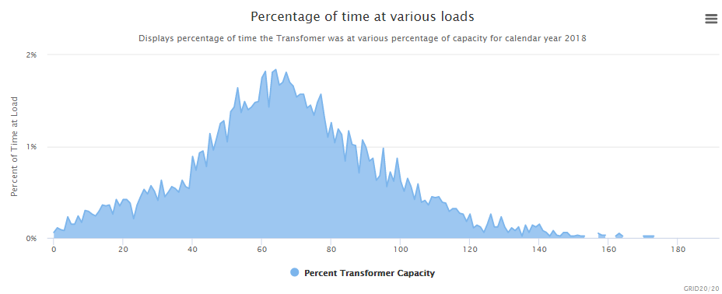
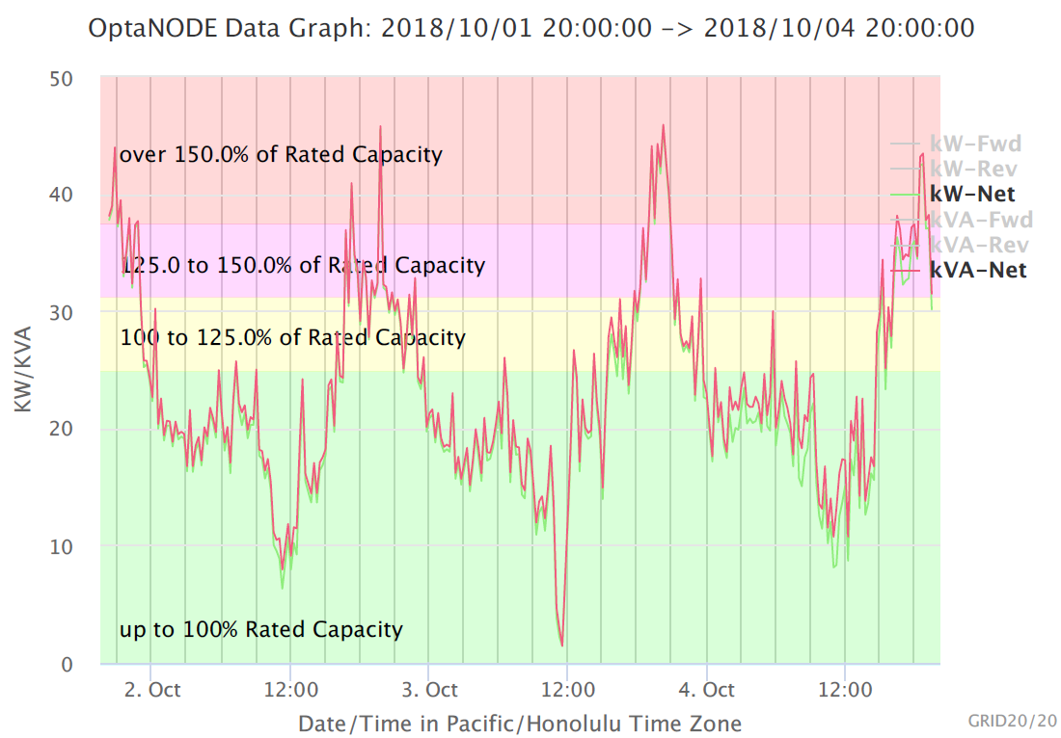
Advanced Transformer Infrastructure

Slide 27
Advanced Transformer Infrastructure
*Achieve Reliability Improvement
*Provide Outage Notifications to Accelerate Restoration
*Reveal Unplanned Loading/Overloading
*Facilitate Improved Fire/Wildfire Mitigation
*Identify Downed Conductor Events
*Proactively Identify Failing Assets
*Reveal DER-Induced Voltage Fluctuations
*Reveal & Document Reverse Energy Entering the Grid
*Facilitate Conservation Voltage Reduction
*Identify Power Theft, Meter Inaccuracies & Bad Multipliers
*Facilitate Safe EV Charging Station & DER Adoption
*Identify Improper Tap Settings

Slide 28
Advanced Transformer Infrastructure
*Identify Harmful Phase Imbalances
*Identify Energy Inefficiencies
*Assist with Clean Energy/Battery Storage Planning
*Reveal GIS Mapping Errors
*Provide Automated Alerts = Hands Free Remote Grid Monitoring
*Support API Calls
*Enhance Microgrids Monitoring
*Facilitate Clean Energy Mandates = Reduce GHG Emissions
*Reduce Corporate Liability Risk

Slide 29
Questions?
John Kretzschmar
SAMSCO
Spartan Armstrong Metering Supply Company
Boiling Springs, SC 29316
john@samscometering.com
864.590.2883

