Slide 1

Case Study—
Switching between the Grid and Back Up Power
Prepared by Tom Lawton, TESCO
TESCO Metering
North Carolina Meter School
Emerging Technologies
Tuesday, June 11, 2024
1:45 PM

Slide 2

Job One--Protecting property
  The Issue:
  Wildfires within many service territories have caused utilities to be proactive and shut down power during threat of wildfire via the Meter’s Disconnect Switch

Slide 3
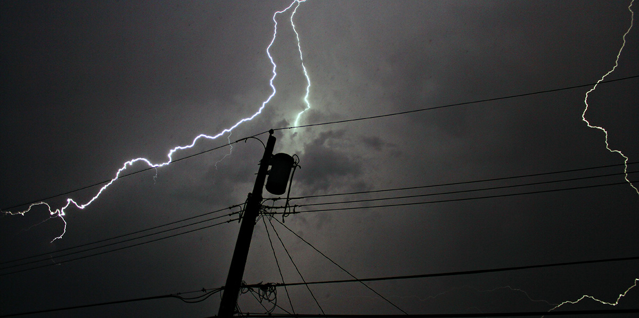
Job One--Protecting property
  The Issue:
  What is needed is a safe way of switching the power supply source from the utility grid to a backup generator in the event of a power outage.

Slide 4

PG&E’s Dilemma
PG&E’s customer’s and The California Public Utility Commission asked/demanded that PG&E provide help to prepare for the next outage(s).
4

Slide 5
Backup Power Transfer Meter (BPTM)
Problem:
“We know that using extension cords with a portable generator is not the most practical solution, and that the cost of purchasing and installing a transfer switch can be prohibitive—in the thousands of dollars,” Vincent Davis, PG&E Vice President of Customer Operations & Enablement
Approach:
Leverage BPTM technology to help customers maximize connectivity of their backup power source to their home through their electric meter and electrical panel.

Slide 6

Job One--Protecting property
  Design parameters given to TESCO:
  A device that has built-in overload protection, avoids the use of dangerous extension cords and is designed to eliminate dangerous backfeed, lost phases, high voltage surges, and intermittent re-connections, using PGE’s existing electric meter with a disconnect (in this case L+G meters).

Slide 7

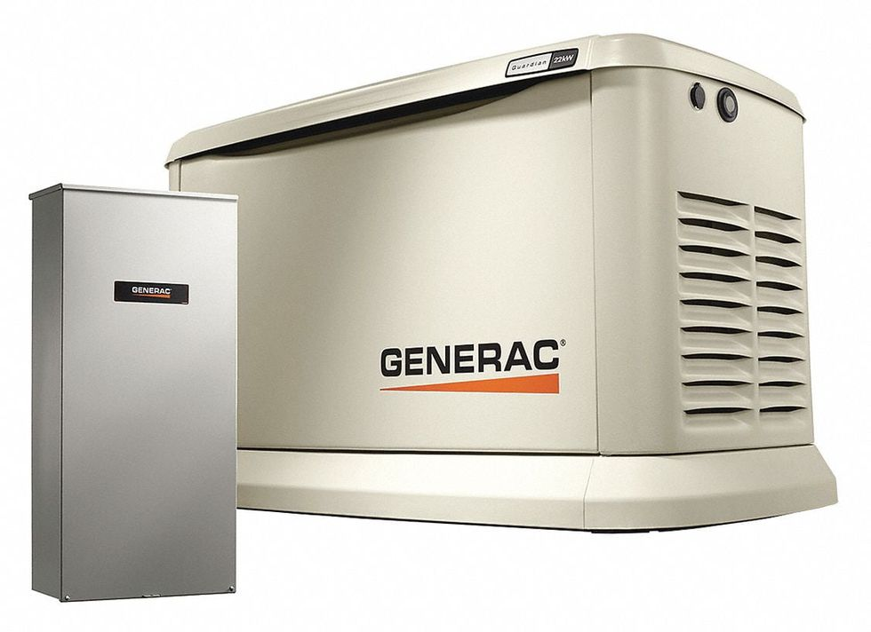
They do
There are several commercial products out on the market for safely switching between the grid and back up power.

Slide 8
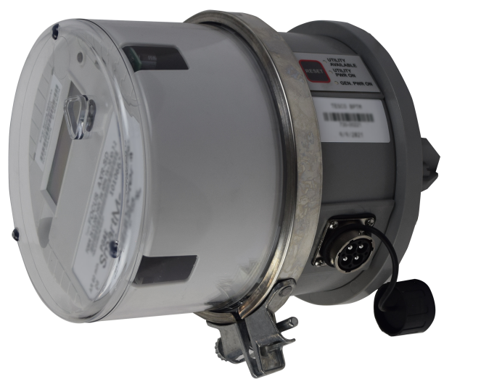
Utility owned vs. Third Party
These are excellent devices, typically UL listed and contain a disconnect device in them.
  The issue here is not that they do not work or that they are unsafe. The issue is that there is now a third party between the Utility’s meter and the customer’s socket box.
  The interface between the meter and the socket box is the most contentious interface between the utility and the rate payer. Many utilities do not want a third part between them and the socket.
PG&E is extremely litigation conscious. They would not accept a third party between them and the customer. Too many potential lawsuits if a house is lost in a wildfire and the generator may or may not have been correctly activated and may or may not have saved all or part of the home. PG&E requested a device that is connected to the meter, is provided as a metering assembly by the utility and uses the meter’s internal disconnect switch to switch between the grid and back-up power.

Slide 9

Our case study focuses on the Utility provided solution
The Backup Power Transfer Meter (BPTM) is designed to automatically switch over to generator power if there is a loss of utility power and a generator is properly connected and started. In addition, the BPTM will automatically switch back to the utility power once it has been restored.

Slide 10
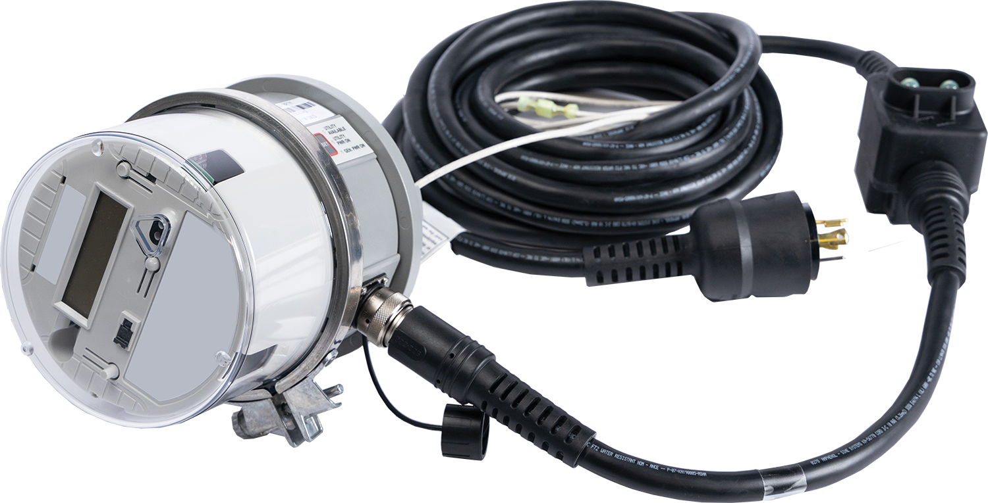
Backup Power Transfer Meter
  Special Features:
Detects and switches to generator power when utility power is off and detects and switches back to utility power when it becomes available.
Allows you to conveniently select which loads in your home need to be powered during an outage using your electrical panel.
LED light indicator to show generator or utility power availability.

Slide 11
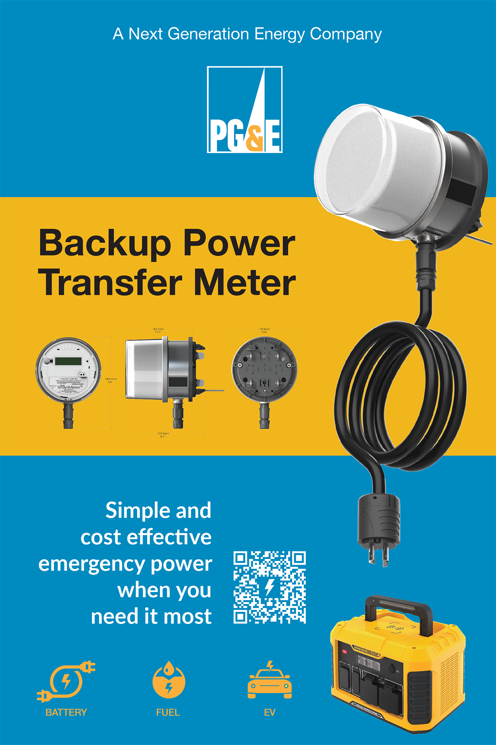
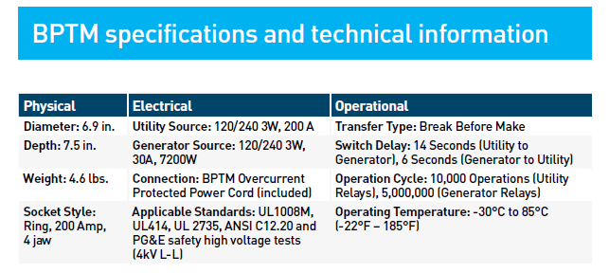

Backup Power Transfer Meter by PG&E and TESCO
Safety Ease of Use Versatile Smart Switching

Slide 12
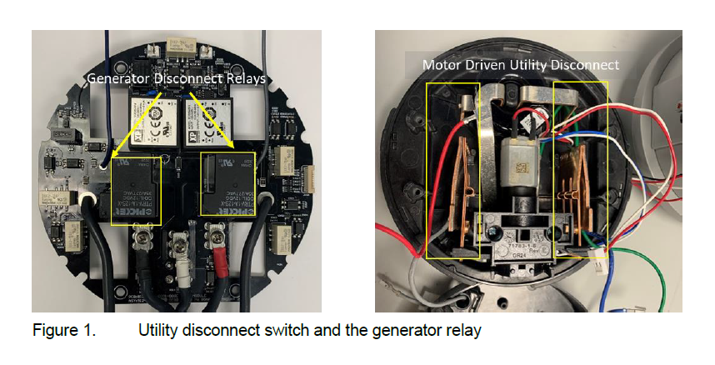
Intelligent Switching Architecture

Slide 13
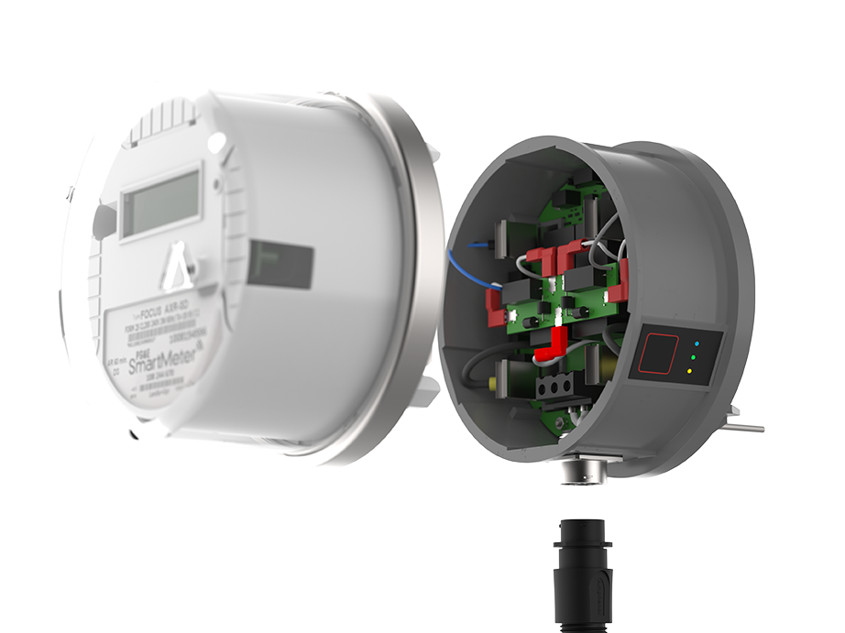
Utility Grade Build and Safety Features
The BPTM offers Utilities the following features:
High Voltage Surge Protection
Back feed detection and disconnect
Lost Phase correction
Current Overload protection
Intermittent Re-connection protection
Eliminates Dangerous extension cords

Slide 14
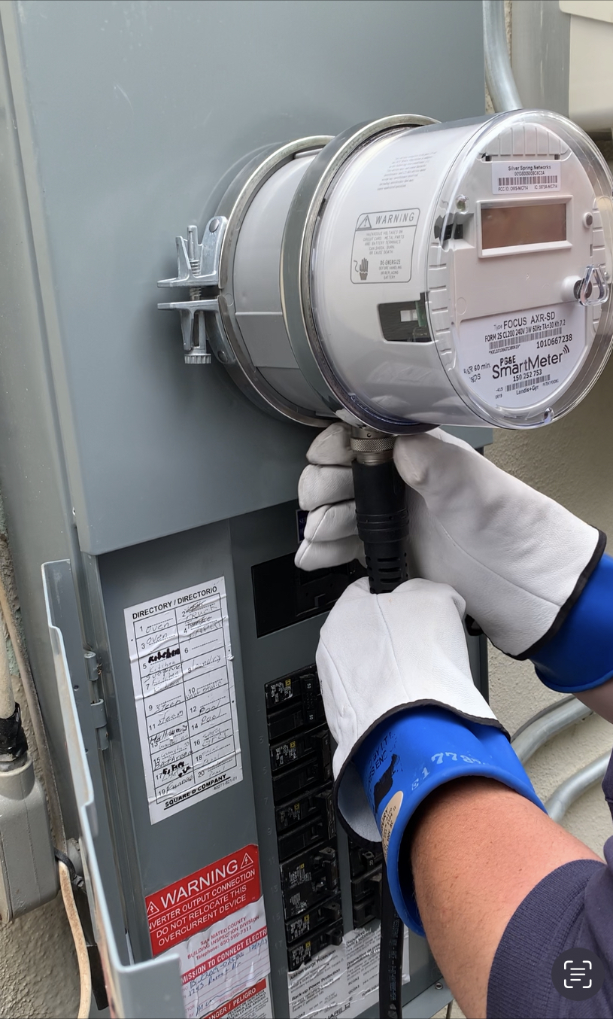
Customer Installations
Typical Install takes 45 mins
Panel inspection
Meter removal
BPTM Install
Customer Training (if available)

Slide 15
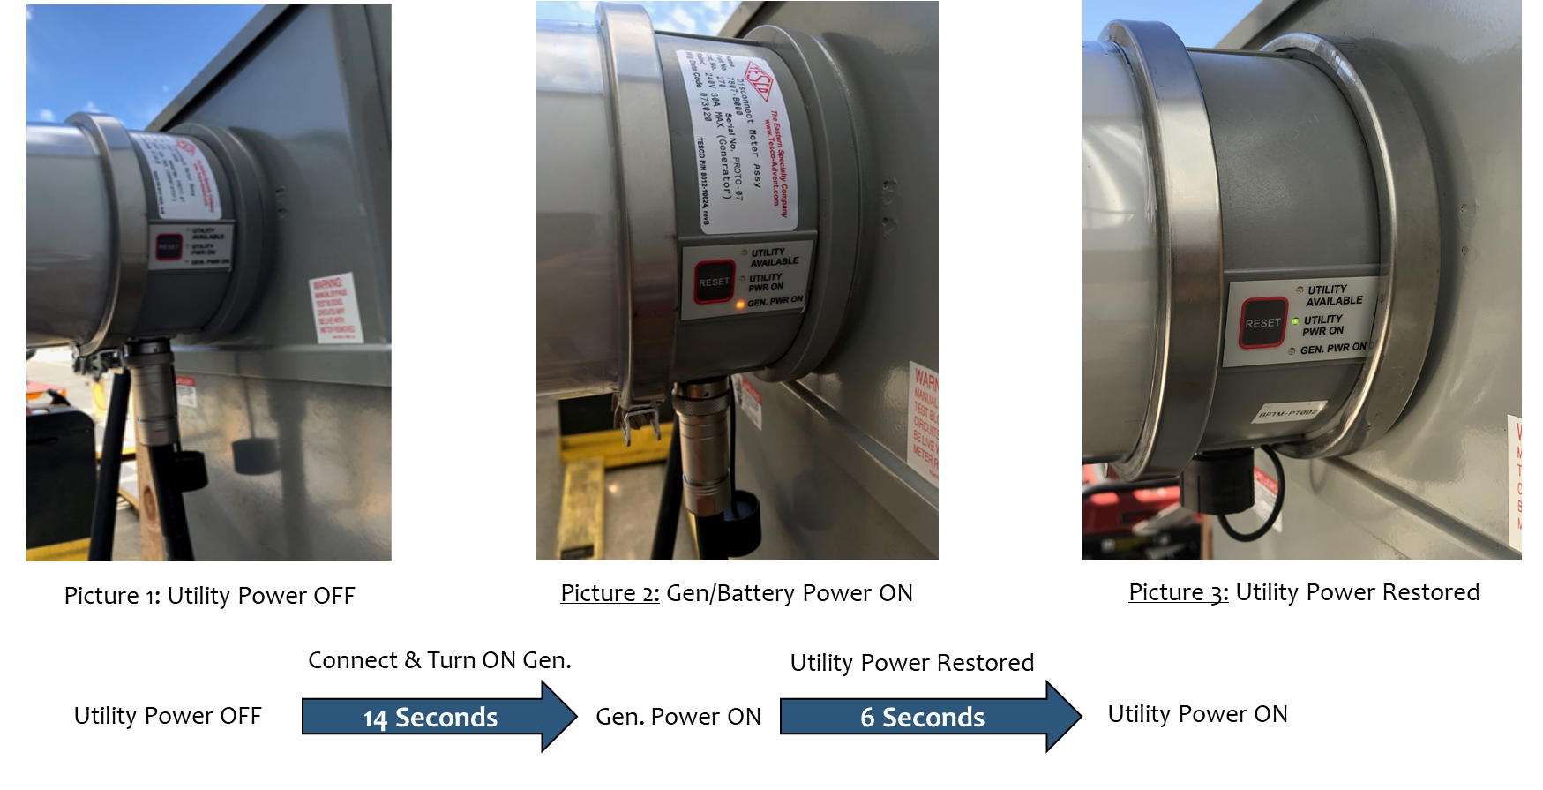
Automatic - Intelligent Transfer Switching

Slide 16

No Overloads
Overloads are mitigated through the overcurrent-protected cable that comes with the BPTM. If you’ve turned on too many circuits for your generator to handle, the BPTM cable’s circuit breakers will halt damage from happening to your generator. These circuit breakers are UL rated and are pushbutton resettable. No special tooling or training is required to reset them. Each 120V line is protected separately.

Slide 17
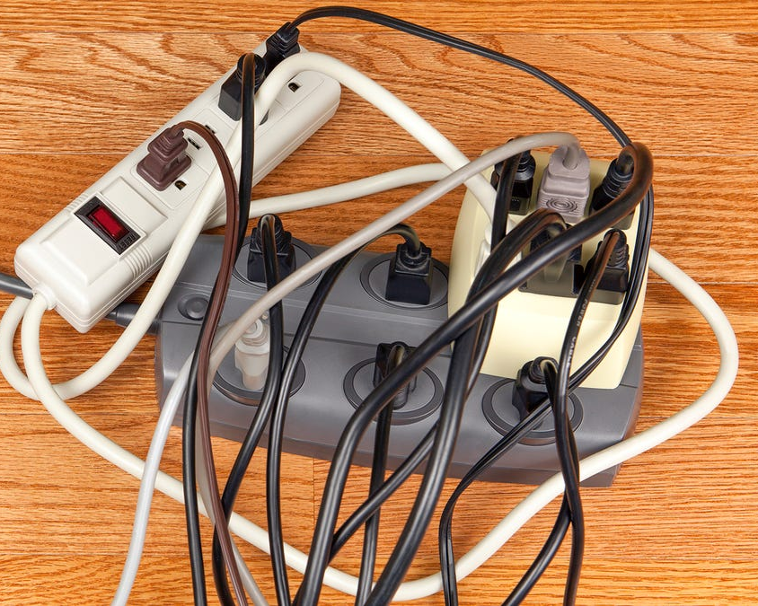
No Extension Cords
With a BPTM, you eliminate the use of hazardous extension cords. Typical extension cords are not made of the appropriate gauge wire for use in this application. This can lead to an overloaded extension cord that can overheat and cause a fire. Inadequate extension cords can also lead to a loss in voltage that could damage expensive appliances.
Appliances such as sump pumps, well pumps, furnaces, ranges, and hot water heaters cannot be connected via an extension cord to a portable generator because they are hard-wired to the circuit breaker panel. BPTM supplies the power to your house through the main circuit breaker panel so that each circuit remains individually protected.

Slide 18
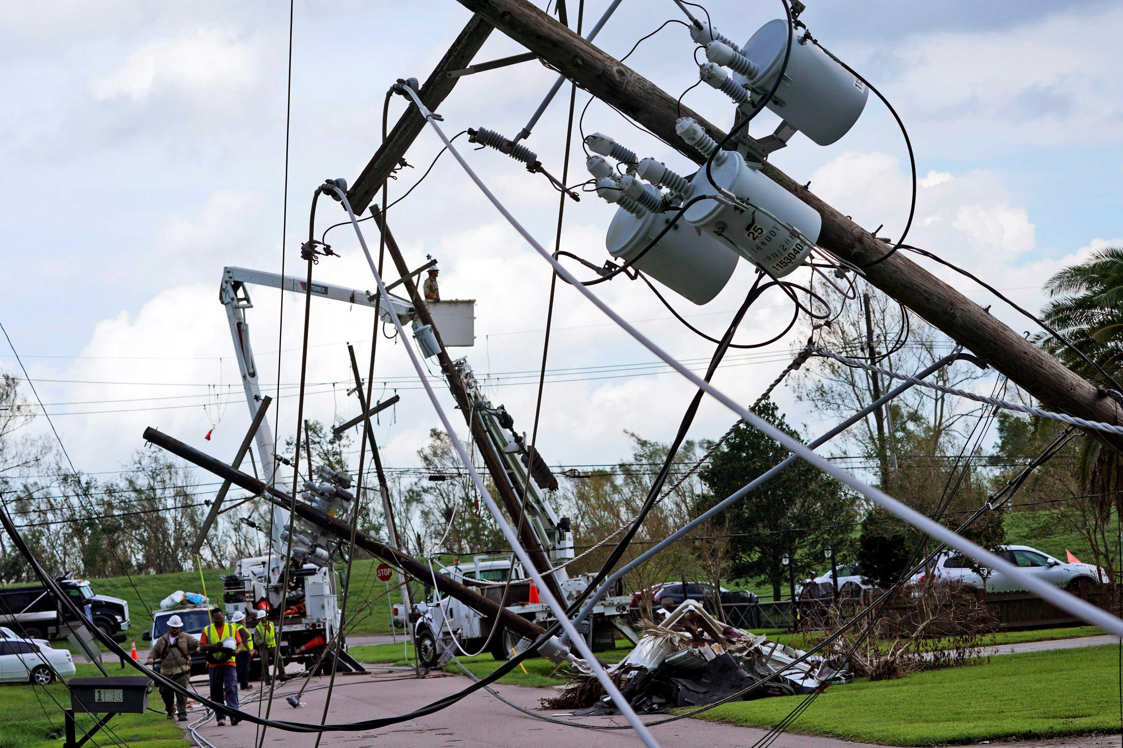
Protection Against Lost Phases
If an outage is caused by a storm or other natural phenomena, the possibility exists for a lost phase, due to a downed power line or malfunctioning pole transformer. BPTM constantly analyzes the condition of both lines entering from the utility service and the generator service to ensure that they are not connected to the circuit breaker panel if only one of the two lines is functioning. This adds a second layer of protection to the homeowner during outages.

Slide 19
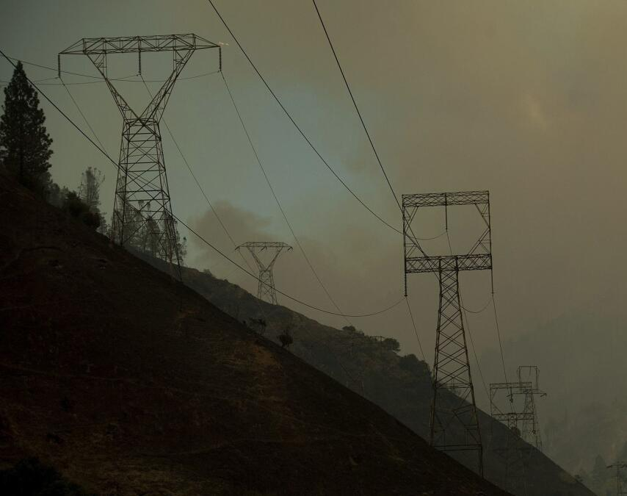
Protection Against
Intermittent re-connections
If an outage is caused by a storm or even high winds on the utility power lines, the possibility exists for utility service to be intermittently re-connected before the service is completely able to provide consistent power. The BPTM will ensure that the switchover between the generator source and the utility source does not happen until the utility source has been connected and at nominal voltage for a number of cycles. This will keep the homeowner’s appliances and electronics from being exposed to potentially damaging surges.

Slide 20
Backup Power Transfer Meter
Operation of the BPTM
When there is a power outage, turn off all the circuits on the main breaker panel in the house.
If you have solar panels (PV system), make sure that the disconnect between the inverter and the circuit breaker panel is open (OFF).
Start your generator. Follow all safety guidelines supplied with the generator.
The BPTM will automatically disconnect the utility lines and connect the generator lines to the house’s main circuit breaker panel in about 14 seconds.
Turn on the appropriate circuits (that can be serviced by the generator) on the main breaker panel.
When utility power is restored, the BPTM will first disconnect the generator power for about 6 seconds, then connect the utility power back to the main circuit breaker panel. You will notice a slight flickering of the lights when this happens.
Once the BPTM has connected the utility power back to the house, the generator can be stopped.

Slide 21

Higher Amperage Requirements
What about higher amperage requirements?
  BPTM units have the capacity to handle generators with a much higher amperage rating as well as the ability to connect solar panels and possibly other sources to power a residence or small business when utility power is not available.

Slide 22

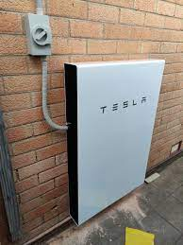


Additional Power Sources
Additional Power Sources would include:
Solar Panel Inverters
Battery Walls
Generators up to 200 Amps
Electric Vehicles

Slide 23

Customer Outreach
Targeted email campaigns
50,000 + customer email campaign
  High Fire Threat
  Medical Baseline
  Circuit w/ 5> EPSS events
Value Added Services for Generator rebates customers.
Date | # Delivered | Unique Open Rates | Unique Click Rates
Feb 17 | 819 | 64.35% | 23.20%
Feb 22 (DNO) | 297 | 22.22% | 7.40%
Jun 3-13 | 3,056 | 47.30% | 6.97%
Aug 19 - Sep 23 | 49,741 | 50.34% | 5.10%

Slide 24

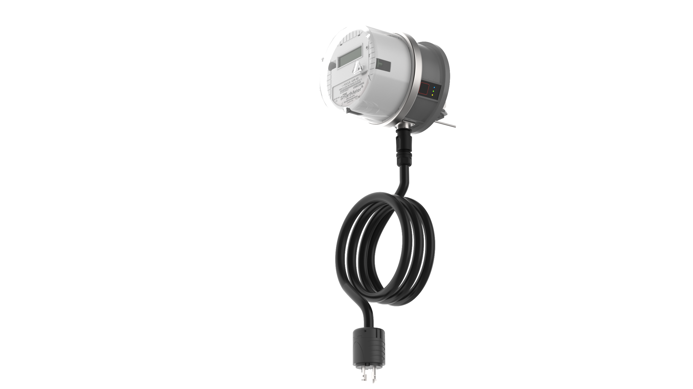
Customers Want F-150 to Home
When a storm or temporary power outage occurs, PG&E has developed a breakthrough solution enabling our customers
a safe, easy and affordable
way to power
their homes.
* Requires Ford Pro-Power 7.2KW package with 240 V / 30 amp outlet

Slide 25

The Future: Next Generation Meter
BPTM PCB
Disconnect Switch
Backup Power Connector Port
NGM HV board
NGM Core modular meter

Slide 26
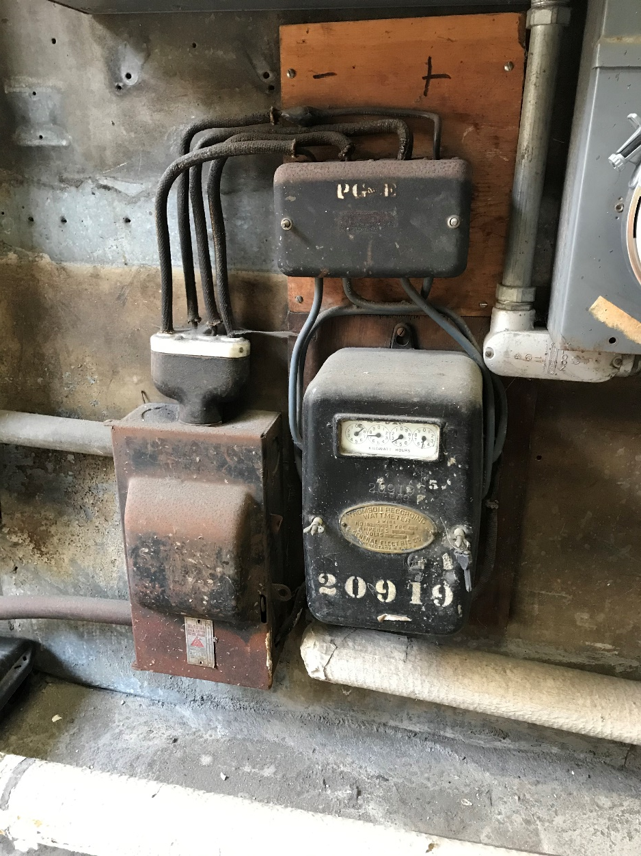
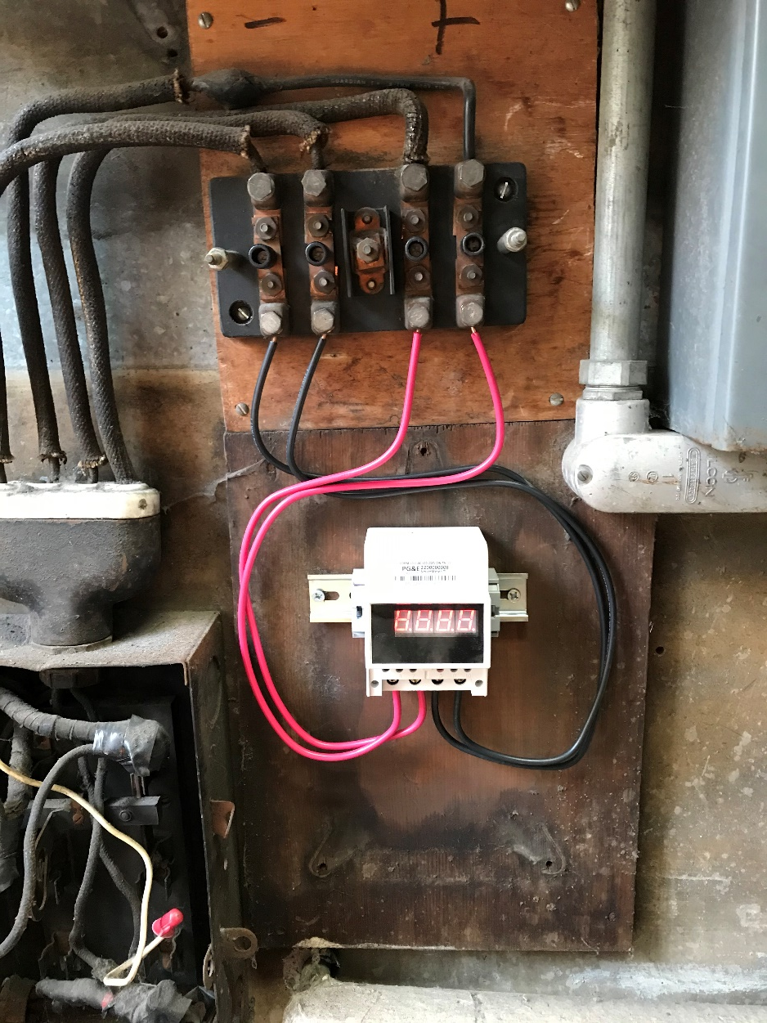
The Future: DC Meter Loads
Legacy
Current Metering
Future Vision

Slide 27

Summary
This solution gave PG&E a Utility biased disconnect/reconnect solution using the meter’s disconnect switch
This solution is owned by the Utility and precludes a third party from getting between the meter and the socket. This is the key differentiator. Many utilities have no issue with a third party in this space. Dan gave a great presentations on robust and reliable devices that fill this niche. This case study takes the alternate road.
This solution plans for the future and the new types of loads and devices that create a need to switch the service on and off the grid, using a utility biased solution.

Slide 28

Questions and Discussion
Tom Lawton
President
tom.lawton@tescometering.com
TESCO Metering Bristol, PA
215.228.0500
This presentation can also be found under Meter Conferences and Schools on the TESCO website: tescometering.com
ISO 9001:2015 Certified Quality Company
ISO 17025:2017 Accredited Laboratory

Slide 29


Tesco hospitality suite
We would like you to join us in the TESCO Hospitality Suite for networking and more discussions about metering. The discussion will not be exclusively metering……….but we love metering and that is the most common topic.
TESCO Hospitality Suite – Brighton Tower
Tuesday 8:00 PM – 10:00 PM

