Slide 1
Metering, Operations and Utilities: 2024 and Beyond
Prepared by Tom Lawton, TESCO
TESCO Metering
North Carolina Meter School
General Session
Monday, June 10, 2024
11:00 AM
Notes:
1

Slide 2
Topics to Cover as We Look to the Future
How Metering Has Changed from the 1870’s to the 2010’s
Metering Today, the status of our Advanced Metering Infrastructure, and the need for smart meters in a smart grid
Meter Services role in the utility of the future
Big Data and Rolling Trucks
Meters – the shape of the future?
Notes:
Get definitions for each buzzword in bullet two

Slide 3
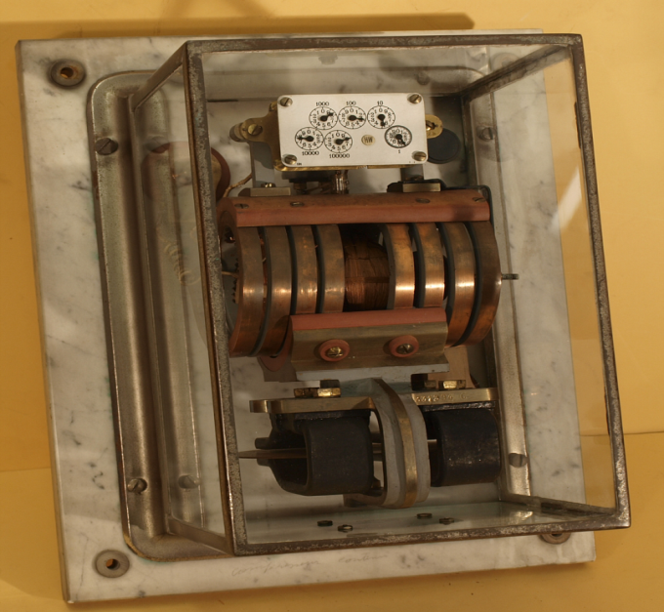
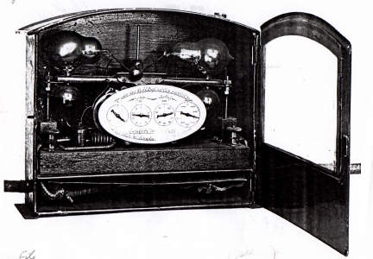
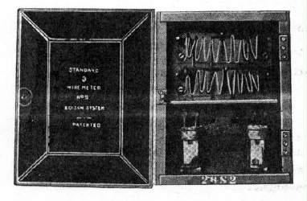
1870’s to 1900
Electric Metering is Invented
After a few interesting “false starts” several inventors and firms developed and began producing induction meters that are still recognizable to us today
Four of the five present meter manufacturer’s were producing meters:
Sangamo (Itron)
GE (Aclara)
Westinghouse (Honeywell)
Duncan (L+G)

Slide 4
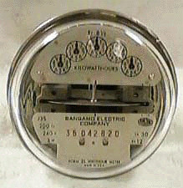
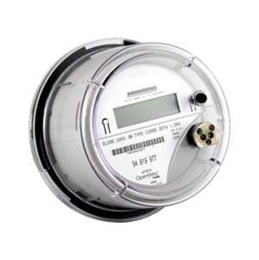
1900 to 2000
Not much changed – we use an induction meter for most of the century and only toward the very end of the century start using electronic meters.
Meters are standardized in the first half of the century
NC Meter School begins 1923 – they had a bell
Socket base meters take over for A-base meters in the 1950’s
Electronic meters are introduced as early as the mid 1970’s but in volume only in the mid 1990’s
Communications begins to be integrated into higher end metering in the 1980’s and 1990’s
Same big four meter manufacturers as we have at the turn of the last century

Slide 5
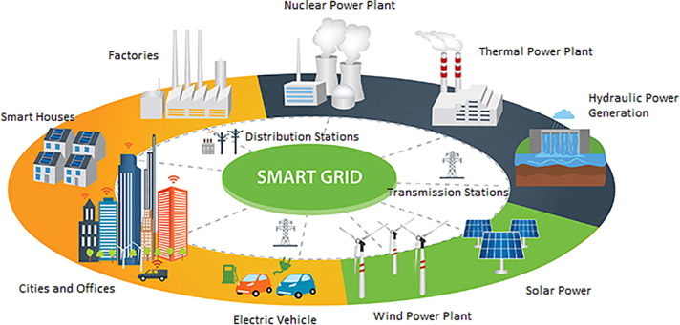
2000 to Present
The last electromechanical meters are produced. All new meters produced in North America are electronic
The concept of a Smart Grid is introduced. Like our metering infrastructure the grid had not changed much in design since the inception of the grid more than a century ago
The “brains” of a Smart Grid is an Advanced Metering Infrastructure (AMI)
The heart of this Infrastructure is a “Smart” meter as the meter becomes a two-way communication device with more features built in than just energy measurement.
Notes:
Put in history by every decade starting 1870’s

Slide 6
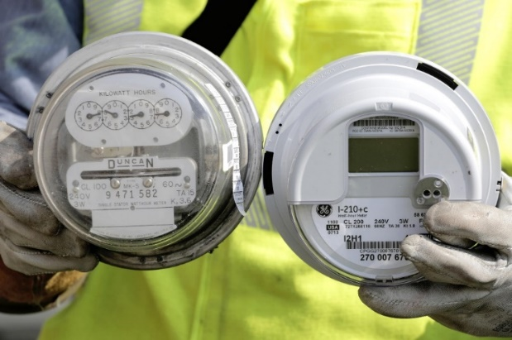
2000 to Present
A host of new communication vendors enter the market and work with meter manufacturers to put their technology under the cover of the meter
Meter Manufacturer’s also develop their own communication technology to put under the cover
Additional features such as Disconnect switches and power quality monitoring become standard accessories to be included under the cover of a new meter
Meters are no longer looked at as simply energy measurement devices
Over 80% of the meters in the US are AMI meters and half of the balance are in the process of being changed out over the next two years.
Early adopters of AMI meters are now starting to replace their original meters
Notes:
Put in history by every decade starting 1870’s

Slide 7
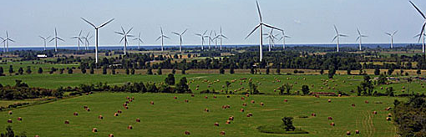
2024 and Beyond
Notes:
As our earlier speaker asked…..Now What?

Slide 8
2024 and Beyond
The best way to know the future is to
pay attention to the present
Notes:
and if possible look without our prejudices coloring our view of the world around us

Slide 9
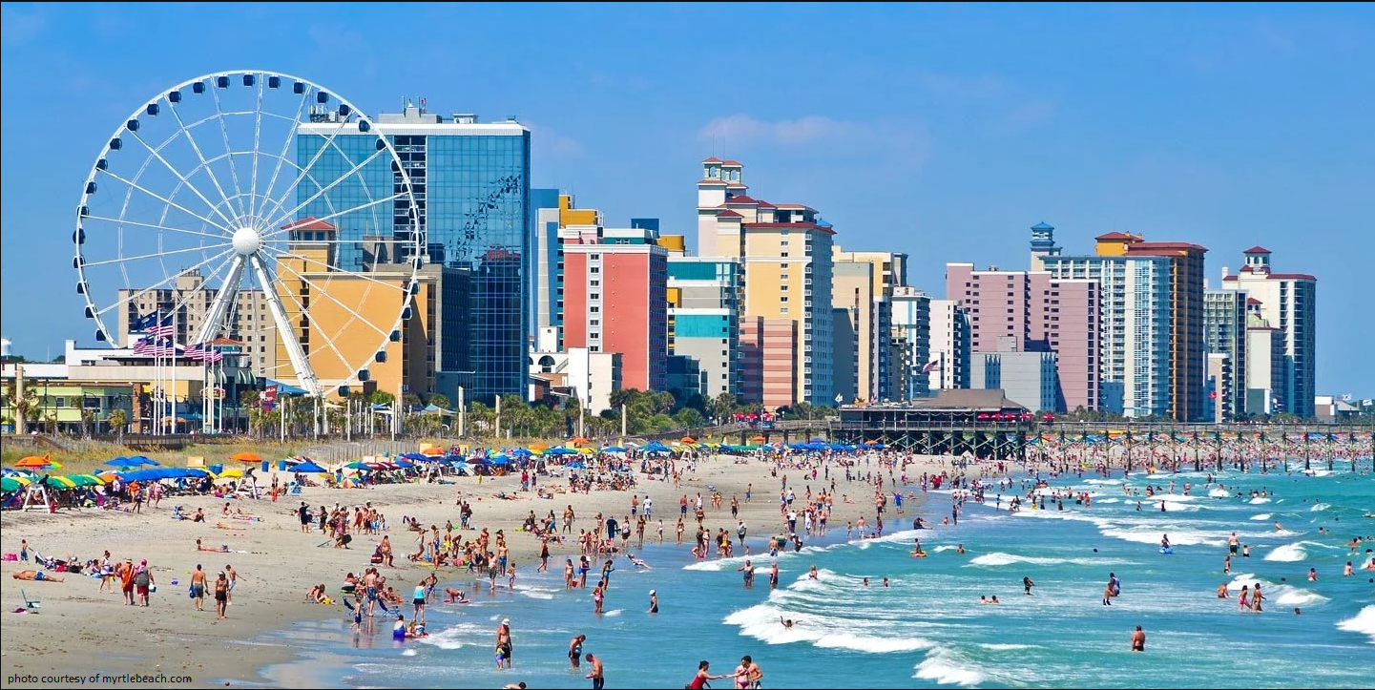
Near Term Projections
Notes:
and if possible look without our prejudices coloring our view of the world around us

Slide 10
Near Term Projections
Notes:
and if possible look without our prejudices coloring our view of the world around us

Slide 11
2024 and Beyond
The best way to know the future is to pay attention to the present.
Best way to do this is to follow the money;
Not the news.
Notes:
and if possible look without our prejudices coloring our view of the world around us

Slide 12
Information, Information and more INFORMATION
Earlier this morning we heard about the Evolution to the Grid Edge and right after lunch we will hear about leveraging data analytics to help make future decisions
The future is all about information and how we use this information
The real question is, ‘How will this information change the way Meter Service Departments will operate in the future?’

Slide 13
New Technologies and Shifts in Meter Services and Electric Operations
Second Generation AMI
New capabilities under glass
The electric meter as an Application Platform
Impedance detection
Theft detection
Broken Neutral detection
Telling the network where the meter exists on the network – real time, closed loop GIS mapping.
Additional data and additional actionable work orders coming from Meter Services
LTL and Private netw

Slide 14
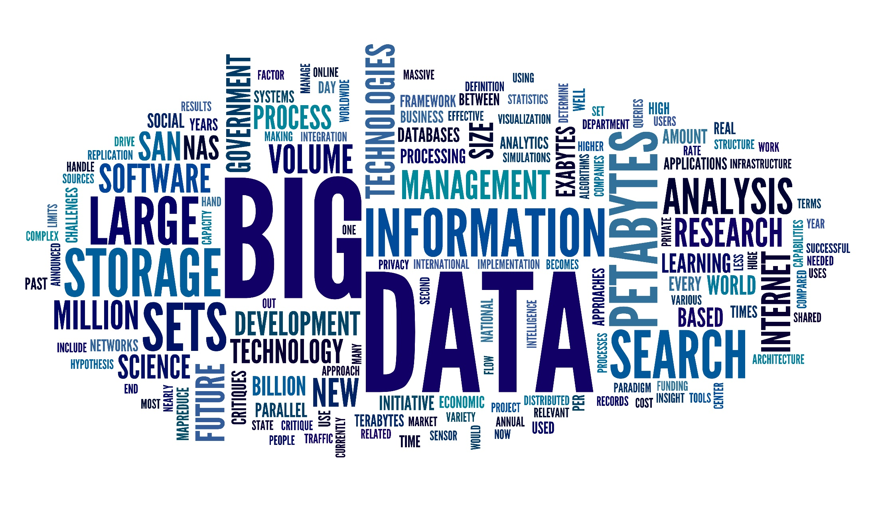
New Technologies and Shifts in Meter Services and Electric Operations
Street Lights
Smart Poles
New services and non-ANSI energy measurement
As Tim mentioned earlier this morning, the amount of data is going up another six orders of magnitude and the appetite for this data will continue to grow. The meter will become the first processor for this data so both Users and Utilities can get this data more easily and on demand
Metering will become enmeshed in distribution and generation and power storage and cyber scurity and data analysis projects.............
...........and this will become part of the every day responsibilities for Meter Service Departments

Slide 15
2024 and Beyond
There is only one thing we know for certain about metering in 2024 and beyond;
Metering will not be the same as today.
Meter Departments will be
New
and
Different

Slide 16
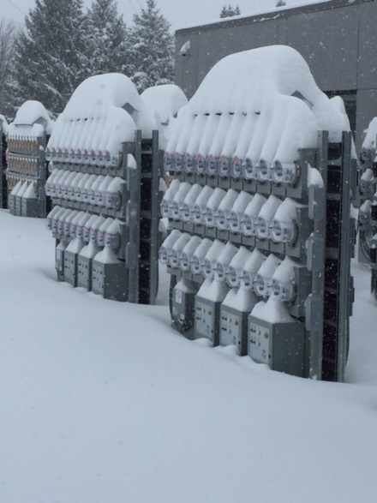
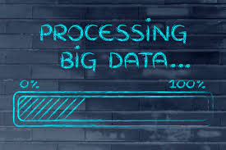
2024 and beyond AMI and Next Generation AMI
Metering will move the center of Distribution Operations at most utilities as analytics are developed, embraced and begin to mature at individual utilities.
Knowledge and Information will rule utility operations
AMI will provide this information and big data/analytics teams will help to provide the tools
Metering professionals will provide the knowledge on how best to utilize these tools
Notes:
Talk about Use cases and Big Data – tie into earlier presentation?

Slide 17
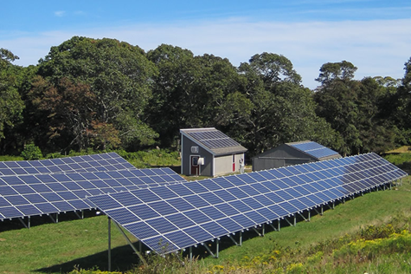
2024 and beyond
The tolerance for non-technical losses of any type will become dramatically less.
As the rest of the Utility and the customers begin to understand that we now have the tools to identify, track down and correct these losses they will demand we look at more data and develop more tools to track down and eliminate these losses
Notes:
Can tie back to theft but also non-malicious losses. Multiplier report.

Slide 18
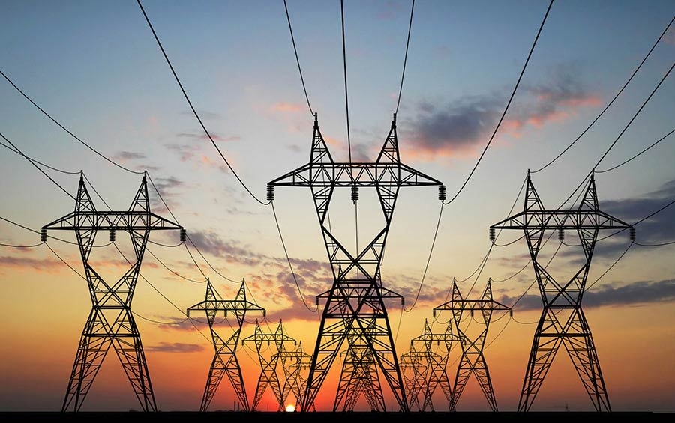
2024 and Beyond
The tolerance for outages will go down as customers get used to us hardening our infrastructure. They will expect that we are identifying and correcting problems without them even reporting them and before or immediately after they even know there is a problem.

Slide 19
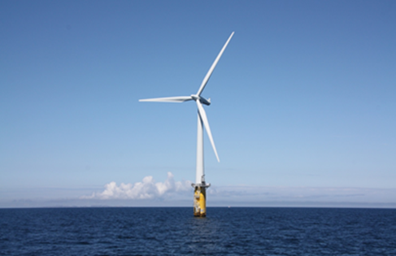
2024 and Beyond
The tolerance for poor power quality will go down as we improve our power quality and begin to educate customers on the effects of poor power quality, harmonics and distortion on our networks. New tariffs may come into effect or new requirements placed on customers (or utilities) to provide power factor correction at the customer site.
Notes:
Waveform generation

Slide 20
Business Use Cases for this Big Data
Data we are already looking at;
Voltage Monitoring (Min, max, average)
Transformer Loading Analysis
Number of customers out of power
Current demand savings from load control (kW)
Outage Index Reporting (SAIDI, SAIFI, MAIFI) at multiple levels
Cumulative outage hours (MTD/YTD)
General line loss analysis
Notes:
Waveform generation

Slide 21
Business Use Cases for this Big Data
Data we are already looking at;
Demand Response (CVR, Peak Reduction, Etc.)
Power quality investigation
Number of blinks, sags, etc. (over time specified)
Peak condition tracking
Power factor by circuit or time of day
Pattern detection (Algorithm to detect patterns in voltage, demand, blinks, etc.)
System efficiency by circuit
Remote Disconnect/Reconnect
Notes:
Waveform generation

Slide 22
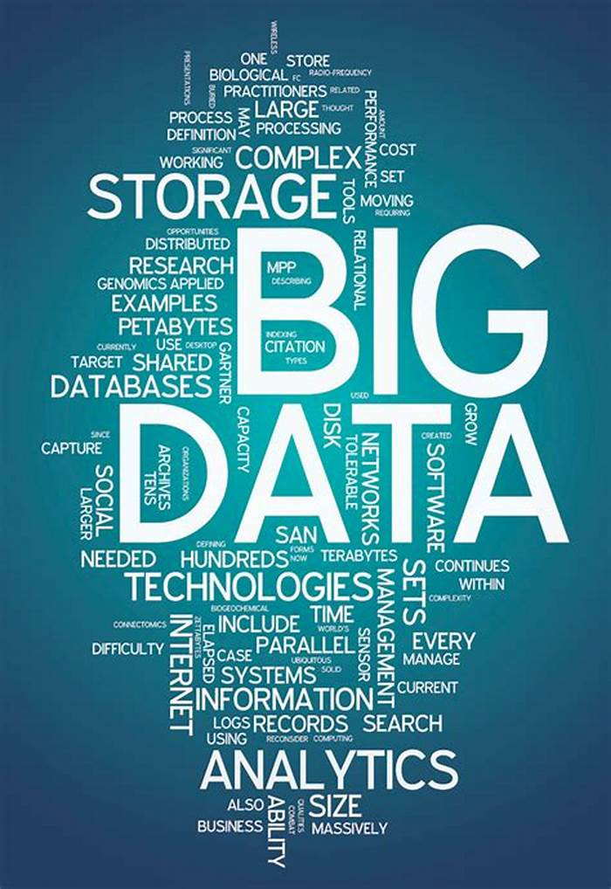
Business Use Cases for this Big Data
Now what can we do with this information? Well….To start;
Isolate and determine where we have voltage issues, correct them and bring an entire line to the same level. This not only works better for our customers but also allows the utility to pursue voltage reduction in a meaningful and controlled way.
Determine what transformers should be used in any location
Determine which transformers to store in which inventory yards
Determine when new loads are present and which transformers are in jeopardy
Notes:
Waveform generation

Slide 23
Business Use Cases for this Big Data
Now what can we do with this information? Well….To start;
Locate Bad connections
Identify increased burden/impedance
Locate Undersized lines
Locate broken neutrals
For Transformer Rated Services determine which ones are operating for a substantial amount of time below 10% of the rated current
Find and remediate theft
Find and remediate remote outages before the user knows they exist
Find and address Power factor issues
Notes:
Waveform generation

Slide 24
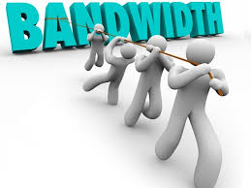
And Now We Want MORE……
More data
Greater frequency
Whatever bandwidth you thought you needed, now you need more.
Notes:
Waveform generation

Slide 25
Next Generation of AMI
Can we use our existing infrastructure?
What are the compelling new features?
Do we have to rip out and replace with new infrastructure?
What about LTL back haul or a Private Network?
What about Power Line Carrier for my remote areas?
Notes:
Waveform generation

Slide 26
Renewables and Storage
We know that renewables by definition are intermittent. They require utility grade energy storage to be effective
Utility grade renewables with accompanying energy storage will replace new generation at an increasing pace as some of the largest capital investment projects for utilities.
The largest renewable generation and energy storage project in the world has just gone operational earlier this year at Edwards Air Force Base in California funded in large part by the Department of Defense. 1.9 Million solar panels covering 4,600 acres of land with a capacity to generate up to 875 megawatts of power. More importantly the utility grade battery storage can store up to 3.3 gigawatt-hours of energy or close to four days of energy storage.
Notes:
The project's new 12.7 meters (42 ft.) diameter, 10.2 kilometers (6.3 mi) long tunnel was officially placed into service on 21 March 2013, helping to increase the generating complex's nameplate capacity by 150 megawatts,^{[1]}
American Samoa

Slide 27
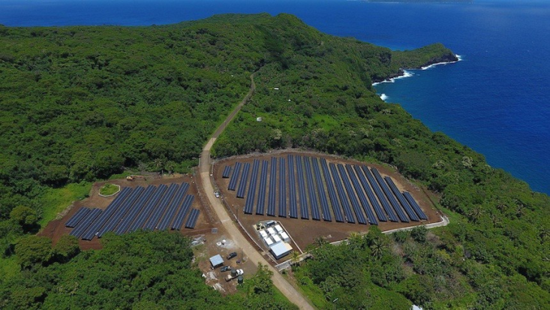
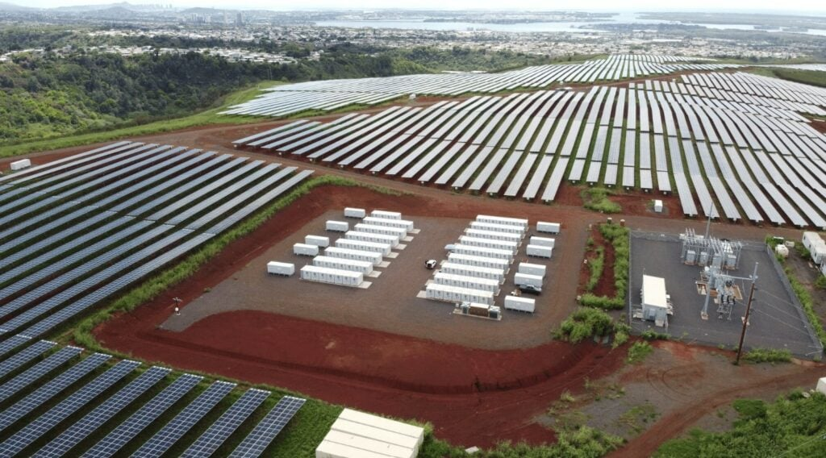
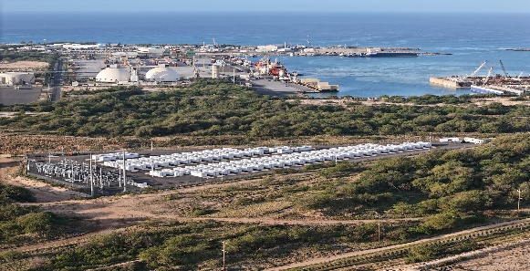
Renewables and Storage
Island communities are already showing us this on larger and larger scales – Ta’u American Samoa; 1.5 megawatts with battery storage for three days coupled with solar
Hawaii Electric opened a 565 Mega Watt hour energy storage facility on the island of Oahu in December 2023. This is nearly 20% of the islands peak energy requirements for up to three hours. Hawaii Electric has just contracted for an additional 2.1 Gwh
Notes:
The project's new 12.7 meters (42 ft.) diameter, 10.2 kilometers (6.3 mi) long tunnel was officially placed into service on 21 March 2013, helping to increase the generating complex's nameplate capacity by 150 megawatts,^{[1]}
American Samoa

Slide 28
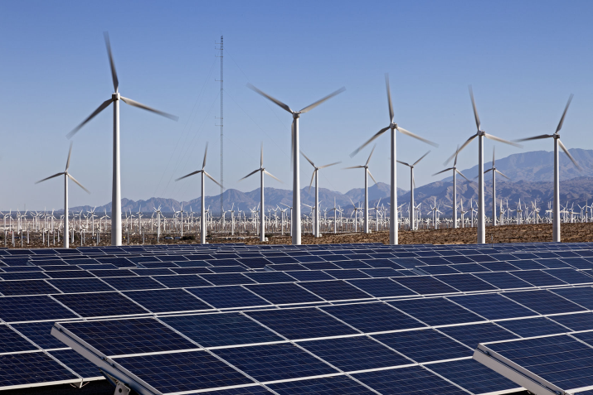
2024 and Beyond
On the distribution side customers will be encouraged to put in more and more renewable energy and they will also add more and more energy storage
Residential loads will move further and further away from power factors of one and put increasing pressure to move to either a Blondel solution for them, a VA/VAR solution for them, or a correction factor for them as AMI systems begin to report back customer power factor for all metering solutions
12S or 2S?

Slide 29
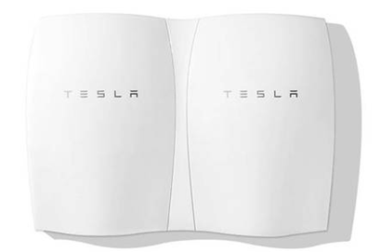
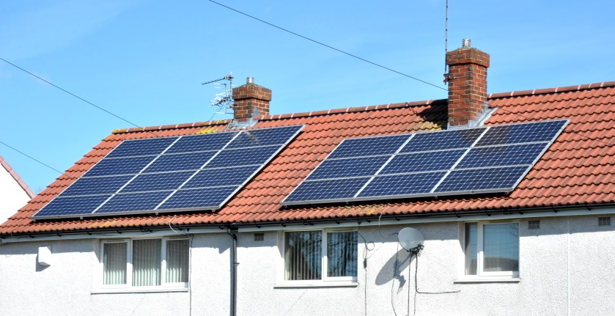
2024 and Beyond
On the distribution side customers will be encouraged to put in more and more renewable energy and they will also add more and more energy storage
Larger customer based energy production and solutions will lead to expanded micro grids.
Second Generation AMI and potentially new communication paradigms as LTL data becomes less and less expensive and reaches larger and larger areas.

Slide 30
AMI 2.0 Infrastructure
Second Generation AMI and potentially new communication paradigms as LTL data becomes less and less expensive and reaches larger and larger areas – without new infrastructure
Research in Power Line Carrier Technology may provide expanded bandwidth to allow for greater data transfer more frequently without as much new infrastructure
Mesh networks continue to improve and AMI 2.0 is anticipating leveraging the infrastructure installed in AMI 1.0

Slide 31
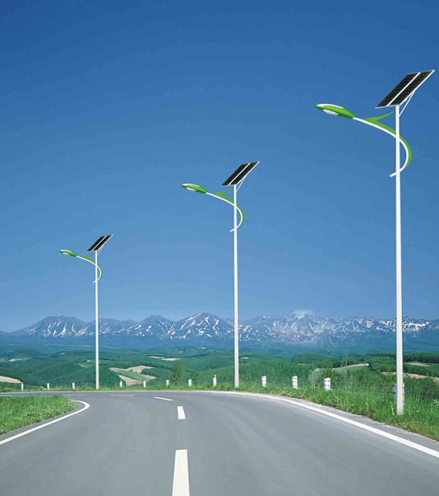
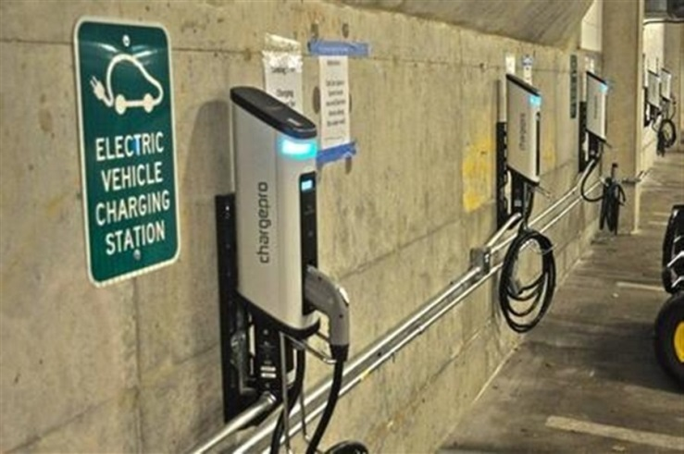
The shape of metering to come 2024 and beyond
Meters that do not look like meters as we know them, will become a part of our world.
Street lights
Smart Poles
Electric vehicle chargers
Sub meters – which may now become our meters

Slide 32
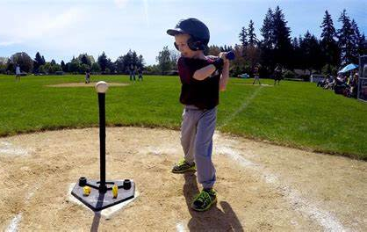
What will Meter Service Departments Look Like?
As in sports the basics will never change. In Tee Ball we practice hitting and catching and so do the Pro’s.
We will move up a league though and this will require us to be better than we were
Meter Tech one and two. Single phase and polyphase
And there is more;
Communications experts for our network communications
Site testing and trouble shooting for our Transformer rated services
Big data analytics using our knowledge of our metering network
Metering in non-traditional areas with non-ANSI applications

Slide 33
What will Meter Service Departments Look Like?
Identifying and correcting line loss
If we accept the premise that the primary difference of reported line loss between utilities is bad metering, then we know we now have or will have in the near future the ability to identify and correct these issues.
Suggest and put together the business case for new rates and tariffs
Directors of Meter Services may start to transition to VP’s for Grid Resiliency and Reliability
Metering budgets will increase as metering continues to move to the center of distribution operations

Slide 34
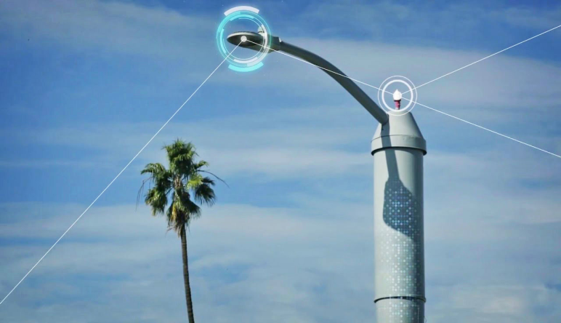
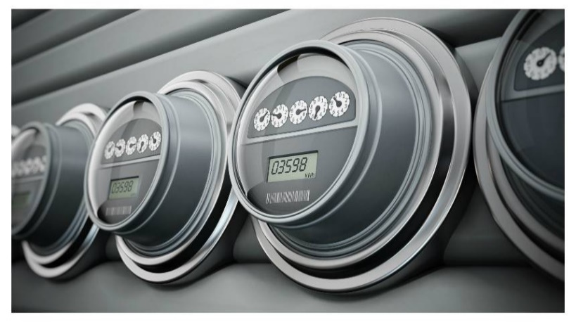
Summary – The Past and the Future
The more things change, the more they will remain the same.
Understanding how to accurately measure a customer's consumption correctly will become an increasingly valuable commodity. This includes a better understanding of the effects on metering of poor power quality and energy distortion.
How to pair an understanding of metering and distribution with big data to provide an increasingly automated set of AMI analytics to monitor and maintain our distribution network and to continue to develop new ones to constantly improve our networks.
Meters may not look like meters in the future, but metering will become the center of the Electric Distribution Universe.
There will continue to be NC Meter Schools to help keep you abreast

Slide 35
Questions and Discussion
Tom Lawton
President
tom.lawton@tescometering.com
TESCO Metering Bristol, PA
215.228.0500
This presentation can also be found under Meter Conferences and Schools on the TESCO website: tescometering.com
ISO 9001:2015 Certified Quality Company
ISO 17025:2017 Accredited Laboratory

Slide 36
Tesco hospitality suite
We would like you to join us in the TESCO Hospitality Suite for networking and more discussions about metering. The discussion will not be exclusively metering……….but we love metering and that is the most common topic.
TESCO Hospitality Suite 1601 – Brighton Tower
Monday and Tuesday 8:00 PM – 10:00 PM

