Slide 1
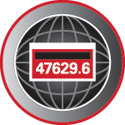
Site Verification – Protocols & Tools for Complex Metering Installations
Prepared by Tom Lawton, TESCO The Eastern Specialty Company
For North Carolina Electric Meter School
Advanced
Wednesday, June 12, 2024
2:45 PM

Slide 2
Premise
Over much of the 20th century, utilities, regulators and customers each relied upon lab and field meter testing efforts which were primarily focused upon the accuracy of the watt-hour meter and demand register.
With over 80% of the meters in North America now being AMI meters. The focus has now shifted to the metering installation as a whole, and not the accuracy of the meter.

Slide 3
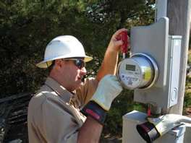
Field Testing
Common Features and Common Sources of Concern
Electro Mechanical meters were subject to registration errors caused by mechanical issues with moving parts resulting in either the loss of revenue to the utility or over billing for the customer. Some of the more common problems were:
Friction wear
Gear mesh misalignment
Retarding magnet failure
Timing motors

Slide 4
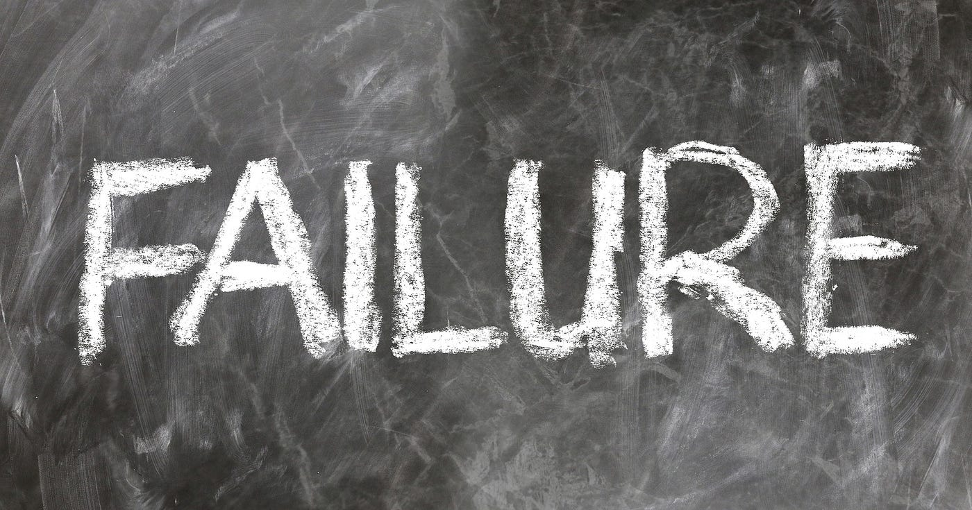
Electronic Meters – New Failure Modes Require New Testing and Inspection Methods
Electronic meters fail as do electro-mechanical meters but differently
Their overall life expectancy is not nearly the same
Failure modes include drift (unexpected)
Failure modes include catastrophic (expected)
Failure modes include non-catastrophic but significant measurement error modes
Failure modes can include non-measurement issues which render the meter ineffective or inaccurate for billing purposes

Slide 5
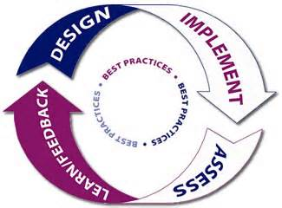
Best Practices
Residential vs Commercial
Self-Contained vs Transformer Rated
Follow the money and be as proactive as possible

Slide 6
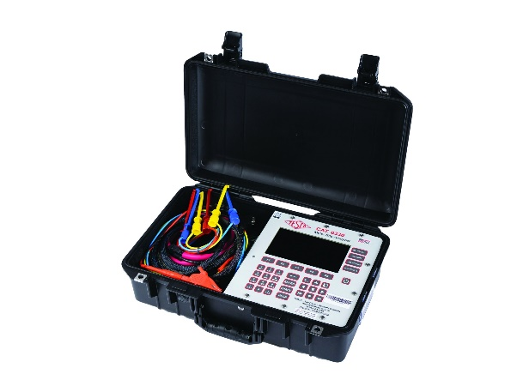
Site Verification: Why should we invest our limited meter service resources here
These customers represent a disproportionately large amount of the overall revenue for every utility in North America.
For many utilities, the ten percent of their customers who have transformer rated metering services can represent over 70% of their overall revenue.
While these numbers will vary from utility to utility the basic premise should be the same for all utilities: This is where Meter Services can make the most difference and should focus their efforts.
This is one of the larger benefits that AMI can provide for our Utilities – more time to spend on C&I metering and less on residential metering.
Easy Answer: Money.

Slide 7
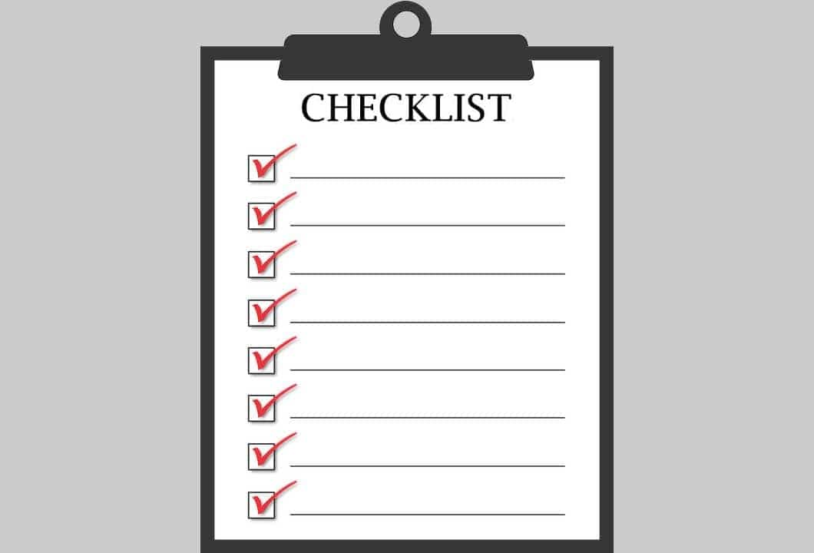
Potential list of tasks to be completed during a Site Verification of a Transformer Rated Metering Site
Double check the meter number, the location the test result and the meter record
Perform a visual safety inspection of the site. This includes utility and customer equipment. Things to look for include intact down ground on pole, properly attached enclosure, unwanted voltage on enclosure, proper trimming and site tidiness (absence of discarded seals, etc.)
Visually inspect for energy diversions (intentional and not). This includes broken or missing wires, jumpers, open test switch, unconnected wires and foreign objects on meters or other metering equipment. Broken or missing wires can seriously cause the under measurement of energy. A simple broken wire on a CT or VT can cause the loss of 1/3 to 1/2 of the registration on either 3 element or 2 element metering, respectively.

Slide 8
Site Verification Checklist (cont)
Visually check lightning arrestors and transformers for damage or leaks.
Check for proper grounding and bonding of metering equipment. Poor grounding and bonding practices may result in inaccurate measurements that go undetected for long periods of time. Implementing a single point ground policy and practice can reduce or eliminate this issue.
Burden test CTs and voltage check PTs.
Verify service voltage. Stuck regulator or seasonal capacitor can impact service voltage.
Verify the condition of metering control wire. This includes looking for cracks in insulation, broken wires, loose connections, etc.
Confirm we have a Blondel compliant metering set up
Compare the test switch wiring with the wiring at the CTs and VTs. Verify CTs and VTs not cross wired. Be sure CTs are grounded in one location (test switch) only.

Slide 9
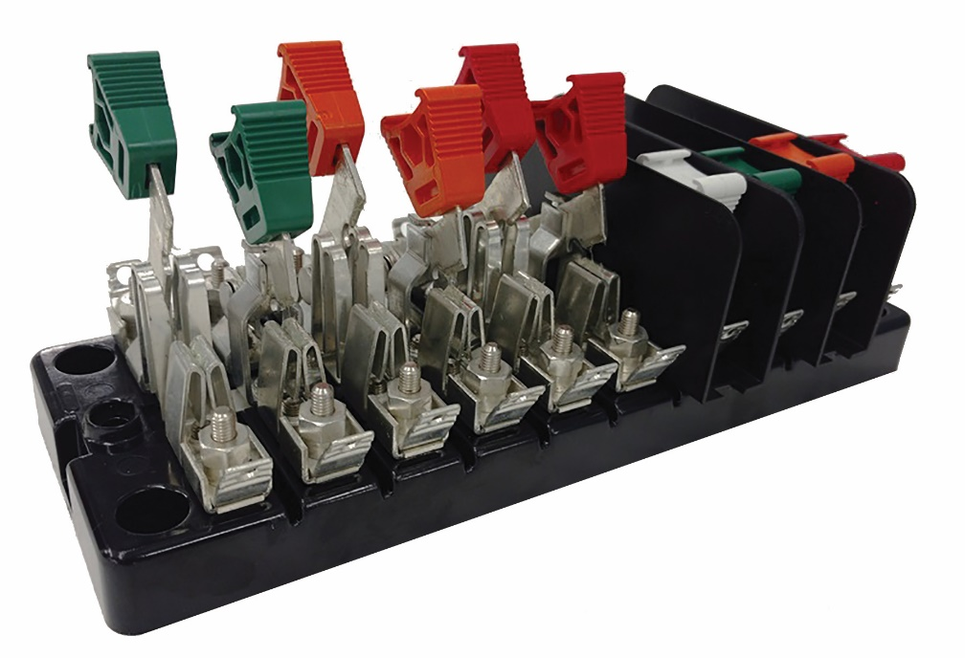
Site Verification Checklist (cont)
Check for bad test switch by examining voltage at the top and bottom of the switch. Also verify amps using amp probe on both sides of the test switch. Verify neutral connection to cabinet (voltage).
Check rotation by closing in one phase at a time at the test switch and observing the phase meter for forward rotation. If forward rotation is not observed measurements may be significantly impacted as the phases could be cancelling each other out, but more importantly could be damaging customer equipment.

Slide 10
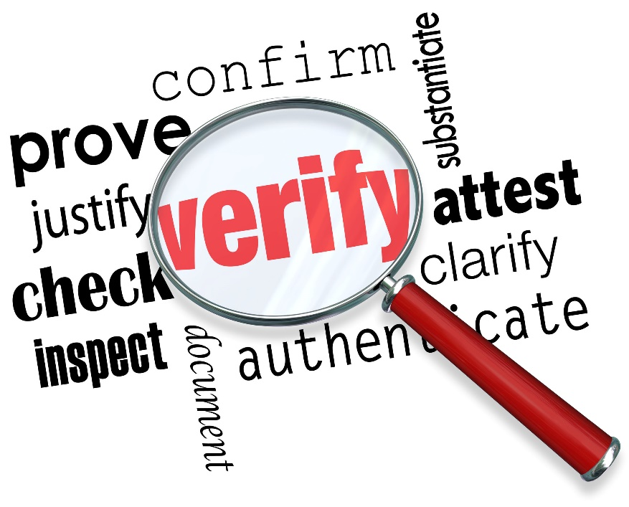
Site Verification Checklist (cont)
Test meter for accuracy. Verify demand if applicable with observed load. If meter is performing compensation (line and/or transformer losses) the compensation should be verified either through direct testing at the site or by examining recorded pulse data.
Loss compensation is generally a very small percentage of the overall measurement and would not be caught under utilities normal high/low checks. However, the small percentages when applied to large loads or generation can add up to significant amounts over time. Billing adjustments can easily reach into the millions of dollars if not caught early.

Slide 11
Site Verification Checklist (cont)
Verify metering vectors. Traditionally this has been done using instruments such as a circuit analyzer. Many solid state meters today can provide vector diagrams along with volt/amp/pf and values using meter manufacturer software or meter displays. Many of these desired values are programmed into the meters Alternate/Utility display. Examining these values can provide much information about the metering integrity. It may also assist in determining if unbalanced loads are present and if CTs are sized properly. The vendor software generally has the ability to capture both diagnostic and vector information electronically. These electronic records should be kept in the meter shop for future comparisons.
If metering is providing pulses/EOI pulse to customers, SCADA systems or other meters for totalization they also should be verified vs. the known load on the meter. If present test/inspect isolation relays/pulse splitters for things like blown fuses to ensure they are operating properly.
Verify meter information including meter multiplier, serial number, dials/decimals, Mp, Ke, Primary Kh, Kr and Rate. Errors in this type of information can also cause a adverse impact on measured/reported values.
Verify CT shunts are all opened.
Look for signs of excessive heat on the meter base e.g.
melted plastic or discoloration related to heat

Slide 12
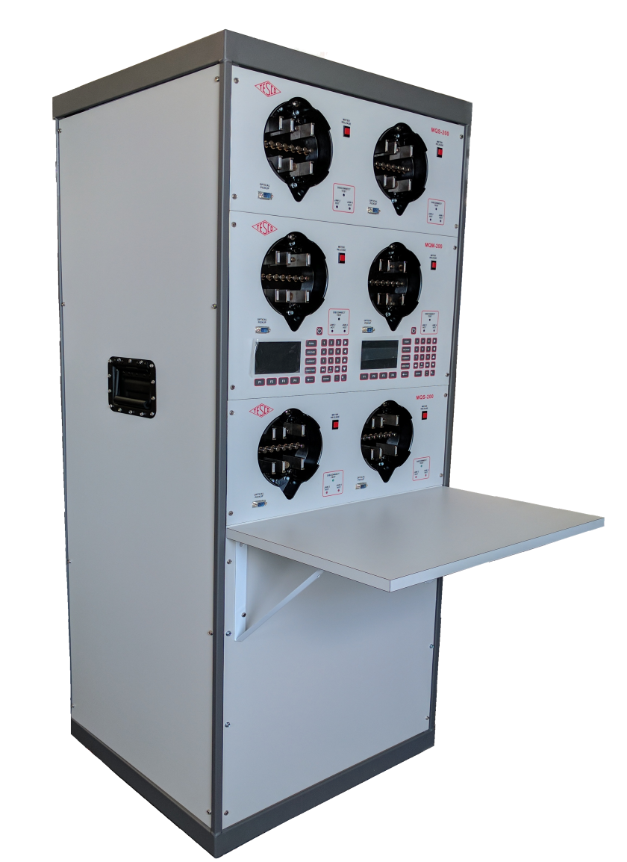
Shop Testing
Accuracy Testing
Meter Communications Performance
Software & Firmware Verification
Setting Verification
Functional Testing
Disconnect/Reconnect Functionality and as left setting

Slide 13
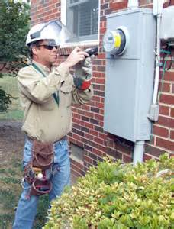
Testing Frequency & Cost
Tools (hardware and software)
Personnel
Frequency
Test
Report
Analyze
Learn, Share, Adapt

Slide 14
Best Practices
Use photos from last visit
Perform admittance tests
Check burden
Perform visual inspection
Clean and tighten all connections
Test
Report
Analyze
Learn, Share, Adapt

Slide 15
Once the box is Open Issues to Look For
Open line – open line side connection to the meter socket.
Missing neutral – missing neutral connection to the center lug in the meter socket
Cross phase condition – cross wiring between the test block and the meter socket.
Hidden jumpers line to load – diversion on both legs.
Dead Short - dead short phase to ground on the load side of one leg of the socket.
Partial Short - partial short phase to ground on the load side of one leg of the socket
Notes:
UMPIRE is a
Universal Meter Programming and Reading System
It reads all meters and recorders
It can control all manufactures software

Slide 16
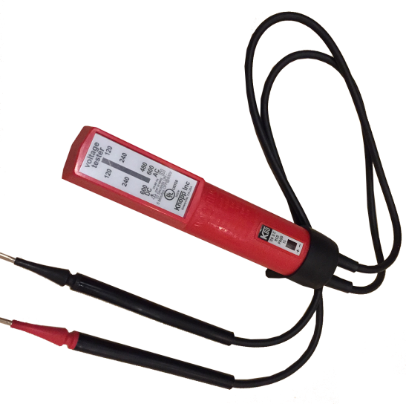
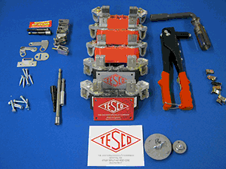
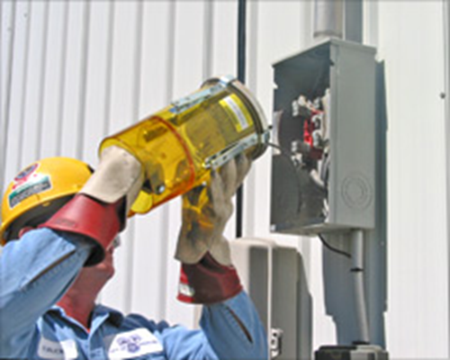
Tools
Socket Pullers
Volt meters
Specialized tools

Slide 17
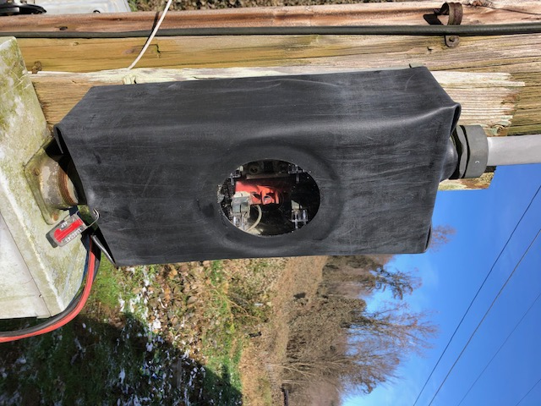
Tools
Temporary Service Cover

Slide 18
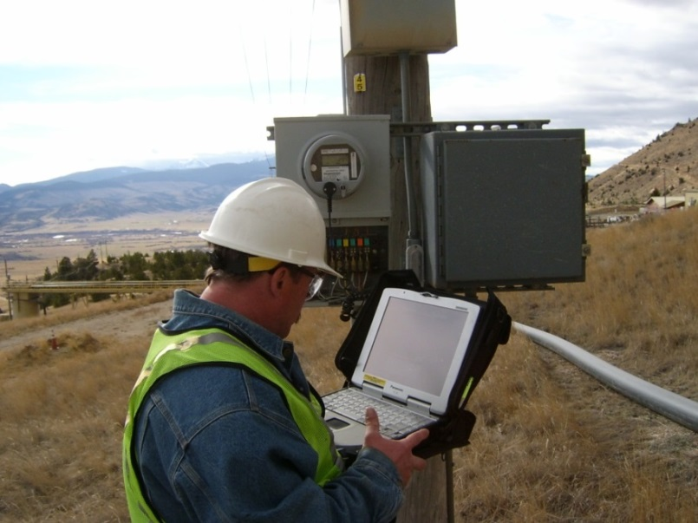
Periodic Site Inspections…..
….Can Discover or Prevent:
Billing Errors
Bad Metering set-up
Detect Current Diversion
Identify Potential Safety Issues
Metering Issues (issues not related to meter accuracy)
AMR/AMI Communications Issues
The need for Unscheduled Truck Rolls due to Undetected Field Related Issues
Discrepancies between what is believed to be at a given site versus the actual setup and equipment at the site

Slide 19
Most Importantly…
We test and verify the sites to make sure we are not losing money or unfairly billing the customer and to make sure the sites are safe.

Slide 20
Questions and Discussion
Tom Lawton
President
tom.lawton@tescometering.com
TESCO Metering Bristol, PA
215.228.0500
This presentation can also be found under Meter Conferences and Schools on the TESCO website: tescometering.com
ISO 9001:2015 Certified Quality Company ISO 17025:2017 Accredited Laboratory

