Slide 1
Status of EV’s 2024
Prepared by Tom Lawton, TESCO
TESCO Metering
North Carolina Meter School
Combined Session
Thursday, June 13, 2024
8:45 AM

Slide 2
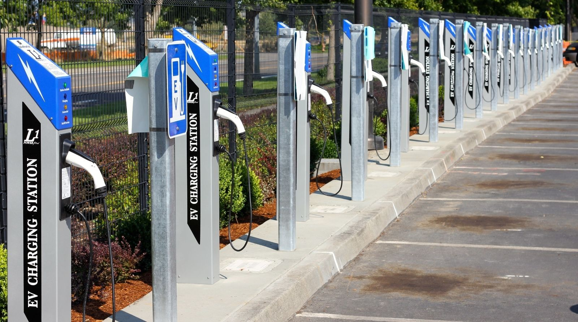
Electric Vehicle Service Equipment - EVSE
What is it all about and why should I care?

Slide 3
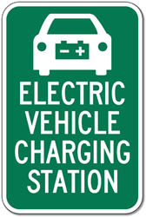
Topic Summary
Overview of Electric Vehicles (EV’s) in 2023
Who is in the market?
Who dominates the market?
How many EV’s are on the road?
Where is the market going?
Types of Electric Vehicle Supply Equipment (EVSE’s or chargers)
Electric Vehicle Charging Networks
Regulatory environment
Business Segment – revenue opportunities and expectations

Slide 4
Overview of Electric Vehicles in 2024

Slide 5
Who is in the EV Market?
Anyone who is not will be in the near future. The following automobile manufacturers have an Electric Vehicle offering in 2024:
Audi
BMW
Chevrolet
Coda
Fiat
Porsche
Ford
Honda
Hyundai
Kia
Jaguar
Lucid
Mercedes
Mitsubishi
Mini
Nissan
Polestar
Rivian
Smart Car
Tesla
Toyota
VW
Volvo
Fisker

Slide 6
Who are the Market drivers? 2022 TESLA: 66.3% Ford: 7.6% Hyundai & Kia: 7.1% (Motor Intelligence)

Slide 7
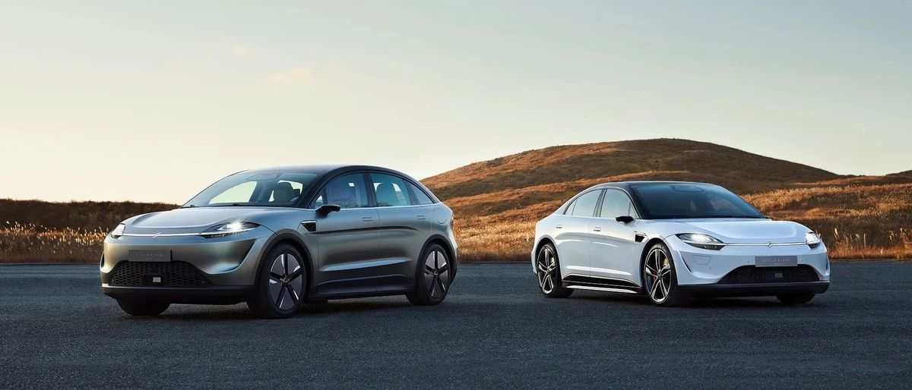
The EV Market
Hyundai Unveils EV Platform, Will Have 23 Global Electric Vehicles by 2025
Toyota Details Six New EV Models Launching for 2020–2025
BMW raises target for EV sales, plans new electric-focused platform
Every major manufacturer has a plan for EV over the next 10+ years

Slide 8
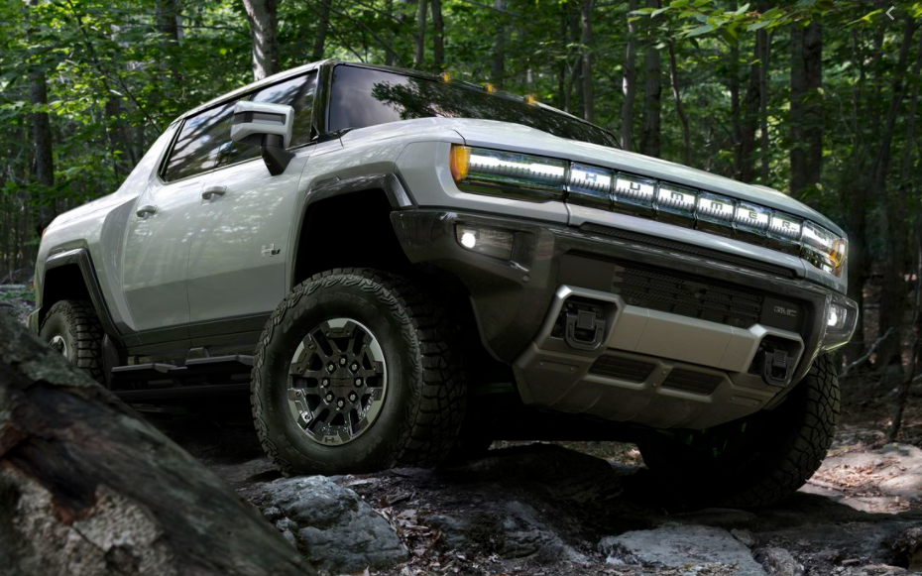
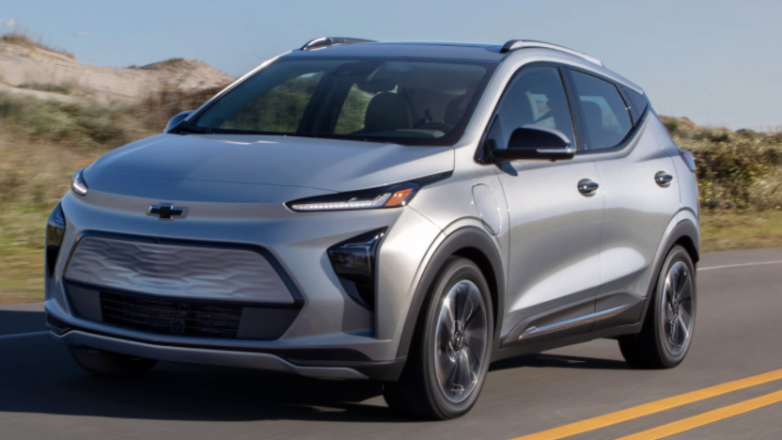
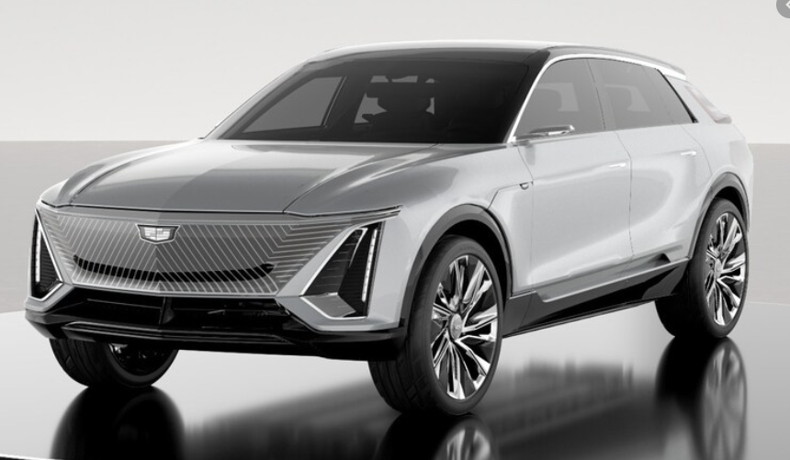
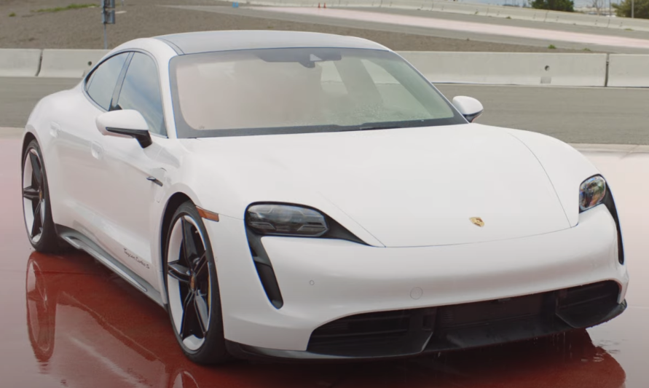
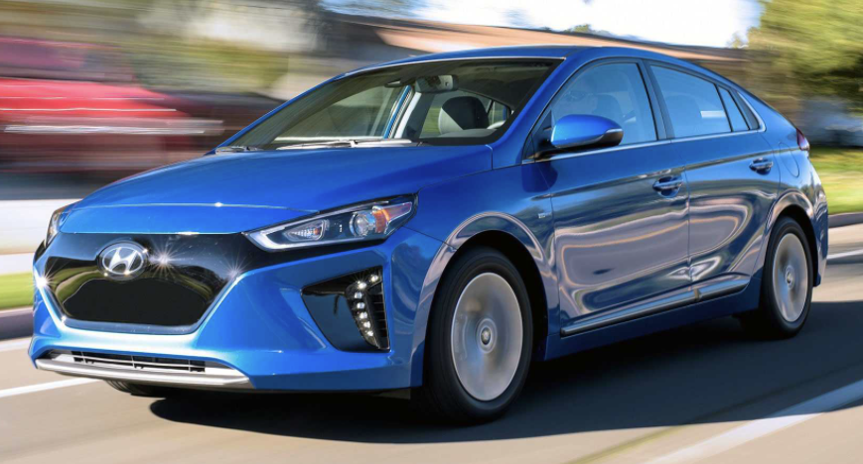
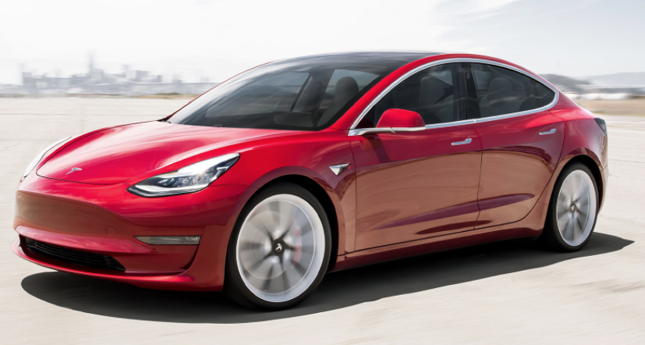
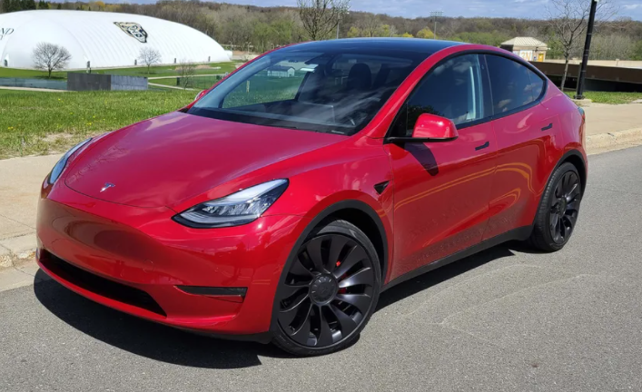
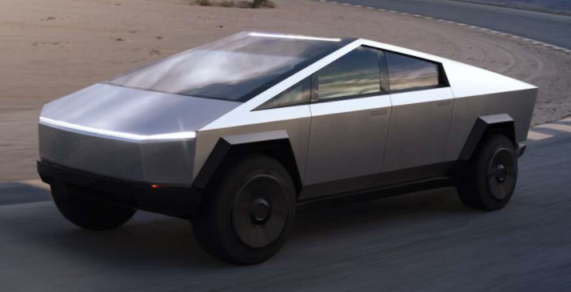
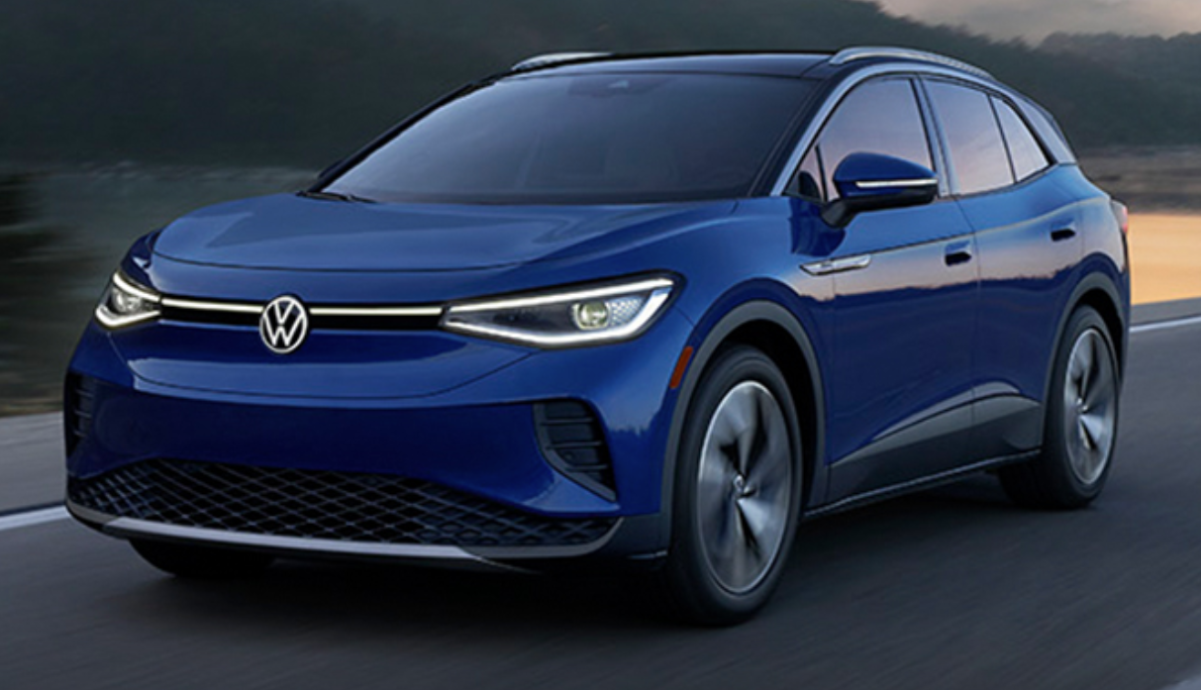
The EV Market
Manufacturers have announced over 100 EV models to be introduced by 2025.

Slide 9
How many EV’s are on the road in the US?
As of 2024 there were 4,300,000 Electric Vehicles operating in the US
By 2025 there are 77,000,000 forecast to be on the road

Slide 10
The US EV Market
Where is the Market Going? Upwards – in a big way

Slide 11
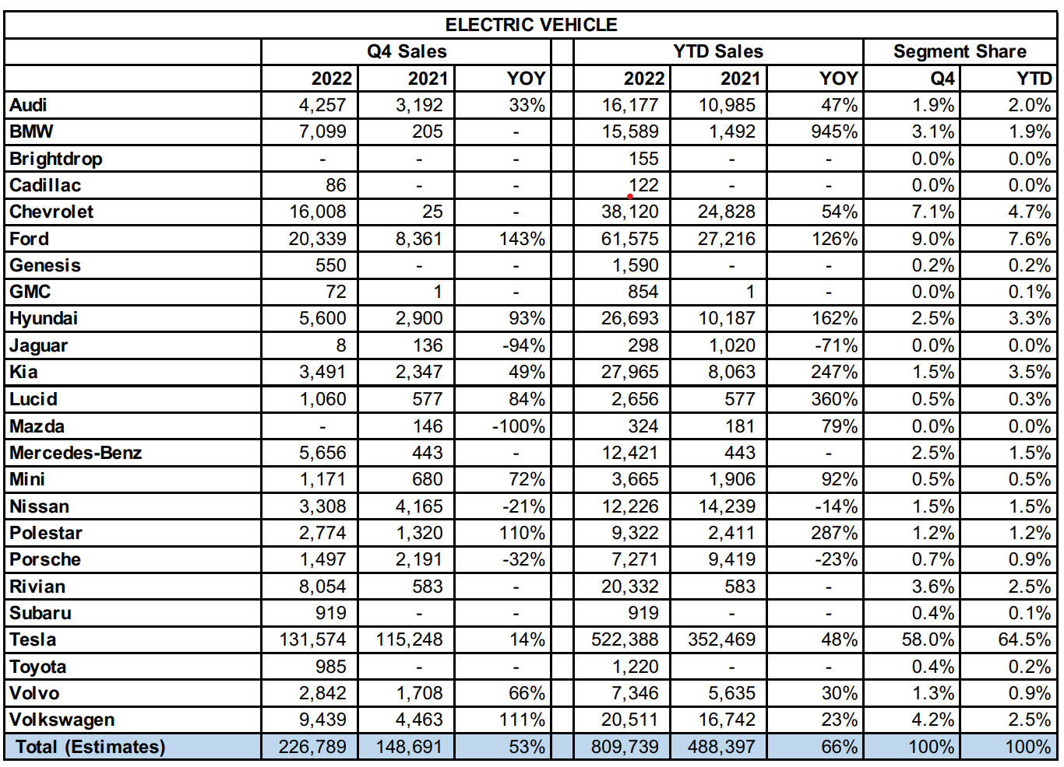
The US EV Market
Source: ELECTRIFIED LIGHT-VEHICLE SALES REPORT Q4 2022 kbb.com

Slide 12
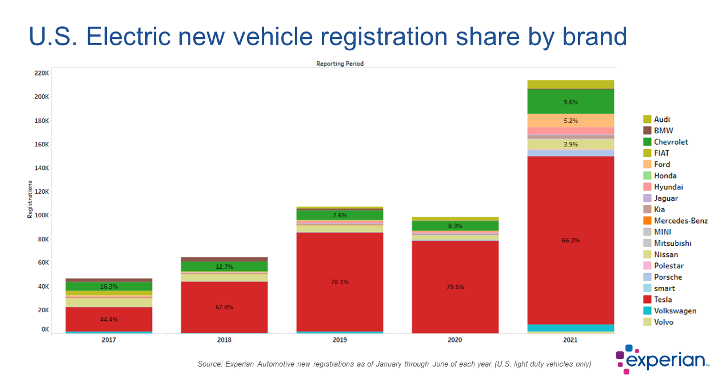
The EV Market

Slide 13
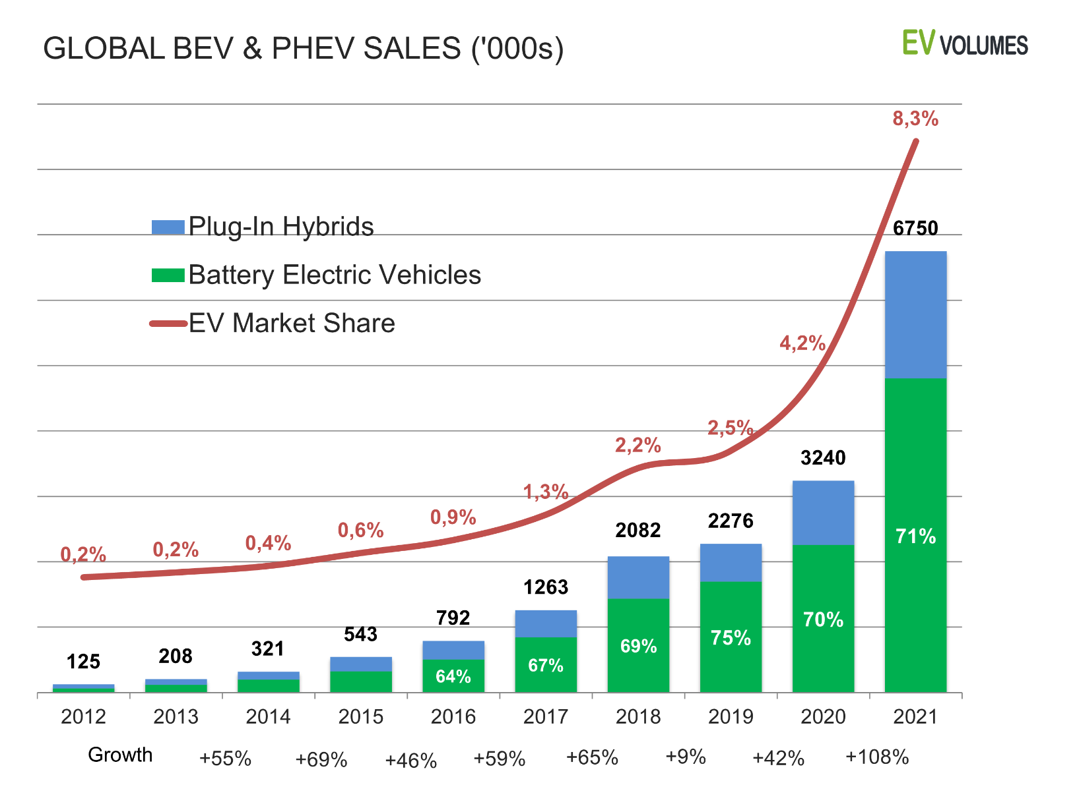
The World EV Market
Source: https://www.ev-volumes.com/

Slide 14
EV Continues to Boom
Sales for light duty vehicles down YoY for 2022
EV sales increased by 65%
EVs accounted for 5.8% of all new cars sold in the US in 2022, an increase from 3.1% the year before
Motor Intelligence, InsideEvs.com

Slide 15
How much energy and how long to charge?
Mfg | EV Offering | Range (miles) | Battery | Battery Capacity | Battery Charge Time (hours)
Tesla | S / 3 / X / Y | S - 405 3 - 272-358 X - 333-351 Y - 303-330 | S - 407 V lithium-ion 3 - 50-82 kWh 350 V lithium-ion X - 100 kWh 410 V lithium-ion Y - 75 kWh 350 V lithium-ion | S - 103 kWh 3 - 50 to 82 kWh X - 100 kWh Y - 75 kWh | S - 8 -15h at 240V 3 - 8.5 to 10h at 240V X - 10.5h at 240V Y - 10h at 240V
Porsche | Taycan | 199-212 | 79.2-93.4 kWh 723 V lithium-ion | 79.2 to 93.4 kWh | 24 hrs @ 120V 12h @ 240V 15m @ 440V
Kia | EV6 / Niro | EV6 - 232-310 Niro - 258 | EV6 - 58-77.4 kWh 523-697 V lithium polymer Niro - 64 kWh 356V lithium-ion | EV6 - 58 to 77.4 kWh Niro - 64 kWh | EV6 - 51-68h @120V 6.3-8.7h @240V 1.1-1.2h @440V Niro - 9.25 at 240V 1.07h at 440V

Slide 16
Changing the Game - Range
Range – In excess of 400 miles with models announced that will achieve over 600 miles.
However, this is not the effective range. Effective range is rarely more than 70% of this number and in colder, hilly climates, traveling on highways this range may only be 50% of the rating.

Slide 17
Changing the Game - Range
For a 200 mile range car this may only give you 100 miles before needing to charge again in a northern climate in the winter.
For a 650 mile range car this should typically give 400 to 450 miles before needing to stop and charge.

Slide 18
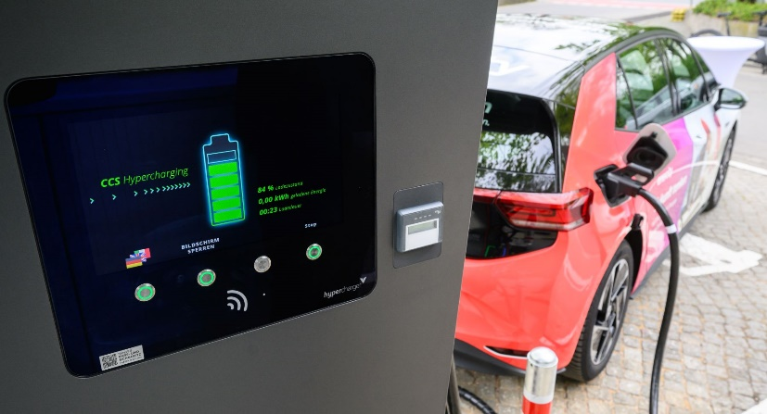
Changing the Game - Time
Charge time – Charging at home is a game changer. You leave every day from home fully charged. This is huge.
We typically are willing to pay for conveniences, but in this case convenience is less expensive.
On the road the DC Superchargers are now capable of getting you on the road in under 10 minutes.
This is now similar to if not the same as fueling with gas.

Slide 19
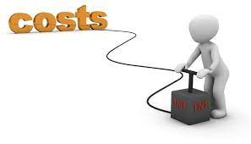
Changing the Game - Cost
Charging even 90% of a 90kwh battery at home for $0.12/kwh is $9.72 and typically will take you 240 miles under typical circumstances for a cost of $0.04/mile.
Assuming you consumed 30 mpg, at a gas price of $2.00/gallon this is a $16.00 fill up and took an extra 10 to 15 minutes out of your life. If you have waited in line at COSTCO you may have spent more tune than that
At $4.00/gallon this is a $32 gallon fill up and at $6.00 per gallon this is a $48 gallon fill up.

Slide 20
Changing the Game – the rest of the world
Small wonder that electric vehicles took off in the rest of the world faster than the US. Gas is significantly more expensive and the distances traveled are typically much less.
On 2/28/22 the average price per gallon in the US was $2.61, in Paris the same gallon of gas was $8.37 or 3.21 times more expensive.
Electricity, on the other hand, is roughly only 1.5 times more expensive, making electric vehicles very attractive to the average driver in Europe.

Slide 21
The EV Market
Ford announced during its fourth-quarter earnings report that it will invest $22 billion in electric vehicles and $7 billion in autonomous vehicles through 2025 and will be “all electric” in Europe by 2030.

Slide 22
Types of Electric Vehicle Supply Equipment (EVSE’s or chargers)

Slide 23
Types of Electric Vehicle Supply Equipment (EVSE)
Except at the high end of the Level 3 chargers – A 90 kwh batter charging from 10 to 80% and adding 210 miles of range will only take 10.5 minutes
Source: forbes.com

Slide 24
EVSE Manufactures
Major charging system manufacturers

Slide 25
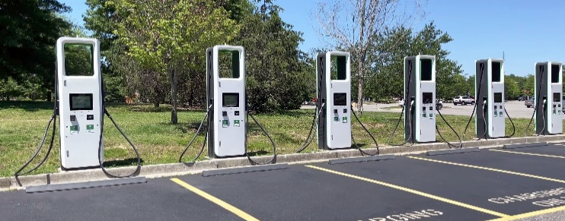
Charging Stations
Deployment is growing rapidly in US
The current administration has set a goal of having 500,000 charging stations by 2030
Total PUBLIC chargers installed as of December 31, 2021:
AC Level 1
AC Level 2
Level 3 (DC Fast Charger/Superchargers)
NOTE: As a point of reference, for TESLA Superchargers there are an average of 9 charging stations per location.
454 locations
46,781 locations
7,219 locations

Slide 26
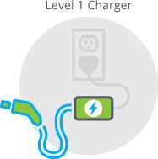
AC EVSE STANDARDS
J1772 AC Level 1
Home Installation
120 Volts at between 12 and 16 Amps
Maximum Power Delivery (1.4 kW)
Typical time to charge between 30-40 hours
3-5 miles per hour of charge @ 16A
Charging 100% can take 2-3 days for most models on a L1 Charger
Source: calevip.org; forbes.com

Slide 27
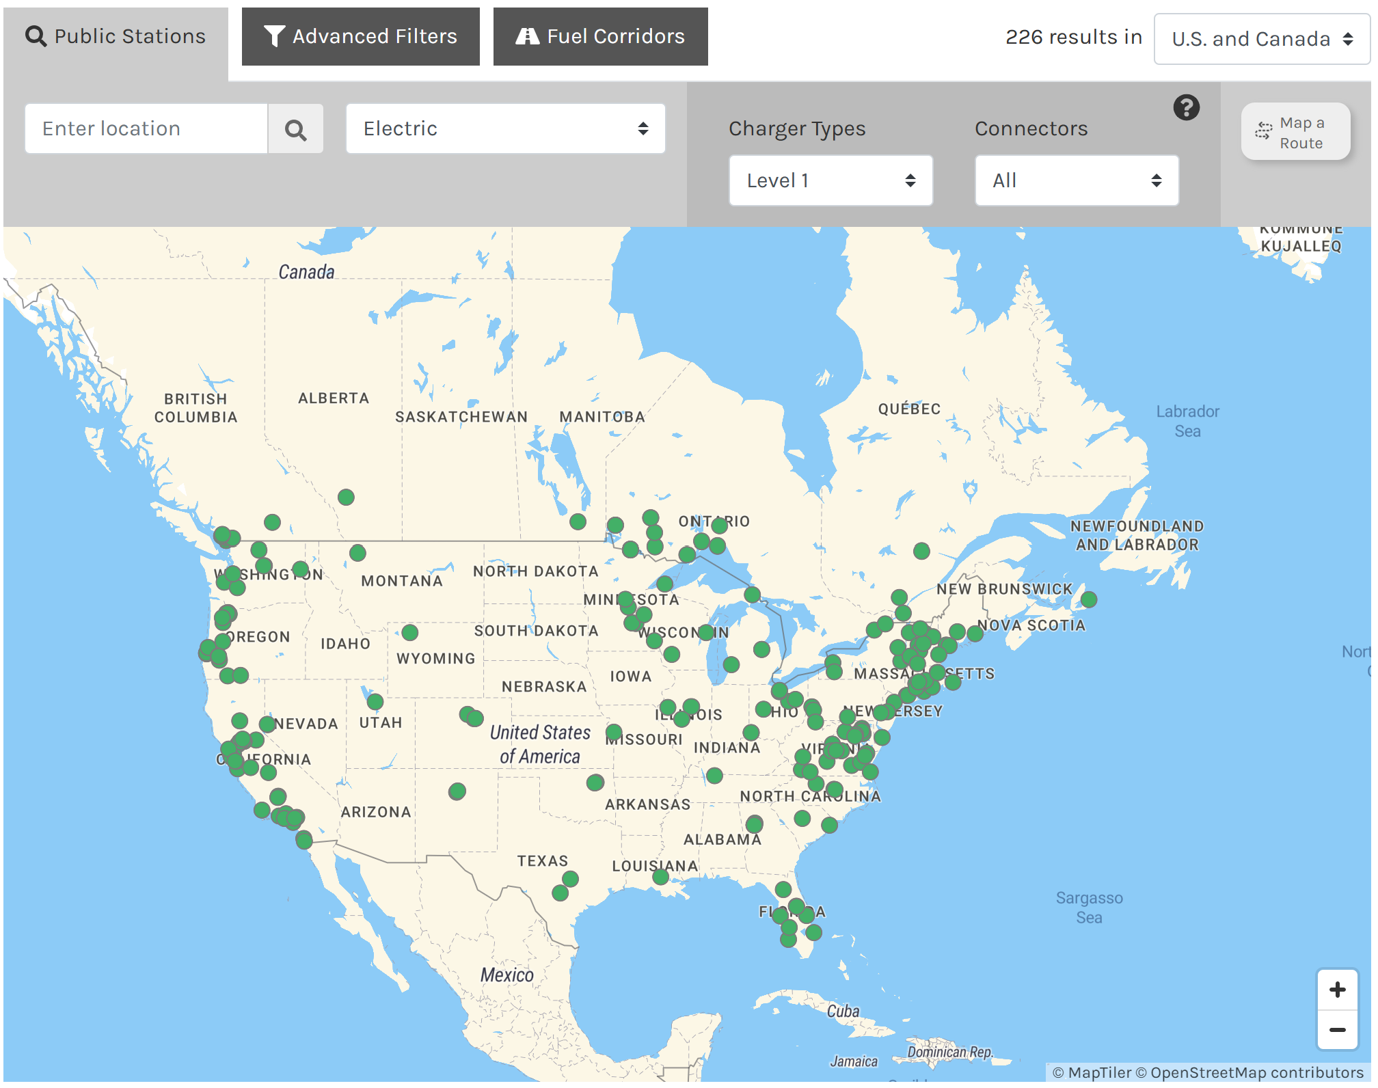
Level 1, AC Chargers
Source: April, 2023 Alternative Fueling Station Data afdc.energy.gov

Slide 28
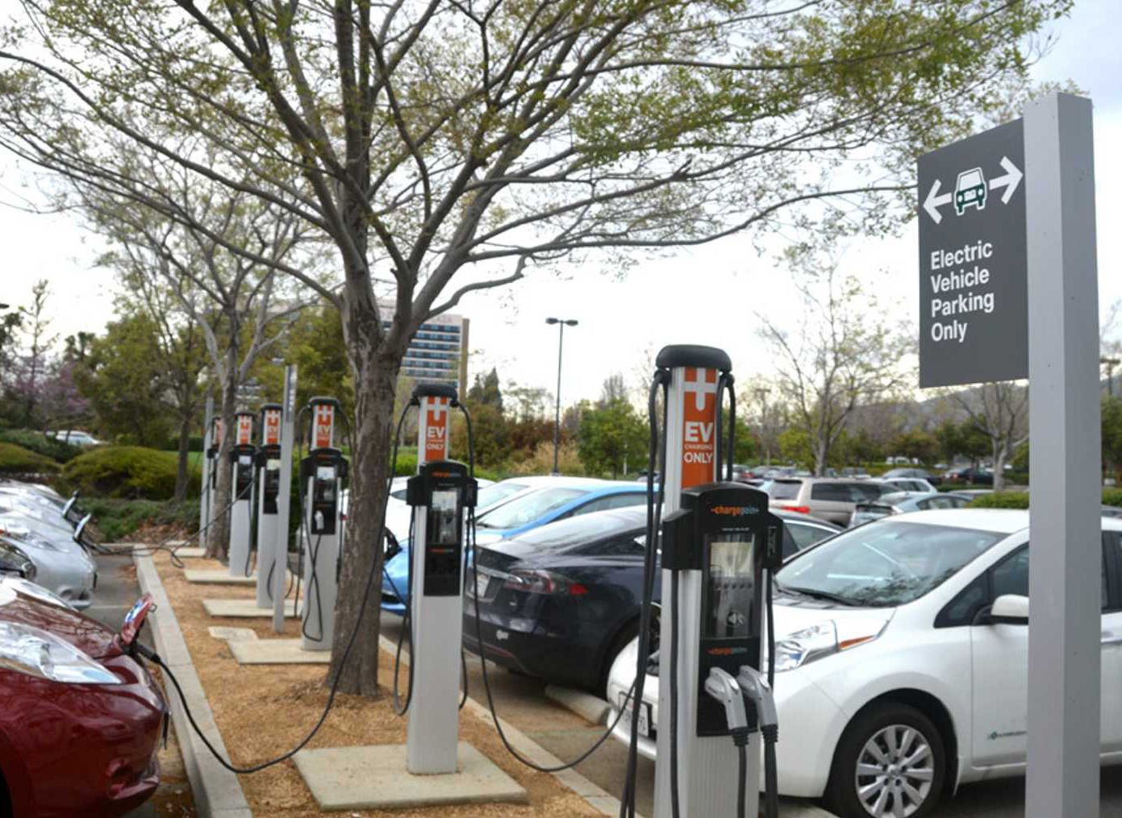
AC EVSE STANDARDS
J1772 AC Level 2
Over 85% of commercial EVSEs are AC Level 2
All current EV/PEV in US can use this type though some (Tesla) need adapters
Stations cost $5K to $8K per port including installation

Slide 29
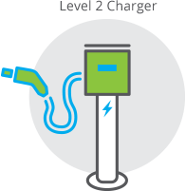
AC EVSE STANDARDS
J1772 AC Level 2
Home and Commercial Installation
240 Volts at up to 80 Amps
30A most common
Home 30A, Commercial 30A, 50A, 75A
Maximum Power Delivery (19.2 kW)
Mostly vehicle limited to 7.2kW
Typical time to charge
Pluggable Hybrid ( 0.5 – 1.5 hours, 0% to 90%)
EV 80 Mile Range (1.5 – 4 hours, 20% to 90%)
EV200 Mile Range ( 3.2 – 10 hours, 20% to 90%)
21 miles per hour of charge @ 30A and over 30 mph @48A
You can virtually always recharge overnight and can typically take advantage of TOU vehicle charging rates where offered.

Slide 30
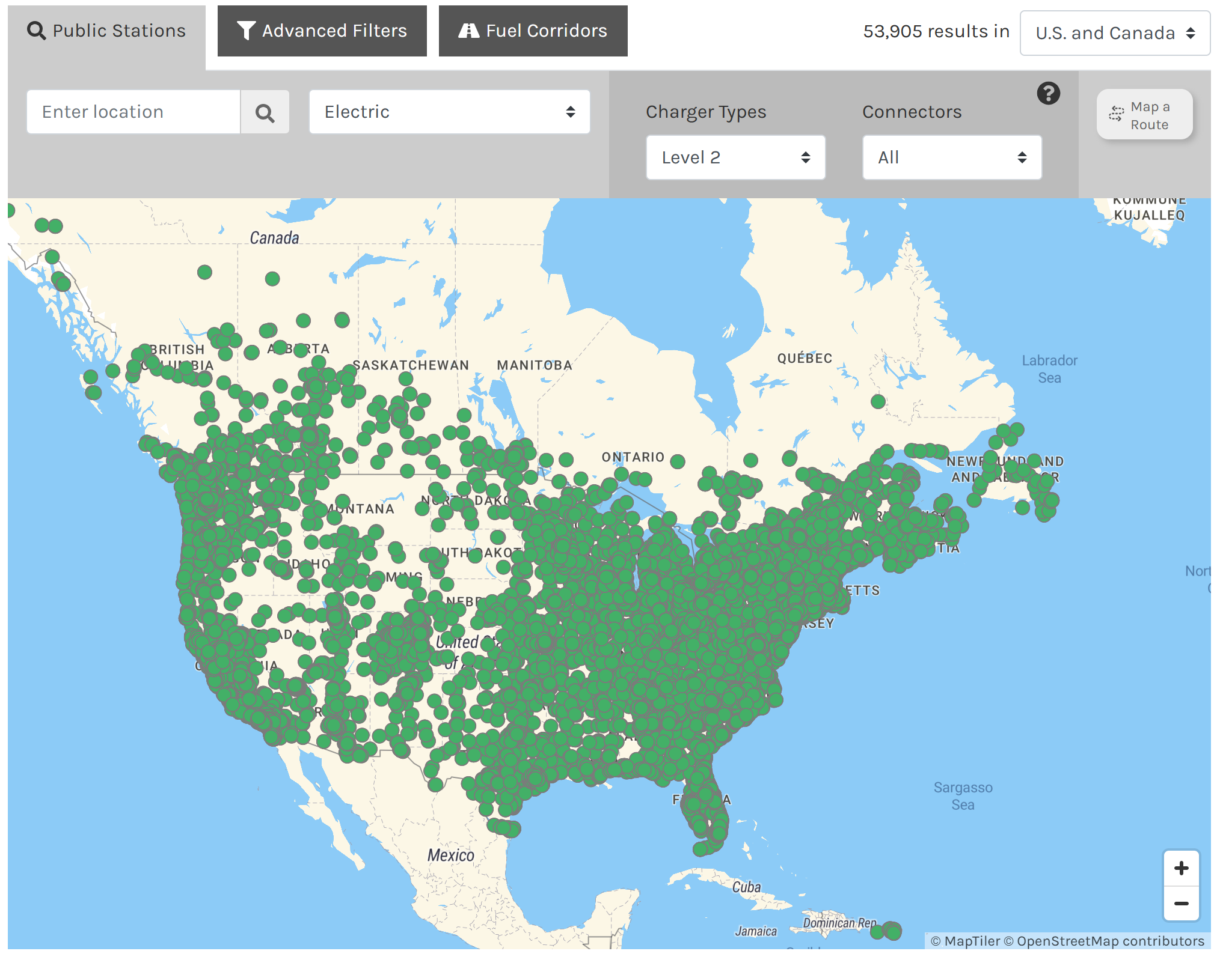
Level 2 Public Stations
2020 Sites:
19,216
2021 Sites:
30,145
2022 Sites:
46,781
2023 Sites:
51,508
Source: April, 2023 Alternative Fueling Station Data afdc.energy.gov
Note: Number of sites, not ports. A site typically has many ports.

Slide 31
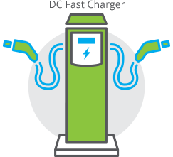
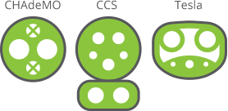
DC EVSE STANDARDS
Standards evolving rapidly
Combined Charging System
CCS1 SAE J1772 North America
CCS2 Europe
CHadeMO (Only Nissan and Mitsubishi)
Tesla V1
Tesla V2/V3 (Introduced in 2019)
Chaoji (China, Japan, India
Successor to CHadeMO and GB/T
>100kW is considered “high end” (400V Systems)
First US 350kW units installed Dec 10, 2018 (800V)
Source: calevip.org; forbes.com

Slide 32
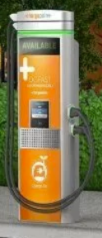
DC EVSE STANDARDS
Market Direction
DC Generation 1 (less than 150kW)
Nominal 400-500 VDC
Up to 300 A max
All current EV’s except one
DC Generation 2 (up to 400 kW)
Nominal 800 VDC (1000VDC max)
Up to 350A typ, 500 A max
Expected to be the norm by 2025
Stations cost roughly $50K per charger

Slide 33
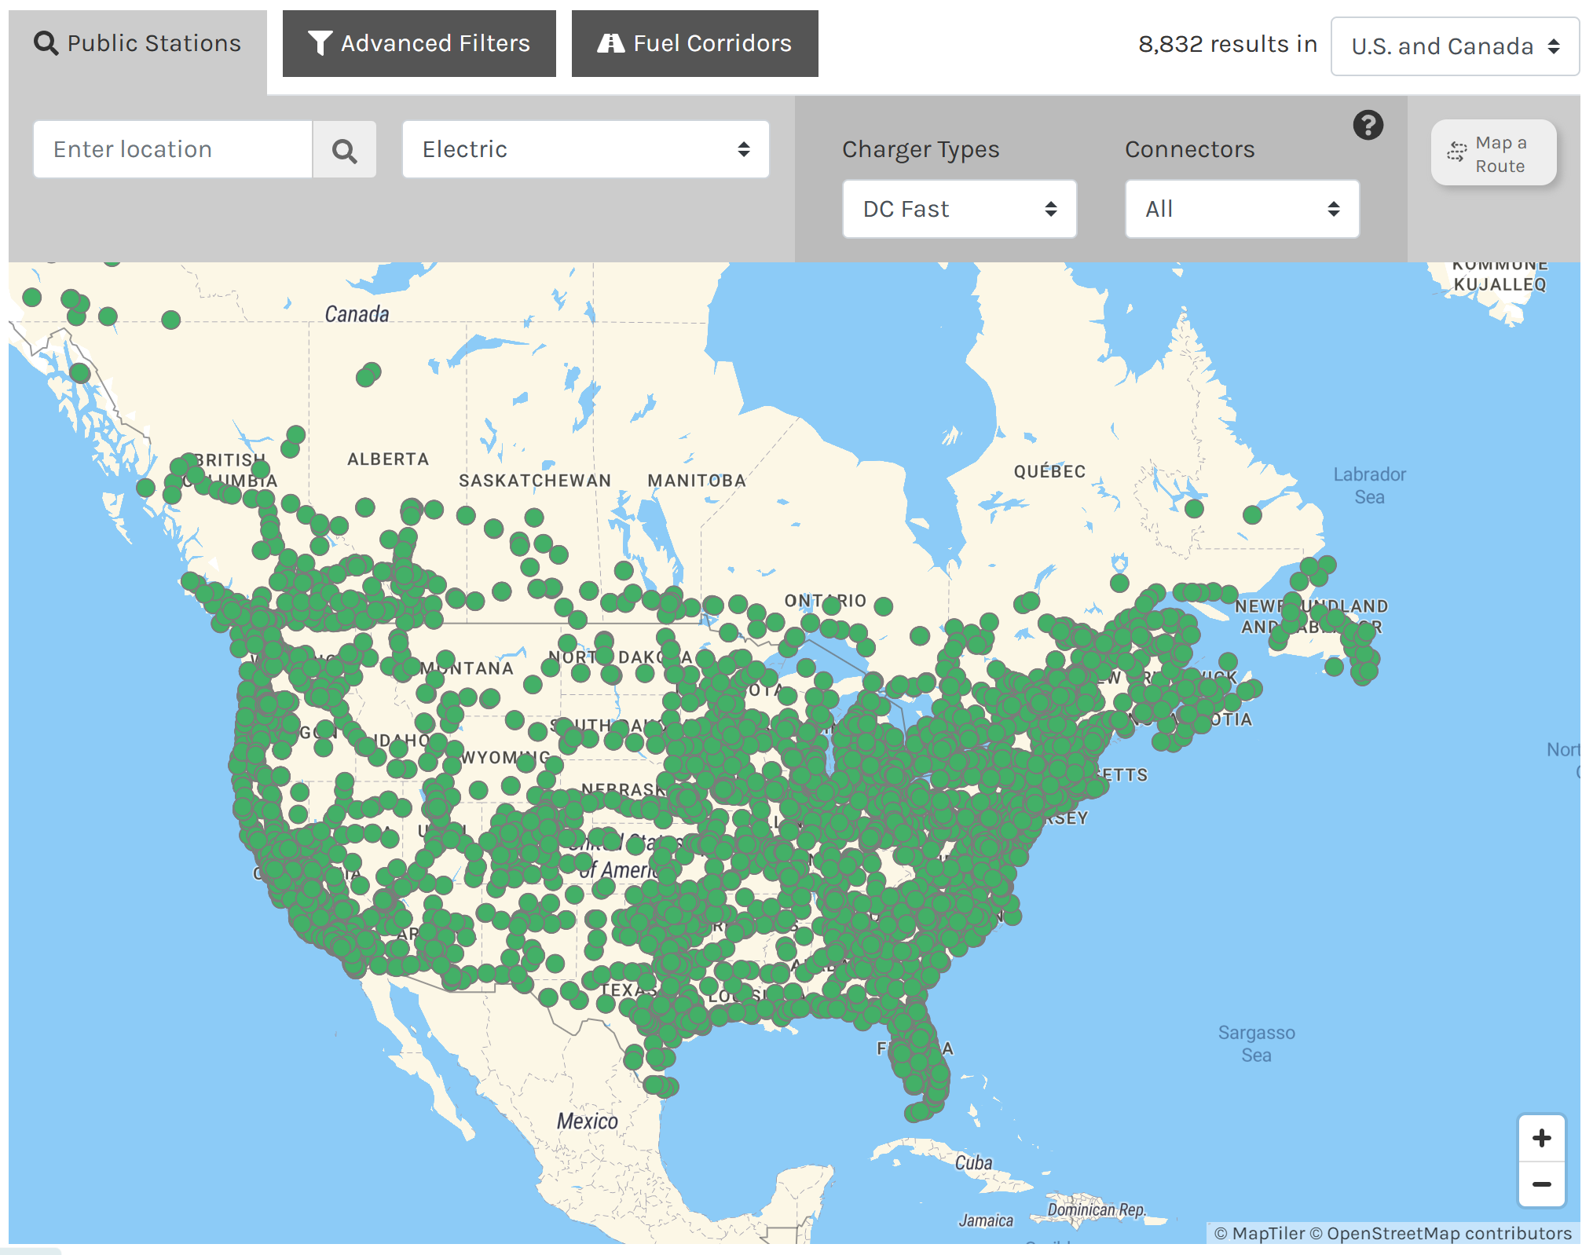
Level 3, DC Superchargers
2022 Sites:
7,219
2023 Sites:
8,832
Source: April, 2023 Alternative Fueling Station Data afdc.energy.gov

Slide 34
Electric Vehicle Charging Networks

Slide 35
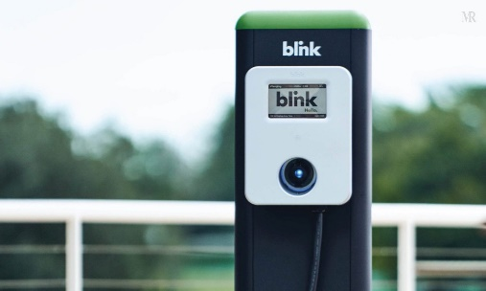
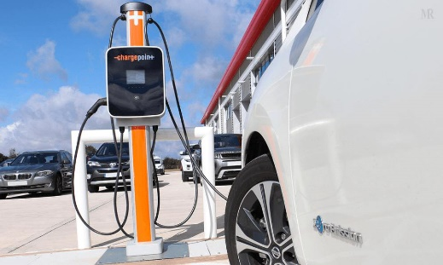
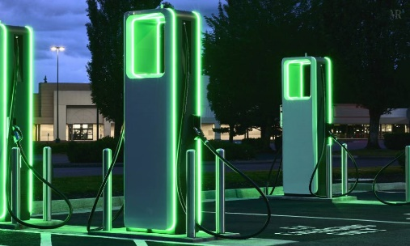
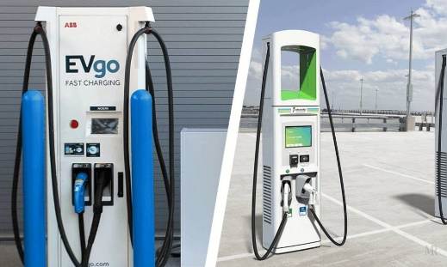
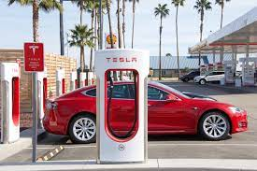
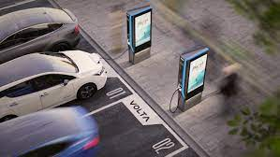
CHARGING NETWORKS
Major charging system networks
Blink
Chargepoint
Electrify America
EvGo
National Electric
Highway Coalition
SemaConnect
Tesla
Volta

Slide 36
Utility Involvement
Many Electric Utilities from small to large offer some electric vehicle charging stations in their service territory. Some are free to promote greater EV adoption, but most charge for the energy.
March 2, 2021 – six electric utilities proposed a network of chargers from Texas to the Carolina’s to be funded by, built by and administered by (i.e. energy sold by) these same utilities.
By December 7, 2021 there were 53 utilities signed up (all Investor owned other than one Coop and TVA) whose footprint covered 120 million of the 150 million connected customers in the US.

Slide 37
Utility Involvement – why?
Utilities can now sell or will be able to sell significantly more electricity
Potentially this power can be sold for two to three times the cost offered to the average consumer at home.
This is now infrastructure that the utility can control and can be placed both in locations where the market needs the charging stations and where the Utility infrastructure can best support these charging stations.
Being able to add 1MW of usage where the utility wants to add this is highly desireable.

Slide 38
Regulatory Environment

Slide 39
Regulatory Background
Sales of electricity as a vehicle fuel are regulated by the Department of Commerce
Like all sales of all things based on quantity sold, EVSE sales are regulated by NIST Handbooks 130 and 44.
HB130 establishes that all sales of electricity as a vehicle fuel must be based on the quantity delivered.
HB44 sets performance requirements for devices (Electric Vehicle Service Equipment) used to dispense electricity for sale.

Slide 40
HB44 APPLICABILITY
A.1. General. – This code applies to devices, accessories, and systems used for the measurement of electricity dispensed in vehicle fuel applications wherein a quantity determination or statement of measure is used wholly or partially as a basis for sale or upon which a charge for service is based.

Slide 41
HB44 REQUIREMENTS
Metrological Requirements of HB44
S.3.1. Metrological Components. – An EVSE measuring system shall be designed and constructed so that metrological components are adequately protected from environmental conditions likely to be detrimental to accuracy.
S.3.5. Temperature Range for System Components. – EVSEs shall be accurate and correct over the temperature range of – 40 °C to + 85 °C (− 40 °F to 185 °F).
S.8. Minimum Measured Quantity (MMQ). – The minimum measured quantity shall satisfy the conditions of use of the measuring system as follows:
(a) Measuring systems shall have a minimum measured quantity not exceeding 2.5 MJ or 0.5 kWh.

Slide 42
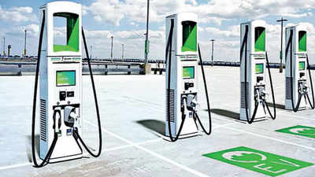
HB44 APPLICABILITY
Use Cases –COVERED
ANY transaction which is based on the amount of energy delivered
Examples
A network of charge stations charges a monthly fee to belong AND a fee based on the amount of energy used
A EVSE charges for the amount of energy delivered
A parking lot charges for parking and EVSEs located in it also charge for the amount of energy delivered if used

Slide 43
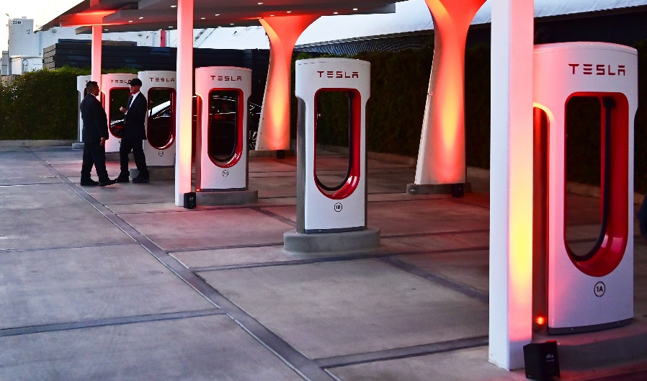
HB44 APPLICABILITY
Use Cases – NOT COVERED
A store provides a free EVSE in its parking lot
A paid parking lot provides EVSEs for which there is no charge based on the amount of energy delivered
Tesla provides free charging services for some owners
An organization charges a monthly fee for unlimited use of its network of EVSEs.

Slide 44
HB44 APPLICABILITY
Exceptions-This code does not apply to:
The use of any measure or measuring device owned, maintained, and used by a public utility or municipality only in connection with measuring electricity subject to the authority having jurisdiction such as the Public Utilities Commission.
Electric Vehicle Supply Equipment used solely for dispensing electrical energy in connection with operations in which the amount dispensed does not affect customer charges or compensation.
The wholesale delivery of electricity.

Slide 45
Certification and Traceability
None of this means anything if we can not certify and provide traceability for these tests.
Two general approaches – New York approach and California Approach
Traceability through a National Lab to an International Standard
This requires a DC “Standard”
Fortunately DC Power = VA
Need a certifiable voltage source and a certified current source and the ability to measure down to the appropriate levels for both Volts and Amps, then have a National Lab do the same test on the lab equipment
ANSI has also spent a great deal of time creating a new Standard to cover DC Metering – ANSI C12.32 ready for re-balloting this year. This will be the DC version of C12.1 for AC metering.

Slide 46
Business Segment – Revenue Opportunities and Expectations

Slide 47
US Primary Energy by Source

Slide 48
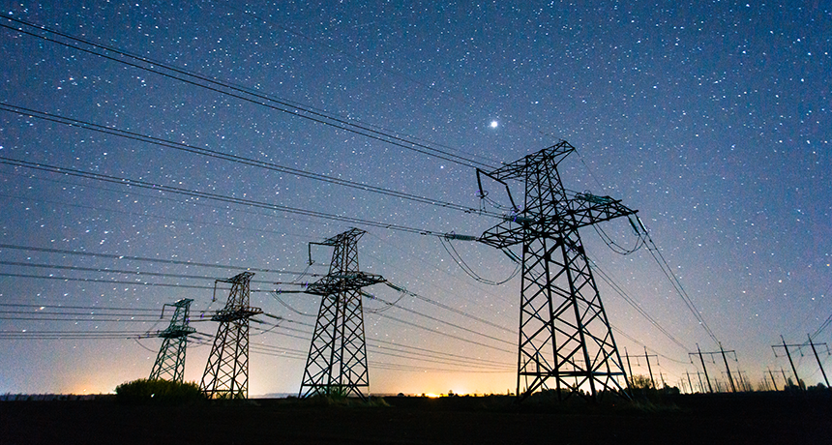
US TOTAL ENERGY CONSUMPTION
December 2021:
Generated 339,684 (thousand MWh or Gwh)
Average Residential retail price: 13.75 cents/kwh

Slide 49
US ELECTRIC ENERGY CONSUMPTION
Americans drove 3.23 trillion miles in 2021. If this was all done in electric vehicles getting 3 mi/kWh, then we would need 1.1 GWh of energy just to charge cars.
Average household uses 10.7 MWh/yr (2021).
Charging our cars could use an additional 8.8 MWh/yr.
Charging at home is a potential market worth $145 billion per year in added revenue to electric utilities

Slide 50
Topic Summary
Overview of Electric Vehicles (EV’s) in 2024
Who is in the market?
Who dominates the market?
How many EV’s are on the road?
Where is the market going?
Types of Electric Vehicle Supply Equipment (EVSE’s or chargers)
Electric Vehicle Charging Networks
Regulatory environment
Business Segment – revenue opportunities and expectations

Slide 51
Electric Vehicle Service Equipment - EVSE
What is it all about and why should I care?

Slide 52
Questions and Discussion
Tom Lawton
President
tom.lawton@tescometering.com
TESCO Metering Bristol, PA
215.228.0500
This presentation can also be found under Meter Conferences and Schools on the TESCO website: tescometering.com
ISO 9001:2015 Certified Quality Company
ISO 17025:2017 Accredited Laboratory

Slide 53
Tesco hospitality suite
We would like you to join us in the TESCO Hospitality Suite for networking and more discussions about metering. The discussion will not be exclusively metering……….but we love metering and that is the most common topic.
TESCO Hospitality Suite – Brighton Tower
Monday and Tuesday 8:00 PM – 10:00 PM

