Slide 1
Meter Testing Introduction
44th Annual Mississippi Power and Meter School
Tuesday February 11, 2025 - 3:00 PM
Tom Lawton
Notes:
1

Slide 2
Questions to Answer
Why do we test?
How do we test?
What types of meter tests are there?
How do utility tests differ from customer request tests?
What is In-Service Testing?
How do we know meter tests are good?
What do we do with the test data?

Slide 3
Why Do We Test?
The first and most important reason is that this is the fundamental contract we have with our customers – we sell them electricity and they pay the agreed upon price. Our rate payers expect that we are charging them fairly and we make every effort to ensure that we are. So, we perform meter tests.
Because of the importance of this, Utility commissions in every state also require some level of meter testing.
But only for accuracy. State regulatory commissions want electric utilities to ensure that no customer is being billed unfairly, and that no subset of customers is being unfairly subsidized by the rest of the rate payers. Some states mandate only accuracy tests and others require demand
and time of use accuracy tests.
Any tests beyond accuracy tests are tests that are simply considered a “good business practice”. And even Utilities who do not have to abide by State Regulatory rules test for accuracy as their customers expect this of them.

Slide 4
Accuracy Testing
The basic accuracy tests puts energy through a meter and the same amount of energy through a traceable standard. That standard is considered 100.0% accurate for the sake of our accuracy test and the ratio of how much energy the meter sees to how much energy the standard sees is the meter accuracy.
Electric meters always come from the factory with a stated accuracy based on exactly this type of test. Typical accuracies might be 99.98% or 99.96%. Typical requirements for residential meters are +/- 2.0% so these meters are far better straight off the manufacturing line than required. Many utilities tighten up these requirements and will not let a meter into the field with any thing more than +/- 0.5%. These new meters are still more than an order of magnitude better than that.

Slide 5
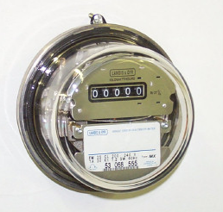
Comparing the Meter to the Standard
The basic watt hour meter is a marvel in simplicity. The old electromechanical meters can continue to accurately (with better than 99.90% accuracy) measure energy consumption after more than 30 years in an outdoor environment. And they were and continue to be relatively inexpensive ($20 to $30). This is pretty incredible.
With electromechanical meters, for every turn of the disk a certain amount of energy passing through the meter (Kh). Count the number of turns and you know how much energy is used over time.
For electronic meters, for every pulse there is a certain amount of energy passing through the meter. Count the pulses after the first one and you know how much energy is used over time.
Modern standards all have pulse outputs and most also provide the comparison with the meter under test.
Landis + Gyr Type MX Electromechanical (1994 to 2009)

Slide 6
Basic Energy Formula
The essential specification of a watthour meter’s measurement is given by the value K_{h} [ Watthours per disk revolution ]
The watthour meter formula is as follows:

Slide 7
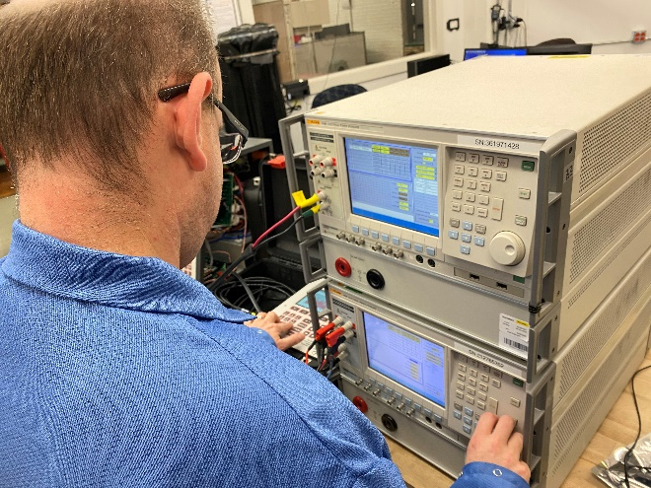
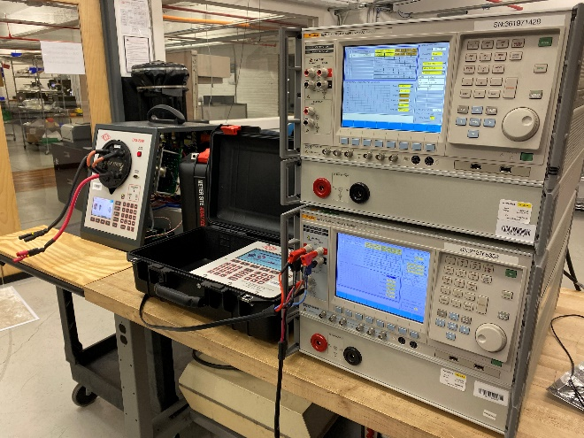
Traceability and Setup
However, there is also the accuracy and traceability of the standard to consider as well as the set-up of the test and whether the test is in the meter lab, the meter shop or the field.
Traceability is the ability to trace the calibration of any one device back to an international standard.
Typical stated accuracies for standards are 0.04%, 0.02% and 0.01%. In the lab, these same standards typically measure better than 0.005%. That is 50 parts per million in accuracy.
Just because you have all the right equipment though, a bad setup can invalidate any test or calibration whether this is in the field or in a more controlled environment.

Slide 8
Meter Testing Traceability
Traceability is defined as ability to link the results of the calibration and measurement to related standard and/or reference (preferably national or international standard) through an unbroken chain of comparisons.
Calibration is typically performed by measuring a test unit against a known standard or reference.
Master standard (i.e., gages) are kept by National Measurement Institute (NMI) of each country.
Notes:
8

Slide 9
Meter Testing Traceability
National Institute of Standards and Technology (NIST) provides internal tracking numbers, which are often used as evidence of traceability.
WARNING! NIST does not certify or guarantee that calibration and measurements are correct, nor does it provide any kind of certification of accuracy and calibration. NIST only provides certifications for the work performed by them.
NIST is the US National Lab but using NRC out of Canada or any other national lab is also acceptable. We need traceability to an international standard and all these national labs do this.
Notes:
9

Slide 10
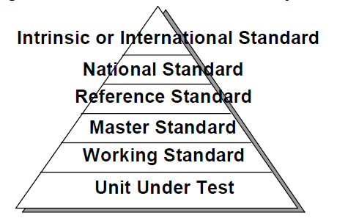
Meter Testing Traceability - Standards
Notes:
10

Slide 11
Meter Testing Traceability - Standards
National Standard
In the US, this is maintained by NIST, in Canada by NRC. Not all countries have a National Standards group and even the US does not have a group for every item of interest to an electric utility (e.g., voltage transformers)
Reference/Master Standard
Item of highest metrological quality located at a site where calibration is being conducted.
Transfer Standard
Lower level of Reference Standard and used for calibration of lower-level calibration requirements measuring devices.
Working Standard
Lower level of Reference Standard and used for calibration of lower-level calibration requirements measuring devices. Should be compared to Master Standard or Reference Standard on regular basis; used for daily checks comparisons of the calibrated devices.
Notes:
11

Slide 12
Test Equipment Calibration
Primary Requirement: Traceable to an International Standard
Meter Test Boards, Field Test Kits calibrated to a known master standard maintained at Meter Shop.
Some periodicity such as monthly or quarterly
Reference or Master standard calibrated by outside vendor traceable to a national lab (e.g., NIST, NRC) or directly by a national lab.
Usually annually for metering

Slide 13
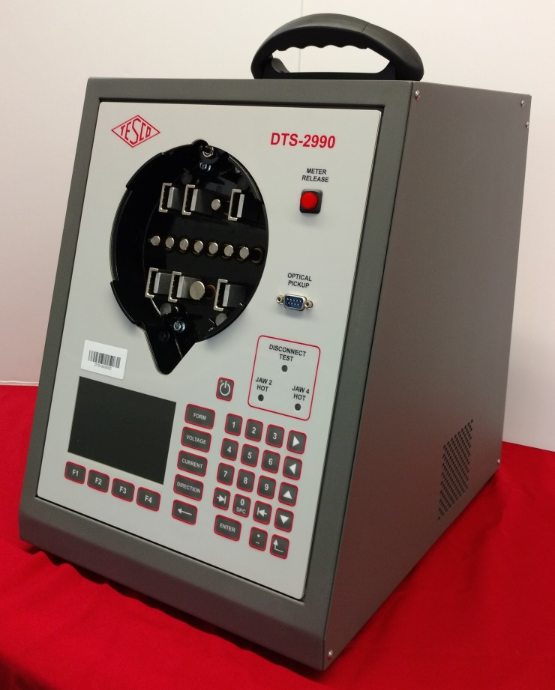
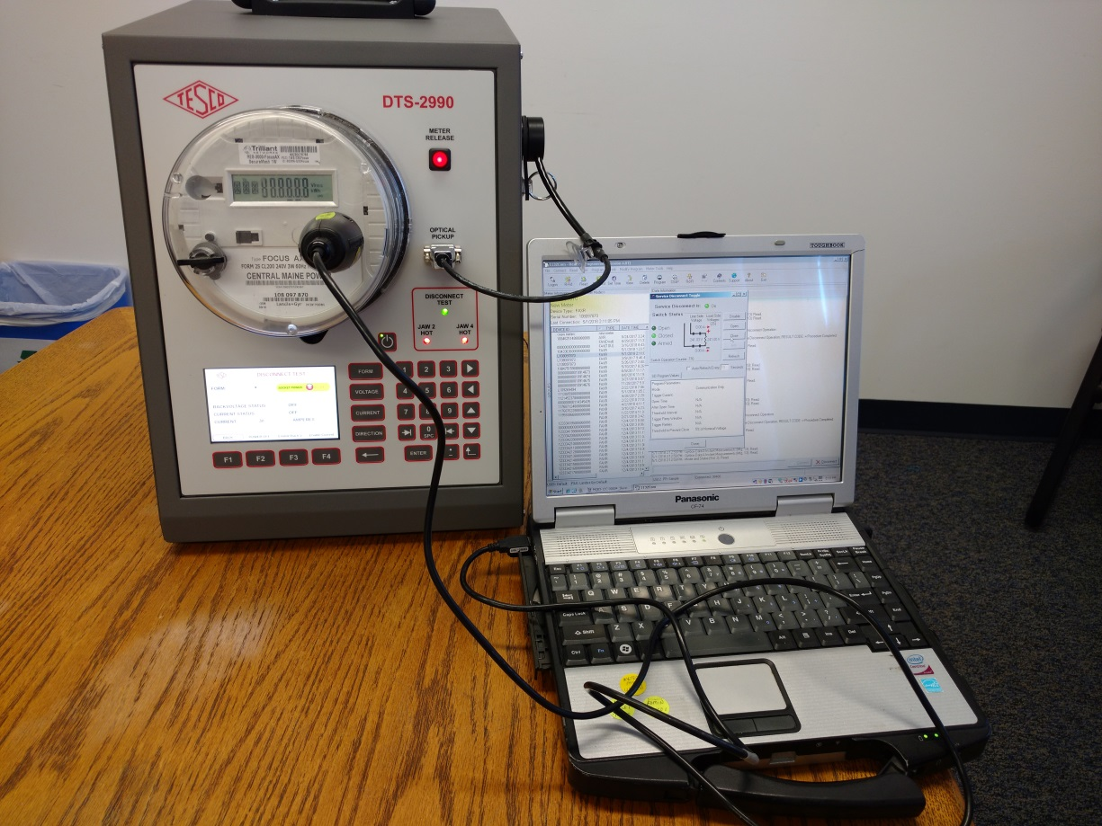
Meter Shop and Field Accuracy Tests

Slide 14
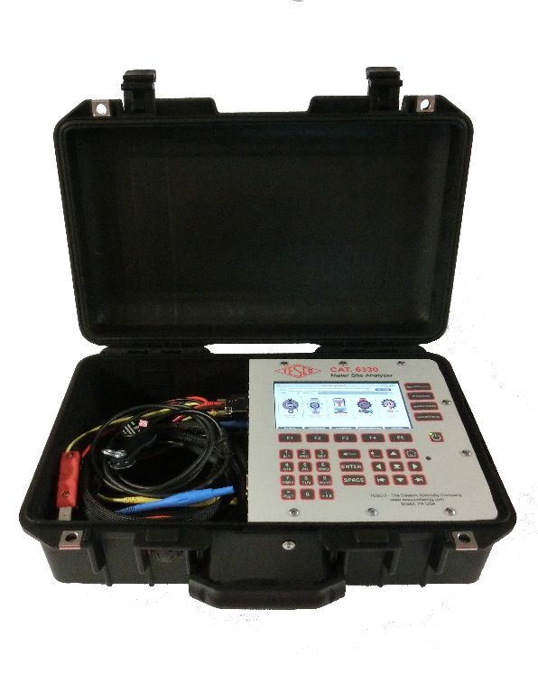
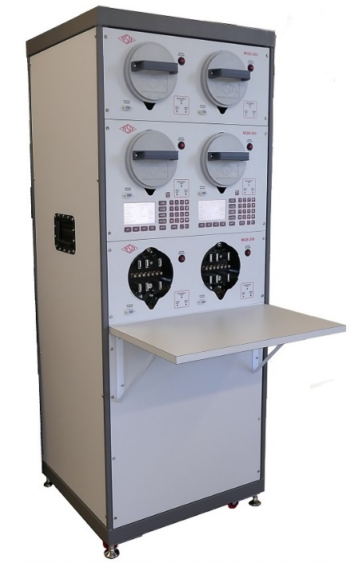
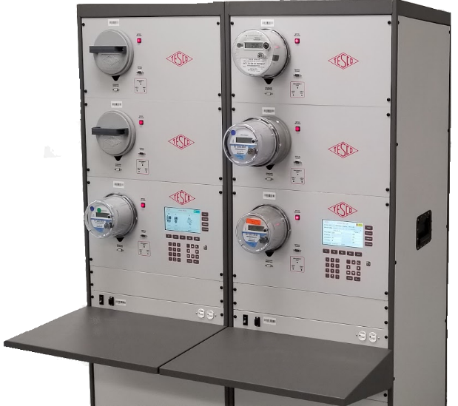
Typical Test Setups for Shop and Field
True Three phase boards – multi position and single position
Series Parallel Boards – multi position and single position
Field Test kits

Slide 15
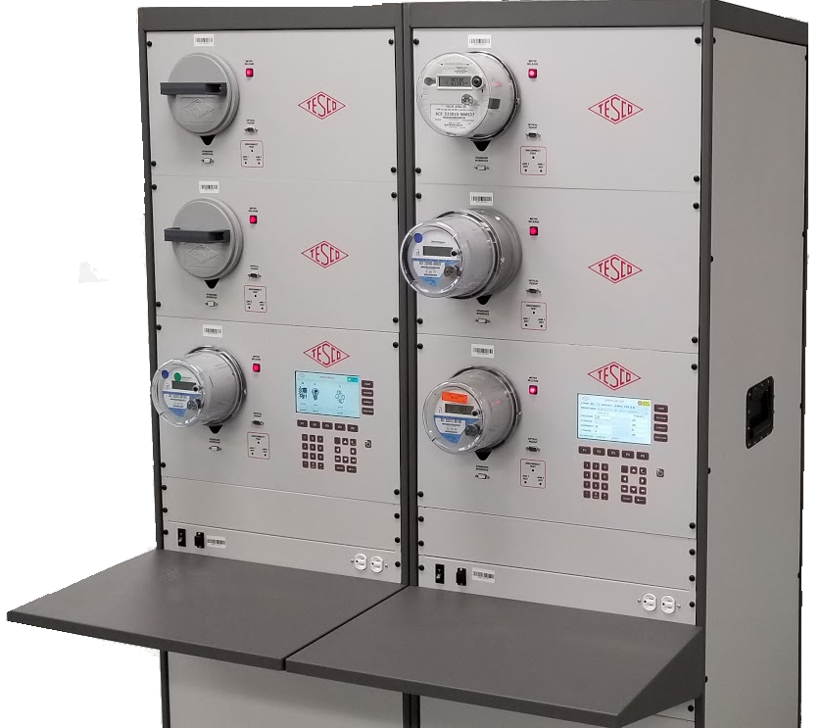
Typical Test Setups for Shop and Field
True Three Phase Boards
Multi-position and Single Position
With true three phase Test Boards the tester can apply true three phase voltage and current to electric meters, enabling the meters to be tested under all possible conditions that may be encountered in the field.
These types of test boards can also be used for a variety of other functional testing and operational tasks.
New AMI/AMR meters settings check-out
Meter program updates
Software revision checking for both the meter and the communications module
Communications module troubleshooting
Checking of problem meters for open/shorted elements

Slide 16
Typical Test Setups for Shop and Field
Series Parallel Boards
Multi-position
Power-up and apply load to electric watt-hour meters for functional and accuracy testing. These types of boards can also assist with AMI Meter Certification process and AMI meter qualification and communication testing.

Slide 17
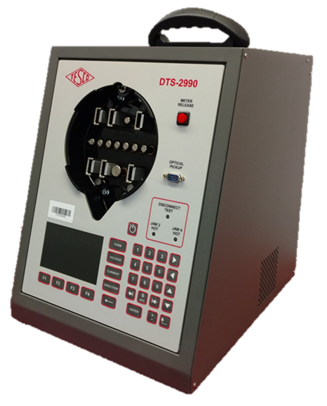
Typical Test Setups for Shop and Field
Series Parallel Boards
Single Position
These types of boards are the same as the multi position boards and off the same functionality. They are transportable and can be moved between locations or located in meter testing vans.
These types of boards are ANSI compliant and newer versions have waveform generator, providing all of the waveforms called out by ANSI C12. These boards typically have a single voltage and three isolated current sources.

Slide 18
Is the Meter Test All About Accuracy?
Once upon a time……….
…….meter testing was only about accuracy. AMI has changed that completely.
We have always tested the functionality of the meter, but when all the meter did was measure energy, this meant all we were interested in was an accuracy test.
Today’s AMI meters typically
Have a disconnect device under the cover
provide a variety of distribution related information including direct voltage and current measurements that can be provided back to the head end
Have two way communication to meter and the meters can be upgraded over the air.
Have a variety of alerts and alarms. The meter can have
temperature alerts
tamper alerts
micro arc detection (hot socket) alerts
last gasp alerts among other alarms.
Wave forms can be recorded, and a host of distribution specific data collected and transmitted.
All this functionality is now becoming part of “meter testing”.

Slide 19
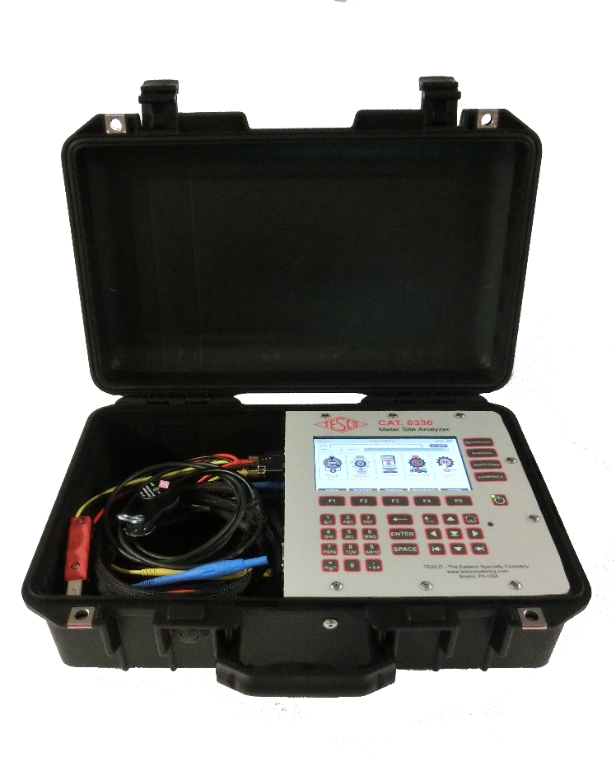
Typical Test Setups for Shop and Field
Field Test Kits
As a utility, most revenue comes from large customers who have transformer-rated services. At transformer rated sites the opportunity for something to go wrong is much greater than at a self-contained site. Studies have shown that at transformer-rated sites, most issues are related to wiring, CTs, PTs and other issues. If you want to be sure that the customer is billed correctly and you are not losing revenue, you must test the whole site, not just the meter.
Complete Site Verification
CT Testing (ratio with Burden, burden, admittance)
Meter Testing
Accuracy, Demand, Timed Register, Timed Run, Energy Delivery

Slide 20
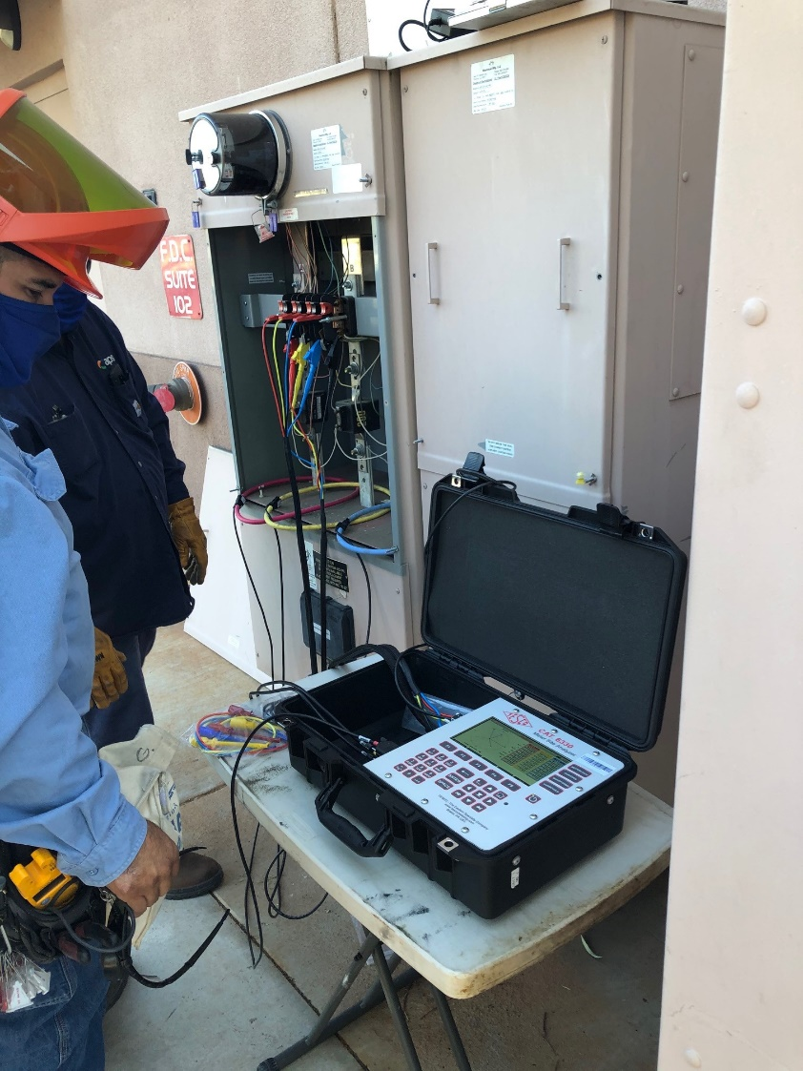
Site Inspection Vs. Meter Testing
For transformer rated services the site inspection and verification is far more important than just the meter test. The meter test is only one component of this work and is often the least important of all the steps on the check list.
We are interested in single phase meter testing in this presentation but even at self-contained residential services performing a visual inspection of the site often determines what the issue or issues may be with the site that have nothing to do with the accuracy of the meter.

Slide 21
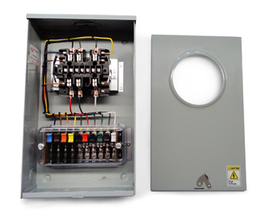
Testing a Meter Vs. Testing a Site
Test an installation and system and not just a meter!
Test programs may need to involve testing and checking the meter performance as well as checking and testing the installation. This more extensive test check list needs to be done especially for the higher revenue C&I customers.

Slide 22
Compliant Testing
Customers always have the right to request a meter test.
Some utilities and some jurisdictions allow for testing at the customer site, others require a test in a laboratory environment.
Some allow the customer to witness the test and others require the utility commission to witness the test.
Utilities must show that the meter tests well and must demonstrate that they have a test program in place to ensure the meters in service are performing well.

Slide 23
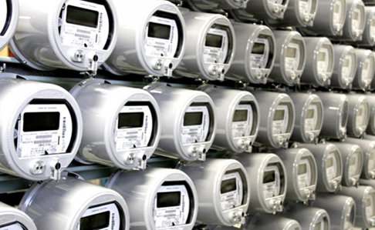
General Meter Testing Requirements
New Meters
Manufacturers tests
In-house tests on new shipments
Return to Service Testing
In-Service Meters
Periodic Tests
Selective, random, or statistical testing
Retirement tests
Testing of related metering equipment

Slide 24
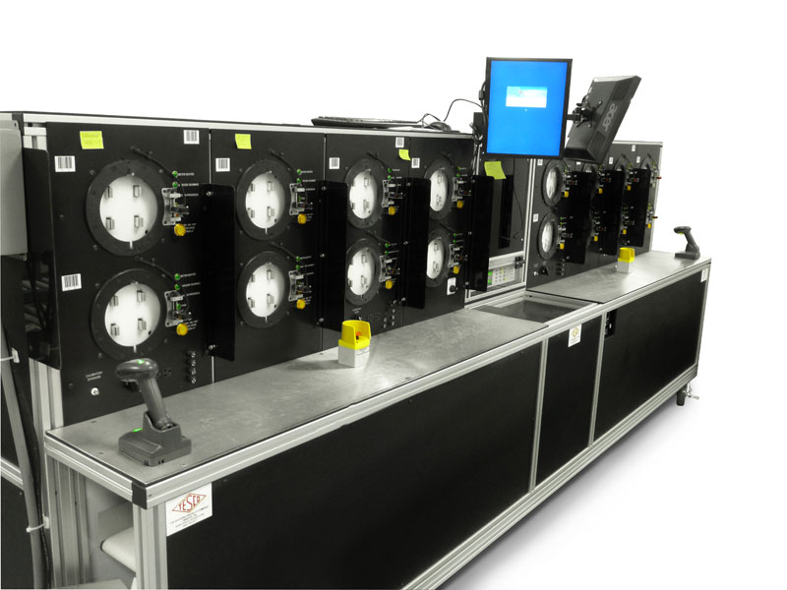
New Meter Testing Programs
Accept the Manufacturer’s Test results
Perform a Statistical Test of an incoming shipment
Perform a 100% test of an incoming shipment

Slide 25
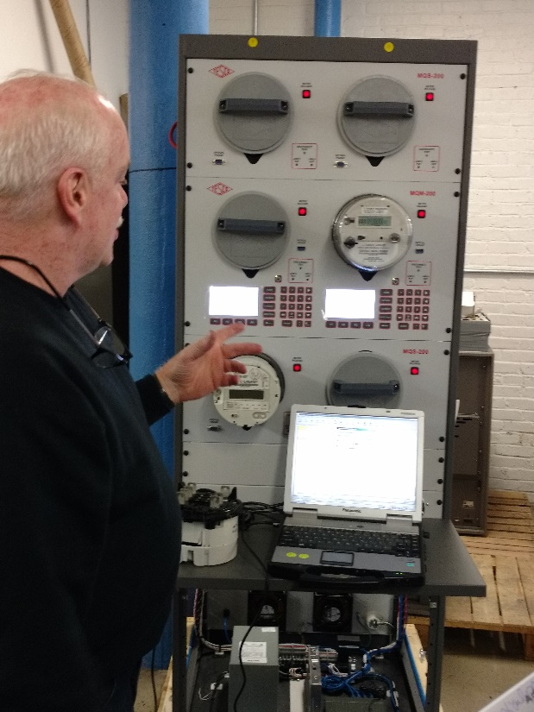
Return to Service Testing
Meters to be returned to service must always (virtually every utility commission requires this) be accuracy tested before being returned to service.
Best business practices also require that the meter is functionally tested as well.

Slide 26
In-Service Testing
Meter Testing for new and in-service meters is specified in ANSI C12.1-2015, American National Standard for Electric Meters, Code for Electricity Metering. Most utility commissions use this Standard a reference or the basis for their meter testing requirements.

Slide 27
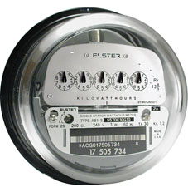
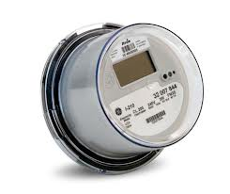
Periodic Test Plans
Periodic
Varies by State
Example provided by ANSI C12.1:
Each Electromechanical meter is tested once every 8 years
All other Meters are tested every 16 years
Appendix D provides details for other meters & devices
No guidance for AMI meters
Generally, average of 12.5% of population tested per year
8 Years
16 Years

Slide 28
Statistical Plans: The Best Approach
ANSI C12.1-2001 Code for Electricity Metering Guidance
Paragraph 5.1.4.3.3 Statistical sampling plan
“The statistical sampling plan used shall conform to accepted principles of statistical sampling based on either variables or attributes methods. Meters shall be divided into homogeneous groups, such as manufacturer and manufacturer’s type. The groups may be further divided into subdivision within the manufacturer’s type by major design modifications.”
NOTE - Examples of statistical sampling plans can be found in ANSI/ASQC Z1.9, the ANSI version of MIL-STD-414 and ANSI/ASQC Z1.4, the ANSI version of MIL-STD-105.

Slide 29
Why Use a Statistical Test Plan?
Focuses testing on the proper meters
Minimizes number of meters to be tested; usually requires less than 30% of what a periodic testing plan requires
Provides data and analysis tools for use in
understanding what is happening with installed meters
or for use in the purchasing of new meters

Slide 30
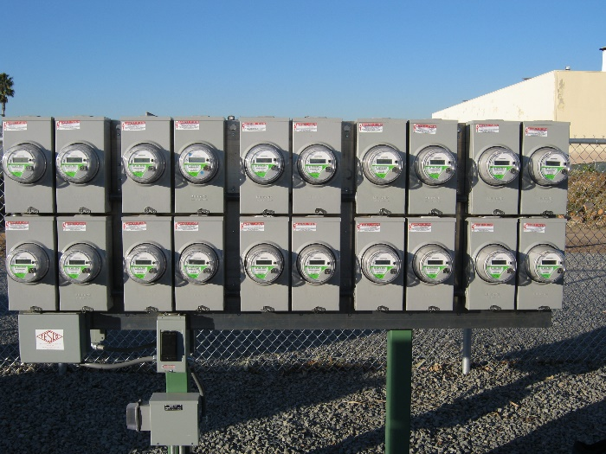
Homogenous Population(s)
The groups or populations being sampled and tested are made up of the same or similar items, items which operate in the same way and were made in the same manner.
For electric meters, this has traditionally been interpreted as being meters of a specific meter type from a manufacturer (i.e., AB1, J5S, MX, etc.).
AMR & AMI programs have helped to make the overall populations more homogenous. This makes a utility with AMR & AMI meters better prepared to take advantage of a statistical sampling plan.

Slide 31
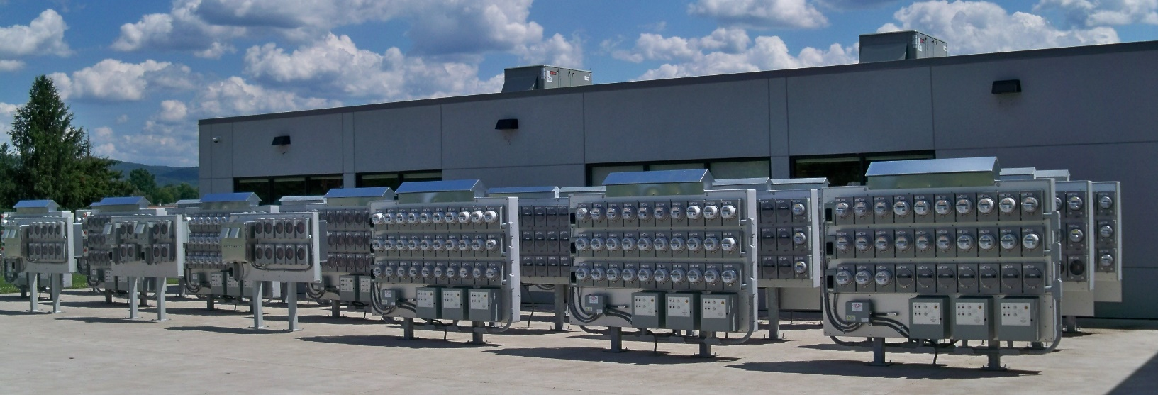
Tracking Meter Records
AMI programs help to update and overhaul meter record systems.
Having the records for the entire meter population updated allows for a better chance that test data is available to answer questions and that any meter may be selected as part of the sample for testing.

Slide 32
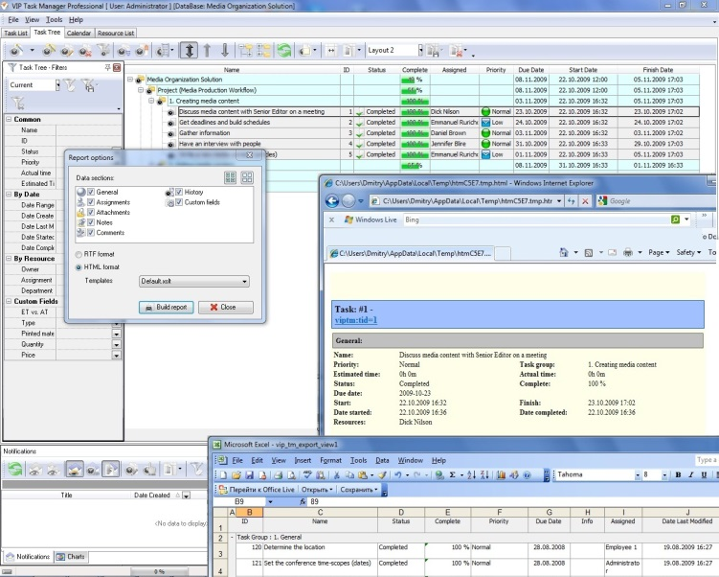
Meter Test Data Tracking
Test data should be tracked throughout meter life
Certification testing, first article, acceptance testing, in-service (field & shop), retirement
Meter test data should be linked to meter record data such as meter form, amps, voltage, display type, etc.
Best time to start to develop the program is before the meters are being installed.
Accuracy test data is usually collected automatically as new meters are tested in meter shops or cross docks.

Slide 33
Meter Test Data Tracking
Need to consider tracking non-accuracy functional testing (meter software configuration, service disconnect testing, voltage, etc.)
Use installation reports to determine if there is any initial concerns about the meters being installed.
Typical reports that should be available:
Failed Meter Report, Project to Date
Electric Meters on Network Report

Slide 34
Meter Testing Traceability
Test equipment to an International standard
Tracking number of meters to be tested per State Commission requirements
Tracking meter test data
Meter Records
Meter Data Management System (MDMS)

Slide 35
Meter Test Data Tracking System
System should track meter test results for ease of future reference or for response to public or Utility Commission inquiries.
Maybe part of Meter Data Management System (MDMS) or a separate Meter Records system.
Requires discipline in collecting & entering data, especially field tests.

Slide 36
Questions to Answer
Why do we test?
How do we test?
What types of meter tests are there?
How do utility tests differ from customer request tests?
What is In-Service Testing?
How do we know meter tests are good?
What do we do with the test data?

Slide 37
Questions and Discussion
Tom Lawton
President
tom.lawton@tescometering.com
TESCO Metering
Bristol, PA
215.228.0500
This presentation can also be found under Meter Conferences and Schools on the TESCO website: tescometering.com
ISO 9001:2015 Certified Quality Company
ISO 17025:2017 Accredited Laboratory

