Slide 1

ANSI C12.1 Overview and Intro to Meter Testing
PREA
March 4, 2025 11:15 AM – 12:30 PM
Tom Lawton and Perry Lawton

Slide 2
ANSI
American National Standard Institute, Inc.
  Not a government agency
  Standards do not have force of Law
  All compliance is voluntary
  ANSI generates standards through the use of a sponsoring organization called the “secretariat” who actually publishes the Standard.
    For C12.1 NEMA (National Electrical Manufacturer’s Association) is the secretariat.
    NEMA has seven sections one of which is for Utility Products and Systems. All meter manufacturer’s and manufacturer’s involved in electric metering are members of NEMA or are eligible to be members.
    Paul Orr has been the NEMA’s secretary assigned to C12 for over ten years providing continuity to the process. NEMA Manufacturing members determine which efforts will be funded and which will not be funded.

Slide 3
ANSI (cont.)
American National Standard Institute, Inc.
  NEMA organizes committees to propose and review standards
  Standards are republished approximately every five (5) years and abandoned if not updated or reaffirmed once every ten (10) years.
  Standards codify consensus approaches in common practice
  In recent years the ANSI committee has had to deal with breaking new ground as well as several controversial issues
    This is unusual for the committee and the committee has responded by no longer being reluctant to address them, staying more on point during contentious debates, and moving through the work required in a far more efficient manner. Another example of how AMI is changing everything in our industry.

Slide 4
ANSI C12
All ANSI Standards related to Electric Metering are in the ANSI C12 group of Standards
C12 Main Committee
  General makeup has expanded slightly over last few years
  30 voting members with representation from three groups (no one group can have more than 40%):
    12 - Manufacturers: Meter, Socket, Test Equipment, etc.
    10 - Users: Utilities
    8 - General Interest: PUC, UL, IEEE, Consultants, etc.
  Meets twice a year in conjunction with EEI/AEIC Meter conference.

Slide 5
ANSI C12 (cont.)
C12 Main Committee
  Has final approval for all activities on any C12 family standard
  Establishes Subcommittees (SC) and Working Groups (WG) to address various standards and issues
  Sub committees and Working Groups also meet twice a year in conjunction with EEI Transmission, Distribution and Metering Conference and also hold regular or ad hoc conference calls throughout the year as members put together drafts and other technical material for consideration at the next face to face meeting.

Slide 6
ANSI C12 (cont.)
C12 Subcommittees
  Various subcommittees have been organized to review specific standards
  This is where the work is really done
  Each operates slightly differently
  Each meets on a schedule of its own choosing
  Most meet at EEI Biannual Transmission, Distribution and Metering Meetings
  Communication WG meets more often and longer
  Various subgroups meet frequently by teleconference

Slide 7
ANSI Standards Related to Electric Metering
ANSI C12 Standards Status – April 2019
Designation | Final Action Date | Title | Responsible Subcommittee | Responsible NEMA Section | Project Action
ANSI C12.1-2014 | 2/1/2016 | Electricity Metering, Code for | SC 1 | 8EI - 1TC | Published 3-30-16
ANSI C12.4-1984 (R2002, R2011) | 5/19/2011 | Registers, Mechanical Demand | SC 1 | 8EI – 1TC | Reaffirmed. Published Jan. 6, 2012 *Reaffirm or Revise?
ANSI C12.5-1978 (R2002, R2012) | 5/19/2011 | Meters, Thermal Demand | SC 1 | 8EI –1TC | Reaffirmed. Published Oct. 25, 2012 *Reaffirm or Revise?
ANSI C12.6-1987 (R2016) | 01/12/17 | Phase-Shifting Devices Used in Metering, Marking and Arrangement of Terminals for | SC 15 | 8EI – 3TC | Published Jan 10, 2018
ANSI C12.7-2005 (R2014) | 8/14/14 | Requirements for Watthour Meter Sockets | SC 15 | 8EI – 3TC | Approved August 14, 2014 Published Feb. 23, 2015
ANSI C12.8-1981 (R2012) | 5/19/2011 | Watthour Meters, Test Blocks and Cabinets for Installation of Self-Contained “A” Base | SC 15 | 8EI – 3TC | Published Dec. 18, 2012 *Reaffirm or Revise? 2 – year BSR-11 Extension request submitted to ANSI Plan to have C12.8 withdrawn after figure needed from C12.8 is placed in C12.7.
ANSI C12.9-2014 | 9/17/14 | Test Switches for Transformer-Rated Meters | SC 15 | 8EI – 3TC | Approved on Sept. 17, 2014 Published Mar. 12, 2015
ANSI C12.10-2011 | 6/28/2011 | Physical Aspects of Watthour Meters – Safety Standard | SC 1 | 8EI –1TC | Approved June 28, 2011 Published Oct 2011. Revisions in discussion Meter Safety WG BSR 11 Extension until Mar 2020

Slide 8
ANSI Standards Related to Electric Metering (cont.)
ANSI C12.11-2006 (R2014) | 5/27/14 | Instrument Transformers for Revenue Metering, 10 kV BIL through 350 kV BIL (0.6 kV NSV through 69 kV NSV) | SC 15 | 8EI – 2TC (work completed by 8EI-3TC) | Approved May 27, 2014 Published July 29, 2014. *Reviewing started April 2016
ANSI C12.14-1982 (R1993) | 8/14/2002 | Electricity Meters, Magnetic Tape Pulse Recorders for | SC 1 | 8EI –1TC | Withdrawn 2002
ANSI C12.17-1991 | 8/14/2002 | Cartridge-Type Solid-State Pulse Recorder for Electricity Metering | SC 1 | 8EI –1TC | Withdrawn 2002
ANSI C12.18-2006 (R2016) | 3/16/17 | Protocol Specification for ANSI Type 2 Optical Port | SC 17 WG4 | 8EI –1TC | Reaffirmation Approved by ANSI BSR on 8-23-16 Published 3-16-17
ANSI C12.19-2012 | 10/2/14 | Utility Industry End Device Data Tables | SC 17 WG2 | 8EI –1TC | Published May 6, 2015 SC17 WG2 Draft Revision In Progress
ANSI C12.20-2015 | 1/24/17 | 0.1, 0.2 and 0.5 Accuracy Class | SC 20 Formerly SC16 | 8EI –1TC | ANSI Approved 1/24/17 Published April 27, 2017
ANSI C12.21-2006 (R2016) | 3/27/17 | Protocol Specification for Telephone Modem Communication | SC 17 WG4 | 8EI –1TC | Revise/reaffirm 2011 Updated (BSR 11 Extension to 2016) Action* BSR 8 PR filed 5-27-16 Reaffirmation Approved by ANSI BSR on 8-23-16 Published 3-27-17
ANSI C12.22-2012 | 1/9/09 | Protocol Specification for Interfacing to Data Communication Networks | SC 17 WG1 | 8EI –1TC | BSR 9 Submitted March 29, 2015 Published July 15, 2015
ANSI C12.23-201X | On hold | AMR Device Compliance Test Standards | SC 17 WG3 | 8EI –1TC | MOU signed – Work on hold as of spring 2015
ANSI Registered C12.24 TR -2011 | May 29, 2011 | Definitions for Calculations of VA, VAh, VAR, and VARh for Poly-Phase Electricity Meters | SC20 & SC24 | 8EI-1TC | Published Oct 2011. (Reaffirm or revise – in REVIEW 4/16) Submit BSR-11 Extension filed 10/2016 (ext. not needed for TR)

Slide 9
ANSI Standards Related to Electric Metering (cont.)
ANSI C12.11-2006 (R2014) | 5/27/14 | Instrument Transformers for Revenue Metering, 10 kV BIL through 350 kV BIL (0.6 kV NSV through 69 kV NSV) | SC 15 | 8EI – 2TC (work completed by 8EI-3TC) | Approved May 27, 2014 Published July 29, 2014. *Reviewing started April 2016
ANSI C12.14-1982 (R1993) | 8/14/2002 | Electricity Meters, Magnetic Tape Pulse Recorders for | SC 1 | 8EI –1TC | Withdrawn 2002
ANSI C12.17-1991 | 8/14/2002 | Cartridge-Type Solid-State Pulse Recorder for Electricity Metering | SC 1 | 8EI –1TC | Withdrawn 2002
ANSI C12.18-2006 (R2016) | 3/16/17 | Protocol Specification for ANSI Type 2 Optical Port | SC 17 WG4 | 8EI –1TC | Reaffirmation Approved by ANSI BSR on 8-23-16 Published 3-16-17
ANSI C12.19-2012 | 10/2/14 | Utility Industry End Device Data Tables | SC 17 WG2 | 8EI –1TC | Published May 6, 2015 SC17 WG2 Draft Revision In Progress
ANSI C12.20-2015 | 1/24/17 | 0.1, 0.2 and 0.5 Accuracy Class | SC 20 Formerly SC16 | 8EI –1TC | ANSI Approved 1/24/17 Published April 27, 2017
ANSI C12.21-2006 (R2016) | 3/27/17 | Protocol Specification for Telephone Modem Communication | SC 17 WG4 | 8EI –1TC | Revise/reaffirm 2011 Updated (BSR 11 Extension to 2016) Action* BSR 8 PR filed 5-27-16 Reaffirmation Approved by ANSI BSR on 8-23-16 Published 3-27-17
ANSI C12.22-2012 | 1/9/09 | Protocol Specification for Interfacing to Data Communication Networks | SC 17 WG1 | 8EI –1TC | BSR 9 Submitted March 29, 2015 Published July 15, 2015
ANSI C12.23-201X | On hold | AMR Device Compliance Test Standards | SC 17 WG3 | 8EI –1TC | MOU signed – Work on hold as of spring 2015
ANSI Registered C12.24 TR -2011 | May 29, 2011 | Definitions for Calculations of VA, VAh, VAR, and VARh for Poly-Phase Electricity Meters | SC20 & SC24 | 8EI-1TC | Published Oct 2011. (Reaffirm or revise – in REVIEW 4/16) Submit BSR-11 Extension filed 10/2016 (ext. not needed for TR)

Slide 10
ANSI Standards Related to Electric Metering (cont.)
ANSI C12.25 (Placeholder) | Discussion | In Service Performance | SC 25 Lawton | 8EI-1TC | Drafting Requirements. May be revision to existing ANSI Std Included in C12.1 now
ANSI C12.26 (Placeholder) |  | Communication Interface Module | SC17 | 8EI-1TC | Inactive
ANSI C12.27 (Placeholder) |  | Meter Upgradeability | SC27 | 8EI-1 TC | Project on hold as of Fall 2014
ANSI C12.29 (Placeholder) |  | Field Testing of Metering Sites | SC29 Hardy | 8EI-1TC | Discussion Phase -Working Group Active
ANSI Registered C12.30 TR | In progress | Test Requirements for: Metering Devices Equipped with Service Switches | SC1 | 8EI-1TC | Technical Report NEMA C&S approved. Registered February 16, 2014.
ANSI C12.31 (Placeholder) | New SC | VA Standard Subcommittee | SC 31 | 8EI-1TC | C12SC31 Formed St. Louis Oct 2014
ANSI C12.46 (Placeholder) | New SC | OIML | SC46 | 8EI-1TC | Developing Draft
C12-IEC 62056-5-3 ED3 |  | ELECTRICITY METERING DATA EXCHANGE - THE DLMS/COSEM SUITE - Part 5-3:DLMS/COSEM application layer | USNC TC 13/C12 | 8EI-1TC | PINS filled April 2018 Passed Ballot. In comment resolution.
C12-IEC 62056-6-1 ED3 |  | ELECTRICITY METERING DATA EXCHANGE - THE DLMS/COSEM SUITE - Part 6-1: Object Identification System (OBIS) | USNC TC 13/C12 | 8EI-1TC | PINS filled April 2018 Passed Ballot. In comment resolution.
C12-IEC 62056-6-2 ED3 |  | ELECTRICITY METERING DATA EXCHANGE - THE DLMS/COSEM SUITE - Part 6-2: COSEM interface classes | USNC TC 13/C12 | 8EI-1TC | PINS filled April 2018 Passed Ballot. In comment resolution.

Slide 11
ANSI Standards Related to Electric Metering (cont.)
C12-IEC TS 62056-8-20 ED 1.0 |  | ELECTRICITY METERING DATA EXCHANGE - THE DLMS/COSEM SUITE - Part 8-20: Mesh communication profile for neighborhood networks, | USNC TC 13/C12 | 8EI-1TC | PINS filled April 2018 Passed Ballot. In comment resolution.
C12-IEC 62056-9-7 ED 1.0 |  | ELECTRICITY METERING DATA EXCHANGE – Communication profile for TCP-UDP/IP networks | USNC TC 13/C12 | 8EI-1 | PINS filled April 2018 Passed Ballot. In comment resolution.

Slide 12
ANSI C12 – Sub-Committees
Sub-Committee | Standards
C12 SC1 | C12.1, C12.4, C12.5, C12.10
C12 SC15 | C12.6, C12.7, C12.8, C12.9, C12.11
C12 SC16 | C12.20, C12.24
C12 SC17 | C12.18, C12.19, C12.21, C12.22, C12.23, C12.26
C12 SC29 | C12.29 Standard for Field Testing of Metering Sites
C12 SC31 | C12.31 VA Measurement Standard
C12 SC46 | C12.46 American National Standard for Electricity Meters - 0.1, 0.2 and 0.5 Accuracy Classes for the Measurement of Active, Apparent and Reactive Power

Slide 13
ANSI C12 SC 1 (cont.)
C12.1 Code for Electricity Metering - Sub Committee Work
  Demand Type Test working group – they are grappling with the reckoning of time for type testing. Demand type testing has never been defined to everyone’s satisfaction (meter manufacturers and Utilities).
  Working Group formed on creating a Standards Road map as some groups are languishing while others are moving ahead at full speed and we are not releasing everything we need as quickly as we need them.
  C12.10 is being converted into a Stand alone safety document. This was going to be withdrawn in favor of UL 2735 that was to be drafted jointly by ANSI and UL. Instead UL created their own. Later an agreement was reached that UL 2735C would be drafted jointly and then once released would also become the new UL 2735. There are still over 70 comments to resolve in the updated 2735 so this is expected to take several more years. C12.10 should be ready as a standalone safety standard by 2020 (several drawings are being updated, then need to be reviewed and balloted)

Slide 14
ANSI C12 SC 1 (cont.)
C12.1 – Code for Electricity Metering Sub Committee Work
  Temperature Rise working group. This was created several years ago to understand what level of temperature rise is to be expected in a meter and can be withstood by a meter and for what period of time. This goes back to hot sockets and their effect on meters. A great deal of data has been generated, L+G is leading this effort. The working group has agreed that based on this data and testing set up they are now need to develop a generic meter box that is not vendor specific that all meter manufacturer’s can use to generate data that can be compared to each other and to the standard. This will hopefully be ready by the next meeting (Spring 2020, Orlando FL) and initial data presented.
  In Service Testing Working group.
    Provide guidance on the use of backdoor meters. Proposed and passed new wording to allow this but to still maintain a statistical comparison of back door meters with pre-selected meters.

Slide 15
ANSI C12 SC 1 (cont.)
C12.1 – Code for Electricity Metering Sub Committee Work
  In Service Testing Working group (cont.)
    Use of attributes vs variables for electronic meters given their non-normal test distribution. Proposed and passed wording to use only attribute testing for sample testing electronic meters. Also proposed and passed a fifth option for failed groups – performing a second tightened test on the group to confirm the initial results
    Provide guidance on how best to set up an in-service test plan after an AMI deployment. Proposed a method where AMI analytics can be used in lieu of a test plan provided that a base line is statistically established showing that the analytics are not missing any unanticipated types of failures. Reworking and re-submitting with presentations by three utilities on how they have statistically been checking this methodology in parallel to their in service plans for several years.

Slide 16
ANSI C12 SC15
C12.7 – Requirements for Watthour Meter Sockets
  Working on the tolerance build up between fixed blade meter blades and fixed meter socket locations and how to prevent incompatibilities going forward
  Incorporating Figure 4 from C12.8
C12.8 – Test Block and Cabinets for Installation of Self contained “A” Base Watthour Meters
  Published without change Dec 2012
  Will be deprecated once Figure 4 is moved to C12.7 in its next release
Notes:
16

Slide 17
ANSI C12 SC17
C12.22 – Protocol Specification for Interfacing to Data Communication Networks
  Last version is from 2012 but was actually published in 2015. This will be re-affirmed with editorial comments. Should be balloted shortly.

Slide 18
ANSI C12 SC20
Sub Committee on Blondel Compliant Metering
  There has been a great deal of discussion about Blondel Compliant Metering at ANSI.
    L+G is proposing a way to modify 2S meters to allow them to act as a 12S and become Blondel Compliant
    Discussion about the economical practicality of retrofitting 2S cabinets to be 12S cabinets
    Discussion on providing guidance to recommend that utilities allow only 12S sockets going forward
    NOTE: Table 2 was updated and Table 2A was added to the latest revision of ANSI C12.20 - 0.1, 0.2 and 0.5 Accuracy Class Metering to clearly list which meter forms and applications were Blondel Compliant and which were not.

Slide 19
ANSI C12 SC20 (cont.)
Sub Committee on Blondel Compliant Metering
  Working group agreed on
    the temperature range that the meters will operate in
    Cleared up some ambiguity in the testing of the meters relative to the reference meters
    Agreed that the standard would be revised and clearly stated that this is for type testing only
    Still working on the voltage range over which the meters will remain accurate
    Expecting to wrap up all work for the April meeting so this can be included in the next publication of C12.1 which is expected to be published by the end of 2020.

Slide 20
Working Group to Merge C12.1 and C12.20
Determined that there is no longer a need for two standards as this is has now proven to become confusing at best and contradictory at worst.
  This has proven to be a huge undertaking as many issues have been uncovered through this detailed editorial revision of both standards line by line

Slide 21
Working Group to Merge C12.1 and C12.20 (cont.)
  The work has progressed extremely fast (under a year and a half) and is expected to be ready for balloting in April and should be published later in 2020 or 2021 depending on type testing issues such as (cont.);
    Disturbances test for memory corruption due to rapid power cycling such as during dropout/reclosure events
    Extended temperature operating ranges
    True poly phase loading
    Harmonics testing
    Auxiliary device influences (requiring accuracy testing with any communication devices active)
    Voltage range to be accurate over
    Temperature range to be accurate over

Slide 22
ANSI C12 SC29
Field Testing of Metering Installations for Accuracy
  This will be published as a Technical Report
  After being released and receiving comments some version of this is expected to be worked into Section 5 of ANSI C12.1 in the 2025 to 2026 time frame (next revision after the one being worked on).
  This Technical Report is more stringent than what is presently in the standard so the reception by utilities to this is mixed at this time, some welcoming the additional guidance and some not welcoming the additional guidance.

Slide 23
ANSI C12 SC29 (cont.)
Field Testing of Metering Installations for Accuracy
  The Technical Report will provide some guidance on acceptable testing under all three types of field testing and what to look for if the installation fails accuracy testing. The three modes of testing defined are;
    Voltage and current supplied by test equipment
    Site voltage, equipment provided current
    Site voltage and current (customer load)
  This will not be an ANSI Standard at this time but only a Technical Report that Utilities may use at their own discretion. Would not carry the force of law if a Utility commission pointed to ANSI C12 as their default Code for Electricity in their State

Slide 24
ANSI C12 SC31
VA and VAR Metering Standard
Establish a legal definition for VA and VAR
VA being addressed first in order to “Fast Track” the result.
  Definitions agreed upon
  Initial draft completed
Discussion about L+G’s proposal of using “source VA” vs Vector VA and Arithmetic VA and the actual load the customer has
There is future potential to promote VA and active energy (watts) as the primary metering quantities, but even if this were to gain traction this would be in the relatively distant future. However once ANSI can agree on the definition to use for VA this will become a metering option with some revenue implications, even if this is simply used to point out metering issues at particular customer locations.

Slide 25
ANSI C12.46
Sub-Committee to Develop a Replacement for C12.1 and C12.20
  Adopts the structure of OIML IR-46
  Addresses Active, Reactive, and Apparent Energy as well as all meter accuracy classes
  Same group working on the merger of C12.1 and C12.20 is working on this
  Expected Publication 2020 or 2021

Slide 26
ANSI C12.46 (cont.)
Sub-Committee to Develop a Replacement for C12.1 and C12.20 (cont.)
  At times the R46 tests are being used as they are close to the ANSI tests. There are ANSI C12.1 and C12.20 tests that are not in R46 so they are being added. This will make the new C12.46 and the new C12.1 (merged C12.1 and C12.20) compatible clearing the way for C12.46 to eventually become the new C12.1 and make the United States compliant with our OIML Standards commitments.
  The Roadmap working group will develop a time line for C12.46 to supersede C12.1

Slide 27
ANSI C12.DC SC 32
Sub-Committee to Develop an ANSI Standard for DC Metering
  This is becoming more an more of an issue as DC Superchargers, although relatively small in number are drawing significant amounts of power
  There is also the potential to use nothing but DC in residential homes in the not so distant future

Slide 28
ANSI Sub-Metering Working Group
  Sub-Metering is also becoming more prevalent and with the official acceptance of sub-metering the need to provide guidance on this area has become necessary
  Working on guaranteeing the system level accuracy given the preponderance of different equipment.
  Regulators want to know how you test these meters and installations
    One difficulty is that the transformers may be located many floors away from the meter.
    Another is that the meter may be installed within the power lines and not readily accessible.
  There are few actual metrology issues

Slide 29
IEEE P1704 – Utility Industry End Device Communications Module
  ANSI also maintains a presence and contributes to Standards that are related to but not covered entirely within the ANSI C12.1 purview.
  This standard will provide a method for providing space for communication modules and USB as the connection method to the Comm module from the meter (vs. RJ11). Micro B USB 2.0 adapter.
  This standard is in editorial and then will go to balloting. The Standard should be published late next year (2020).

Slide 30
OIML R46
Organisation Internationale de Métrologie Légale
  The International Organization of Legal Metrology was formed in 1955. By Treaty 86% of the world’s population is covered and 96% of the world’s economy.
  The Group works with the International Bureau of Weights and Measures and the International Organization for Standardization (ISO) to ensure compatibility between each organizations work.
  Once again this organization has no legal authority to impose solutions on the members but the recommendations are typically used by the member states as part of their own domestic law.

Slide 31
OIML R46 (cont.)
Organisation Internationale de Métrologie Légale
  Latest meeting was held in Europe this past May.
  ANSI voted to have a representative from NIST lead the delegation and TESCO’s CTO emeritus Bill Hardy to go as the technical liaison as he is heading or an active participant in each of the relevant working groups for ANSI
  They did not get through the entire document to resolve differences but they made continued progress.
  There will be more sub groups to work on this and there will be another meeting in 2Q 2020 most likely.
  They will work on Electric Vehicles as one of the sub groups.
  There is also a new standard D31 to cover how software verification is done on a wide array of items including electric meters. R46 will need to reference how we comply with D31 going forward.

Slide 32
Meter Testing 101
Metrology
The science of measurement
Ensures that commerce and trade is fair and accurate
Process relies on standards and traceability to the SI

Slide 33
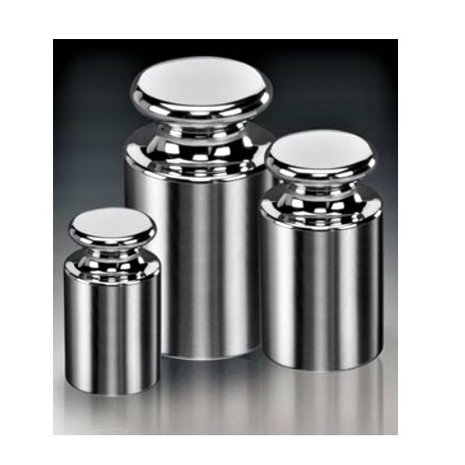
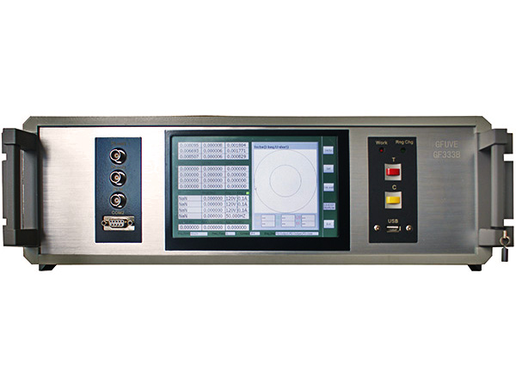
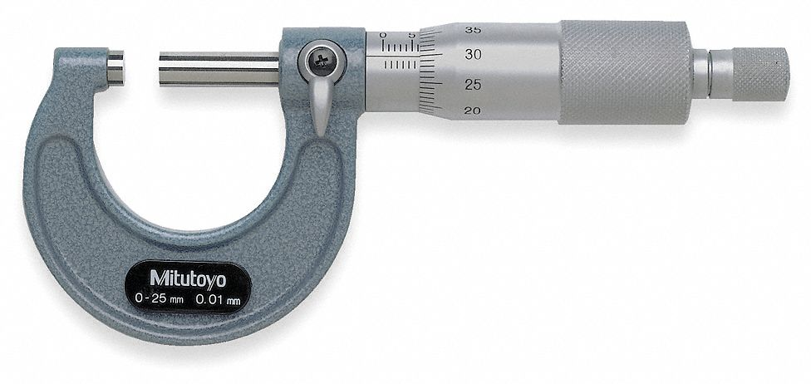
Meter Testing 101
Reference Standards
Measurement Device
Higher accuracy class than the DUT
Traceability path to a national lab and SI

Slide 34

Meter Testing 101
NIST and SI
NIST – National Institute of Standards and Technology
Division of the Commerce Department
Gaithersburg VA (near DC)
House and maintain “THE volt” and “THE ohm”

Slide 35
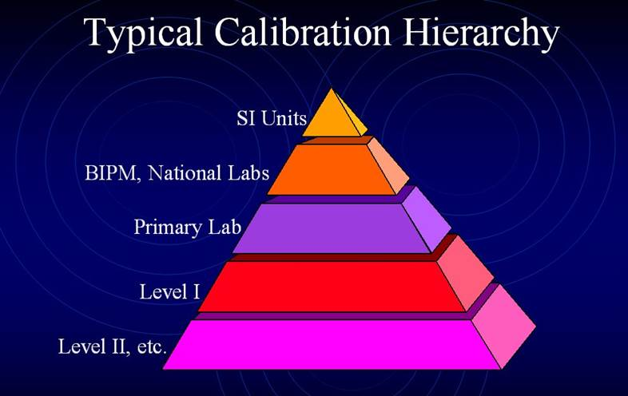
Meter Testing 101
NIST and SI
7 base units (meter, kilogram, second, ampere, kelvin, mole and candela) and 22 derived units. The base units are derived from constants of nature.
Maintained by the BIPM (Bureau International des Poids et Measures – Internation Bureau of Weights and Measures) – Metre Convention 1875
NIST
PTB
NRC
NMIJ

Slide 36
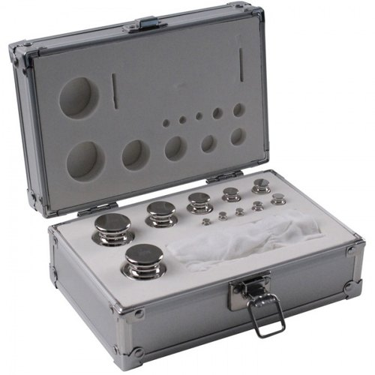
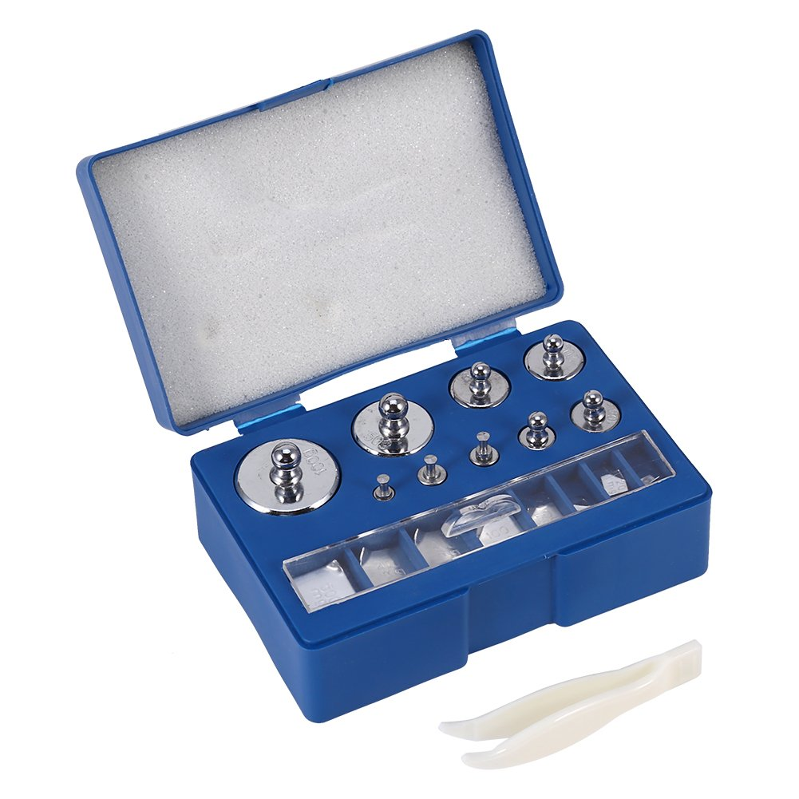
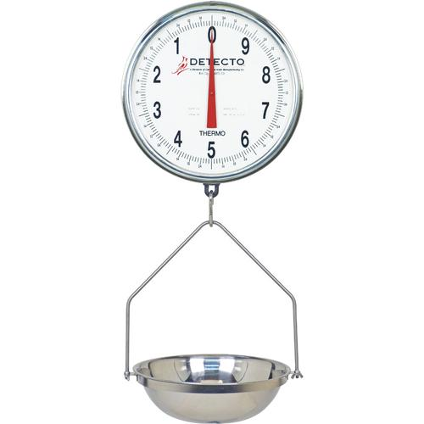

Meter Testing 101
Metrology – Apple Example
NIST
NIST
TRACEABILITY
PATH

Slide 37
Meter Testing 101
Metrology – Accuracy Classes
NIST
+/- .05LBS
NIST
TRACEABILITY
PATH
+/- .1LBS
+/- .2LBS

Slide 38
Meter Testing 101
Metrology – Accuracy Ratios
NIST
+/- .05LBS
NIST
TRACEABILITY
PATH
+/- .1LBS
.2 : .1
=
2 : 1
Accuracy Ratio
+/- .2LBS

Slide 39
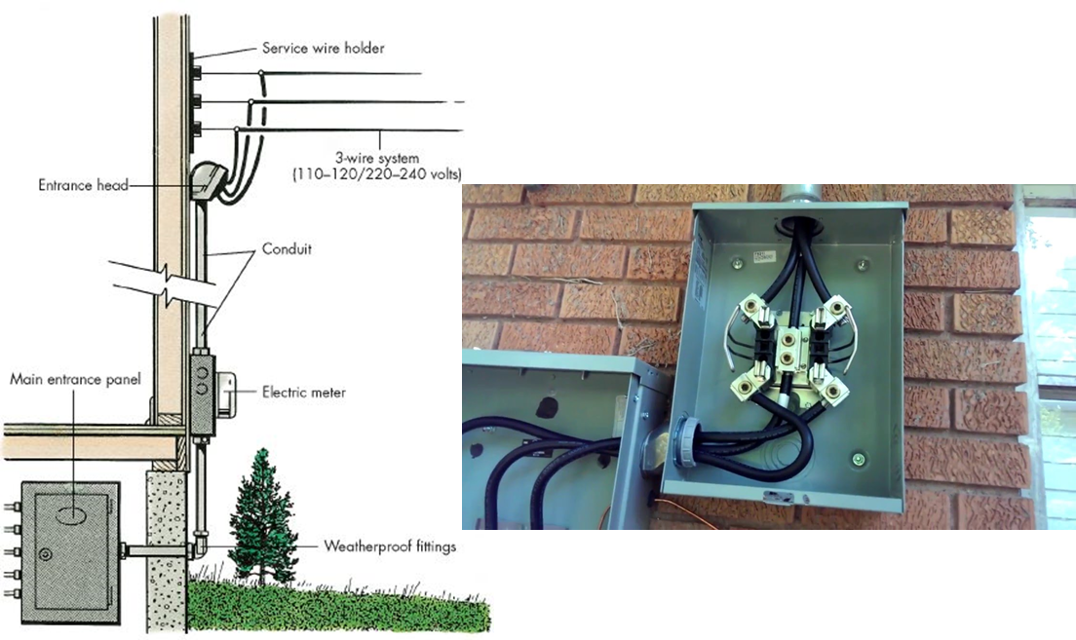
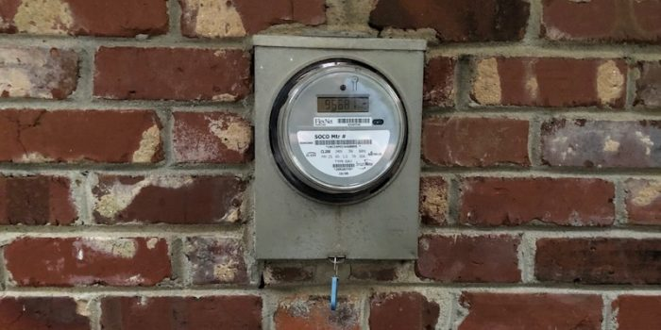
Meter Testing 101
Electric Meter Testing

Slide 40
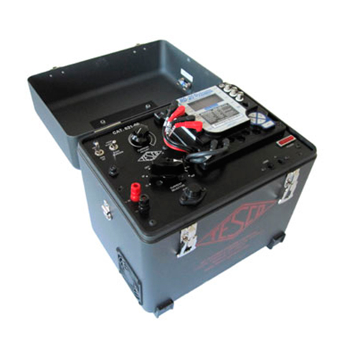
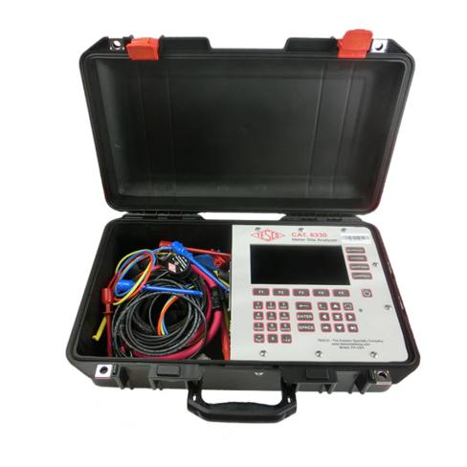
Meter Testing 101
Electric Meter Testing

Slide 41
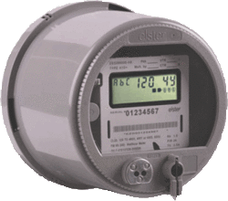
Testing Theory and Equipment
Meter Accuracy Testing – A Comparison Test
POTENTIAL SOURCE
CURRENT SOURCE
ENERGY REFERENCE STANDARD
XXXXXXXXX

Slide 42

Testing Theory and Equipment
Meter Accuracy Testing – A Comparison Test
POTENTIAL SOURCE
CURRENT SOURCE
ENERGY REFERENCE STANDARD
XXXXXXXXX

Slide 43
Testing Theory and Equipment
Meter Accuracy Testing – A Comparison Test
POTENTIAL SOURCE
CURRENT SOURCE
ENERGY REFERENCE STANDARD
XXXXXXXXX

Slide 44
Testing Theory and Equipment
Meter Accuracy Testing – A Comparison Test
POTENTIAL SOURCE
CURRENT SOURCE
ENERGY REFERENCE STANDARD
XXXXXXXXX
Watthour Meter
Measures Electrical Energy (kWh)
Potential (V) * Current (I) = Power (W)
Power Over Time = Energy (kWh)

Slide 45
Testing Theory and Equipment
Meter Accuracy Testing – A Comparison Test
POTENTIAL SOURCE
CURRENT SOURCE
ENERGY REFERENCE STANDARD
XXXXXXXXX
Energy Reference Standard
Measures Electrical Energy (kWh)
Higher Accuracy Class
Traceability to SI

Slide 46
Testing Theory and Equipment
Meter Accuracy Testing – A Comparison Test
POTENTIAL SOURCE
CURRENT SOURCE
ENERGY REFERENCE STANDARD
XXXXXXXXX
Apply the Same Voltage and Current to the Standard and Meter for a Defined Period of Time
Standard and Meter Should Measure the Same Energy
The Difference is the Error of the Meter

Slide 47
Testing Theory and Equipment
Meter Accuracy Testing – A Comparison Test
POTENTIAL SOURCE
CURRENT SOURCE
ENERGY REFERENCE STANDARD
XXXXXXXXX
Example:
Standard Registers 100kWh / Meter Registers 101.38
Then the Error of the Meter is 1.38%

Slide 48

Questions and Discussion
Tom Lawton
President
tom.lawton@tescometering.com
Perry Lawton
Northeast Regional Sales Manager
perry.lawton@tescometering.com
TESCO – The Eastern Specialty Company
Bristol, PA
215.228.0500
This presentation can also be found under Meter Conferences and Schools on the TESCO website: tescometering.com
ISO 9001:2015 Certified Quality Company
ISO 17025:2017 Accredited Laboratory

